Slide 1
Tableau chart types: comparisons
Life expectancy in five countries (2020)
Bar chart
Dot plot
Lengths compare values. Start the scale at zero.
Positions make small differences easier to see.
Select fields, then open Show Me. The options depend on your fields.
Notes:
Both examples use the same five countries in 2020. Bar chart: Country on Rows, AVG(Life Expectancy) on Columns, Bar marks, sort descending. Keep the bar value axis at zero. Dot plot: use Circle marks with the same shelves; a narrower value axis can help compare small differences. Dot plots are an arrangement of marks rather than necessarily a separate Show Me icon. The example dot axis starts at 60 and labels its actual values. First select fields in the Data pane, then open Show Me; available choices depend on field types and count.
Data for slides 1-5: local course file data/gapminder/hans.csv. Snapshot is 2020, not current data. Histories use 1960-2020 at 10-year intervals. Exclude nonpositive Life Expectancy as invalid. Use the dataset GDP label without inventing its currency or per-capita definition. Country counts refer to the 197 distinct country records in this file, not an authoritative list of sovereign states. Some regions and Population values are missing.
Tableau chart types and construction: https://help.tableau.com/current/pro/desktop/en-us/dataview_examples.htm
https://help.tableau.com/current/pro/desktop/en-us/what_chart_example.htm

Slide 2
Tableau chart types: change over time
A line shows a trajectory. An area also emphasizes magnitude.
Line chart
Area chart
Life expectancy in Japan, China and India
Japan’s population, in millions
Line: compare trends over time.
Area: use a meaningful zero baseline.
Notes:
Line chart shows Life Expectancy in Japan, China and India from 1960-2020, every decade. Year continuous on Columns, AVG(Life Expectancy) Rows, Country Color, Line marks. Convert Year to Dimension if Tableau initially treats it as a numeric measure. Area chart shows only Japan Population in millions; Year continuous Columns, SUM(Population) Rows, Area marks, Country filter Japan. A zero baseline is important for the filled area. Do not stack country life expectancy, which is not additive. Population values for Japan are present for every displayed year; do not silently fill missing values for other countries with zero.
Data for slides 1-5: local course file data/gapminder/hans.csv. Snapshot is 2020, not current data. Histories use 1960-2020 at 10-year intervals. Exclude nonpositive Life Expectancy as invalid. Use the dataset GDP label without inventing its currency or per-capita definition. Country counts refer to the 197 distinct country records in this file, not an authoritative list of sovereign states. Some regions and Population values are missing.
Tableau chart types and construction: https://help.tableau.com/current/pro/desktop/en-us/dataview_examples.htm
https://help.tableau.com/current/pro/desktop/en-us/what_chart_example.htm

Slide 3
Tableau chart types: distributions
What is typical, and how much variation is there?
Histogram
Box-and-whisker plot
How many countries fall in each range? (2020)
Country life expectancy within each region (2020)
90
80
70
60
50
40
Africa
Americas
Asia
Europe
Oceania
A histogram counts values in numeric bins.
Median, middle 50%, spread and outliers.
Notes:
Histogram: positive Life Expectancy values in 2020, one value per country, bins of 10 years from 40 through 90. The highest interval includes 90 only if any values equal 90. Filter Year=2020 before binning. In Tableau, select Life Expectancy and Show Me > Histogram; edit the bin size to 10. Box plot: show distribution of country Life Expectancy by named region in 2020. region on Columns, AVG(Life Expectancy) Rows, Country on Detail, then Show Me box-and-whisker plot (Desktop). Keep countries separate, otherwise there are only region averages. Boxes contain Q1 through Q3, line is median, whiskers reach observed values within 1.5 IQR, dots are outliers. Quartiles here use inclusive linear interpolation. Unknown region records are omitted only from the box plot.
https://help.tableau.com/current/pro/desktop/en-us/buildexamples_histogram.htm
https://help.tableau.com/current/pro/desktop/en-us/buildexamples_boxplot.htm
Data for slides 1-5: local course file data/gapminder/hans.csv. Snapshot is 2020, not current data. Histories use 1960-2020 at 10-year intervals. Exclude nonpositive Life Expectancy as invalid. Use the dataset GDP label without inventing its currency or per-capita definition. Country counts refer to the 197 distinct country records in this file, not an authoritative list of sovereign states. Some regions and Population values are missing.
Tableau chart types and construction: https://help.tableau.com/current/pro/desktop/en-us/dataview_examples.htm
https://help.tableau.com/current/pro/desktop/en-us/what_chart_example.htm

Slide 4
Tableau chart types: relationships and patterns
One pair of measures, or a matrix of repeated comparisons
Scatter plot
Highlight table
GDP and life expectancy, one circle per country
Life expectancy by country and decade
1980
1990
2000
2010
2020
Japan
76
79
81
83
85
Germany
73
75
78
80
80
China
64
68
71
74
77
Brazil
62
67
71
73
74
India
55
59
62
67
70
40
50
60
70
80
90
Association does not establish cause.
One shared color scale, in years.
Notes:
Scatter plot: GDP and Life Expectancy in 2020, Country on Detail, positive values only, equal circle sizes. Linear GDP axis here; students can optionally choose a logarithmic GDP axis. Correlation is not evidence of causation. Highlight table: five countries by five decades, AVG(Life Expectancy) on Color and Label, Square marks. Use a common sequential color scale across all cells, fixed 40-90 years. Columns are 1980,1990,2000,2010,2020. This is a highlight table, distinct from a density heatmap.
https://help.tableau.com/current/pro/desktop/en-us/buildexamples_highlight.htm
Data for slides 1-5: local course file data/gapminder/hans.csv. Snapshot is 2020, not current data. Histories use 1960-2020 at 10-year intervals. Exclude nonpositive Life Expectancy as invalid. Use the dataset GDP label without inventing its currency or per-capita definition. Country counts refer to the 197 distinct country records in this file, not an authoritative list of sovereign states. Some regions and Population values are missing.
Tableau chart types and construction: https://help.tableau.com/current/pro/desktop/en-us/dataview_examples.htm
https://help.tableau.com/current/pro/desktop/en-us/what_chart_example.htm

Slide 5
Tableau chart types: parts of a whole
How many countries fall in each life-expectancy band? (2020)
Pie chart
Treemap
Shares of a total
Parts sized by area
Under 70
68
70–79 years
97
80+ years
29
194 countries with valid life expectancy. Shares of countries, not people.
Life band → Color COUNTD(Country) → Angle / Size
Notes:
Both charts count countries by Life Expectancy band in 2020. Filter Year=2020 and Life Expectancy>0, excluding nulls. Calculated field Life band: IF [Life Expectancy] < 70 THEN "Under 70" ELSEIF [Life Expectancy] < 80 THEN "70–79" ELSE "80+" END. Pie marks: Life band on Color, COUNTD(Country) on Angle. Put Life band and COUNTD(Country) on Label; add a second COUNTD(Country) to Label with Quick Table Calculation > Percent of Total (compute over Life band). Treemap: Life band on Color and COUNTD(Country) on Size and Label. Sort counts descending. Counts: 97,68,29; total194. Percentages: 50.0%,35.1%,14.9%. Never sum life expectancy, or use incomplete Population as a total. These are country shares, not shares of people. Pie start angle/layout may differ by Tableau version.
https://help.tableau.com/current/pro/desktop/en-us/buildexamples_pie.htm
https://help.tableau.com/current/pro/desktop/en-us/buildexamples_treemap.htm
Data for slides 1-5: local course file data/gapminder/hans.csv. Snapshot is 2020, not current data. Histories use 1960-2020 at 10-year intervals. Exclude nonpositive Life Expectancy as invalid. Use the dataset GDP label without inventing its currency or per-capita definition. Country counts refer to the 197 distinct country records in this file, not an authoritative list of sovereign states. Some regions and Population values are missing.
Tableau chart types and construction: https://help.tableau.com/current/pro/desktop/en-us/dataview_examples.htm
https://help.tableau.com/current/pro/desktop/en-us/what_chart_example.htm

Slide 6
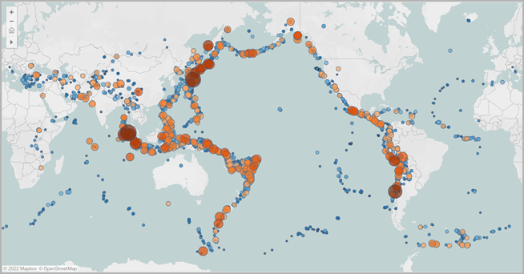
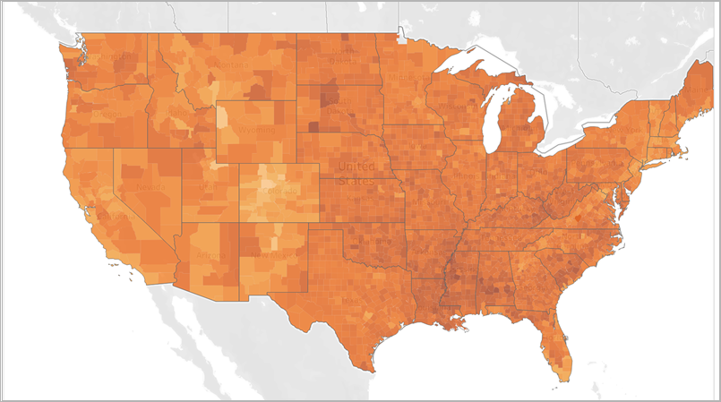
Tableau chart types: geography
A map answers a question about location
Symbol map
Filled map
Size represents a value at each location.
Color represents a value for each area.
Try hans.csv: Country as a geographic field; Year = 2020; Life Expectancy on Color.
Map images: Tableau documentation examples
Notes:
Tableau documentation examples, not hans.csv data. Left: proportional symbol map of earthquake locations and magnitude. Right: filled (choropleth) US choropleth map. Symbol size can encode a quantity at a location; a filled map colors geographic areas, often using rates or ratios. For a hans.csv variation, set Country geographic role Country/Region, filter Year=2020, use AVG(Life Expectancy) on Color and Map marks. Check unmatched country names. Do not use incomplete Population values as if all countries had values.
Image sources and original map examples: https://help.tableau.com/current/pro/desktop/en-us/maps_build.htm
https://help.tableau.com/current/pro/desktop/en-us/Img/maps_symbol6.png
https://help.tableau.com/current/pro/desktop/en-us/Img/choropleth_maps1.png
Data for slides 1-5: local course file data/gapminder/hans.csv. Snapshot is 2020, not current data. Histories use 1960-2020 at 10-year intervals. Exclude nonpositive Life Expectancy as invalid. Use the dataset GDP label without inventing its currency or per-capita definition. Country counts refer to the 197 distinct country records in this file, not an authoritative list of sovereign states. Some regions and Population values are missing.
Tableau chart types and construction: https://help.tableau.com/current/pro/desktop/en-us/dataview_examples.htm
https://help.tableau.com/current/pro/desktop/en-us/what_chart_example.htm

