Slide 1
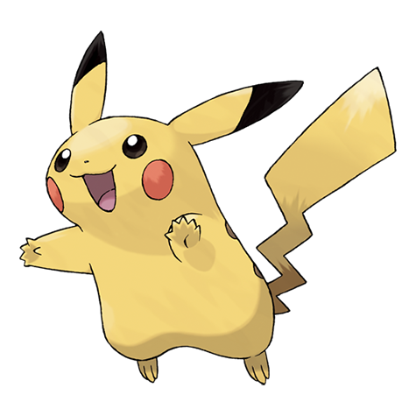
Notes:
Pokémon Challenge opening image. Existing course image assets/images/lecture/pikachu.png. Image source: https://raw.githubusercontent.com/PokeAPI/sprites/master/sprites/pokemon/other/official-artwork/25.png . Pokémon imagery belongs to its respective rights holders.

Slide 2
Pokémon Challenge
One dataset. Your question. No Pokémon knowledge needed.
15 min Solo
Choose a question. Make one chart in Tableau.
Give it a title that communicates your finding.
Groups of 4 Share
Everyone explains their finding and one visual choice.
Choose one chart for its insight and clarity.
One group submission
Submit names, title, finding and why you chose it.
Include one screenshot. A second is optional.
CSV + variable guide
Submit group work
Results / show and tell
Notes:
Follow the Week 4 Activity 1 instructions: content/weeks/04-find-the-unexpected.md. Start with 15 minutes of individual Tableau work using data/pokemon-review.csv. Choose one question, make one chart and give it a clear title. Groups of four share everyone's work, then select one chart for its finding and clarity. One representative submits group number, all names, title, finding and selection reason, one required screenshot and an optional second image via activity-submit.html?week=4. Use activity-results.html?week=4 for show and tell. Variable definitions: pokemon-variables.html. This is an in-class group submission, separate from individual homework.

Slide 3
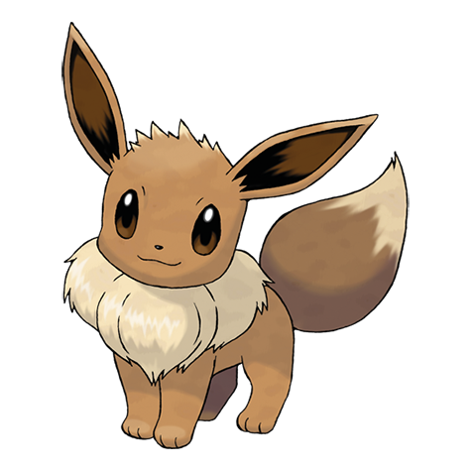
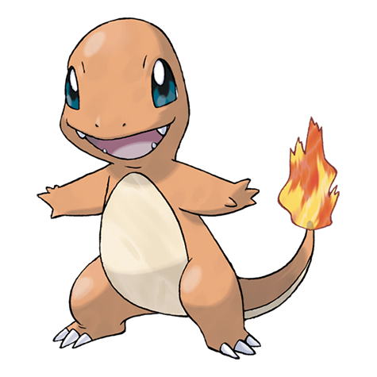
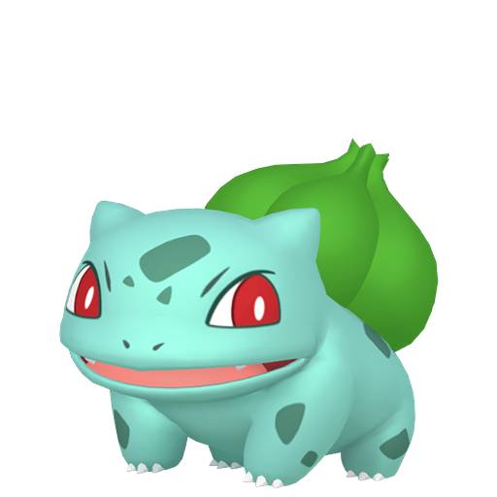
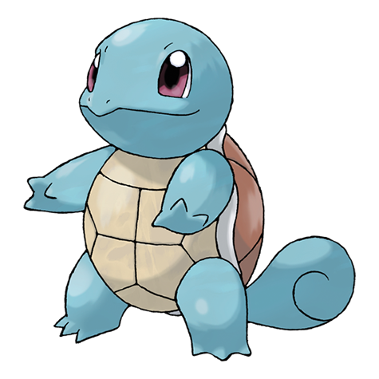
A first chart with Pokémon images
Compare Attack for five Pokémon
01
Open updated pokemon-review.csv.
Open a new worksheet.
02
Name to Filters: select the five shown.
03
Right-click Image_URL in the Data pane:
Image Role > URL.
04
Rows: Image_URL first, then Name.
05
Columns: Attack > Measure > Average.
Marks: Bar.
06
Image_URL > Sort: Descending, Field,
Attack, Average. Marks > Label: show labels.
07
Standard view. Widen the image header.
Format > Cell Size > Taller. Axis starts at 0.
Images are row headers.
Notes:
Download the updated class CSV and refresh the Tableau connection. Filter Name to Bulbasaur, Charmander, Eevee, Pikachu and Squirtle. Use a discrete Image_URL dimension with Image Role > URL. Rows shelves, left to right: Image_URL then Name. Columns: AVG(Attack). Marks Bar. Right-click Image_URL on Rows and choose Sort: Descending, Sort by Field, Attack, Average, turn on labels and retain a zero baseline. Increase row height to roughly80 pixels by dragging a row divider, and widen the image header column to make the artwork visible. Use Standard view rather than Entire View if fitting shrinks the five rows. Images appear in headers, not as scatterplot marks. The illustrated bars are actual base Attack from the CSV: Pikachu55, Eevee55, Charmander52, Bulbasaur49, Squirtle48. Tie order may differ. These are base Attack statistics, not universal battle strength. Artwork from the Image_URL values. https://help.tableau.com/current/pro/desktop/en-us/image_role.htm

