Slide 1
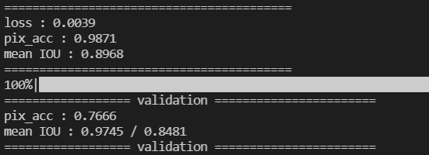
2d unet model
Aslloss
Slice input
Trainset : valset = 9:1
Epoch ~= 30
Model name : u_net_slice_asl.pt"

Slide 2
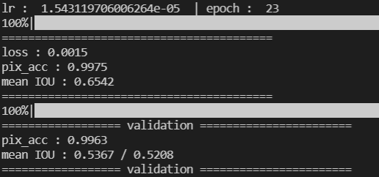
3d unet model
No argumentation
Aslloss
Adam : init 0.01, lr decay 0.985^epoch, weight decay : 1e-5
3d input
Trainset : valset = 9:1
Epoch = 50
Model name : u_net_3dmodel_asl.pt

Slide 3
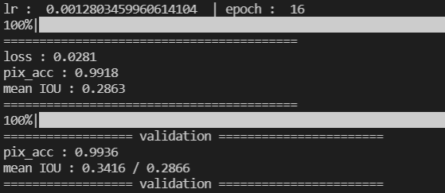
3d unet model (1,2,32)
No argumentation
Bcewithlogic loss
Adam : init 0.01, lr decay 0.985^epoch, weight decay : 1e-5
3d input
Trainset : valset = 9:1
Epoch = 16
Model name : u_net_3dmodel_bce.pt

Slide 4
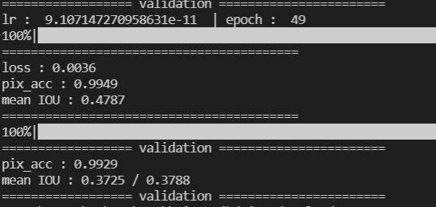
3d unet model (1,2,16)
No argumentation
asl loss
Adam : init 0.01, lr decay 0.985^epoch, weight decay : 1e-5
3d input
Trainset : valset = 9:1
Epoch = 50
Model name : u_net_3dmodel_asl16.pt

