Slide 1

nRc
A co-operative R & RStudio coding group within NRC
Jenna MacKinnon
Jenna.mackinnon@nrc-cnrc.gc.ca

Slide 2
Intro to R & RStudio
Sessions will be virtual and recorded
(this is my reminder to start the recording if I have not already)
Learning the R vocabulary
Creating organized and clear scripts
Using GitHub repositories for sharing scipts

Slide 3
Schedule
Introduction to R & RStudio (25-MAY-2022)
Introduction to Data Visualization (08-JUN-2022)
Basic plots
Introduction to Statistics (22-JUN-2022)
ANOVAs, GLMs, etc.
Advanced Graphing and Statistics with ggplot2 (06-JUL-2022)
Scatter plots, line graphs, bar graphs
Advanced Graphing and Statistics with ggplot2 (20-JUL-2022)
Multivariate analyses, PCAs
Advanced Graphing and Statistics with ggplot2 (03-AUG-2022)
Heat maps, trees

Slide 4
Resources
http://www.cookbook-r.com/
Introduction to R Online Course | DataCamp
https://cran.r-project.org/
https://datacarpentry.org/R-genomics/01-intro-to-R.html
https://www.rstudio.com/resources/cheatsheets/
More advanced links:
https://r-graph-gallery.com/

Slide 5
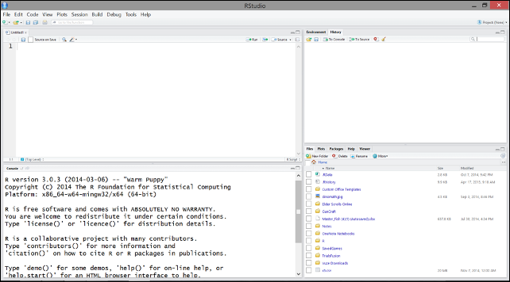
ENVIRONMENT
Current objects and data
SOURCE
Able to save and edit scripts continually
HISTORY
Log of previously-run code
PLOTS
Shows all output plots here
CONSOLE
Shows code output and can be used for coding that will NOT be saved
PACKAGES
HELP

Slide 6
