Slide 1

n c
A co-operative R & RStudio coding group within NRC
06-JUL-2022
Jenna MacKinnon
Jenna.mackinnon@nrc-cnrc.gc.ca

Slide 2
Schedule
Introduction to Data Visualization 08-JUN-2022
Basic plots, Intro to ggplot2
Advanced Graphing with ggplot2 22-JUN-2022
Scatter plots, line graphs, bar graphs
Introduction to Statistics 06-JUL-2022
ANOVAs, Normality etc.
Advanced Graphing and Statistics 20-JUL-2022
GLMs, Multivariate analyses, PCAs
Advanced Graphing and Statistics 03-AUG-2022
Heatmaps, phylogenetic trees

Slide 3
Schedule
Basic Predictive Analysis & Modelling 17-AUG-2022
Spectral Data Processing & Binning 31-AUG-2022
Any other ideas?
What kind of data are you generally working on?
Send us your dataset with some explanation

Slide 4
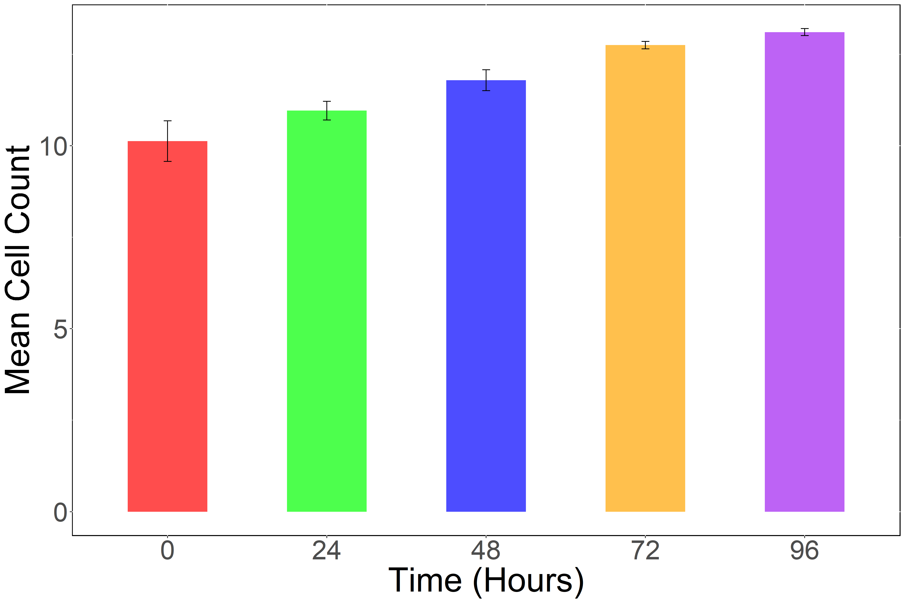
mean_data <- data %>%
group_by(Time) %>%
summarize(mean_cells = mean(CellCount), sdcell = sd(CellCount))
Time2 <- as.factor(mean_data$Time)
plot1 <- ggplot(mean_data) +
geom_bar(aes(x=Time2, y=mean_cells, fill=Time2),show.legend = F, stat='identity', width = 0.5, alpha=0.7) +
xlab("Time (Hours)") +
ylab("Mean Cell Count")+
scale_fill_manual(values = c('red', 'green', 'blue', 'orange','purple')) +
theme(text = element_text(size = 40))+
theme(panel.background = element_rect(fill="white",colour="black",size=1,linetype="solid")) +
geom_errorbar (aes(Time2, ymin=mean_cells-sdcell, ymax=mean_cells+sdcell, width=0.05))

Slide 5
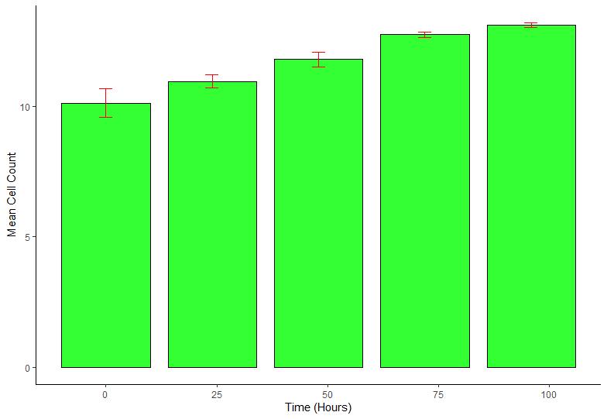
mean_data2 <- data %>%
#recreate the summary table for plotting
#this time including a standard deviation for error bars
group_by(Time) %>%
summarize(mean_cells = mean(CellCount),stdev_cells = sd(CellCount))
view(mean_data2)
ggplot(mean_data2) +
geom_bar( aes(x=Time, y=mean_cells), stat="identity", color="black", fill="#00ff00", alpha=0.8, width=20) +
#colors can be specified WHERE CAN I GET THE COLOR CODES FROM?
# stat="identity" allows the actual values to be used, instead of a frequency plot which uses "bin" as default which is count"
#alpha is the transparency 0-1 with lower being more transparent
# fill colors can be obtained from https://www.w3schools.com/colors/colors_picker.asp
# geom_errorbar function is used to plot error bars
xlab("Time (Hours)") +
ylab("Mean Cell Count") +
theme_classic() +
geom_errorbar(aes(x=Time,ymin=mean_cells-stdev_cells,ymax=mean_cells+stdev_cells), width=3, color="red")

Slide 6
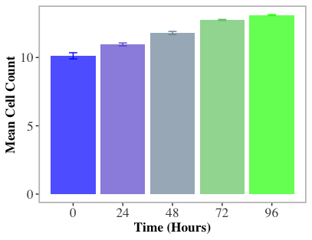
data %>%
group_by(Time) %>%
dplyr::summarise(mean_cells = mean(CellCount), se_cells = (sd(CellCount))/(sqrt(n()))) %>%
ggplot() +
geom_bar(aes(x=Time, y=mean_cells, fill = Time), show.legend = FALSE, stat="identity", alpha=0.7) +
labs(x = "Time (Hours)", y = "Mean Cell Count") +
scale_x_continuous(breaks = c(0, 24, 48, 72, 96)) +
scale_fill_gradient( low = "blue", high = "green", aesthetics = "fill") +
scale_colour_gradient( low = "blue", high = "green", aesthetics = "colour") +
geom_errorbar(aes(x = Time, ymin = mean_cells - se_cells, ymax=mean_cells + se_cells, color = Time), width = 4) +
theme(text=element_text(family="Times"),
axis.text= element_text(size=13, face="plain"),
axis.title=element_text(size=13, face="bold"),
panel.background = element_rect(fill="white",colour= "grey", size=1.2,linetype="solid"),
panel.grid.major = element_blank(),
panel.grid.minor = element_blank())

