Slide 1


N C
A co-operative R & RStudio coding group within NRC
Jenna MacKinnon
Jenna.mackinnon@nrc-cnrc.gc.ca

Slide 2
Schedule
Introduction to Data Visualization 08-JUN-2022
Basic plots, Intro to ggplot2
Advanced Graphing with ggplot2 22-JUN-2022
Scatter plots, line graphs, bar graphs
Introduction to Statistics 06-JUL-2022
ANOVAs, GLMs, etc.
Advanced Graphing and Statistics 20-JUL-2022
Multivariate analyses, PCAs
Advanced Graphing and Statistics 03-AUG-2022
Heatmaps, phylogenetic trees

Slide 3
Schedule for future courses
Basic Predictive Analysis & Modelling 17-AUG-2022
Spectral Data Processing & Binning 31-AUG-2022
Any other ideas?
What kind of data are you generally working on?
Send us your dataset with some explanation

Slide 4
Introduction to Data Visualization Basic plots, Intro to ggplot2 08-JUN-2022

Slide 5
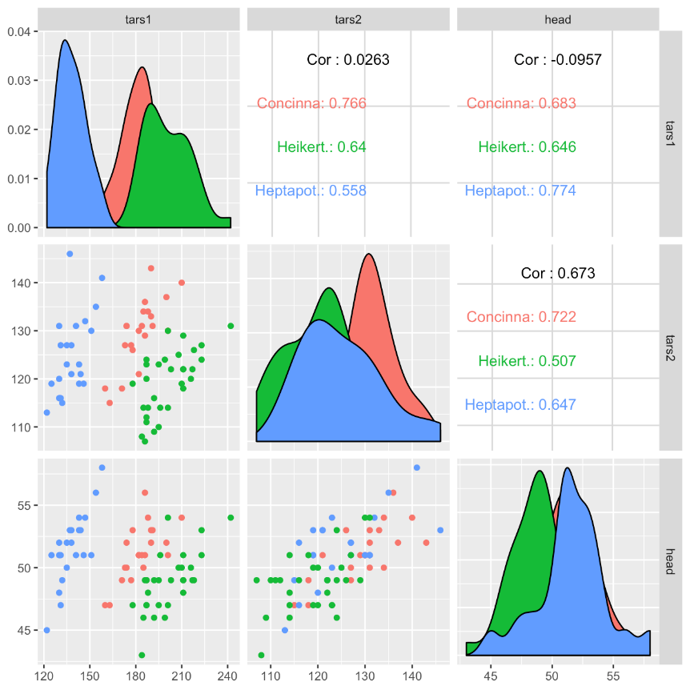
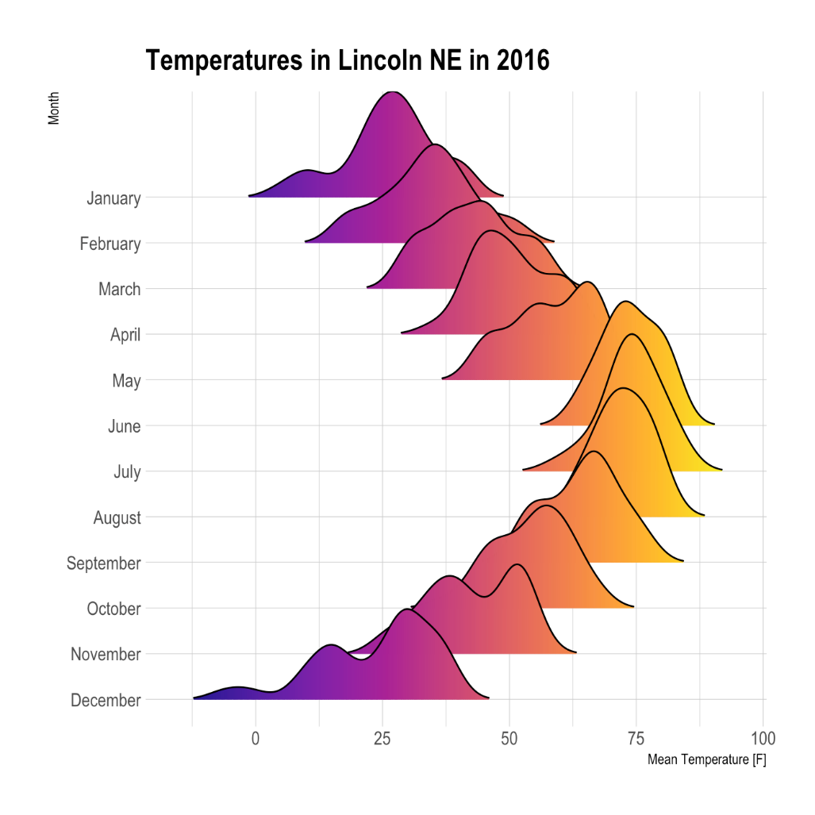
Introduction to Data Visualization Basic plots, Intro to ggplot2 08-JUN-2022
Examples from the R Graph Gallery

Slide 6
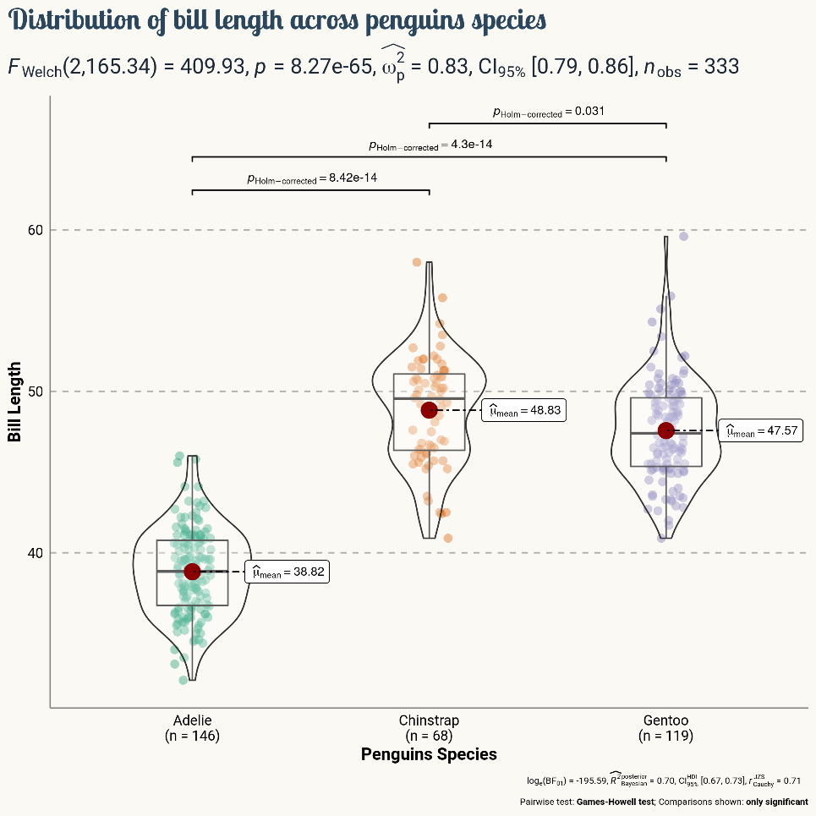
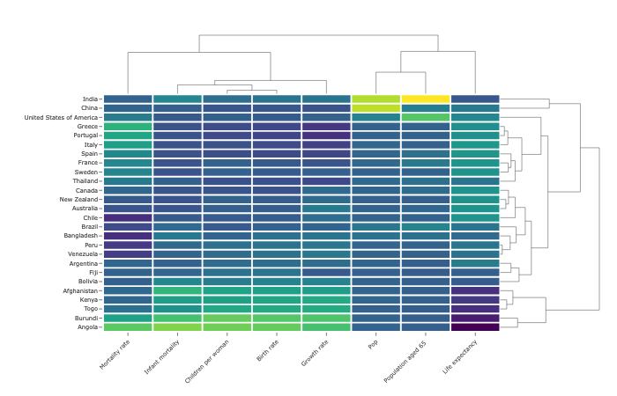
Introduction to Data Visualization Basic plots, Intro to ggplot2 08-JUN-2022
Examples from the R Graph Gallery

Slide 7
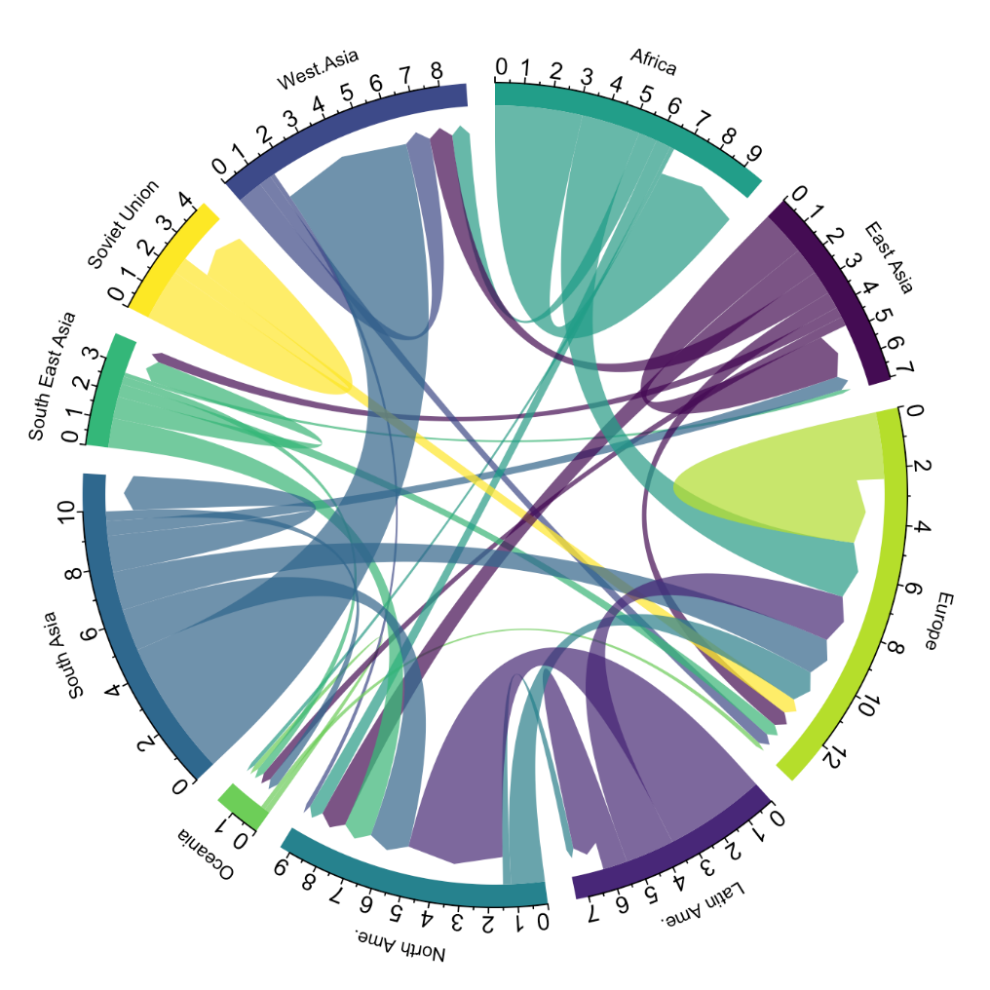
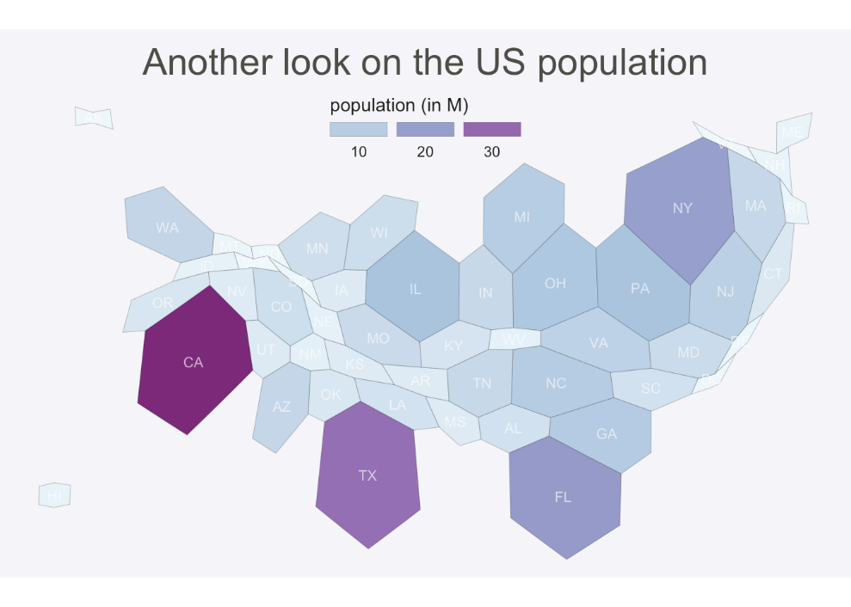
Introduction to Data Visualization Basic plots, Intro to ggplot2 08-JUN-2022
Examples from the R Graph Gallery

Slide 8

Useful links
Today’s course was inspired from:
https://datacarpentry.org/R-ecology-lesson/index.html
The Evolution of a ggplot (Ep. 1) - Cédric Scherer (cedricscherer.com)
https://www.cedricscherer.com/2019/05/17/the-evolution-of-a-ggplot-ep.-1/
From data to Viz | Find the graphic you need (data-to-viz.com)
https://www.data-to-viz.com/
The R Graph Gallery – Help and inspiration for R charts (r-graph-gallery.com)
https://r-graph-gallery.com/

