Slide 1

Project Title –SEASONAL AGRICULTURAL PERFORMANCE ANALYSIS
STUDENT NAME : YOJANA SHERPA
COLLEGE NAME : SIKKIM MANIPAL INSTITUTE OF TECHNOLOGY
AICTE STU ID: STU69cb6281b79a31774936705

Slide 2

PROBLEM STATEMENT
Agricultural activities are influenced by seasonal variations in environmental conditions, farming practices, resource availability and market conditions.
As a result, agricultural performance may differ from one season to another. However, raw agricultural data does not clearly explain how agricultural performance changes across seasons or what patterns can be observed in different seasonal conditions.
The problem is to analyze the given agricultural dataset and investigate seasonal differences in agricultural performance by identifying meaningful patterns, trends, relationships and variations within the available data.

Slide 3
Project description
Seasonal Agricultural Performance Analysis is a data analytics project implemented in Python using pandas, numpy, matplotlib, and seaborn to evaluate how seasonal shifts impact farming metrics, resource usage, and crop yields.
Project Scope & Architecture
Dataset: 4,000 farm-level records spanning 28 features, including environmental conditions, operational practices, and financial variables.
Data Hygiene: Addressed missing values via median imputation and verified duplicate-free integrity.
Analytical Pipeline: Leveraged Exploratory Data Analysis (EDA), IQR-based outlier detection, bivariate comparisons, and multivariate visualizations (heatmaps, pair plots).

Slide 4
Key Findings & Insights
Seasonal Concentration: Operations heavily skew toward the Kharif monsoon season, contrasting with the artificial irrigation demands of Rabi and Zaid periods.
Revenue vs. Profit Disparity: Cash crops (like Sugarcane and Chilli) generate massive gross revenues exceeding 1.0M INR, but net profits hover near break-even due to heavy overhead and resource expenditures.
Resource & Risk Clusters: Micro-irrigation significantly enhances water efficiency metrics ($\text{t}/1000\text{m}^3$) during drier windows, while high temperature and humidity combinations strongly correlate with elevated pest risks exceeding 60%.

Slide 5

WHO ARE THE END USERS?
Farmers & Agricultural Practitioners: Primary users who can leverage seasonal insights, crop performance benchmarks, and irrigation efficiency recommendations to optimize water allocation, minimize pest vulnerabilities, and improve overall net profitability.
Agricultural Planners & Policymakers: Regional authorities who can utilize district-level risk assessments and seasonal resource distribution data to design targeted pest management programs and formulate regional resource support policies.
Agri-Tech & Farm Management Consultants: Analysts and advisors who can use the underlying data models and exploratory analytics framework to advise farms on high-revenue cash crop overhead management and seasonal cost-benefit strategies.

Slide 6

Technology Used
Python (Core Programming Language)
Pandas (Data Manipulation & Structured Dataframes)
NumPy (Numerical Computations & Array Operations)
Matplotlib (Data Visualization & Plotting)
Seaborn (Statistical Data Visualization & Heatmaps/Pairplots)

Slide 7
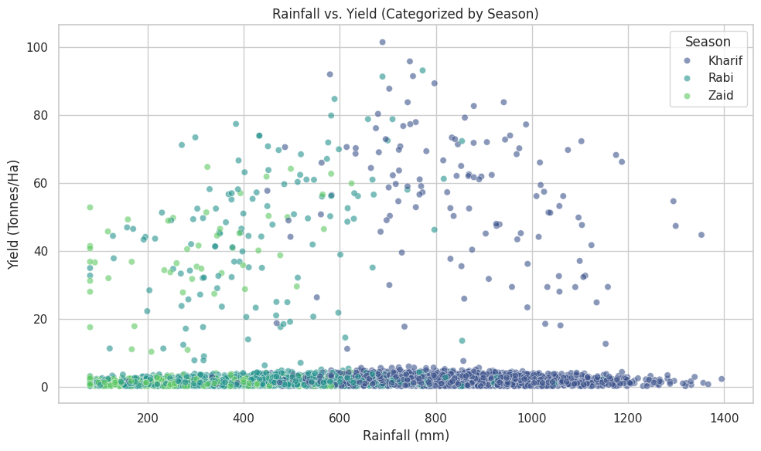
RESULTS
This plot is basically showing how crop yield changes with rainfall in different seasons.
In Kharif (dark blue), which depends heavily on monsoon rains, yields rise with more rainfall.
In Rabi (teal), crops are grown in winter with less rain, so yields don’t rely much on rainfall.
In Zaid (green), the short summer season, yields are scattered and less tied to rainfall.
So in simple words: rain matters most for Kharif crops, less for Rabi, and Zaid is somewhere in between.

Slide 8
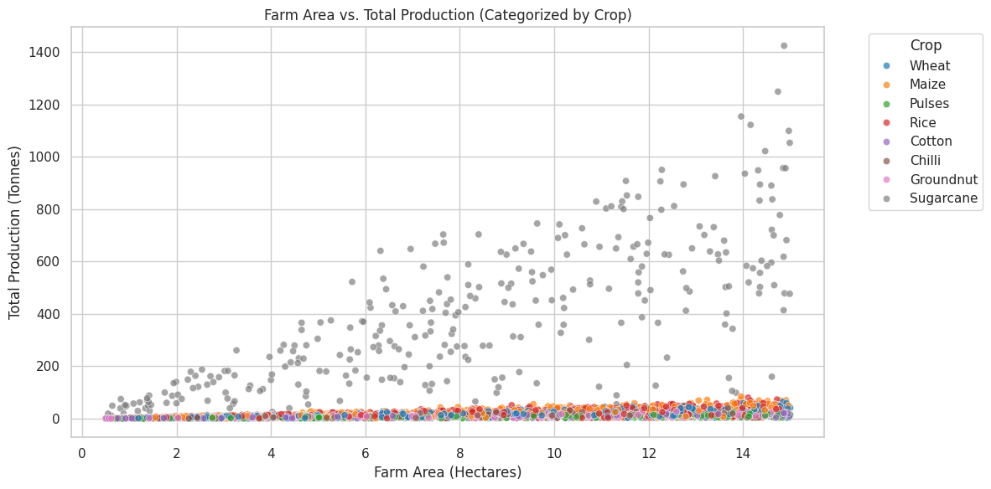
RESULTS
This plot is showing how different crops produce differently depending on farm size.
Sugarcane (gray) stands out — even with small farm areas, it gives very high production compared to all other crops.
Wheat, maize, pulses, rice, cotton, chilli, and groundnut mostly stay near the bottom, meaning their production is much lower for similar farm sizes.
In simple words: Sugarcane is a powerhouse crop, while the rest give modest outputs even if the farm area is similar.

Slide 9
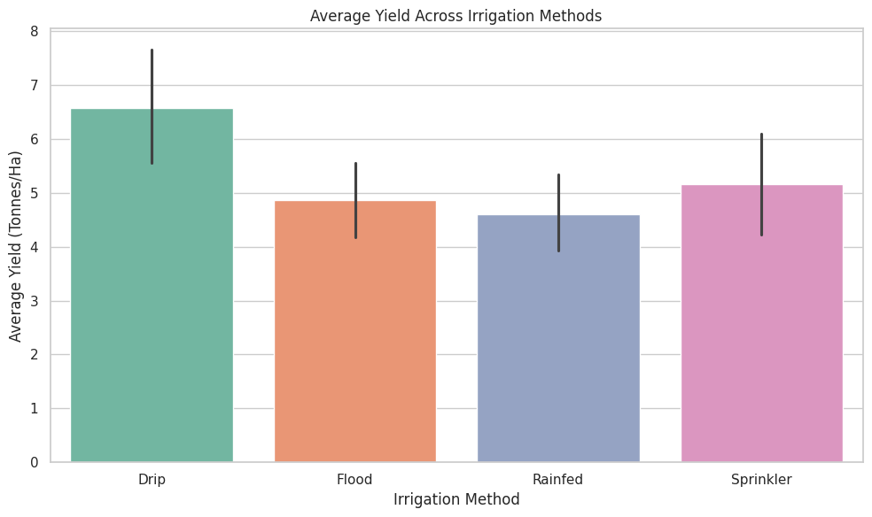
RESULTS
This chart is simply showing which irrigation method gives better crop yields.
Drip irrigation comes out on top — it produces the highest yields.
Sprinkler is next, giving good results but not as high as drip.
Flood irrigation and rainfed farming are lower, meaning they produce less on average.
In plain words: modern methods like drip and sprinkler help crops grow more, while traditional flood or relying only on rain gives less.

Slide 10
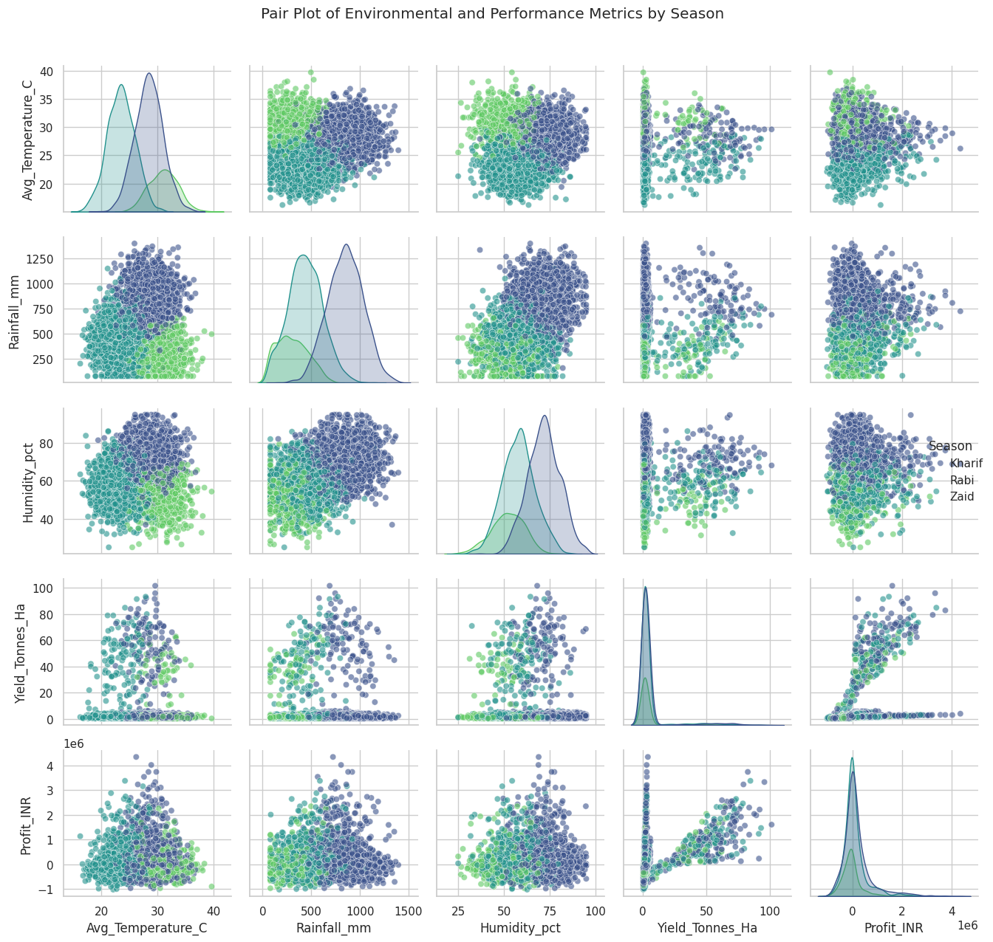
RESULTS
This plot is like a big picture of farming seasons and their conditions.
It shows how temperature, rainfall, and humidity connect with yield and profit.
Each season — Kharif, Rabi, and Zaid — has its own color, so you can see how the same factors play out differently across them.
For example, you might notice that rainfall links strongly with yield in Kharif, while profit patterns shift with temperature or humidity in other seasons.
In simple words: it’s a map of how weather and farming results are tied together, season by season.

Slide 11
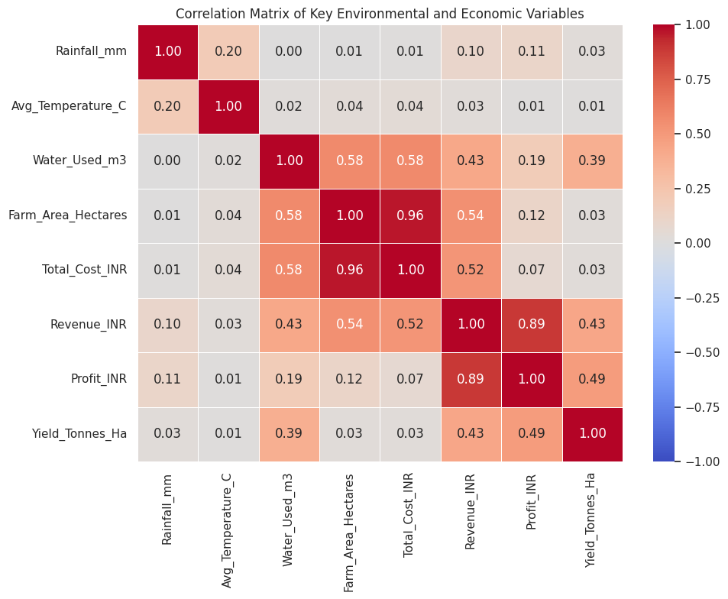
RESULTS
This heatmap is showing how farming and money factors are connected.
Revenue and profit are strongly tied together — more revenue usually means more profit.
Yield also links positively with profit and revenue, meaning better harvests bring better earnings.
Rainfall and water use connect with yield, but temperature sometimes shows weaker or even negative links.
Farm area relates to cost and revenue — bigger farms spend more but also earn more.
In simple words: good harvests and smart water use drive profit, while bigger farms scale both costs and income.

Slide 12
Future scope
The future scope includes several advanced technical extensions and practical deployments:
Predictive Yield Modeling: Integrate machine learning regression models (such as Random Forest, XGBoost, or Long Short-Term Memory networks) to forecast future crop yields dynamically based on real-time weather forecasts and soil conditions.
Automated Irrigation Control Systems: Connect the water efficiency and irrigation method insights with IoT-based smart farming hardware to automatically regulate drip and sprinkler systems according to seasonal moisture deficits.
Geospatial & Satellite Integration: Incorporate GIS mapping and remote sensing data to monitor regional crop health, rainfall distribution, and pest vulnerability zones at a finer district-level resolution.
Economic Risk & Price Forecasting Dashboard: Build interactive web applications (using Streamlit or Dash) to help farmers simulate market price volatility and net profit margins before committing capital to high-revenue cash crops.

Slide 13
GitHub Link
PROFILE LINK : https://github.com/yojana22-sherpa
REPOSITORY LINK : https://github.com/yojana22-sherpa/Seasonal-Agricultural-Performance-Analysis

Slide 14

VOIS Course completion certificate s
Course name- Data Visualization

Slide 15
Thank you
.
.

