Slide 1
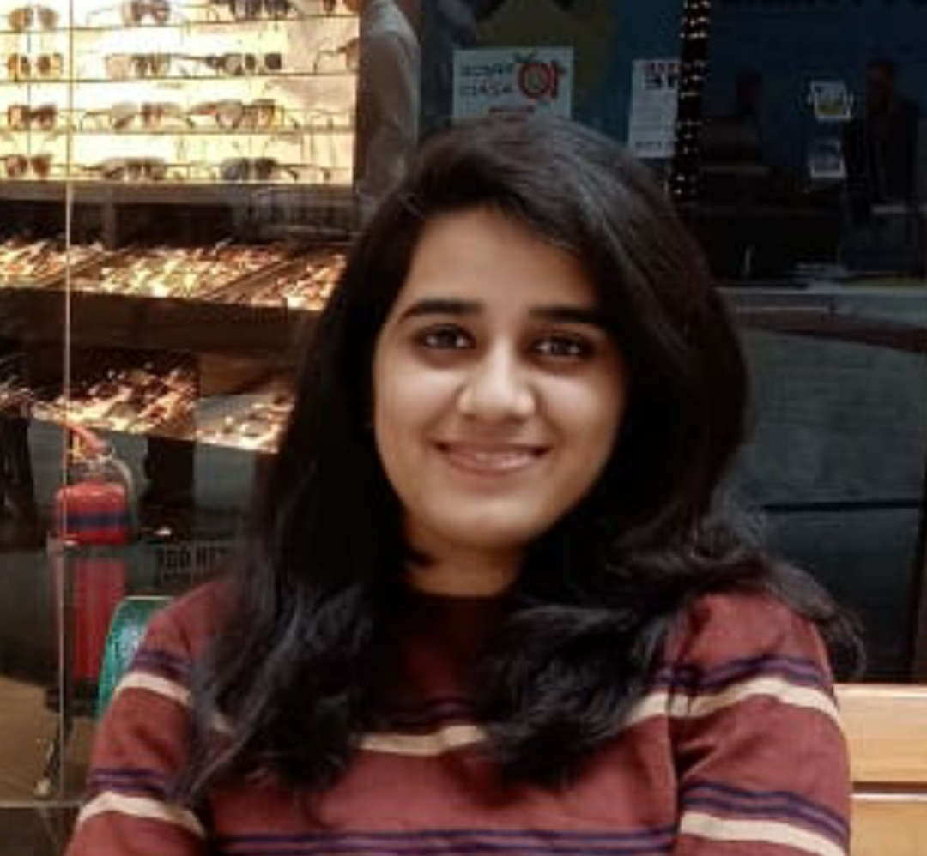



Yojana Gajavelli
Analyst/Software Engineer
Bachelor of Engineering
Electronics and Communication: 2017 - 2021
Bangalore
Skills
Java
Spring Boot
Spring MVC
Spring Rest
Mongo CRUD
Full Stack
Angular
Spring
Mongo DB
Database
No SQL Database – MongoDB
Web Technologies
HTML5
CSS3
JavaScript
Typescript
Add-Ons
GitHub
Maven
Tools
VS Code
Eclipse
Postman
xxxxxxxxxxxxxx@capgemini.com
+91 9121072474
A4
Hands on experience with a demonstrated history of work using Java at the backend, Angular at the frontend including HTML5, CSS3 and JavaScript and various other languages and tools.
Proficient in creating Single page Web Application in Angular with Authentication with route guards, Angular reactive forms, angular routing, CSS
Completed the training along with case study using Java Full Stack Angular as the technology.
Eager to grab the opportunity in order to improve myself by learning and experimenting on new technologies .
Team player with efficient communication skills and aim to work for the better output results.
Flight Booking System
Created and completed the Flight Booking System case study using Java Full Stack with Angular.
Multiple microservices are implemented using Spring Boot, Spring Cloud and connecting them via a discovery service i.e. Netflix Eureka and routing using API Gateway.
Frontend with Angular 12, using Angular Material and Angular CLI for creating a user friendly UI.
Backend with MongoDB Atlas, along with versioning control using GitHub
Completed the i-Transform Java Full Stack Angular training
Check out my work on GitHub & Video Profile

