Slide 1
CMPLXSYS 530
Computer Modeling of Complex Systems
Cellular Automata and Conway’s Game of Life
2/14/19

Slide 2
Cellular Automata
Borrowing from Sayama p.185
Automata refers to a theoretical machine that changes its internal state based on inputs and its previous state (usually finite and discrete)
Cellular automata (CA) are automata arranged along a regular spatial grid, whose states are simultaneously updated by a state-transition function

Slide 3
Cellular Automata

Slide 4
Cellular Automata
So what?
Simple rules → Exceptionally complex outcomes (sometimes)
Prototypical example: Wolfram’s exploration of 1-D CA

Slide 5
Cellular Automata
Rule 50
00110010 = 50 in binary

Slide 6
Cellular Automata
Wolfram’s Classification
Class I – almost always evolve to same uniform pattern (boring!)
Class II – Simple pattern with nested structure (pretty!)

Slide 7
Cellular Automata
Wolfram’s Classification
Class III
CAs that produce patterns with the statistical properties of randomness
(surprising!...why?)

Slide 8
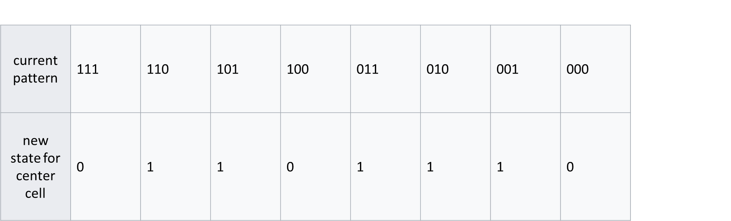
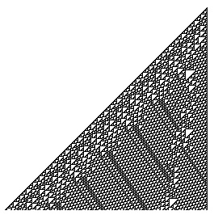
Cellular Automata
Wolfram’s Classification
Class IV
Evolve in complex ways that involve a mix of “chaotic” and “ordered” (Class II and Class IV)
Rule 110, 250 timesteps

Slide 9
Cellular Automata
Wolfram’s conjecture:
Class IV CAs are capable of universal computation
So far, this has been proven for Rule 110
(Bwaahh?!?!?!)
Wolfram, S. A New Kind of Science. Champaign, IL: Wolfram Media
Rule 110, 250 timesteps

Slide 10
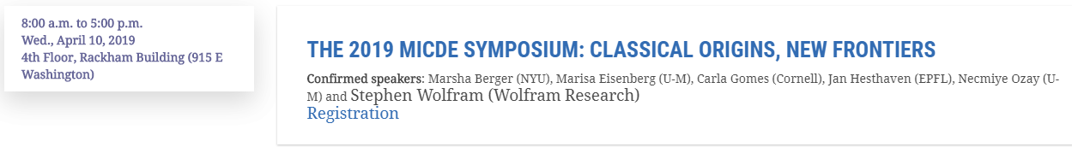
Cellular Automata

Slide 11
Cellular Automata
Dimensionality
How many dimensions?
Neighborhood
Ex: Von Neumann, Moore, radius
State Set
How many states can a cell be in?

Slide 12
Cellular Automata
Boundaries
None, Periodic (aka Wrapped), Fixed
Rules
“Totalistic”, symmetrical (in different axes)
Starting States, number of cells, etc…

Slide 13
Cellular Automata
Wide World of CA
A lot of CA models have been developed, some with stronger connections to the Real World than others
Forest Fire model
Sand Heap/Avalanches
Majority Rule and Voter Models
Diffusion Limited Aggregation (DLA) and Percolation

Slide 14
Cellular Automata
Wide World of CA
Arguably there is no CA so famous or well-loved, however, than that of Conway’s Game of Life*
Epic animation
It has inspired countless articles, entire communities of hobbyists, and even helped give rise to an entire research subfield known as “Artificial Life”
*Note: GoL has also been proven to be capable of universal computation!!! (Crazy!!!)

Slide 15
Welcome to the “Game of Life” Rabbit Hole…
Go research and play around!
Note, Netlogo and PyCX have versions
How would you do this in your own Python model?
Python Implementation of Schelling Model
Explore the model (e.g. vacancies, window size, pop. size, tolerance)
Design Challenges
Limit how far away an agent can move
Create a 3rd type of occupant
Vary tolerance according to type
Change boundary conditions

