Slide 1
CMPLXSYS 530
Computer Modeling of Complex Systems
Networks I
3/19/19

Slide 2
Agenda for Today
ABM and Networks
What is being represented?
Classes of network dynamics
Terminology
Overview of basic network terms and concepts
Network Metrics
Overview of metrics characterizing network structure
Notebooks

Slide 3
ABM and Networks
Networks in ABM
In contrast to either perfectly mixed and regular grid topologies, networks provide a way of getting at the role of non-homogeneous interaction structures in emergent processes
Consequently, understanding of networks often proves to be important in computational model of complex systems

Slide 4
ABM and Networks
What is being represented in a network?
Networks are an extraordinarily flexible means of representing the relationships/interactions between entities within a system
As with ABM more generally, networks can handle a wide range of conceptual concreteness – from empirically driven to highly abstracted

Slide 5
ABM and Networks
What is being represented in a network?
Examples:
Links between webpages
Family trees
Food webs among species
Friendships
Diplomatic relationships btwn countries
Gene regulatory networks
Boolean networks
CAUTION!!!
Just because you can think of a network representation of a system does not make it a meaningful representation of that system

Slide 6
ABM and Networks
Dynamics on networks
models with fixed topologies wherein the processes of interest occur over the network structure
Dynamics of networks
models concerned with the mechanisms that generate certain topologies, network features, or characteristics
Adaptive networks
models looking at the interplay of the two

Slide 7
Network Terms and Types - Overview
Basic Terms
Network, Graph

Slide 8
Network Terms and Types - Overview
Basic Terms
Network, Graph
Node, Vertex, Actor

Slide 9
Network Terms and Types - Overview
Basic Terms
Network, Graph
Node, Vertex, Actor
Tie, Edge, Link

Slide 10
Network Terms and Types - Overview
Basic Terms
Walk
List of edges sequentially connected to form a continuous route
Path
Walk that doesn’t visit any node twice
Cycle
Walk that starts and ends at same node

Slide 11
Network Terms and Types - Overview
Basic Terms
Subgraph
Part of the graph
Connected Graph
Graph in which every node is “reachable” from every other
Connected Component
Subgraph that is connected w/in itself but not the rest of the graph

Slide 12
Network Terms and Types - Overview
Complete Graph
All pairs of nodes are connected

Slide 13
Network Terms and Types - Overview
Regular Graph
All nodes have the same degree

Slide 14
Network Terms and Types - Overview
Bipartite (n-partite) Graph
Graph whose nodes can be divided into n groups such that no edges connect w/in a group

Slide 15
Network Terms and Types - Overview
Tree and Forests
A tree is a graph with no cycles; forest is a graph containing multiple trees

Slide 16
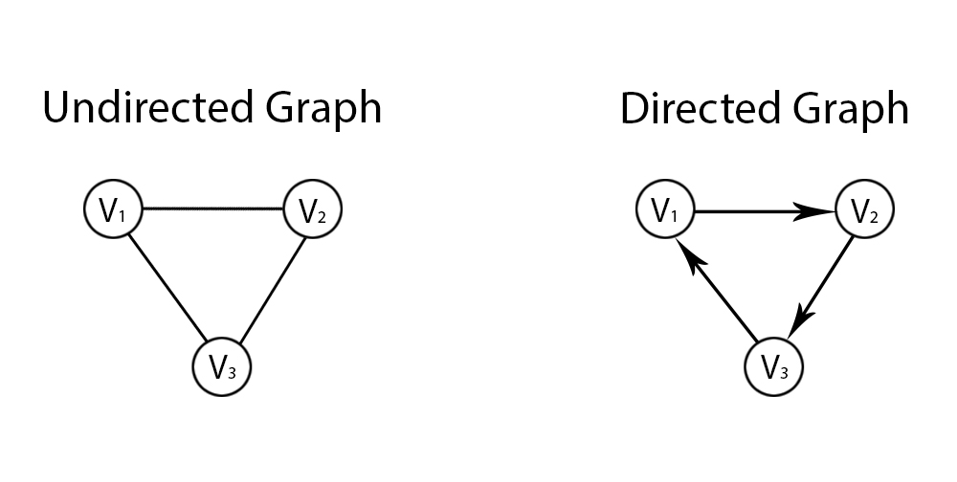
Network Terms and Types - Overview
Undirected: symmetrical relationships [e(1, 2) = e(2,1)]
Directed: asymmetrical relationships [e(1, 2) =/= e(2,1)]

Slide 17
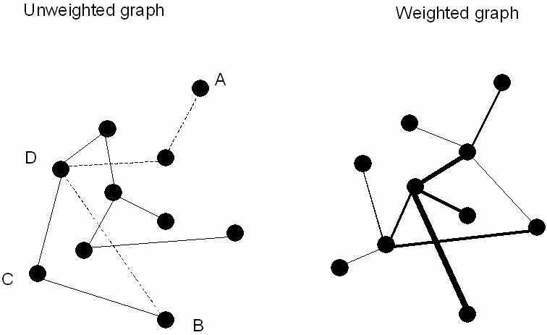
Network Terms and Types - Overview
Unweighted: Edges are binary [0,1]
Weighted: Edges have weight values attached to them

Slide 18
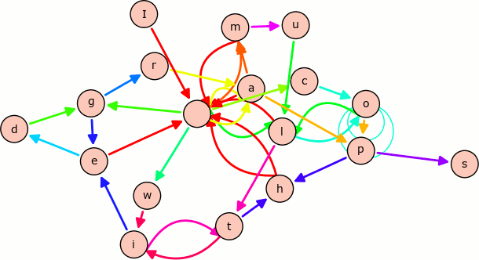
Network Terms and Types - Overview
Multiple Edge Graphs
Graph containing multiple edge types (i.e. multiple edge sets)

Slide 19
Network Terms and Types - Overview
Adjacency Matrix vs. Adjacency List

Slide 20
Network Metrics
Network Measures
There are variety of measures, of varying levels of complexity, that are used to characterize networks at both the “micro” (i.e. node and edge) and “macro” (i.e. network) levels

Slide 21
Network Metrics
Size
Number of nodes and edges in a network
Density
Portion of all realized edges relative to possible edges
n = number of nodes
m = number of edges
D = 2m/n(n-1) [for undirected]

Slide 22
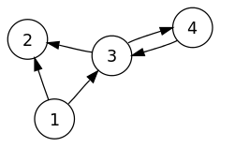
Network Metrics
Degree
Number of edges connected to a node [Ex: deg(5) = 2]
Average Degree
Average degree of nodes in network
In/Out Degree
In a directed graph, number of edges coming into or out of a node

Slide 23
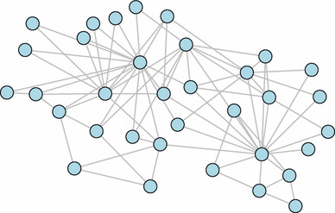
Network Metrics
Degree Distribution
Distribution of node degrees in a network [probability distribution indicating probability of a node having degree k ]

Slide 24
Network Metrics
Average (Characteristic) Path Length
Average of the shortest path lengths between all pairs of nodes in the network
Eccentricity
For each node, shortest path to the node farthest away from it in the network
Network Diameter
Maximum eccentricity value in the network

Slide 25
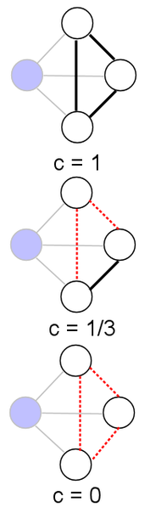
Network Metrics
Clustering Coefficient
For a node, proportion of realized ties between neighbors as compared to possible ties between neighbors
Average Clustering Coefficient
Average of all individual node clustering coefficients; gets at “clumpiness” or “cliquishness” of a network
Also related to the notion of network transitivity

Slide 26
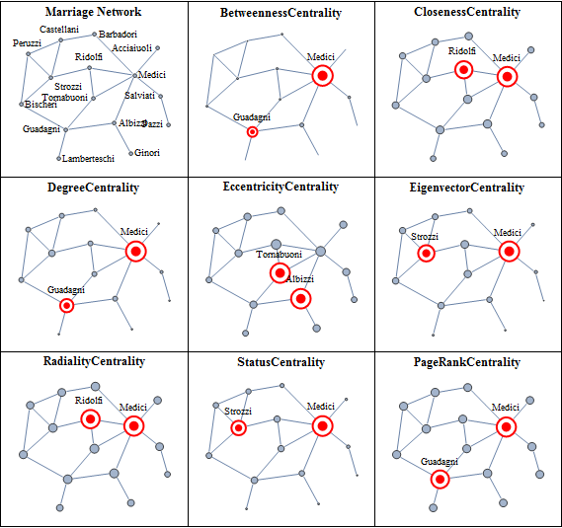
Network Metrics
Centrality Measures
Way of getting at how “important” a node is in a network
Many different approaches to assessing this…
Centrality of Florentine Families
(from Wolfram Mathematica)

Slide 27
Networks in ABM
NetLogo
Nodes → Turtles
Node attributes are “turtles-own” variables
Node sets are the agentsets of turtles
Ties → Links
Links treated as their own agents in NetLogo
Identified by the “who” id of the turtles they connect
Default is undirected, but can be directed
Tie attributes handled through “links-own”
Neighbor set is identified via “[turtle] link-neighbors”
Further flexibility available via the NetLogo Network Extension

Slide 28
Networks in ABM
Python (NetworkX package)
Graph
The entire graph is stored as a NetworkX Graph object
Nodes →
View nodes using a special, “dictionary-like” object called through <Graph object>.nodes()
Node attributes are kept in a dictionary associated with node. View node attributes with <Graph object>.nodes.data()
Can transform view nodes and view nodes data objects into a list with list(<Graph object>.nodes()) or dictionary dict(<Graph object>.nodes.data())
Edges →
View edges similarly as you do nodes with <Graph object>.edges and <Graph object>.edges.data()
Can manipulate into lists and dictionaries in same way
Also able to view as an adjacency list with <Graph object>.adj (object resembles series of nested dictionaries)

Slide 29
Networks in ABM
Network Notebooks

