Slide 1
CMPLXSYS 530
Computer Modeling of Complex Systems
Basic Components of an ABM
1/22/19

Slide 2
Agenda for Today
Basic Components of an ABM
Agents
Environment
Interactions
First Assignment: NetLogo practice
NetLogo – the Simple Life

Slide 3
Basic Components of an ABM
There are 3 main building blocks to any Agent Based Model (ABM)
Agents
Environment in which agents are situated
Interactions between agents and/or environment
When beginning an ABM project, useful to begin by conceptually divvying the task up into specifications of these three aspects

Slide 4
Basic Components of an ABM
There are 3 main building blocks to any Agent Based Model (ABM)
(Macal and North, 2010)

Slide 5
Basic Components of an ABM
Essential characteristics of agents
Self-contained
Clear boundaries between self/other; distinguished from and recognizable to other agents
Autonomous
Self-directed and functions independently; takes in local information and executes behaviors based on it
States
Possesses a set of attributes that can change via interactions and which drive its behavior
Social
Interactions of agents with one another influences their behaviors

Slide 6
Basic Components of an ABM
Potential characteristics of agents
Adaptive
Rules that modify behaviors based on accumulated experience (i.e. some form of learning)
Goal-directed
Outcomes can be judged against whether they achieve a goal and future behaviors adjusted accordingly
Heterogeneous
Agents within a model can vary on all previously described dimensions

Slide 7
Basic Components of an ABM
Agent design can be broken out into two basic components:
Agent Attributes
Defines the state of the agent
Can be either static or dynamic
Captured via “<agent>-owned” variables (NetLogo) or via entries in a data structure (e.g. list, array, dictionary) or class attributes (Python)
Agent Methods
How state and interaction information translates into the behavior of the agent
Also used to update attributes
Captured via agent executed procedures (NetLogo) or via functions on agent-related data structures or class methods (Python)

Slide 8
Basic Components of an ABM
(Macal and North, 2010)

Slide 9
Basic Components of an ABM
What are the agents’ attributes in the “Ants” model?
What are the agents’ methods?

Slide 10
Basic Components of an ABM
Interactions
One of the most important features of ABM that allows it to “get at” complex system behavior comes from the fact that its macro-level outcomes arise out of agents’ reliance on local information to drive their behavior
This makes specification of the agent-environment and agent-agent interactions as critical to an ABM as the specification of the agents themselves
What is meant by “local information”? Examples of what does and does not fall under this heading?

Slide 11
Basic Components of an ABM
Major Design Decision:
Who will be interacting with whom and with what part of the environment?
Relevant terminology:
Agent’s local environment: local area around the agent
Neighbors: subset of agents with whom an agent interacts
Neighborhood: social or spatial areas in the “world” containing an agent’s neighbors
Topology: how agents are connected to one another within the system
What determines how agents interact with each other and their environment?
Recall “simple rules” to “complex outcomes” from last week…

Slide 12
Basic Components of an ABM
Examples of Topologies
(Macal and North, 2010)
Why does topology matter?
How does it relate to the issue of having to make simplifications in models?
What dangers might lay here?

Slide 13
Basic Components of an ABM
The final component to consider is the environment within which agents are situated.
Environments in ABM vary widely on many characteristics:
Abstraction vs Realism
Representation of physical vs. social space
Static vs Dynamic
How much they have influence on agents
How much they are influenced by agents
Dimensionality
Continuous vs. discrete
Boundary conditions
These features matter - Choose wisely!!!

Slide 14
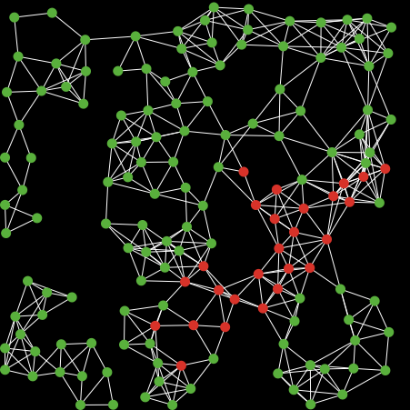
Basic Components of an ABM
Examples of variation in environments:

Slide 15
NetLogo Exercises
Assignment 1: NetLogo Exercises
Due in 1 week, Tues. 1/29/19 via Canvas Dropbox

Slide 16
The Simple Life
Setup for the Game of Life
Individuals cells are fixed and situated in a square lattice structure with other cells. Cells can either be “alive” or “dead”.
Rules
If a cell has less than 2 live neighbors, it dies (loneliness)
If a cell has more than 3 live neighbors, it also dies (crowding)
If a cell has exactly 2 live neighbors, it stays the same
If a cell has exactly 3 live neighbors, it comes back to life if its dead or just stays alive if it already is
Task: Create an ABM for this

