Slide 1
CMPLXSYS 530
Computer Modeling of Complex Systems
Sensitivity Analysis and Robustness
2/21/19

Slide 2
Agenda for Today
Sensitivity Analysis and Robustness
Motivations and Basic Framework
Active Nonlinear Tests (ANTs)
Lightning Talks Next Week
Python Homework

Slide 3
Sensitivity Analysis and Robustness
Sensitivity analysis or robustness checks are the natural next step after model verification.
Beyond just a confirmation of the mapping between conceptual and computational models, the purpose here is to gain a better understanding how dependent (i.e. sensitive) our model results are on specific conditions, design choices, assumptions, etc.
The more insensitive (i.e. robust) our models are, the more confidence we tend to have in the conclusions we draw from them.
Such a thing as model that is “too robust”?

Slide 4
Sensitivity Analysis and Robustness
Basic Setup:
Change something you think matters a lot to the model
See how much the model results change (see if it “breaks”)
How do we determine what “matters” to the model?
What results do we assess? What counts as a major “change”?

Slide 5
Sensitivity Analysis and Robustness
Example (Wilensky and Rand) :
Assumed an initial 50/50 distribution of randomly placed voters.
This proportion was not a “free parameter” for the original model.
Voter Model

Slide 6
Sensitivity Analysis and Robustness
Example (Wilensky and Rand) :
Assumed an initial 50/50 distribution of randomly placed voters.
This proportion was not a “free parameter” for the original model.
Robustness Check:
How much did this assumption “drive” the final distribution of voters?
Voter Model

Slide 7
Sensitivity Analysis and Robustness
Example (Wilensky and Rand):
Small changes in initial proportion do seem to have a lot of effect on final percentage, especially at starting values near 50%
Same qualitative patterns of emergent “islands” of different voters still arises, however
Is this model “robust”? How does this information impact the conclusions we draw?
Sensitivity Analysis

Slide 8
Sensitivity Analysis and Robustness
What other things might also potentially “drive” this model’s results?
Sensitivity Analysis

Slide 9
ANTs
For every design choice, parameter range, initial condition, etc. and combination thereof, we have a feature whose adjustment could potentially alter our model results in profound ways.
As mentioned in the directly related issue of parameter sweeps, this leads to a combinatoric explosion that makes an exhaustive exploration of the feature and design space infeasible.
Nevertheless, in many cases, explorations of such “non-linearities” are the best for exposing model sensitivities.

Slide 10
ANTs
This leads to the question:
Is there a “smarter” and more efficient way of exploring this space in our testing of complex models (ABM or otherwise)?
Miller (1998) addresses this issue by proposing one approach
Active Non-linear Tests (ANTs)

Slide 11
ANTs
Potential application of ANTs:
Multivariate Sensitivity Analysis
Model breaking and verification
Extreme Case Scenario Discovery
Policy Discovery

Slide 12
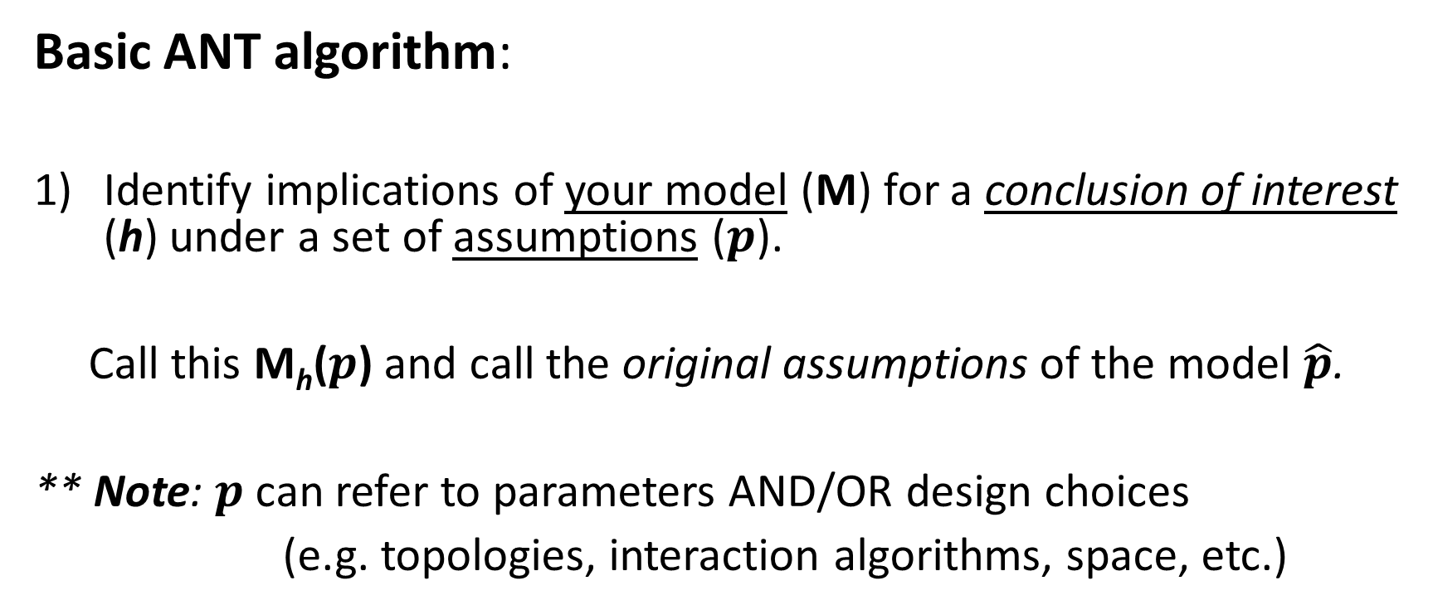
ANTs
Basic ANT algorithm:
Identify implications of your model (M) for a conclusion of interest (h) under a set of assumptions ($p$).
Call this M_{h}($p$) and call the original assumptions of the model $\hat{p}$.
** Note: $p$ can refer to parameters AND/OR design choices
(e.g. topologies, interaction algorithms, space, etc.)

Slide 13
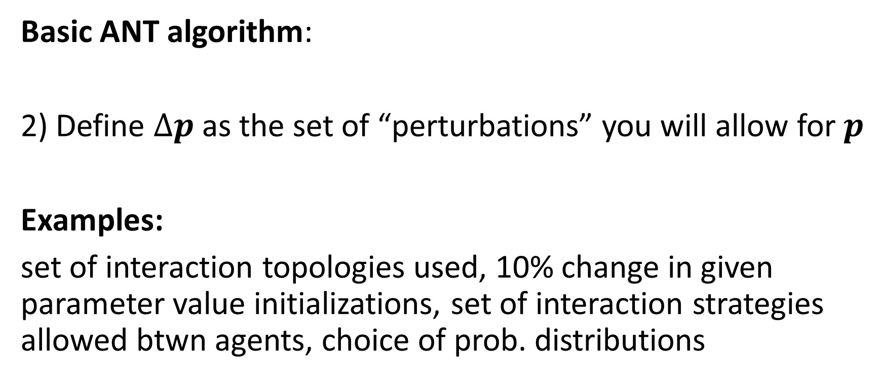
ANTs
Basic ANT algorithm:
2) Define $∆p$ as the set of “perturbations” you will allow for $p$
Examples:
set of interaction topologies used, 10% change in given parameter value initializations, set of interaction strategies allowed btwn agents, choice of prob. distributions

Slide 14
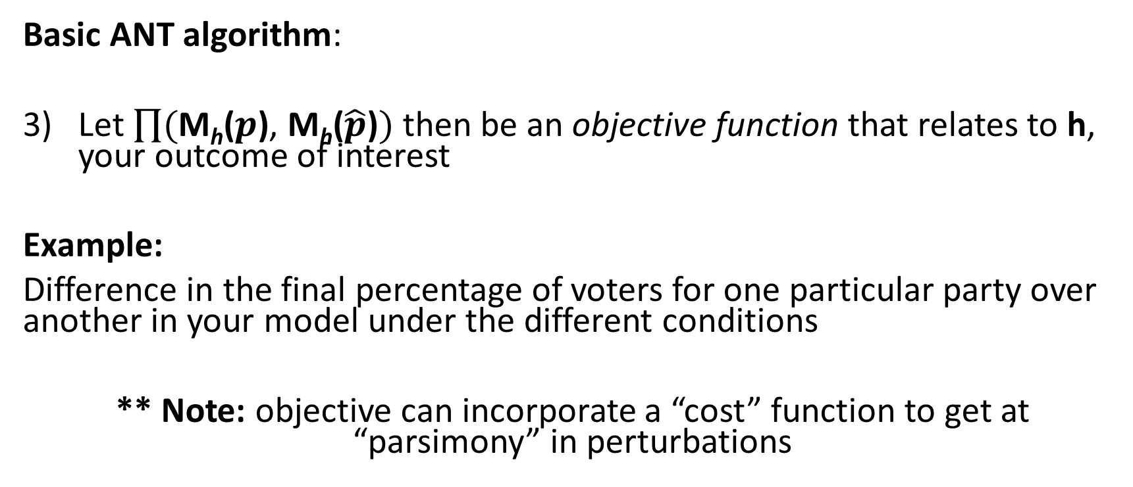
ANTs
Basic ANT algorithm:
Let $\prod{(\text{M}\text{h}\text{(}p\text{)}\text{,} \text{M}\text{h}\text{(}\hat{p}\text{)})}$ then be an objective function that relates to h, your outcome of interest
Example:
Difference in the final percentage of voters for one particular party over another in your model under the different conditions
** Note: objective can incorporate a “cost” function to get at “parsimony” in perturbations

Slide 15
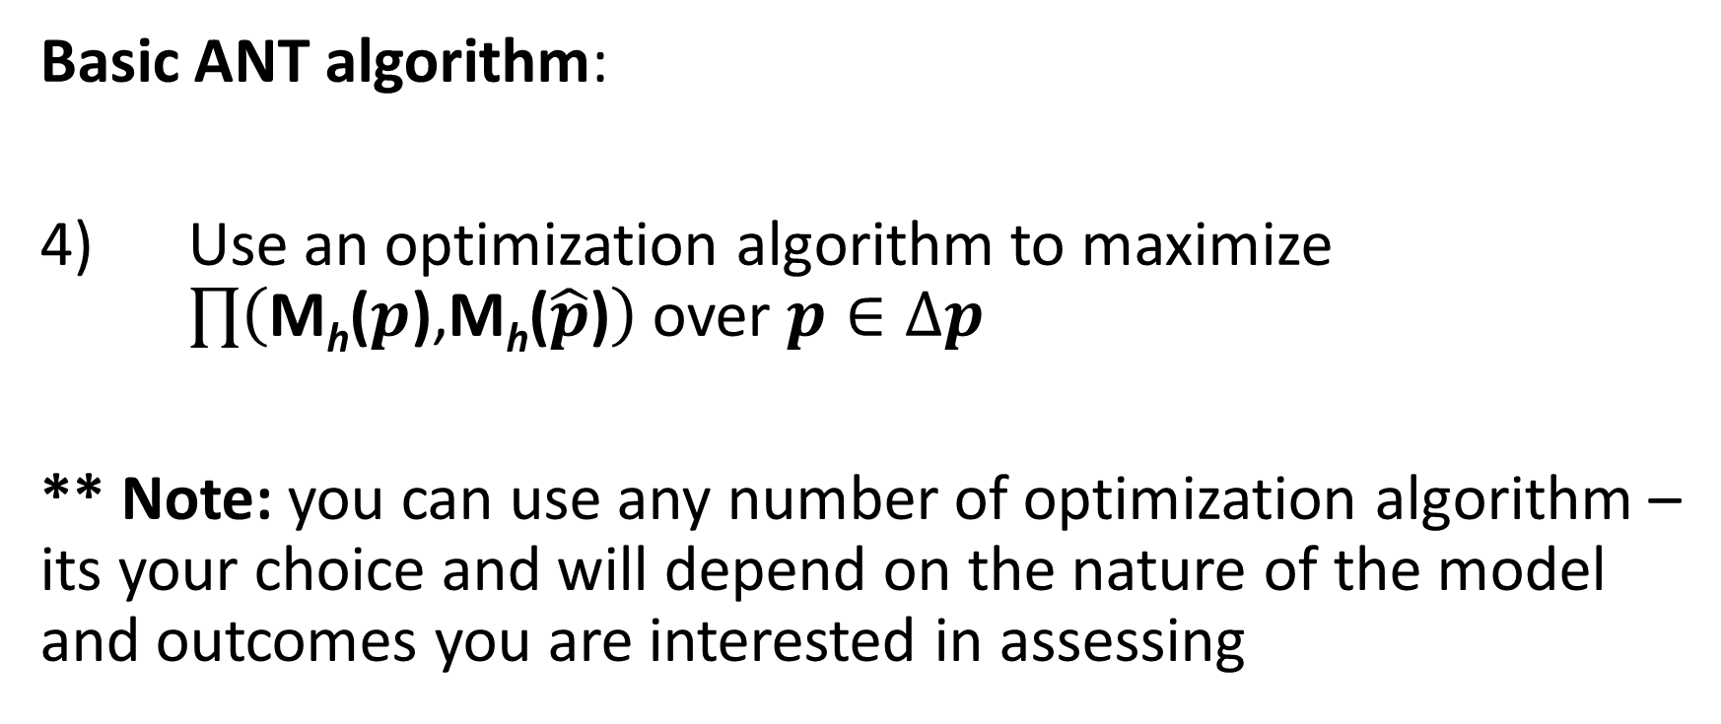
ANTs
Basic ANT algorithm:
4) Use an optimization algorithm to maximize $\prod{\left(\text{M}\text{h}\text{(}p\text{)}\text{,}\text{M}\text{h}\text{(}\hat{p}\text{)}\right)}$ over $p∈∆p$
** Note: you can use any number of optimization algorithm – its your choice and will depend on the nature of the model and outcomes you are interested in assessing

Slide 16
ANTs
World3 Example – Application of ANTs to the World3 Model
Ambitious, complex global system model developed in 1974 (Note - NOT an ABM)
Designed to simulate system dynamics relevant to human sustainability
Model schematics:
272 model variables with 96 that need to be initialized
150 equations
508 parameters needed to specify functional forms

Slide 17
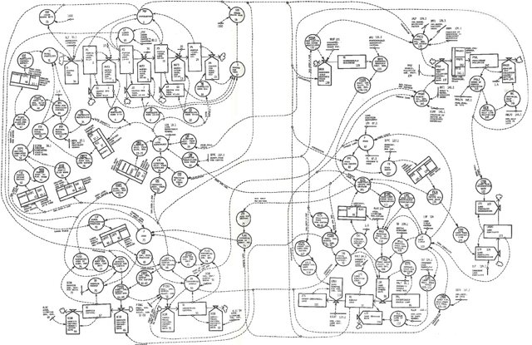
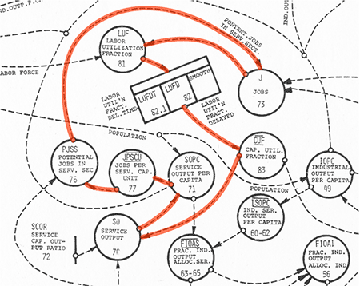
ANTs
World3 Example – Application of ANTs to the World3 Model

Slide 18
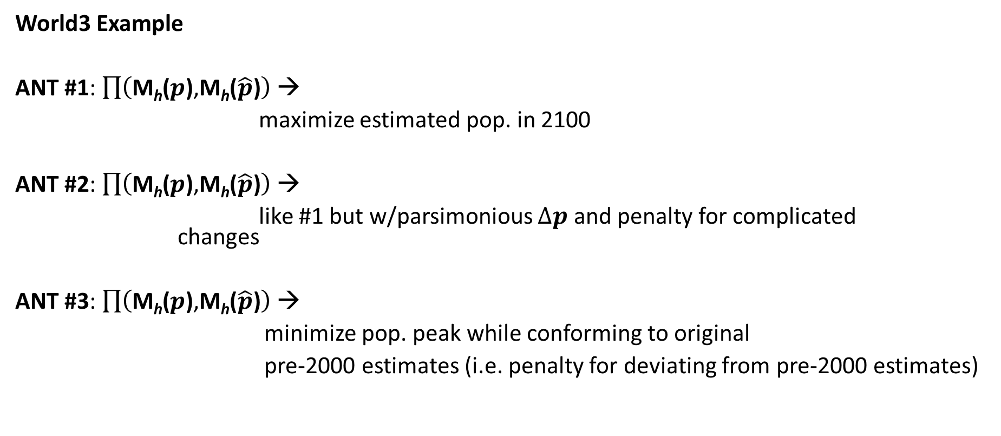
ANTs
World3 Example
ANT #1: $\prod{\left(\text{M}\text{h}\text{(}p\text{)}\text{,}\text{M}\text{h}\text{(}\hat{p}\text{)}\right)}$ →
maximize estimated pop. in 2100
ANT #2: $\prod{\left(\text{M}\text{h}\text{(}p\text{)}\text{,}\text{M}\text{h}\text{(}\hat{p}\text{)}\right)}$ →
like #1 but w/parsimonious $∆p$ and penalty for complicated changes
ANT #3: $\prod{\left(\text{M}\text{h}\text{(}p\text{)}\text{,}\text{M}\text{h}\text{(}\hat{p}\text{)}\right)}$ →
minimize pop. peak while conforming to original
pre-2000 estimates (i.e. penalty for deviating from pre-2000 estimates)

Slide 19
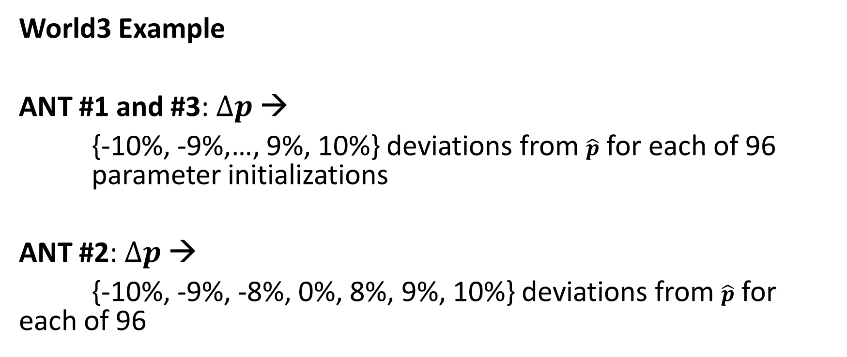
ANTs
World3 Example
ANT #1 and #3:$∆p$→
{-10%, -9%,…, 9%, 10%} deviations from $\hat{p}$ for each of 96 parameter initializations
ANT #2: $∆p$→
{-10%, -9%, -8%, 0%, 8%, 9%, 10%} deviations from $\hat{p}$ for each of 96

Slide 20
ANTs
Optimization algorithms:
For each ANT, 2 different optimization algorithms were independently applied in 30 trials for the sake of comparison
Hill-climbing algorithm
Genetic algorithm
A random-search of the parameter space was also done to provide a baseline of comparison

Slide 21
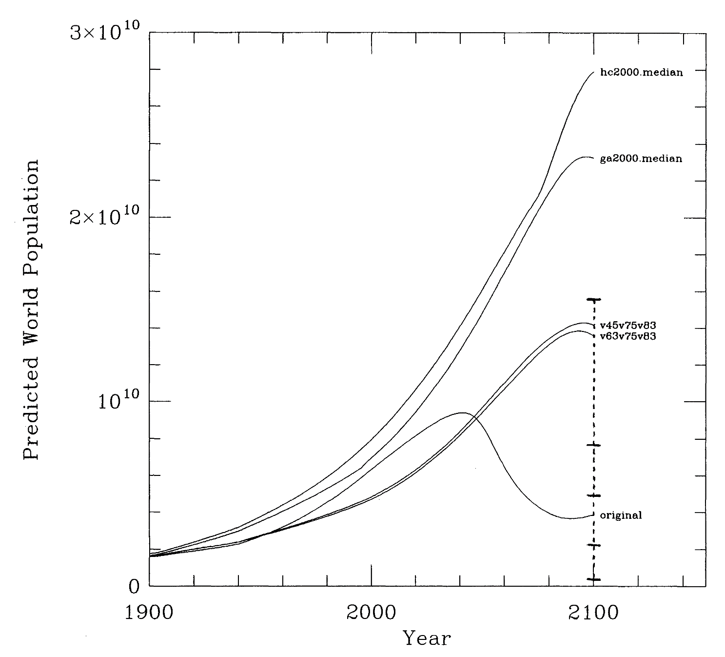
ANTs
Results: ANT 1
Can substantially increase population estimate in 2100 (can “break” the model)

Slide 22
ANTs
Results: ANT 1
Note comparison against random search!

Slide 23
ANTs
Results: ANT 2
Found that altering only parameter 75 increases by 2.3 billion and parameter 83 by 1.2b. Altering in combination, however, leads to 7.4 billion increase

Slide 24
ANTs
Results: ANT 3
Possible to notably reduce population prediction, even with pre-2000 constraint
Considering what parameters were adjusted to do this can yield possible policy implications

Slide 25
ANTs
Applying ANTs in your work
ANTs is a powerful framework, but it’s not a rote formula.
You will still will have to make a lot of choices about model outcomes to focus on and model assumptions to test, and furthermore, the optimization approach you will apply.
For Python, you will need to write your own
NetLogo offers BehaviorSearch

Slide 26

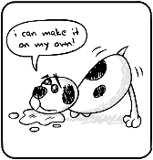
Your Options for Next Week…
Option 3: Lone Wolf Style
Neither!
[Final project will be worth 40%...]
[…also you still have to show up…]
Option 1: Original Style
Talk about your ideas for 5 min and get super helpful feedback!
[Automatic %5 for final grade]
Option 2: Group Style
Participate in “speed dating” type activity to pitch project and/or discuss what you’d like to contribute to one!
[Automatic %5 for final project]

