Slide 1
CMPLXSYS 530
Computer Modeling of Complex Systems
Course Introduction and Overview
1/10/19

Slide 2
Agenda for Today – Welcome to CMPLXSYS 530!
Introductions
Course Overview
Complex Systems
What this course does cover
What it does not cover
Main Objectives
Course Logistics
Class structure
Course website
Grade breakdown
Readings and assignment schedule
A note on prior background coming into this class…
Software Installation
NetLogo
Anaconda
First Day of Class Survey

Slide 3
Introductions
Instructor: Lynette Shaw
Office: 719 Weiser Hall
Office Hours: 10am-12pm Weds.
Interest Areas:
Culture and Cognition, Social Construction, Economic Sociology, Cryptocurrency, Valuation Processes, Social Theory

Slide 4

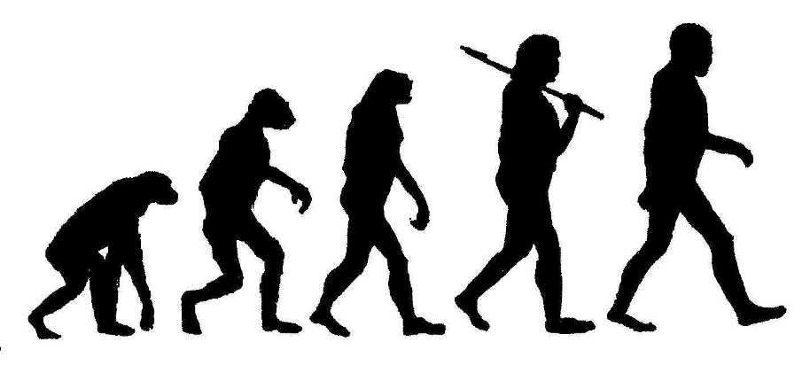

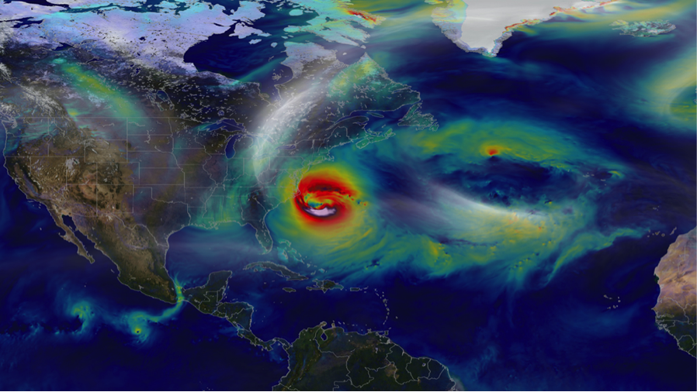


Course Overview
What exactly is a “complex system”?

Slide 5
Course Overview
What exactly is a “complex system”?
Wikipedia:
“A system composed of many components which may interact with one another”
NECSI:
“…a new field of science studying how parts of a system give rise to the collective behaviors of the system, and how the system interacts with its environment”
Sayama (p. 3):
“Complex systems are networks made of a number of components that interact with each other, typically in a nonlinear fashion. Complex systems may arise and evolve through self-organization, such that they are neither completely regular nor completely random, permitting the development of emergent behavior at macroscopic scales.”

Slide 6
Course Overview
Key characteristics of “complex systems” (from CSCS)
SELF-ORGANIZATION into patterns, as occurs with flocks of birds, periodicity in disease outbreaks, or residential segregation.
EMERGENCE of functionalities, such as cognition in the brain or the robustness of networks.
CHAOS, where small changes in initial conditions ("the flapping of a butterfly's wings in Argentina") produce large later changes ("a hurricane in the Caribbean").
"FAT-TAIL" BEHAVIOR, where rare events (e.g. mass extinctions, market crashes, and epidemics) occur much more often than would be predicted by a normal (bell-curve) distribution.
ADAPTIVE INTERACTION, where interacting agents (as in markets or the Prisoner's Dilemma) modify their strategies in diverse ways as experience accumulates to produce cooperative behavior.

Slide 7
Sayama, p.5

Slide 8
Course Overview
What this Course will cover…
The central focus of this course is to teach you how to design, build, and analyze your own Agent-Based Models (ABM)
Secondary subjects we’ll hit along the way:
Philosophy of science behind modeling
Basic to intermediate computer programming in NetLogo and Python
Basic statistics and probability
Networks (i.e. Graphs)
Collective Behavior, Pattern Formation, Game Theory [Tangentially]
Review of a number of models of physical, biological, and social systems

Slide 9
Course Overview
What this Course will not cover…
Equation-based modeling of system dynamics (either continuous or discrete)
Data-driven, predictive models
Large scale “microsimulations”
Questions or clarifications on course content?

Slide 10
Course Overview
Main Objectives
Leave this class with an ABM you have designed, built, and analyzed that will (hopefully) be useful to you in your future research
Develop familiarity and competencies in two programming languages, NetLogo and Python
Get good at modeling in general and understand what models are (and are not) useful for
Become a sophisticated consumer of articles involving ABM and gain a solid grounding in some of the key models in the field
End the course ever-so-slightly mad with power given your new found ability to model ALL THE THINGS…

Slide 11
Course Logistics
Class Structure
One of the main benefits/drawbacks of this course is the balance it strikes between conceptual development and computational skill development
First half of class days: Lecture and Discussion*
(* Discussion is a BIG part of this class!)
Second half of class days: Hands-on demos and practice/exercises with code

Slide 12
Course Logistics
Course Website
https://github.com/lynetteshaw/cscs-530-wi2019

Slide 13
Course Logistics
A Note on Prior Background …
Prior coursework in Complex Systems is not required for this course, but hopefully you are coming in with some significant interest in the field. Some prior experience with at least beginner-level programming and basic statistical and math concepts is strongly encouraged.
Prior Programming Experience
Professional
(like, you could be making a lot more money right now…)
Never seen a line of code before
Lots of time spent on computational aspect, simpler project ABM (but will leave with a great new skill set!)
Time spent on coding may seem a bit remedial, but you will have lots of opportunities to get into deeper levels of modeling and develop a very sophisticated project ABM
Nice balance between learning about complex systems modeling and beefing up your coding experience

Slide 14
Software
Bringing a laptop* every day is required for this course
* If you don’t have access to a personal laptop, let me know ASAP and we can make arrangements through LSA to get you one for the semester

Slide 15
Software
To Install
NetLogo
https://ccl.northwestern.edu/netlogo/
Anaconda (strongly suggest Python 2.7 version)
https://www.anaconda.com/download/
- Jupyter Notebook
- Spyder

Slide 16
Wider Complex Systems Happenings…
CSAAW
(Complex Systems Advanced Academic Workshop)
https://lsa.umich.edu/cscs/graduate-students/csaaw.html
SFI Complex Systems Summer School
https://www.santafe.edu/engage/learn/schools/sfi-complex-systems-summer-school

Slide 17
For next time…
Read
“More is Different,” Anderson 1987
“Why Model?”, Epstein 2008
Sayama, Chp. 2
Wilensky, Chp. 0-1
Do
- Download and Install NetLogo to personal computer

