Slide 1
CMPLXSYS 530
Computer Modeling of Complex Systems
ABM Questions and Considerations
1/29/19

Slide 2
Agenda for Today
Design process of an ABM
Questions to ask at the outset
Design tasks
Considerations when Building an ABM
Modifying vs. building from scratch
Agent considerations
Granularity
Cognition
Inheritance and incorporating “Evolution”
Scheduling
Second Assignment: Project Brainstorm and Lit. Review
Python – CodeAcademy

Slide 3
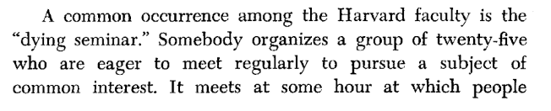
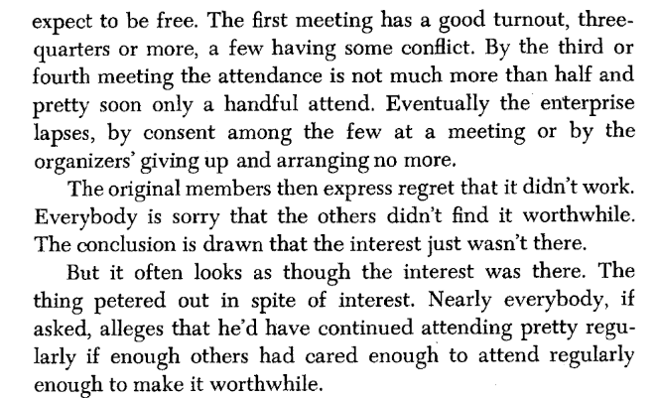
Design Process of ABM
From Schelling’s Micromotives, Macrobehavior, p. 92
So you want to build an ABM?
Illustrative Example:
Interventions on Schelling’s dreaded “Dying Seminar”

Slide 4
Design Process of ABM
Questions from Macal and North (2010):
What specific problem should be solved by the model? What specific questions should the model answer? What value-added would agent-based modelling bring to the problem that other modelling approaches cannot bring?

Slide 5
Design Process of ABM
Questions from Macal and North (2010):
What should the agents be in the model? Who are the decision makers in the system? What are the entities that have behaviours? What data on agents are simply descriptive (static attributes)? What agent attributes would be calculated endogenously by the model and updated in the agents (dynamic attributes)?

Slide 6
Design Process of ABM
Questions from Macal and North (2010):
What is the agents’ environment? How do the agents interact with the environment? Is an agent’s mobility through space an important consideration?

Slide 7
Design Process of ABM
Questions from Macal and North (2010):
What agent behaviours are of interest? What decisions do the agents make? What behaviours are being acted upon? What actions are being taken by the agents?

Slide 8
Design Process of ABM
Questions from Macal and North (2010):
How do the agents interact with each other? With the environment? How expansive or focused are agent interactions?

Slide 9
Design Process of ABM
Questions from Macal and North (2010):
Where might the data come from, especially on agent behaviours, for such a model?

Slide 10
Design Process of ABM
Questions from Macal and North (2010):
How might you validate the model, especially the agent behaviours?

Slide 11
Design Process of ABM
Design Process Tasks (Sayama, Chp. 10)
1. Design the data structure to store the attributes of the agents.
2. Design the data structure to store the states of the environment.
3. Describe the rules for how the environment behaves on its own.
4. Describe the rules for how agents interact with the environment.
5. Describe the rules for how agents behave on their own.
6. Describe the rules for how agents interact with each other.
How will these be implemented differently when using different platforms?

Slide 12
Considerations – Things to keep in mind
Thinking about some of the many choices you’ll need to make when building your ABM…
Modifying vs. building from scratch
Agent decisions
Granularity
Cognition
Inheritance and incorporating “Evolution”
Scheduling

Slide 13
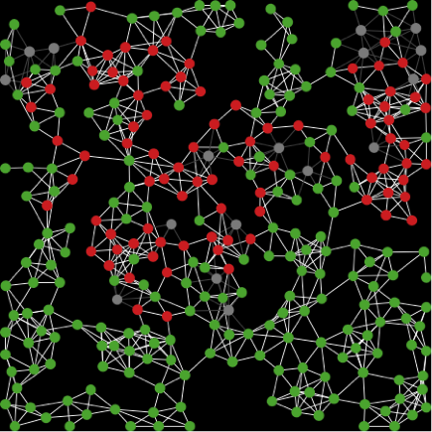
Considerations – Things to keep in mind
Modifying vs. Building from Scratch
One of the most basic things to consider at the outset is whether you need to build your ABM from scratch or if you might be able to “repurpose” or extend other models – either from within or outside your particular substantive field.
Benefits and drawbacks of either?
Spread of a “virus on a network”
What arenas could this be applied to?

Slide 14
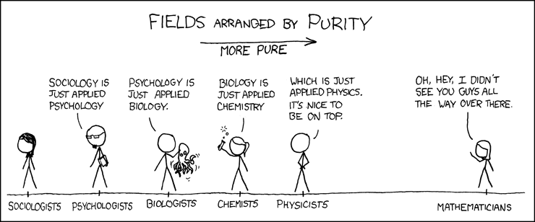
Considerations – Things to keep in mind
Agents - Granularity
Granularity involves what level in the complexity hierarchy you are choosing to use for your agents.
https://xkcd.com/435/

Slide 15
Considerations – Things to keep in mind
Agents - Granularity
Should we make mental processes, people, or organizations our agents in the seminar example?
What do our choices of granularity entail for the foundational assumptions of our model?
Tumor vs AIDS Model
The left is at the level of the cell, the right at the level of the individual

Slide 16
Considerations – Things to keep in mind
Agents - Granularity
Ultimately depends on identifying the fundamental level of interaction that matters for your questions about a phenomenon.
Possible to create multiple layers of agents in a model (meta-agents composed of lower level agents).
Must be careful to keep the “scale” of interactions appropriate (e.g. cells operating on different timescales than organs w/in a model)
Tumor vs AIDS Model
The left is at the level of the cell, the right at the level of the individual

Slide 17
Considerations – Things to keep in mind
Agents - Cognition
How smart are your agents?
Reflexive Agents
simple, static rules
Goal-Based Agents
rules adjust according to being in goal state
Utility-Based Agents
rules attempt to maximize utility function(s)
Adaptive
Agents
rules update based on experience
-
+
Cognitive Complexity

Slide 18
Considerations – Things to keep in mind
Agents - Evolution
Do your agents die and reproduce? Does the next generation change based on the experiences of the previous generation?
How will you incorporate “fitness” in this model? Inheritance? Variation across generations?
*see work on genetic algorithms for an expansive exploration of these subjects*

Slide 19
Considerations – Things to keep in mind
Schedule refers to the order in which the model operates. Decisions in this arena can fundamentally alter the behavior of your model.
At the most general level, the schedule of any given ABM is:
Initialize model
Loop through set of agent and environment interactions
Stop

Slide 20
Considerations – Things to keep in mind
Scheduling – Asynchronous vs. Synchronous Updating
Synchronous:
Changes made by an agent are not seen until the next clock-tick (i.e. simultaneous updating by all agents)
Asynchronous:
Changes made by an agent are immediately viewable to other agents

Slide 21
Considerations – Things to keep in mind
Scheduling – Parallel vs Sequential Updating [for Asynchronous]
Sequential:
Only one agent acts at a time
Parallel:
Agents act independently, at the same time
In practice, most ABM will work sequentially (e.g. by iterating through a list or agentset). True parallel requires parallel processors, though “simulated concurrency” is available in some cases.
Which of these is more “realistic“?
Which seems most likely to lead to “weird” or hard to understand behavior in your model?

Slide 22
Considerations – Things to keep in mind
Scheduling – Example of the need to be careful with order
Goal: Turn green patches red, and red patches green
Will these procedures do the same thing? Is one more computationally efficient?

Slide 23
Assignment #2
Assignment #2 – Project Brainstorm and Lit Review
Due: Tuesday, 2/12 via Canvas Dropbox

Slide 24
Python Basics
Option 1:
Go to Codecademy.com
Create a profile under “sign-up”
Find Python 2 lessons under “Catalogue”
Option 2:
Install and run PyCx from http://pycx.sourceforge.net/
Option 3:
Scan through Think Python and find a concept you’d like to practice up on. Read about it and then undertake some of the exercises provided.

