Slide 1
CMPLXSYS 530
Computer Modeling of Complex Systems
The Challenge of Modeling Complex Systems
1/17/19

Slide 2
Agenda for Today
Challenges of Modeling Complex System
What makes modeling complex systems unique
From top-down to bottom-up explanations
ABM and Complex Systems
The fit between ABM and Complex Systems
A “new kind of scien(tific)” model
NetLogo – Ants!

Slide 3
Challenges of Modeling Complex Systems
What are some of the most characteristic features of complex systems?
Emergence*
Simple rules, complex outcomes
Chaotic/path dependent
Self-organization (e.g. pattern formation)
Non-linearity
Structure of interactions matter (e.g. networks)
Evolution and adaption
[Are super cool and totally sweet]
Question:
What might make modeling these sorts of systems especially tricky???

Slide 4
Challenges of Modeling Complex Systems
Emergence: “the arising of novel and coherent structures, patterns, and properties through the interactions of multiple distributed elements” (Wilensky and Rand, p. 6)
When investigating complex systems, we are usually interested in describing, understanding, and explaining the unintended order that arises at the system level from the interaction of individual parts of that system
The kind of order we are talking about here matters…

Slide 5
Challenges of Modeling Complex Systems
Hayek’s (1973) consideration of two different Greek conceptions of “order”:
Taxis: An arranged, top-down order. A “made” or “designed” order, purposefully built and imposed by a part onto the greater whole.
Cosmos: A grown, bottom-up order. An order that arises spontaneously and unintentionally from the interaction of parts within a whole.
Which sort of order have humans been historically biased toward seeing in natural and social systems?

Slide 6
Challenges of Modeling Complex Systems
Deterministic-Centralized (DC) mindset
(Wilensky and Resnick)
Deterministic: discount the role of randomness in the creation of order
Centralized: order arises from the actions of a centralized controller or orchestrator
How would a top-down or DC perspective explain this picture?

Slide 7
Challenges of Modeling Complex Systems
Complex Systems modeling requires us to move away from top-down, DC type thinking in order to develop new orientation to looking for how order arises from the bottom-up
Must deal directly w/features that are often “simplified out” of traditional models (e.g. randomness, heterogeneity, non-linearities, decentralized structures, etc.)
What might make this difficult?

Slide 8
ABM and Complex Systems
Learning to think differently is a critical first step in modeling complex systems.
The next step, however, requires finding a “symbol system” (Ostrom) that can handle the sorts of bottom-up, non-DC models you might come up with.
Example: Murmuration
How would you develop a verbal model of this system? One using aggregate based equations?
How about with a computational model?

Slide 9
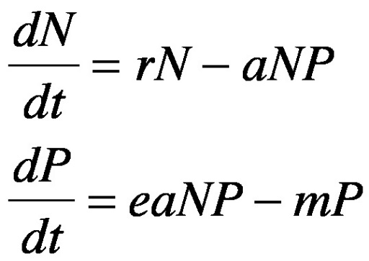
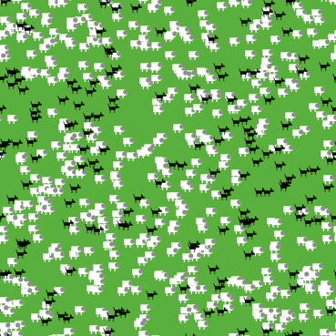
ABM and Complex Systems
When it comes specifically to complex systems, computational, agent-based models (ABM) hold some advantages to traditional equation-based models (EBM):
Better at heterogeneity
Discretization of models
Focus on individuals, not aggregates
Easy to incorporate randomness
Greater accessibility of models
Adaption and complexity in individual behavior
Incorporate more complex interactional structures

Slide 10
ABM and Complex Systems
When it comes specifically to complex systems, computational, agent-based models (ABM) hold some advantages to traditional equation-based models (EBM):
What might be some disadvantages ???

Slide 11
ABM and Complex Systems
All this accumulates into some shifts in how we think about scientific models (Think Complexity, 4-7):
Deterministic → Stochastic
Reductionism → Holism
One, two → many
Homogeneous → composite
Continuous → discrete
Centralized → decentralized
Analysis → computation

Slide 12
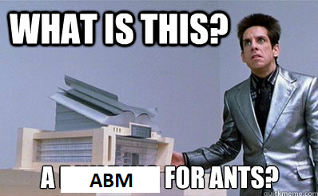
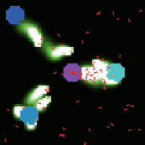
NetLogo Time!

Slide 13
NetLogo Time!
Interface
Using different parameter settings, make the ants consume from multiple piles simultaneously
Figure out how to make the ant colony really inefficient OR really efficient at consuming food
Code
a) Move food sources farther away from and make one bigger and another one smaller b) make a new food source between the ant hill and another food source [Bonus: add the new food source to the plot output]
Change the default color of ants from “green” to “red”; make them “purple” when they have food [without breaking the model!]
Bias ants’ movements to be better at turning to the right but make it so the can a) only smell things to the left and then b) only smell things to the right.
“Poison” one of the food sources so that ants who eat from it have a) a 50% chance of dying immediately and then b) have a 50% chance of dying within 5 ticks of eating from it
ALTERNATIVELY
Go through Netlogo Tutorials at either https://ccl.northwestern.edu/netlogo/docs/tutorial1.html or
http://backspaces.net/wiki/NetLogo_Tutorial_Overview

Slide 14
For next time…
Read
Macal and North, 2010
Wilensky, Chp. 3
Do (optional)
- Tinker around with a NetLogo model you find interesting

