Slide 1
CMPLXSYS 530
Computer Modeling of Complex Systems
Analyzing ABM Results
2/7/19

Slide 2
Agenda for Today
ABM Results
High dimensionality issues
Parameters and Measuring Outcomes
Standard Analysis Approaches
Statistical
Visual
Exploring the “input-output space”
Parameter Sweeps
Assignment #2 reminder and more w/PyCX

Slide 3
ABM Results
High dimensionality of ABM
A major benefit of ABM is the ability to explore relationships between a large space of system inputs to a large space of system outputs
Also allows for exploration of stochastic processes and evolution of systems across time and space
In terms of analysis, however, all these benefits potentially entail a very high dimensionality of data to deal with in analysis

Slide 4
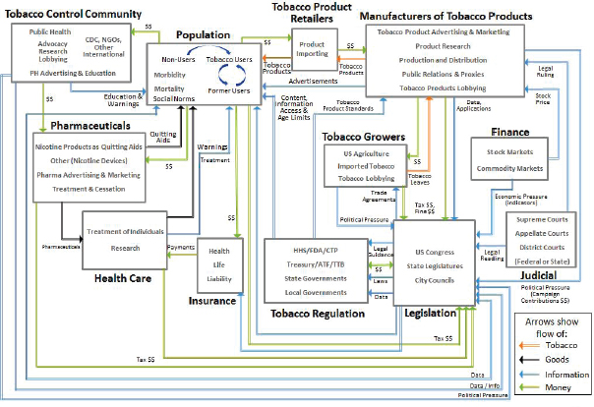
Design Process of ABM
FIGURE 2-1 Agents and relationships within the tobacco control landscape
Example from
Assessing the Use of Agent-based Models
for Tobacco Regulation,
Robert Wallace, Amy Geller, and V. Ayano Ogawa, Editors

Slide 5
ABM Results
The “Input-Output” Space (examples)
Level | Model Parameters | Model Outputs
Agent | Initial distribution of resources, breed or type, preference structure, direction, number, density | Final distribution of resources, density, proportion in a given state, position
Interaction | Type of strategy, topology, adaptation | Strategy prevalence, network structure
Environment | Resources, elevation, type, layout | Resources, elevation, percent of environment in a given state

Slide 6
ABM Results
The “Input-Output” Space (examples)
Level | Model Parameters | Model Outputs
Agent | Initial distribution of resources, breed or type, preference structure, direction, number, density | Final distribution of resources, density, proportion in a given state, position
Interaction | Type of strategy, topology, adaptation | Strategy prevalence, network structure
Environment | Resources, elevation, type, layout | Resources, elevation, percent of environment in a given state
Determining how (and when!) you will measure your outputs is as important as any other aspect of model design –
Choose wisely!

Slide 7
ABM Results
All this freedom of design means you can easily end up with way too many variables to analyze effectively
Simplicity is consequently going to be the running mantra:
Start simple, get more complicated
Shoot for “as simple as possible, but no more”
KISS principle (Keep It Simple and Stupid)*
*Arguments for when this principle might not be as appropriate?

Slide 8
Standard Analysis Approaches
Stats are your friend
As explored last time, the incorporation of randomness into ABM entails a reliance on the logic on Monte Carlo simulation methods when characterizing and analyzing models
Consequently, the bulk of ABM model analysis usually involves the use of standard statistical methods to characterize behaviors of a model over many individual runs

Slide 9
Standard Analysis Approaches
How many individual runs do you need?
Definitely not too few…
No matter your model, you need to do enough runs to have a large enough sample size to generate reliable statistical estimates.
Should probably be thinking of 100 runs as the lowest possible bar here.
Why would having a very complicated model make this requirement more difficult?

Slide 10
Standard Analysis Approaches
How many individual runs do you need?
Not ridiculously many either though…
Too many runs can actually give you so much statistical power in your estimates, that you run the risk of pulling out very small effects that are in truth, not of key importance to the model’s behavior

Slide 11
Standard Analysis Approaches
How many individual runs do you need?
Okay, but seriously *how many* runs do I actually need???
That’s a deep question. Ultimately, it’s going to depend on your analysis objectives and the complexity of your model (more parameters and outputs, more runs).
Discerning exactly how many appropriate, however, is a difficult problem:
The Complexity of Agent-Based Modeling Output Analysis (Lee et. al. 2015)

Slide 12
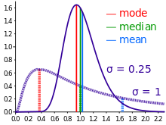
Standard Analysis Approaches
Statistical Analysis of ABM
Basic Descriptive
Mean
Stand. Dev./Variance
Mode
Median
Proportions

Slide 13
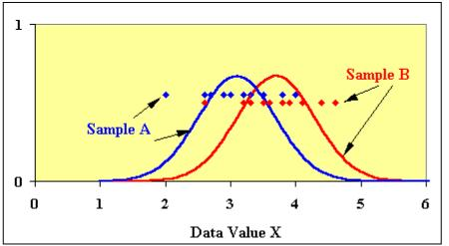
Standard Analysis Approaches
Statistical Analysis of ABM
Comparison of outcomes under different conditions
Student’s t-test
ANOVA

Slide 14
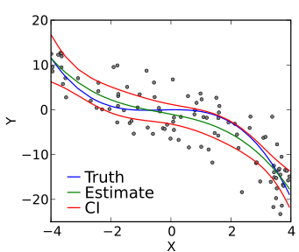
Standard Analysis Approaches
Statistical Analysis of ABM
Modeling relationship between parameters and outcomes
Regression (e.g. multiple, Poisson, Ordered probit, etc.)
Classification (e.g. PCA, clustering, etc.)
Model Outcome
Parameter of Interest

Slide 15
Standard Analysis Approaches
Visual Analysis of ABM
Effective visual comparisons of model outcomes are sometimes as important as statistical descriptions
This is especially true when trying to capture “weird” behavior of a model or interesting qualitative features of its behavior

Slide 16
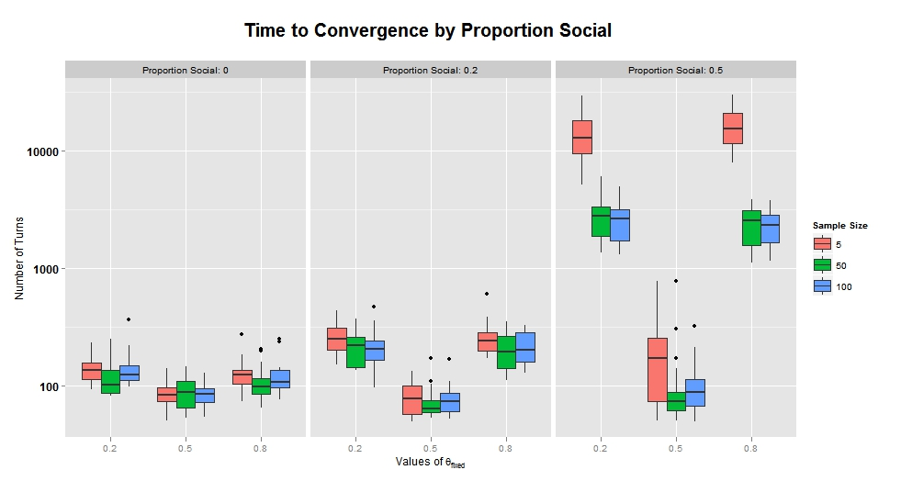
Standard Analysis Approaches
Scatterplots
Box-and-Whisker Plots
(know them, love them)

Slide 17
Standard Analysis Approaches
3D Chart of NUM-PEOPLE and DISEASE-DECAY versus time to 100 percent infection
Visualizing Multivariate Relationships

Slide 18
Standard Analysis Approaches
Providing examples of “prototypical” temporal and spatial patterns
More sophisticated visualization of spatial-temporal patterns

Slide 19
Exploring the “input-output space”
Given the number of parameters and outcomes one could potentially include, undertaking an effective and principled exploration of the “input-output space” of an ABM can be a difficult issue
Example
In a model including 1,000 agents who are characterized 5 binary attributes, there are 2⁵ or 32 types of agents possible and 32¹⁰⁰⁰ different possible starting populations to potentially consider

Slide 20
Exploring the “input-output space”
Per this, a complete exploration of the input-output space of a model is not usually feasible.
Instead, we’ll be relying on generating individual sets of runs (usually of n= 100+ each) at a series of different parameter settings.
This is what is known as a parameter sweep.

Slide 21
Exploring the “input-output space”
Which parameter settings do we use in the sweep?
No single answer to this either, but there are many possible approaches…
Manual/human guided
Sampling
Regular intervals, random, factorial design, one at time vs. many, etc.
Optimization and machine learning to select parameters
See Lee et. al. 2015 reading for more discussion

Slide 22
Assignment #2
Assignment #2 – Project Brainstorm and Lit Review
Due: Tues., 2/12 via Canvas Dropbox

Slide 23
PyCX
“Less Random Walks”
Bias the “walks” of the agents toward the bottom left
Use a different probability distribution to generate steps
Make the agents more likely to take big steps
Change the agents’ color
Challenges
Make agent color change based on location
Create two different types of agents with different biases in their movements
Create interactive sliders to adjust the mean and stand. dev. of steps (see PyCX documentation)

