Slide 1
CMPLXSYS 530
Computer Modeling of Complex Systems
The Nature of Modeling
1/15/19

Slide 2
Agenda for Today
What exactly is a Model?
Simplifying Reality: the Map vs. the Landscape
Features of “good” models
How to Model?
Process of model building
Modeling methodologies and “symbol systems”
Why model?
An incomplete but useful list of reasons to build an explicit model
The issue of prediction
Getting to know NetLogo

Slide 3
Simplifying Reality
Meditations on Falling…
In the dark forest
A berry drops.
The sound of water.
- From “The Way of Zen” by Alan Watts

Slide 4
Simplifying Reality
Meditations on Falling…
What happened?
How did it happen?
Why did it happen?
Is this a complex or complicated event?

Slide 5
Simplifying Reality
Meditations on Falling…
Are the explanations the same? Is one more “correct” than the others?
What information are you including here? What information has been left out? What has been assumed?
How did this event in particular happen? How do berries dropping and water making sounds happen in general? Are these the same explanation? Which type is more “true”?
Can this event ever occur again?
Are the answers to these questions the same as the event itself?

Slide 6
Simplifying Reality
We are unavoidably dependent on what are essentially maps of the vastly more detailed and complex landscapes of reality we traverse.
These maps are what we refer to as “models”…

Slide 7
Simplifying Reality
Some definitions:
“A model is a simplified representation of a system.” (Sayama, p.13)
“By a model, we mean an abstracted description of a process, object, or event.” (Wilensky, p. 21)
Others?

Slide 8
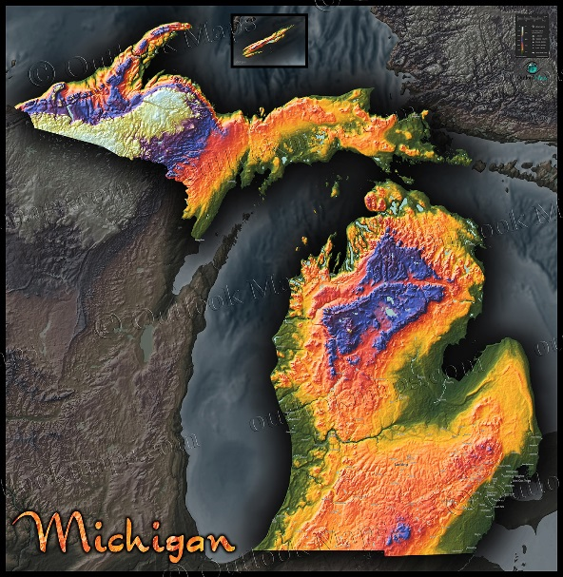
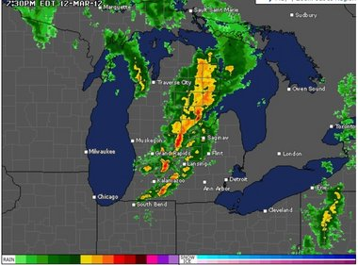
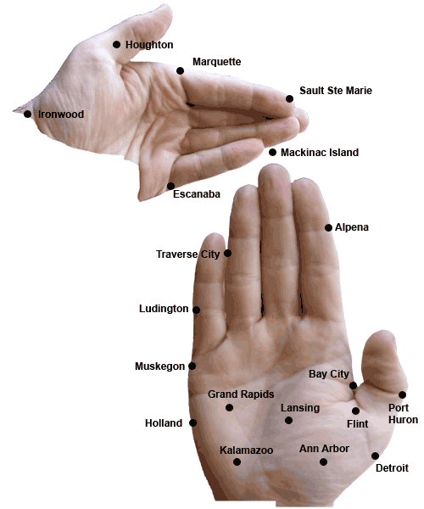

Features of “good” models
Are these models of the same thing?
Which of these models is “correct” or “true”?
Which of these is “the best” model?
How do we evaluate the quality of these models?

Slide 9
Features of “good” models
“Essentially, all models are wrong, but some are useful.”
- George Box

Slide 10
Features of “good” models
Are all models equally useful or good?
Features of a “good” model:
Valid (both internally and externally)
Simple (i.e. parsimonious )
Robust
Generalizable

Slide 11
How to build a model
The good news: you are already a natural at building models!
The bad news: ... and that’s exactly what gets us in trouble
Example: Conspiracy Theories
Example: “Wet lawn” scenario

Slide 12
How to build a model
How to Science:
Translate our implicit models into explicit models
Elaborate, explore, examine, and refine those explicit models
Test them against reality until they break
Come up with a new set of models using the information about how the old ones broke
[Shout out to Kuhn’s The Structure of Scientific Revolutions, 1962]

Slide 13
How to build a model
Clarifying your Intentions
Is your main purpose to represent what the system looks like or how the system will behave? (Sayama, p. 14-15)
Descriptive modeling:
miniatures, pattern recognition algorithms, maps, biographies
Rule-based modeling:
fluid dynamics, evolutionary theory, game theory

Slide 14
How to build a model
A process for Rule-based modeling (Sayama, p.15)
Observe the system of your interest
Reflect on possible rules that might cause the system’s characteristics that were seen in observation
Derive predictions from those rules and compare with reality
Repeat the above steps to modify the rules until you are satisfied with the model

Slide 15
How to build a model
There’s more than one way to represent a cat…
In modeling, its not just how you simplify reality, but also the choices you make in how you represent that simplification that matter
Example from Wilensky: Roman vs. Hindu-Arabic numerals

Slide 16
How to build a model
In practice, this translates into making choices about different modeling methodologies or what some refer to as the use of different “symbol systems” (Ostrom, 1988)
Big 3:
Mathematical (closed form, analytical)
Verbal
Computational

Slide 17
How to build a model
Examples of the different types of methodologies or symbol systems used?
Drawbacks and advantages of them?
Criteria for choosing?
** If you’re really into thinking about this stuff, I strongly recommend checking out Gödel, Escher, Bach: the Eternal Golden Braid by Douglas Hofstadter **

Slide 18
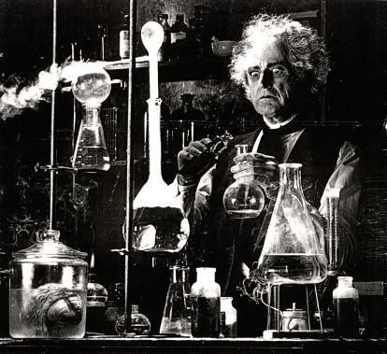
Why Model?
“Because it’s my jam” or “For SCIENCE!” are completely valid answers to why one would choose to develop explicit models of the world.

Slide 19
Why Model?
Nonetheless, if you are going to be doing this in a professional capacity, you probably want to get a more nuanced set of answers
(especially if you are in a field where you are likely to run into resistance…)

Slide 20
Why Model?
#1 all time reason to model (in my humble opinion):
Everybody is actually applying models all the time, so we might as well make them explicit so they can actually be analyzed, vetted, refined, tested, etc.

Slide 21
Why Model?
Another 16 good reasons from Epstein (2008):
Explain
Guide data collection
Illuminate core dynamics
Suggest dynamical analogies
Discover new questions
Promote a scientific habit of mind
Bound (bracket) outcomes to plausible ranges
Illuminate core uncertainties
Offer crisis options in near-real time Illuminate core dynamics
Demonstrate tradeoffs /suggest efficiencies
Challenge the robustness of prevailing theories
Expose prevailing wisdom as incompatible with data
Train practitioners
Discipline the policy dialogue
Educate the general public
Reveal the apparently simple (complex) to be complex (simple)

Slide 22

Why Model?
“Yeah, but can you predict????”
As just shown, there is a lot of value to modeling that is independent of being able to predict.
Furthermore, prediction without sufficient attention to underlying models can end up with problem
Example: use of “Big Data” and data-mining in the legal system

Slide 23

Why Model?
“Yeah, but can you predict????”
That said, prediction is ultimately one of the chief goals of science – not just for its own sake but also that of falsifiability and testing (why?)
Developing good models precedes our future ability to predict

Slide 24
Netlogo
Getting to know NetLogo – your new best friend for at least the next two weeks
https://ccl.northwestern.edu/netlogo/

Slide 25
Netlogo
Model Library > Social Dynamics > Traffic Basic
What is this a model of? What has been simplified away? What has been kept? Is this useful?
What are the different sliders and buttons doing in the GUI?
What is the emergent result of interest? How is it being represented in the GUI output?
Can you get the red car to move without starting and stopping?
Code:
What are the “globals” and “turtles-own” parts?
How many procedures are there? How/when are they called? What does each one do?
Done? Bonus stuff to try:
- Go to “Traffic Grid” model and compare
- Change the car colors
- Create a different type of car which is more “aggressive” or “defensive” in its driving

Slide 26
For next time…
Read
Think Complexity, Chp. 1
Wilensky, Chp. 2
Ostrom, 1988
Anderson, 1972

