Slide 1
CMPLXSYS 530
Computer Modeling of Complex Systems
Game Theory in ABM
4/2/2019

Slide 2
Agenda for Today
An Absurdly Brief Overview of Game Theory
- The Basics
Game Theory and ABM
- Limitations of traditional Game Theory
- Games into ABMs
Classic Example: Axelrod’s Evolution of Cooperation
Python Implementations

Slide 3
An Absurdly Brief Overview of Game Theory
Game Theory
Game theory is motivated by the realization that the study of strategically interdependent behavior can be greatly enhanced via analysis of mathematical models of conflict and cooperation between “rational” decision-makers
First got going as a field in 1940s per publication of Theory of Games and Economics work by von Neumann and Morgenstern

Slide 4
An Absurdly Brief Overview of Game Theory
Game Theory - Applications
Applied to a host of topics:
Social sciences (economics, sociology, political science)
Biology (genetics, species)
Computer Science and Logic
Basic gist is that if we can conceptualize the interdependencies of individuals in a system as a game, will be able to “solve” for outcomes (for individuals all the way to population levels)

Slide 5
An Absurdly Brief Overview of Game Theory
Game Theory – Basic Features
Game:
Circumstances where results depends on the actions of 2 or more individuals (players)
Outcomes (payoff structures) are knowable and pre-defined
Players:
Possess choices (strategies) they can play
Seek to maximize their own utility/payoff (self-interest) and have the information and cognitive capacity to do so (rationality)
Everybody has common knowledge

Slide 6
An Absurdly Brief Overview of Game Theory
Game Variants
Games come in a wide number of varieties:
Non-cooperative vs. cooperative
Zero-sum vs. non-zero-sum
One shot vs. Iterated
Symmetric vs. Non-symmetric
Simultaneous vs. Sequential (Normal vs. Extensive forms)
Two vs. Many player

Slide 7
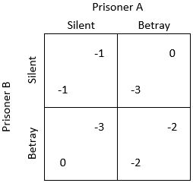
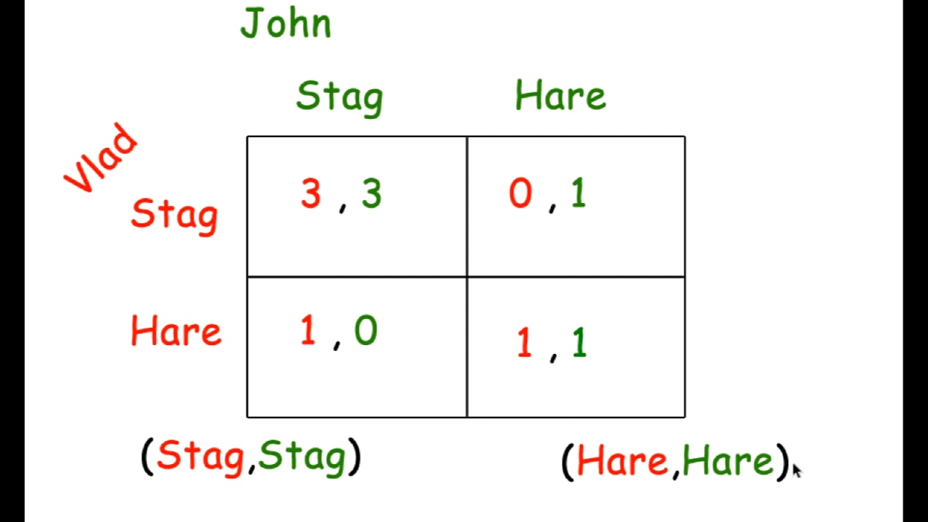
An Absurdly Brief Overview of Game Theory
Two Prominent Examples
Prisoner’s Dilemma
Coordination Game (Stag Hunt)

Slide 8
An Absurdly Brief Overview of Game Theory
Solutions to Games
Anticipating the outcome of a games is often oriented toward analytically solving for the “stable” configuration of choices individuals can make
Specifically, oriented toward identifying the Nash equilibria of a game:
Given that all players know each others’ equilibrium strategies, no player can benefit from changing their own strategy while the other players’ strategies remain unchanged

Slide 9
An Absurdly Brief Overview of Game Theory
What are the equilibria here?
Prisoner’s Dilemma
Coordination Game (Stag Hunt)

Slide 10
Game Theory and ABM
Problems with Games
The need to remain analytically tractable makes it difficult to incorporate certain aspects of real world circumstances into games:
Temporal evolution of populations
Stochasticity
Space and interaction topology
Explorations of heterogeneity
Multiple or no equilibria situations

Slide 11
Game Theory and ABM
Problems with Games
Relatedly, this analytical tractability also requires very strong assumptions about rationality which make it difficult to incorporate
more empirically plausible models of individual behavior
Bounded rationality (i.e. limited computational ability and imperfect information)
Adaptive learning

Slide 12
Game Theory and ABM
Problems with Games
Within Game Theory, there have been many successful analytical approaches to tackling these issues (e.g. “trembling hand equilibrium”, Evolutionary Game Theory, etc.)
Given concerns with things like heterogeneity, space, interaction topology, simplistic actors, adaptation, and temporal dynamics, however, leads one to suspect the potential usefulness of computational modeling in understanding these dynamics as well…

Slide 13
Game Theory and ABM
Game Theory Models into ABMs – Basic Mapping
Player Level
Game Level
Global variable called during agent interaction
Players
Agents
Payoff Structure
Strategies and Actions
Agent rules
Iterations
Time Steps
Player Payoff
Agent variable
Number of agents involved in an interaction
Number of Players

Slide 14
Game Theory and ABM
Game Theory into ABMs – More Realistic Players
Capture bounded rationality with agents using simple behavioral rulesets based only on local information
Capture rudimentary “learning” through incorporation of agent memory in behavioral rules
Introduce interaction topologies to determine who plays with whom

Slide 15
Game Theory and ABM
Game Theory into ABMs – Population Dynamics
Link agent payoffs to fitness and begin with a heterogeneous mix of agents imbued with different strategies
Can use a tournament to assess robustness of different strategies or go further and link payoffs to reproduction in next rounds
Even investigate strategy evolution through allowing strategy mutations during reproduction (Genetic Algorithms)

Slide 16
Evolution of Cooperation
Perhaps the most famous example of incorporating game theoretic model into an ABM context comes in classic study of the Evolution of Cooperation (Axelrod and Hamilton, 1981; Axelrod 1984)
Begins with a persistent problem in both the social sciences and biology:
How can cooperative behavior in groups arise and persist?

Slide 17
Evolution of Cooperation
Cooperation and the Prisoner’s Dilemma
Historically, there has been a major debate on how individually costly behavior that benefits the group can arise and sustain within populations.
Problem can be clarified by thinking in terms of a PD game.
Prisoner’s Dilemma

Slide 18
Evolution of Cooperation
Cooperation and the Prisoner’s Dilemma
Being in a group of cooperators is good, but being a defector in a group of cooperators is even better.
Holds true for biology as well – if payoffs are linked to reproduction, who will produce the most offspring?
Prisoner’s Dilemma

Slide 19
Evolution of Cooperation
Axelrod’s Insight
In a one-shot PD game, “Always Defect” [ALL D] always wins at both the individual and population levels (anything else can always be “invaded” by a population of [ALL D])
In an iterated PD game with an uncertain time horizon and a basic ability to remember prior interactions, however, other strategies may also be potentially stable

Slide 20
Evolution of Cooperation
Axelrod’s Question
Are there simple strategies relying on simple memory that can allow cooperative group behavior to succeed in situations of on-going interaction?
Success Criteria
Robustness: thrive in mixed population of strategies
Stability: once established can resist “invasion”
Initial viability: can establish in the midst of a lot of Defectors

Slide 21
Evolution of Cooperation
Axelrod’s Tournament (Round 1)
Agents
Agents are assigned to play one of 14 extremely simple to somewhat more elaborate strategies submitted by a set of experts
Strategies also include [All D], [All C], and [Random]
Model Setup
Round-robin tournament of one-to-one matchups of all strategy pairs
Each matchup goes for 200 iterations (but agents don’t know that)
Model Outcome Assessment
See which strategy had the highest average payoff across whole tournament

Slide 22
Evolution of Cooperation
Axelrod’s Tournament (Round 1)
The Winner:
Tit-for-Tat [TFT]
Even though extremely simple and involving only a very short memory, [TFT], that involves basic “nice” reciprocal cooperation, won out over everything else – including [ALL D]!

Slide 23
Evolution of Cooperation
Axelrod’s Tournament (Round 2)
Agents
64 more strategies submitted from experts in a large number of fields (including Game Theory)
Model Setup
Same round-robin tournament of one-to-one matchups of all strategy pairs
Also looked at an “ecological” variant wherein populations for the next tournament were proportional to success in prior tournament (generated a time path of strategy distributions)

Slide 24
Evolution of Cooperation
Axelrod’s Tournament (Round 2)
The Winner:
Tit-for-Tat [TFT] (Again)
Here too, this basic strategy dominated both in terms of average success AND by completely taking over the population distribution in the “ecological variant”

Slide 25
Evolution of Cooperation
Takeaways
Given a set of extremely plausible assumptions (like some initial clustering of cooperatively inclined individuals in a population), the basic principle of reciprocal cooperation can outperform an “All Defection” approach
Without any appeals to “group selection,” can explain from “the bottom-up” emergence and persistence of cooperative behavior
Given importance of bounded rationality, heterogeneity, and temporal evolution of populations in this analysis, very unlikely we could have gotten these results without availability of computational modeling

Slide 26
GAME TIME!
(now with more Python)

