Slide 1
CSED226 Introduction to Data Analysis Competition: Classification & Regression

Slide 2
Overview
In this assignment, you will create models which solve the classification task and the regression task.
Your goal is to increase your model's performance to the maximum extent you can.
You can use some techniques such as data preprocessing, model selection, and hyperparameter tuning.
You should submit your model’s result to Kaggle, and then you can monitor your scores and your rankings in real-time on the leaderboard in Kaggle.
You should make sure that you can only submit 20 times per day. You can utilize your own local machine to check the performance.

Slide 3
Rules
In this competition, you are allowed to use one of the following options: Decision Trees, Rule-based Models, k-Nearest Neighbor, or Naïve Bayes Classifier. If not, you will get a 0 score.
You can use any machine learning libraries including sklearn, pytorch, etc., except for large language models.
Only individual teams are allowed. You should do this competition by yourself.
You must also submit your training code to the PLMS. TAs can check whether your code reproduces the results or not. Any significant differences in reproduced results may result in severe penalties.
If anything that violates the honor code is found, TAs will contact you. If you cannot answer reasonably, you will get severe penalties.

Slide 4
Dataset – NBA player dataset
You will get the stats of the NBA player per year.
The dataset consists of personal statistics, such as the goals, assists, blocks, steals and more.
In the classification task, your goal is to predict the position of the player. (Column ‘position’ in csv file)
In the regression task, your goal is to predict the minutes played in a year. (Column “MIN” in csv file)
The detail can be checked in the Kaggle site.
Summary
Training set : 15000
Test set : 2000
Classification task class number : 6
Regression task range of the label : 0 ~

Slide 5
Evaluation
In the classification task, we will use Weighted F1 score for the evaluation metric.
In the regression task, we will use Mean Squared Error for the evaluation metric.
For more details, please refer to the official document.
F1 Score : https://www.kaggle.com/code/metric/f1-score?scriptVersionId=151169352
MSE : https://www.kaggle.com/code/metric/mean-squared-error?scriptVersionId=151169627

Slide 6
Competition
You can enter the competition by the link below.
Classification task : https://www.kaggle.com/t/5ddcb6fa9e3d424db15720604c91512d
Regression task : https://www.kaggle.com/t/1a5971d43d22427da3916a4cd9edbfad
Please thoroughly read both PPT and the descriptions provided on the Kaggle page.
If there are any questions, please leave the questions on the Q&A board.

Slide 7
Format
The deadline in Kaggle is 2024-11-10 23:59 PM.
The deadline in PLMS(code submission) is 2024-11-11 23:59 PM.
When you submit the code in the PLMS, you should follow the format below.
[student_id].zip
There are no restrictions on the file names or structure inside the [student_id].zip file.

Slide 8
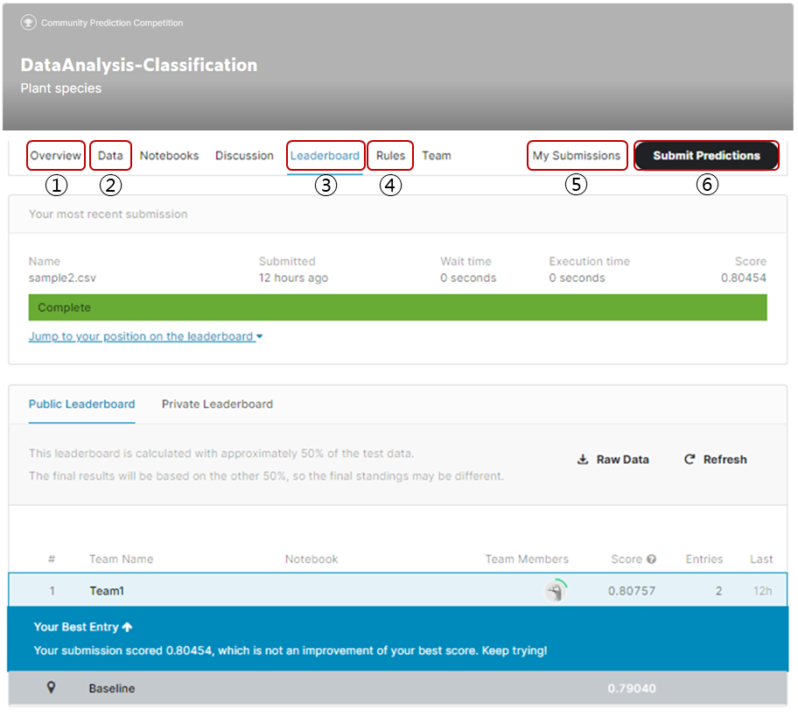
Competition
Kaggle-site
① Overview: Description of the task
② Data: Files to be used in the competition
③ Leaderboard: Current score updated in real time
④ Rules: What you must follow in the competition
⑤ My submissions: Files you submitted
⑥ Submit Predictions: Submission

Slide 9
Tips
In Kaggle competition, the test dataset is divided into two groups.
Public test dataset : In the leaderboard, the score will be calculated by testing with public test dataset. This is 50% of the test dataset.
Private test dataset : The final score, which will be used to grade your homework, is test with the private test dataset. This is 50% of the test dataset.
If your model is overfitted to the public test dataset, your final score may be lower.
You cannot check the performance on the private test dataset.

