Slide 1
CSED 226 Introduction to Data Analysis Competition: Clustering

Slide 2
Overview
The goal is to improve your model’s performance as much as possible.
You can improve your model’s performance through data preprocessing, model selection, and hyperparameter tuning.
You can submit your model’s results to Kaggle and view your scores in real-time on the leaderboards.
You can only submit a maximum of 20 per day.

Slide 3
Rules
In this competition, you can build a model using any clustering method.
You must participate as an individual team in this competition.

Slide 4
Rules
You can use any models or methods you have learned in class (Decision Tree, Ensembles, SVM, etc.) *except kNN*.
You can use all the deep learning library (pytorch, tensorflow, etc.), except for large language model.
Only individual team is allowed. You should do this competition by yourself.
You must submit your training code to the PLMS. TAs can check whether your code reproduces the results or not. Any significant differences in the reproduced results will result in severe penalties.
If anything that violates the honor code is found, TAs will contact you. If you cannot answer reasonably, you will get severe penalties.

Slide 5
Evaluation
Submissions are evaluated on the Adjusted Rand Index between the ground truth cluster labels of the data and your predicted cluster labels (assignment).
Please refer to the link.
You are not given the number of ground truth clusters or any training labels.
This is a completely unsupervised problem.
We recommend cluster indices that start with 0. (e.g., 0, 1, 2, ...)

Slide 6
Dataset
Survey Dataset
You are provided with demographic data to cluster people Employment Type such as self-employed, government employee (in Korean, 자영업자, 공무원)

Slide 7
Dataset Description
Feature Name | Feature Type
age | Numerical
education | Categorical
education level | Categorical
marital status | Categorical
Occupation | Categorical
relationship | Categorical
race | Categorical
sex | Categorical
Investment profit | Integer
Investment loss | Integer
hours per week | Integer
Native country | Categorical
income | Categorical

Slide 8
Format
The deadline in Kaggle is 2024-12-08 23:59 PM.
The deadline in PLMS(code submission) is 2024-12-09 23:59 PM.
When you submit the code in the PLMS, you should follow the format below.
[student_id].zip
The contents in the .zip file have no format. Please implement free.

Slide 9
Competition
You will enter the competition individually through Kaggle.
Kaggle Site: https://www.kaggle.com
Competition URL: https://www.kaggle.com/t/570ca68bb34541a3b704dd79ae274dc4

Slide 10
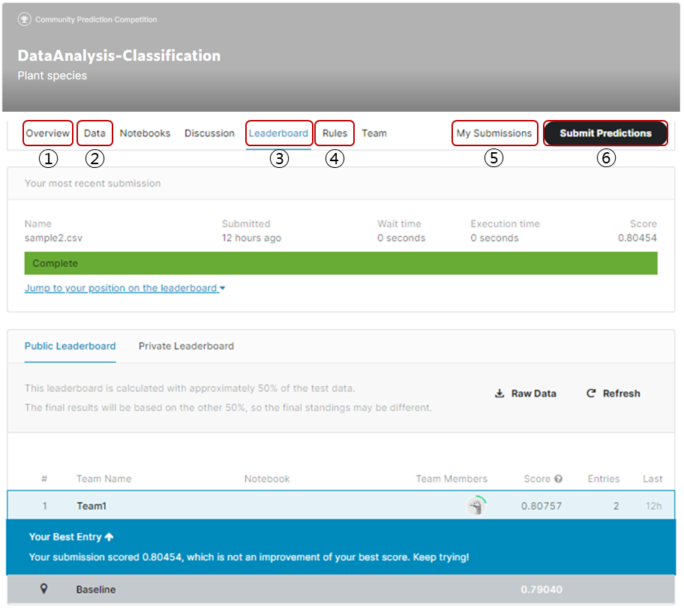
Competition
Kaggle-site
① Overview: Description of the task
② Data: Files to be used in the competition
③ Leaderboard: Current score updated in real time
④ Rules: What you must follow in the competition
⑤ My submissions: Files you submitted
⑥ Submit Predictions: Submission

