Slide 1
Weekly Report Team 2

Slide 2
Members
Do Ngoc Anh
Do Tien Duong
Le Van Dong
Ta Van Duc
Truong Phi Lan
Mentor : Hoang Anh Duc – C2

Slide 3
Contents
Given Tasks
Completed Tasks
Archived Files
Next Week’s Tasks
Difficulties & Solutions

Slide 4
1. Given Tasks

Slide 5
Tasks given by mentor
- To Do App
- Users list App
+ Function Component
+ API
+Redux
+Hook

Slide 6
2. Completed Tasks

Slide 7
Completed Tasks
ES6
Destructuring
Spread
Rest
Callback / Promise
Async / Await
React
Redux
Function Component
Local Storage
Hook

Slide 8
3. Archived Files

Slide 9
Saved files
Duc : To Do App
Dong : To Do App
Duong : To Do App + Users List App
Lan : To Do App + Users List App (wip)
Ngoc Anh :

Slide 10
4. Next Week’s Tasks

Slide 11
React
Finish Users List App
TypeScript
@Types/React Library
Interface
Intersection Type, Union Type
Extended Type
Generic

Slide 12
5. Difficulties & Solutions

Slide 13
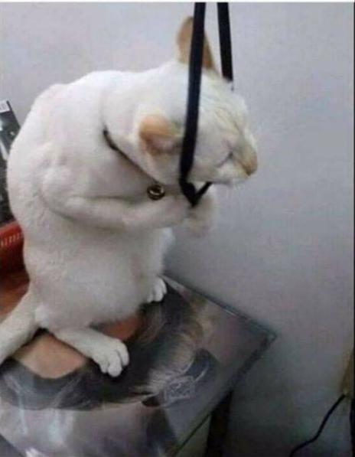
A picture is worth a thousand words
Router
Redux-Saga
Call API
Ngoc Anh need to catch up with others

Slide 14

Thanks for listening

Slide 15


