Slide 1
ARTIFICIAL INTELLIGENCE WAS NOT USE IN THE MAKING OF THIS PRESENTATION.

Slide 2
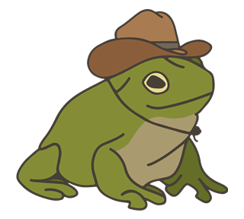
PRESENTATION ON
AMPHIBIANS
2026 June 1
Arunima Shikshya Sadan Sec. School
Class 10

Slide 3


Introduction
Amphibians are animals that can live both in water and on land.
They are vertebrates, meaning they have a backbone.
The word "amphibian" means "double life."
Most amphibians start their lives in water and later move to land.
Examples include frogs, toads, salamanders, and newts.
2
Amphibians: Cold blooded vertebrates
that live part of their life in water
and part on land.

Slide 4
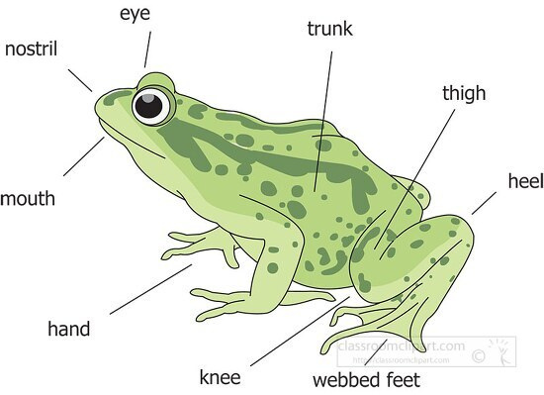

Characteristics of Amphibians
They are cold-blooded animals.
Their skin is smooth, moist, and without scales.
They can breathe through their skin and lungs.
Most amphibians lay eggs in water.
They have a three-chambered heart.
They usually live in moist environments.

Slide 5
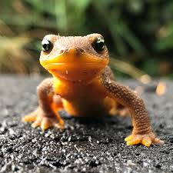
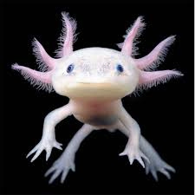
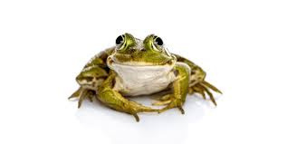
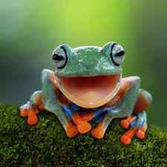
Examples of Amphibians
Newt – A type of salamander that spends part of its life in water.
Frog – The most common amphibian, found near water.
Salamander – Has a long body and tail.
Toad – Similar to frogs but has drier, rougher skin.
Fun Fact:
There are more than 8,000 known species of amphibians around the world!

Slide 6


Importance of Amphibians
Control insect populations: Amphibians eat insects such as mosquitoes, flies, and crop pests,
helping to reduce their numbers naturally.
Serve as food for other animals: Many birds, fish, reptiles, and mammals depend on amphibians as an important food source.
Help maintain ecological balance: Amphibians are both predators and prey, playing a vital role in food
chains and ecosystem stability.
Indicators of environmental health: Because their skin is sensitive to pollution and environmental changes, scientists use amphibians to monitor the health of ecosystems.
Contribute to scientific research: Some amphibians are studied in medicine and biology because of their unique skin secretions and ability to regenerate body parts.

Slide 7
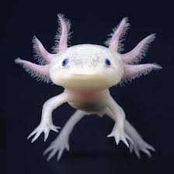
Why Moist Environments Are Important
Habitat of Amphibians
Amphibians have thin, moist skin that helps them breathe and absorb water.
Dry conditions can cause them to lose water quickly and become dehydrated.
Most amphibians need water for reproduction and egg-laying.
Ponds: Many amphibians lay their eggs and spend part of their life cycle in ponds.
Lakes: Lakes provide water, food, and shelter for various amphibian species.
Wetlands: Wetlands are ideal habitats because they remain moist and support a rich variety of plants and animals.
Forests near water bodies: Amphibians often live in damp forest areas close to rivers, streams, ponds, or lakes.

Slide 8


HABITAT DESTRUCTION
THREATS TO AMPHIBIANS
Deforestation, urbanization, and draining of wetlands reduce the natural habitats where amphibians live and breed.
POLLUTION
Chemicals, pesticides, and waste in water bodies can harm amphibians and their eggs.
Effects
Decrease in amphibian populations.
Disruption of food chains and ecosystems.
Some species are becoming endangered or extinct.
CLIMATE CHANGE
Changes in temperature and rainfall patterns can affect breeding, food availability, and survival.
DISEASES
Certain fungal diseases and infections have caused major declines in amphibian populations worldwide.

Slide 9
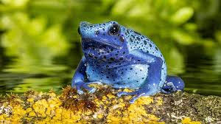
THANK YOU !
AMPHIBIANS ARE UNIQUE VERTEBRATES THAT CAN LIVE BOTH IN WATER AND ON LAND.
THEY HAVE SPECIAL ADAPTATIONS, SUCH AS MOIST SKIN AND METAMORPHOSIS, THAT HELP THEM SURVIVE IN DIFFERENT ENVIRONMENTS.
AMPHIBIANS PLAY AN IMPORTANT ROLE IN ECOSYSTEMS BY CONTROLLING INSECT POPULATIONS AND SERVING AS FOOD FOR OTHER ANIMALS.
THEY ARE SENSITIVE TO ENVIRONMENTAL CHANGES, MAKING THEM IMPORTANT INDICATORS OF ECOSYSTEM HEALTH.
PROTECTING AMPHIBIANS AND THEIR HABITATS HELPS PRESERVE BIODIVERSITY AND MAINTAIN ECOLOGICAL BALANCE.
Any questions?

