Slide 1



Quicksort – Best and Worst Case Analysis
MICRO PROJECT-DESIGN AND ANALYSIS OF ALGORITHM
NAME : YOKARAJAN R
ROLL NO : 23ITR180
JAIHARI D (19ITR028)

Slide 2

In sorting tasks, the performance of algorithms like Quicksort depends on how the input data is arranged. Some inputs make sorting fast, while others slow it down.
We are given:
An array of n real numbers
The Quicksort algorithm to sort the array
Special cases like:
All elements are equal
Strictly decreasing order
The aim is to find whether these inputs cause best, worst, or average performance in Quicksort.

Slide 3
Algorithm Design technique
Quicksort uses Divide and Conquer
It picks one number (called pivot).
Splits the array into parts: less than and greater than pivot.
Sorts each part separately
3

Slide 4
Decide on Appropriate Data Structure
Chosen Data Structure: Array
Arrays are easy to access and sort.
Suitable for testing different input types in Quicksort.

Slide 5
Decide on Appropriate Algorithm
Algorithm Used: Quicksort
Quicksort is faster in general compared to bubble or insertion sort.
Based on selecting a pivot and sorting around it.

Slide 6
Input Size
Small and large arrays are tested.
Examples:
[5, 5, 5, 5] (Equal values)
[9, 7, 5, 3, 1] (Strictly decreasing)

Slide 7
Efficiency Class
Case Type | Time Complexity | Example Input
Best Case | O(n log n) | Balanced partitions
Average Case | O(n log n) | Random input
Worst Case | O(n²) | All equal or decreasing

Slide 8
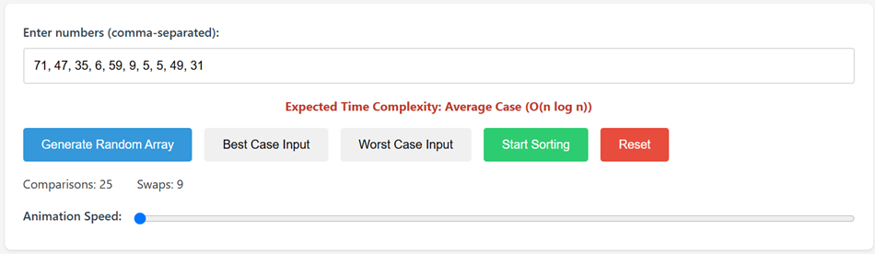
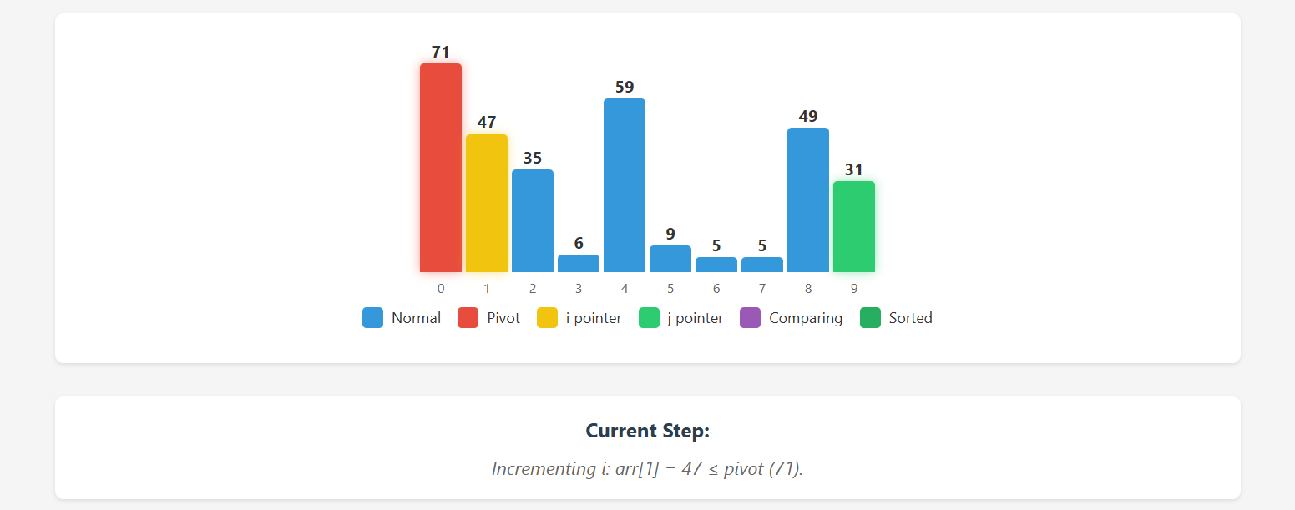
OUTPUT

Slide 9
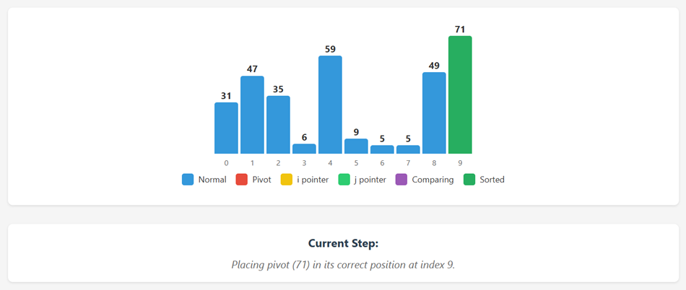
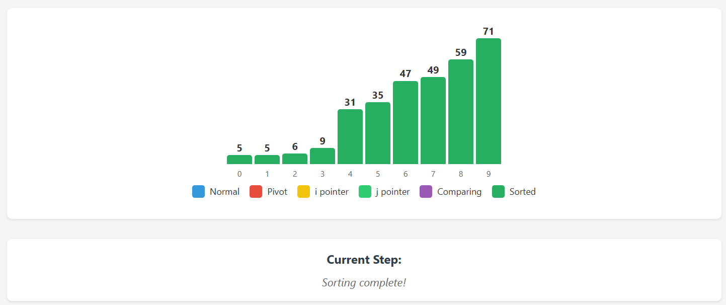

Slide 10
Thank You

