Slide 1

Disaster Damage Assessment
An Overview
,

Slide 2
DEFINITION
Preliminary but fairly accurate onsite evaluation of damage or loss caused by an accident or natural event before filing a formal claim or disaster declaration. Damage assessment records the extent of damage, what can be replaced, restored, or salvaged, and time required for their execution.

Slide 3
Context of Damage Assessment
• Primary focus is on condition of physical
assets:
– Buildings (Residential, Office, Commercial,
Lifeline etc.)
– Roads and Bridges
– Water supply and sanitation structures
– Dams and other irrigation structures
– Industrial facilities (including power plants)
– Ports and other coastal structures
– Electrical and Communications system
structures
2

Slide 4
Objectives of Damage Assessment
• Will depend on the type and intensity of
the disaster
• Minor/moderate disasters:
– Estimate total losses (for reporting and policy
purposes)
– Help develop repair/rehabilitation procedures
• Major disasters:
– Same objectives as for minor/moderate disasters
– Also assess extent of damage to buildings and
other structures (and its geographical distribution)
3

Slide 5
Objectives of Damage Assessment
• Short-Term (within a few days):
– To quickly identify the safe and unsafe buildings
– To quickly estimate total damage losses (for reporting
and policy purposes)
– To quickly identify status of lifeline buildings and other
structures
• Medium-Term (within a few weeks):
– To assess safety status of doubtful category structures
– To reassess and quantify damage losses
•
Long-Term (few months to years):
– To help develop rehabilitation/retrofitting procedures
– To help identify deficiencies in prevalent technical
knowledge and its implementation mechanisms
4

Slide 6
Primary Focus for DA
• Structures which are owned by multiple
agencies of the government
• Structures that may require government
funds for repairs or rehabilitation (including
private buildings)
• Structures that affect a large number of
people
Buildings
Bridges
Tanks and storage reservoirs (UGSR, GSR &
ESR)
5

Slide 7
Secondary Focus for DA
• Structures owned or operated by specialised
agencies
• Very complex structures that require high-
level technical skills for assessment
Complex industrial facilities
Port and harbour structures
Petrochemical infrastructure
Dams
Roads
Electrical generation & transmission networks, etc.
6

Slide 8
Damage Assessment for Buildings
Method should dependent on building type
Very large number of buildings are likely to
be damaged in a major disaster – Method
should be relatively rapid
Structural repairs are based on technically
detailed evaluation – Method should be
technically rigorous
Method should consider the variations in
international “best practices”
8

Slide 9




Approximate Equivalence Between Existing Damage
Scales for Buildings
Damage Level
(%)
HAZUS-99
FEMA-273
EMS-98 /
MSK-64
ATC-13
ATC-20
0
No-Damage Limit State (Grade 0)
10
Grade 1
Slight
20
Immediate
Occupancy
Slight Damage
Green Tag
30
Grade 2
Light
40
Damage
Control
50
Moderate
Damage
Moderate
60
Grade 3
Life Safety
Yellow Tag
70
80
Limited Safety
Heavy
90
Extensive
Damage
Near Collapse
Grade 4
Red Tag
100
Partial Collapse
Major
Collapse Limit State (Grade 5)
9

Slide 10



Approximate Equivalence Between Existing Damage
Scales for Buildings
Damage Level
(%)
HAZUS-99
FEMA-273
EMS-98 /
MSK-64
ATC-13
ATC-20
0
No Damage Limit State
10
Grade 1
Slight
20
Immediate
Occupancy
Slight Damage
Green Tag
30
Intended for
rapid safety
assessment
Grade 2
Light
40
Damage
Control
50
Moderate
Damage
Moderate
60
Grade 3
Life Safety
Yellow Tag
70
80
Limited Safety
Heavy
90
Extensive
Damage
Near Collapse
Grade 4
Red Tag
100
Partial Collapse
Major
Collapse Limit State
10

Slide 11



Approximate Equivalence Between Existing Damage
Scales for Buildings
Damage Level
(%)
HAZUS-99
FEMA-273
EMS-98 /
MSK-64
ATC-13
ATC-20
0
No Damage Limit State
10
Grade 1
Intended for
estimating
Value of
damage
Slight
20
Immediate
Occupancy
Slight Damage
Green Tag
30
Grade 2
Light
40
Damage
Control
50
Moderate
Damage
Moderate
60
Grade 3
Life Safety
Yellow Tag
70
80
Limited Safety
Heavy
90
Extensive
Damage
Near Collapse
Grade 4
Red Tag
100
Partial Collapse
Major
Collapse Limit State
11

Slide 12



Approximate Equivalence Between Existing Damage
Scales for Buildings
Damage Level
(%)
HAZUS-99
FEMA-273
EMS-98 /
MSK-64
ATC-13
ATC-20
0
No Damage Limit State
10
Grade 1
Slight
20
Immediate
Occupancy
Slight Damage
Green Tag
Intended for
earthquake
intensity
estimation
30
Grade 2
Light
40
Damage
Control
50
Moderate
Damage
Moderate
60
Grade 3
Life Safety
Yellow Tag
70
80
Limited Safety
Heavy
90
Extensive
Damage
Near Collapse
Grade 4
Red Tag
100
Partial Collapse
Major
Collapse Limit State
12

Slide 13






Approximate Equivalence Between Existing Damage
Scales for Buildings
Damage Level
(%)
HAZUS-99
FEMA-273
EMS-98 /
MSK-64
ATC-13
ATC-20
0
No Damage Limit State
10
Grade 1
Slight
20
Immediate
Occupancy
Slight Damage
Green Tag
Multiple methods are
required to satisfy
overlapping objectives
30
Grade 2
Light
40
Damage
Control
50
Moderate
Damage
Moderate
60
Grade 3
Life Safety
Yellow Tag
70
80
Limited Safety
Heavy
90
Extensive
Damage
Near Collapse
Grade 4
Red Tag
100
Partial Collapse
Major
Collapse Limit State
13

Slide 14
Proposed Procedure for Damage
Assessment for Buildings
International experience clearly shows that a
single “fit-all” methodology not feasible to
satisfy all short, medium and long-term
objectives
Three-step methodology has been proposed:
Rapid Safety Assessment
Detailed Safety Assessment
Engineering Evaluation
14

Slide 15
Proposed Procedure for Damage
Assessment for Buildings
Rapid Safety Assessment
– Required for ALL damaged buildings after a disaster
– Method is based on ATC-20 with suitable modifications
Detailed Safety Assessment
– Required for all doubtful buildings
– Required for all buildings being considered for
compensation
– Method is based on international best practices after
elimination of deficiencies in existing practice
Engineering Evaluation
Required for buildings considered for engineered
rehabilitation/retrofitting
15

Slide 16
Damage Assessment for Bridges
Low redundancy structures – collapse may be
sudden and catastrophic
Structural repairs are based on technically
detailed evaluation – Method should be
technically rigorous
Damage assessment likely to be carried out
by technical persons from the responsible line
departments
Damage assessment procedure developed
based on these considerations
16

Slide 17
Damage Assessment for Roads
Damage assessment based on visual
evaluations
Damage assessment likely to be carried out
by technical persons from the responsible line
departments
Damage assessment procedure developed
based on these considerations
17

Slide 18
Damage Assessment for
Storage Reservoirs
Low redundancy structures – collapse may be
sudden and catastrophic
Repairs are based on technically detailed
evaluation – Method should be technically
rigorous
Initial damage assessment likely to be carried
out by owners or users with limited technical
skills
Damage assessment procedure developed
based on these considerations
18

Slide 19
Damage Assessment for
Irrigation Structures
Damage assessment mainly based on visual
observations
Initial damage assessment likely to be carried
out by owners or users with limited technical
skills
Damage assessment procedure developed
based on these considerations
19

Slide 20
Damage Assessment for
Surface Pipelines
Damage assessment mainly based on visual
observations
Initial damage assessment likely to be carried
out by owners or users with limited technical
skills
Damage assessment procedure developed
based on these considerations
20

Slide 21
Damage Assessment for
Water Supply and Sewerage
Damage assessment mainly based on visual
observations
Initial damage assessment likely to be carried
out by owners or users with limited technical
skills
Damage assessment procedure developed
based on these considerations
21

Slide 22
Damage Assessment for
Ports and Harbours
Damage assessment initially based on visual
observations
Repairs are based on technically detailed
evaluation – Method should be technically
rigorous
Initial damage assessment likely to be carried
out by owners or users with limited technical
skills
Damage assessment procedure developed
based on these considerations
22

Slide 23
Damage Assessment for
Electricity Generation Structures
Damage assessment initially based on visual
observations
Repairs are based on technically detailed
evaluation – Method should be technically
rigorous
Initial damage assessment likely to be carried
out by owners or users with limited technical
skills
Damage assessment procedure developed
based on these considerations
23

Slide 24
Damage Assessment for
Electricity Transmission and Distr.
Damage assessment mainly based on visual
observations
Initial damage assessment likely to be carried
out by owners or users with limited technical
skills
Damage assessment procedure developed
based on these considerations
24

Slide 25
Damage Assessment for
Industrial Structures
Damage assessment initially based on visual
observations
Repairs are based on technically detailed
evaluation – Method should be technically
rigorous
Initial damage assessment likely to be carried
out by owners or users with limited technical
skills
Damage assessment procedure developed
based on these considerations
25

Slide 26
Damage Assessment for
Environmental Impact
Environmental Impact assessment needs to
consider the environmental and social impact
of the disaster
Assessment needs to be carried out over
long-term to quantitatively evaluate the
impact
Damage assessment procedure developed
based on these considerations
26

Slide 27

27

Slide 28
Case Study -
Using Drones for Disaster Damage Assessments in Vanuatu

Slide 29
Summary:
Cyclone Pam struck Vanuatu and destroyed thousands of homes, schools and other buildings. The Humanitarian UAV Network carried out aerial surveys as the first operational project related to the World Bank UAVs for Resilience programme. The UAV team formulated standard operating procedures and coordination mechanisms, and carried out about 200 flights. Logistical and communication challenges, a lack of clarity about specific data requirements and the lack of a standardized file format limited the success of the project, but the drones mapped areas more quickly than any other available method, and the World Bank notes that extensive learning and insights were gained through the UAV mission.

Slide 30
Background:
On 13 March 2015, tropical Cyclone Pam, a category 5 storm, struck Vanuatu, a collection of 82 islands that stretch across 1 300 kilometres, and became one of the worst natural disasters in the country’s history. Wind gusts reached as high as 320 km/hour destroying thousands of homes, schools and other buildings, leaving 16 people dead and displacing 3 300 people. The cyclone affected a total of 132 000 people, including 54 000 children. Within days the World Bank asked the Humanitarian UAV Network (UAViators) to carry out aerial surveys of as many disaster-affected areas as possible to supplement the post-disaster needs assessment. The Government of Vanuatu, through the South Pacific Commission, identified priority areas for the aerial surveys while carrying out their own initial damage assessments in the wake of Cyclone Pam. The priority areas were Shefa (Efate Urban, Efate Rural, Epi, Tongoa) and Tafea (Tanna, Erromango) and Malampa (Ambrym, Pentecost). The World Bank chose to use UAVs instead of helicopters due to the limited and unpredictable availability and cost of chartered helicopters in Vanuatu. In addition, producing high-resolution ortho-rectified mosaics requires specific flight plans and altitudes that are typically not achievable with helicopters. The purpose of the aerial surveys was to complement the field-based disaster damage assessments to identify which buildings were fully destroyed versus damaged but reparable versus largely intact. The mission was carried out between 28 March and 12 April 2015.

Slide 31
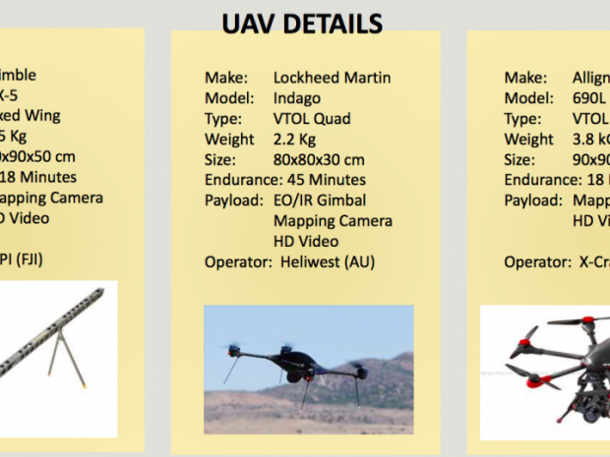

Slide 32
Implementation:
Within 48 hours of receiving the World Bank activation request, UAViators interviewed five professional UAV teams that are members of UAViators and listed on the network’s dedicated roster of UAV pilots. Heliwest from Australia and X-Craft from New Zealand were ultimately selected. Heliwest deployed a two-person team while X-Craft deployed a three-person team. UAViators served as the primary coordinator and liaison between the World Bank and the two UAV teams. The main UAV assets included a Lockheed Martin Indigo quadcopter, which has a flight time of 45 minutes; three Allign hexacopters, which have a flight time of 18 minutes; and two DJI Phantoms, which have a flight time of about 20 minutes.

Slide 33
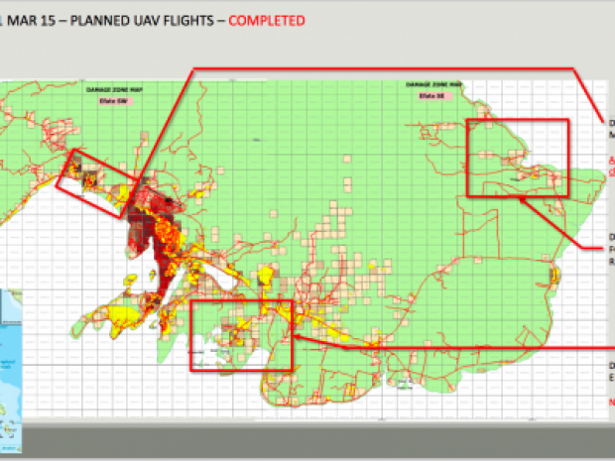

Slide 34
