Slide 1


OUR TEAM
TEAM LEADER :
Richard Nicholes M
TEAM MEMBERS :
Santhosh Kumar P
Sathyamoorthy A
Vinoth S
Yokeswaran K
Vasudevan K

Slide 2
Water Quality Analysis

Slide 3
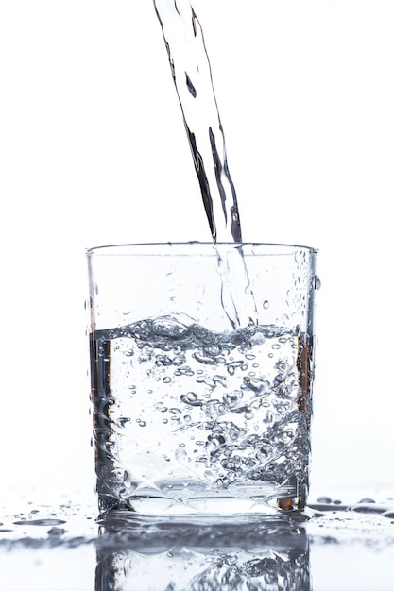
Introduction
Water is one of the most essential resources on our planet, and its quality profoundly impacts human health, ecosystems, and various industrial processes. Water quality analysis is the systematic assessment and monitoring of the physical, chemical, and biological characteristics of water to determine its suitability for specific purposes and to identify potential contaminants or pollutants.

Slide 4
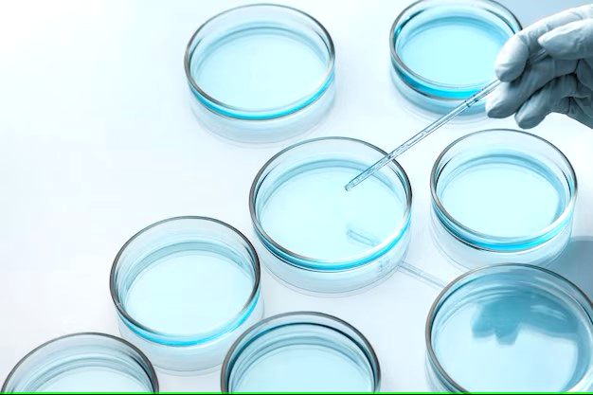
What is Water Quality Analysis ?
Water quality analysis is crucial for ensuring safe drinking water, protecting aquatic ecosystems, managing water resources, and complying with environmental regulations. It involves collecting water samples from various sources, conducting laboratory tests, and interpreting the results to make informed decisions about water treatment, pollution control, and resource management. Continuous monitoring and analysis help safeguard human health and the environment while ensuring sustainable access to clean water.

Slide 5

Data Collection
Water Quality Analysis is done by using the Dataset of “Water_Potability” provided by the dataset site www.Kaggle.com
DATASET: https://www.kaggle.com/datasets/adityakadiwal/water-potability

Slide 6
Common Water Quality Parameters
pH
Dissolved Oxygen
The measure of acidity or alkalinity of water, affecting aquatic life, corrosion, and nutrient availability.
Indicates the presence of oxygen for aquatic organisms and aerobic decomposition of organic matter.
Turbidity
Potable
The clarity of water, a vital parameter for understanding sediment loads and ecosystem health.
Potable refers to the quality of water being safe and suitable for drinking.
Hardness
Solid
Hardness of water refers to how much dissolved minerals, primarily calcium and magnesium, it contains.
"Solids" in water refer to tiny particles or substances that are suspended or dissolved in the water.

Slide 7
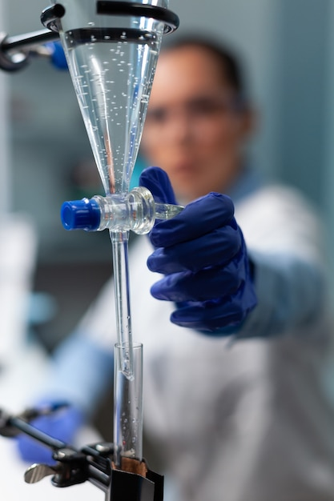
Interpreting Water Quality Data
1
Standards & Guidelines
2
Long-Term Trends
Tracking changes over time helps identify impacts of pollution, climate change, and conservation efforts.
Comparing data against established regulations and recommended thresholds to assess water quality.
3
Regional Comparisons
Comparing data across different geographic areas to identify localized issues or variations.

Slide 8
Visualization Strategy
To effectively communicate insights from out analysis, we need a plan for visualizing the data. IBM Cognos is an excellent tool for creating informative dashboards and reports.
Python libraries is also provide great Data Visualization using Jupyter Notebook.
Data Visualization
Graphs & Charts
Maps & Heatmaps
Infographics
Visual representations of water quality data can help identify patterns, trends, and anomalies at a glance.
Geospatial visualizations provide a spatial context for water quality data, highlighting hotspots and distribution patterns.
Engaging visual summaries that convey complex water quality information in a simplified and accessible manner.

Slide 9
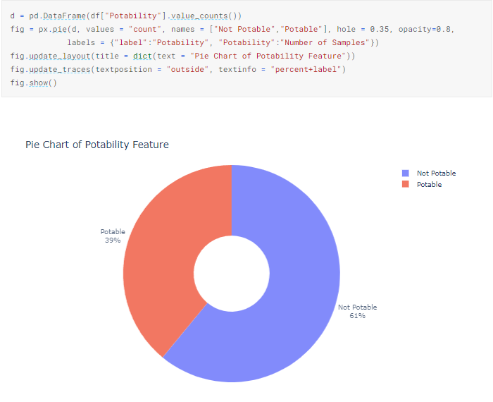

Slide 10
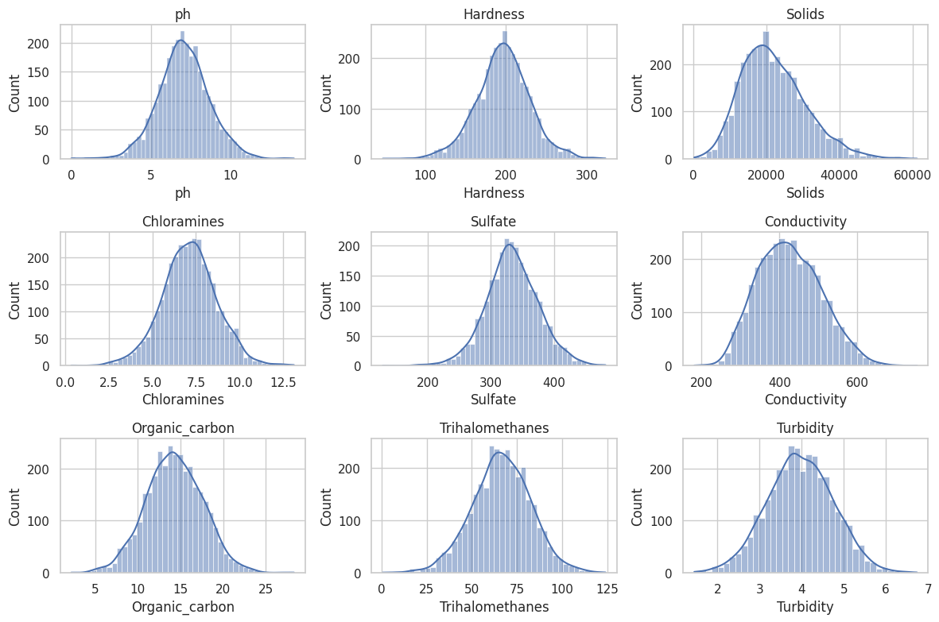
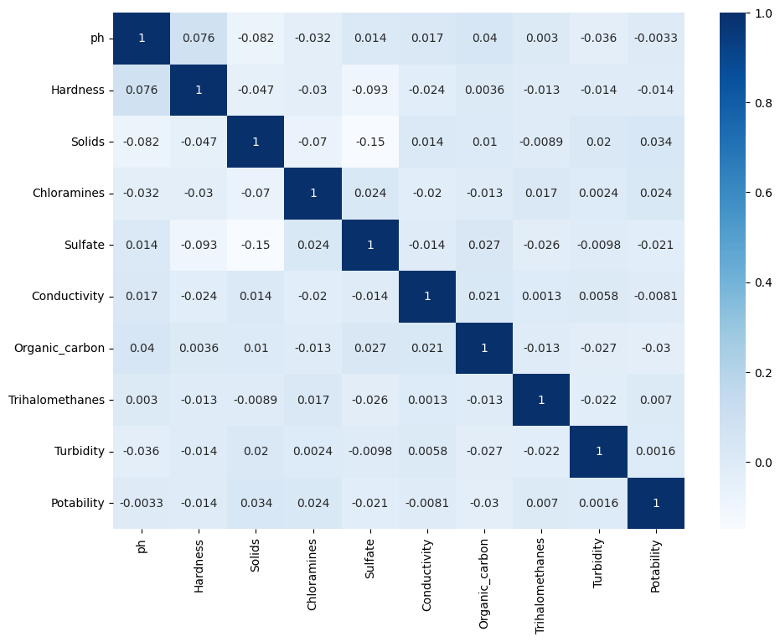
White Grid :
Heatmap :

Slide 11



Impact of Contaminated Water
Human Health Risks
Ecosystem Disruption
Economic Consequences
Exposure to contaminated water can lead to waterborne diseases, infections, and long-term health issues.
Contaminated water disrupts natural habitats, affecting aquatic life, biodiversity, and ecosystem functioning.
The impact of polluted water on industries, agriculture, tourism, and global economies is significant.

Slide 12
Impact of Water Quality Analysis
1
Scientific Research
Water quality analysis enables scientific studies to understand ecological systems and address environmental challenges.
Policymaking & Regulation
2
Accurate data drives informed policies and regulations to protect water resources and public health.
3
Community Awareness
Engaging with communities and raising awareness about water quality helps foster local stewardship and responsibility.

Slide 13
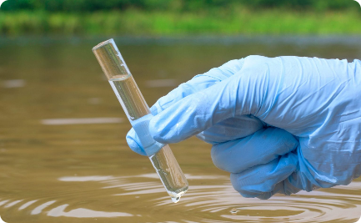
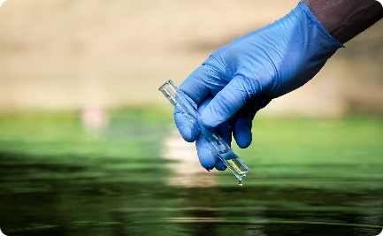
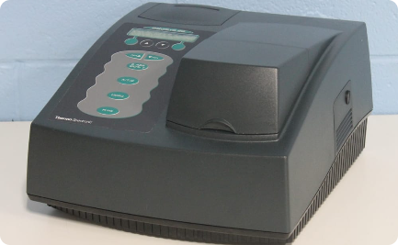
Methods for Water Quality Analysis
Grab Sampling
Continuous Monitoring
Chemical Analysis
Collecting a single, instantaneous water sample for analysis at a designated location.
Automated sensors and data loggers providing real-time measurements for long-term monitoring.
Using various laboratory techniques and equipment to identify and quantify water constituents.

Slide 14
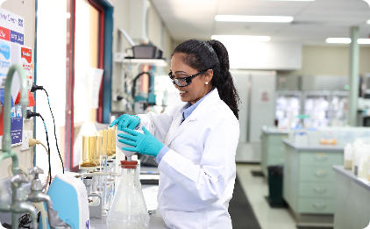
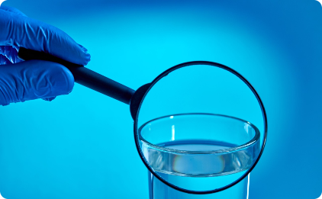
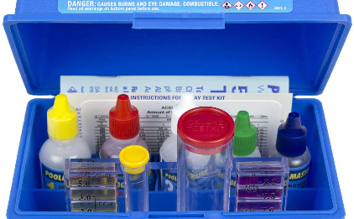
Analytical Methods for Water Quality Testing
Chemical Analysis
Microbiological Analysis
Field Testing
A wide range of analytical methods can determine the presence and concentration of chemical contaminants in water, including atomic absorption spectroscopy and gas chromatography.
These methods detect and quantify pathogenic microorganisms in water, including bacteria and viruses, that can cause serious illnesses.
Simple tests like pH strips and colorimeters can give a basic assessment of water quality on site, providing quick results for routine testing.

Slide 15
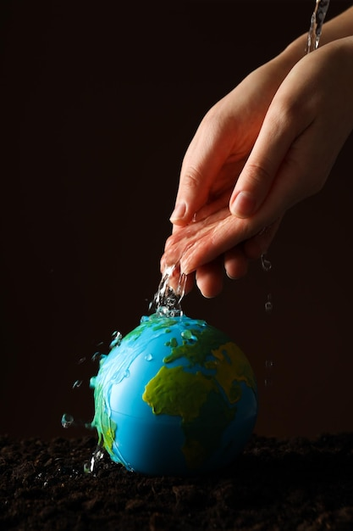
Conclusion
Water quality analysis plays a critical role in protecting public health, preserving ecosystems, and ensuring sustainable resource management. By assessing, interpreting, and visualizing water quality data, we can work towards a future with safe, clean water for all.

