Slide 1
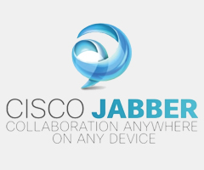


Citi Jabber Collaboration Project
November 23rd 2012

Slide 2

Citi Jabber Collaboration Project – Agenda
Team Introduction
Purpose of the project ( Goal , advantages)
About the project (Technical overview)
Use Cases
Project Implementation Strategy
Implementation Demo
Future Implementation
References
Q&A

Slide 3




Citi Jabber Collaboration Project – Team Member
David Amouyal
Currently at NYU as an MS-Information Systems student, graduating in Dec 2012
Attended the French engineering school Ensimag specialized in Computer Science and applied math
Completed internships at :
  Christie's
  start-up company called Topi located in New York developing a high tech social app..
Yu Jin
Currently at NYU as an MS-Information Systems student , graduating in May 2013
Experience of 2 years , working for ZTE company in China
Delivered innovative, custom-made products and services to Singapore, Czech, Slovakia, Pakistan, Libya, Cambodia of the Congo and many other countries.

Slide 4




Citi Jabber Collaboration Project – Team Member
Sanjana Jacob Mammen
Currently at NYU as an MS-Information Systems student , graduating in Dec 2012
Have 3 years of work experience working for :
  J P Morgan Chase
  RBS
  Infosys Technologies Limited.
Ritika Singh
Currently at NYU as an MS-Information Systems student, graduating in May 2013 .
Experience of 2 years , working for Infosys Technologies Limited, India
Internships with :
  a financial software startup called Advise Technologies
  currently with Nickelodeon as S/w engineer, QA

Slide 5
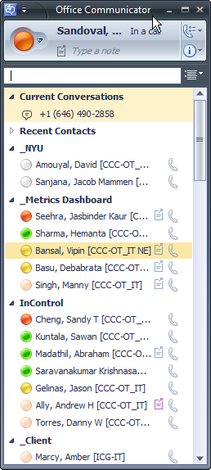
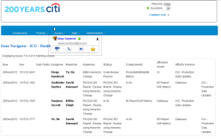
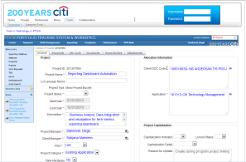

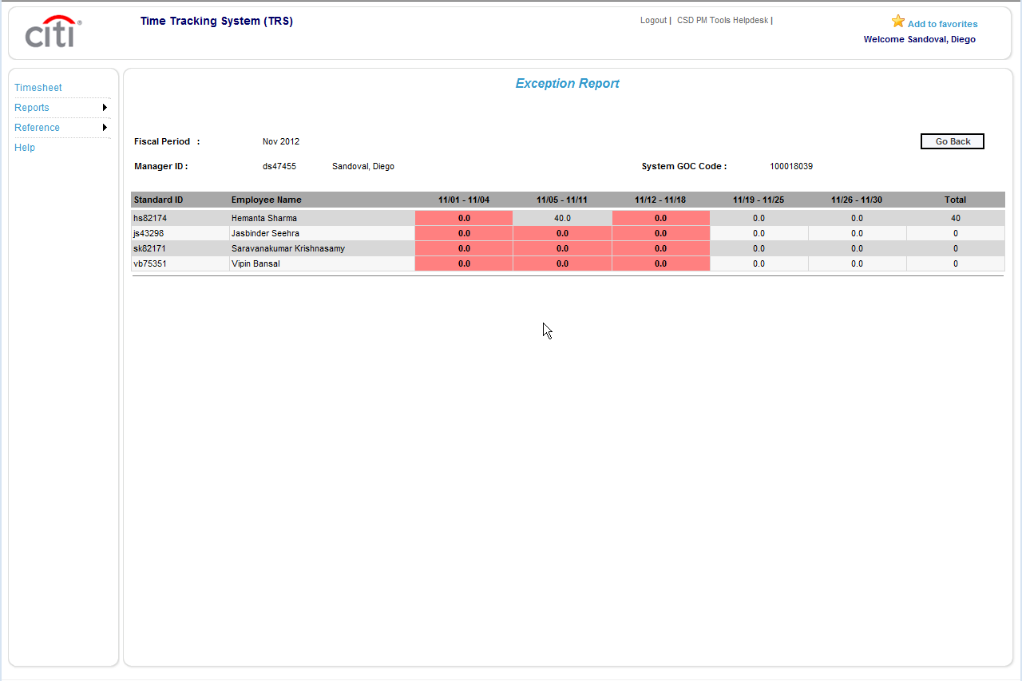
Citi Jabber Collaboration Project – Motivation Behind the Project
Citi Apps
JIRA App
2 - Search for the contact
1 - Switch to Desktop
3 - What was the context?
PTS-W App
4 - Switch to Application
TRS App
5 - Switching between applications and desktop
Notes:
A developer receive an email from an enterprise issue tracking application regarding a bug
reported by a user of software she has developed.
From this email, the developer then logs into the issue tracking application to read more information about the particular bug. Needing additional details she may then look up the user’s name in her IM client to chat with him on the same topic.
The developer has not yet started work on fixing the bug yet she needed to interact with 3 different applications to be made aware of the bug, read information on it and ultimately communicate with the user to get actionable detail.
Imagine a new way to accomplish the same tasks. The developer is working within an internal
Citi portal which already hosts a number of applications she interacts with on a regular basis.
Within the portal she notices an alert pop up that a new issue was raised regarding her
software. She clicks on the alert which navigates her portal to the issue description and lists the users who reported it. By clicking on the user’s name, the developer can instantly invoke an IM conversation, call or even video conference to get the detail she needs to start working on a fix. By applying this concept enterprise-wide, developers, analysts, and managers would no longer need leave their applications to interact with one another. They can invoke communication via voice, IM, and video using their browser, streamlining workflows, adding cost and time efficiencies.

Slide 6
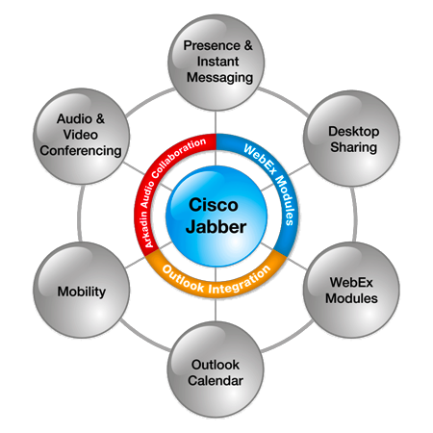
Citi Jabber Collaboration Project – What is Jabber?
Cisco Jabber is a unified communications (UC) application
lets users be more productive, anytime, from anywhere on any device.
Provide a collaboration tool to connect with the right people ,at the right time and resolve issues sooner

Slide 7
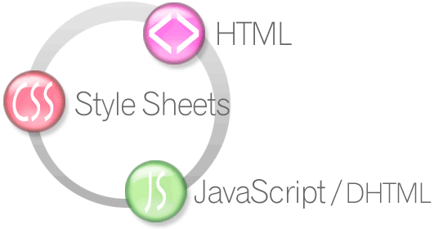


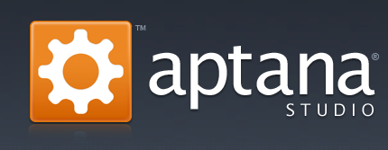
Citi Jabber Collaboration Project – Technologies Used
HTML/HTML5
Cascading Style Sheets
JavaScript
Bootstrap Twitter Framework
Aptana IDE
Jabber Web tool kit
Operating Systems:
  Windows XP/Windows 7 32/64-bit
  Mac OSX 10.6 (Snow Leopard) and 10.7 (Lion)
Tested Browsers:
  Internet Explorer 7+
  Firefox 6+
  Chrome 10+
  Safari 5.1

Slide 8
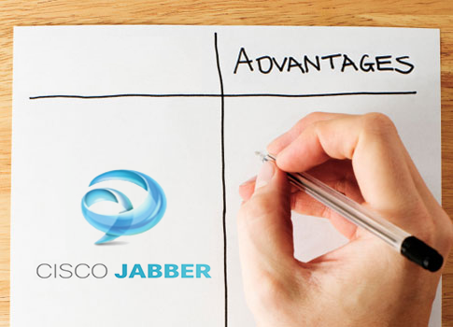
Citi Jabber Collaboration Project – Advantages of using Jabber
Incorporate voice, video, instant messaging (IM), presence, capabilities into web applications
All that's required is a browser and logon ID
Saves time and effort
Reduces IT dependency on additional software
Homogenization

Slide 9
Citi Jabber Collaboration Project – Jabber – IM and Presence SDK
Web Client
Cisco AJAX XMPP Lib
AJAX JavaScript XMPP client library
Object-oriented
client-side library which communicates to a BOSH server component
Used for integration of instant messaging, Presence and roster services from the Cisco WebEx Collaboration Cloud
UI API
JQuery
Application HTML
Application JavaScript
Core API
Bosh Client
XMPP over HTTP(BOSH)
BOSH Server
Cisco Webex
Cisco Unified Presence
Notes:
The Cisco AJAX XMPP Library (CAXL) provides a foundation for developing web-based applications that utilize the XMPP protocol. For detailed information on the XMPP standard, please visit http://xmpp.org
It is comprised of the following components:
jQuery: an open-source library for searching, traversing, and manipulating the browser's DOM
CAXL Core: a high-level API for messaging and Presence
CAXL UI: HTML UI components built on top of the core CAXL API
BOSH (Bidirectional-streams Over Synchronous HTTP) technology is used as an HTTP binding for XMPP communications that is useful in situations where a device or client is unable to maintain a long-lived TCP connection to an XMPP server, .g.e in a web browser.

Slide 10
Citi Jabber Collaboration Project – Jabber Voice & Video SDK
JQUERY based JavaScript toolkit
Exposes methods and events to enable softphone control.
Uses browser plug-in
Web Browser
Sample.html
Application HTML , JS, CSS
Jabber Voice & Video SDK
JavaScript: cwic.js , jQuery
Browser plugin C++
SIP or CTI
HTTP REST
CUCM
Optional node remote services

Slide 11
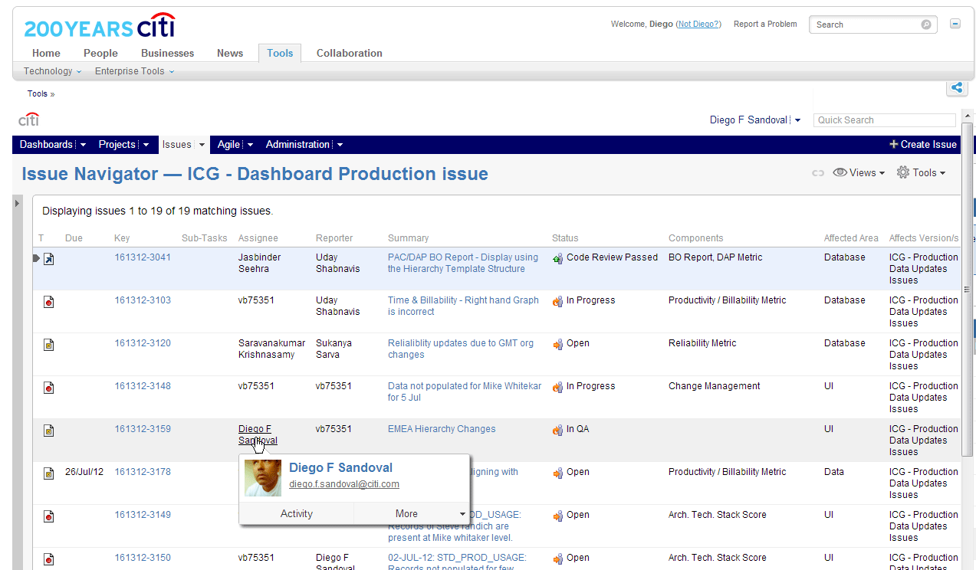
Citi Jabber Collaboration Project – Use Case – JIRA Application

Slide 12
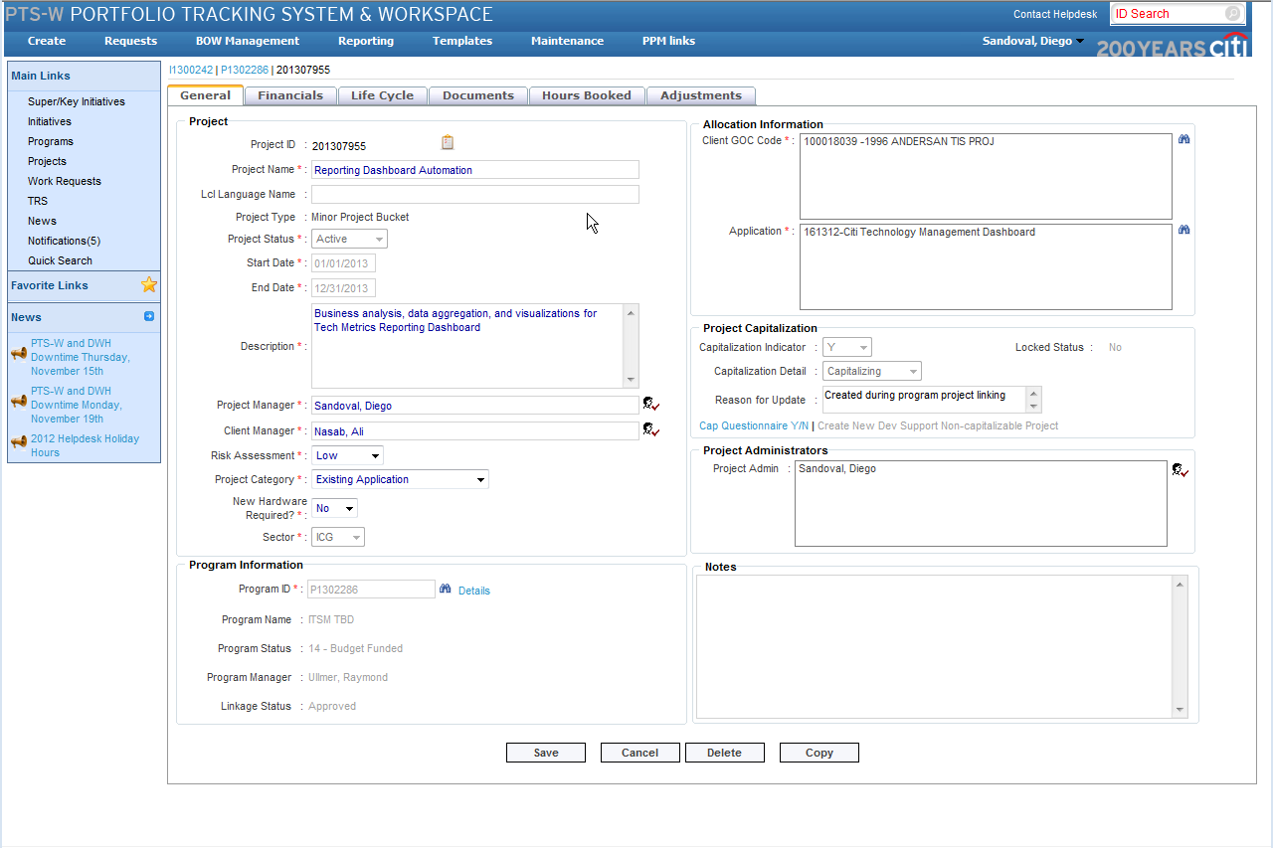
Citi Jabber Collaboration Project – Use Case – PTS-W Application

Slide 13
Citi Jabber Collaboration Project – Use Case – TRS Application

Slide 14


Citi Jabber Collaboration Project – Project Implementation Strategy
Introduction to Project
Weekly Scrums
Wireframes Designs
Learn using Jabber SDK
Project Manager
LiveMeeting
Sessions
High Fidelity Mock-ups
Development Dummy UI Based on the Mock-ups
Warren Lab
Setup
Development Dummy UI Based on the Mock-ups
Testing
Implementation Using Free Jabber Server
Implementation Using Free Jabber Server
Project Manager
Re-Think Lab
Integration with Jabber Instance Located in Warren Lab
High Fidelity Mock-ups

Slide 15
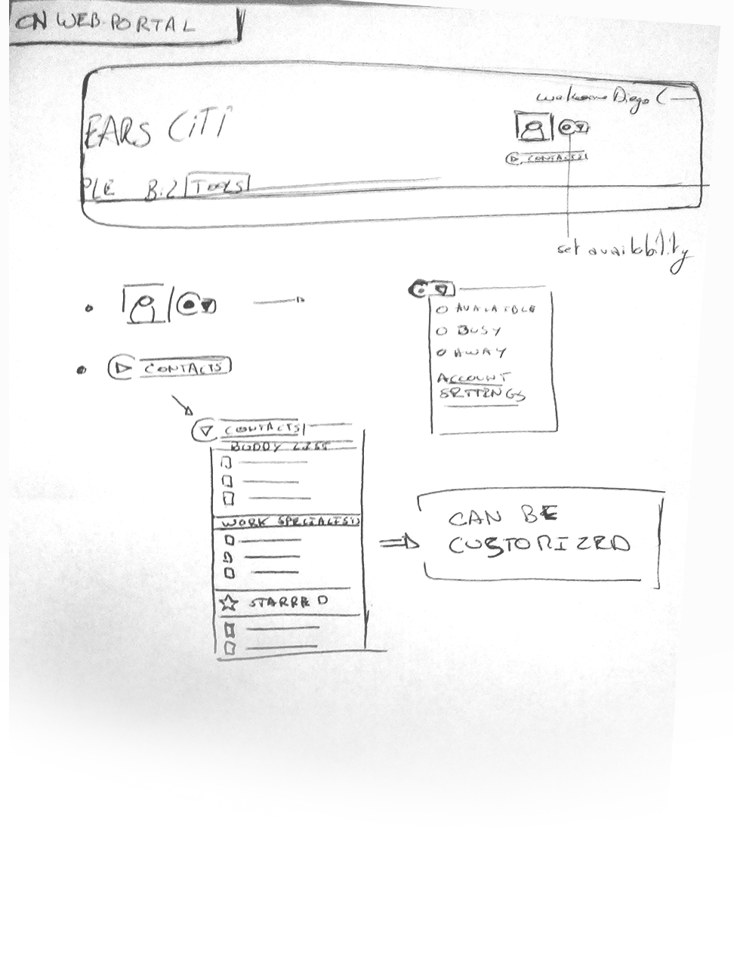
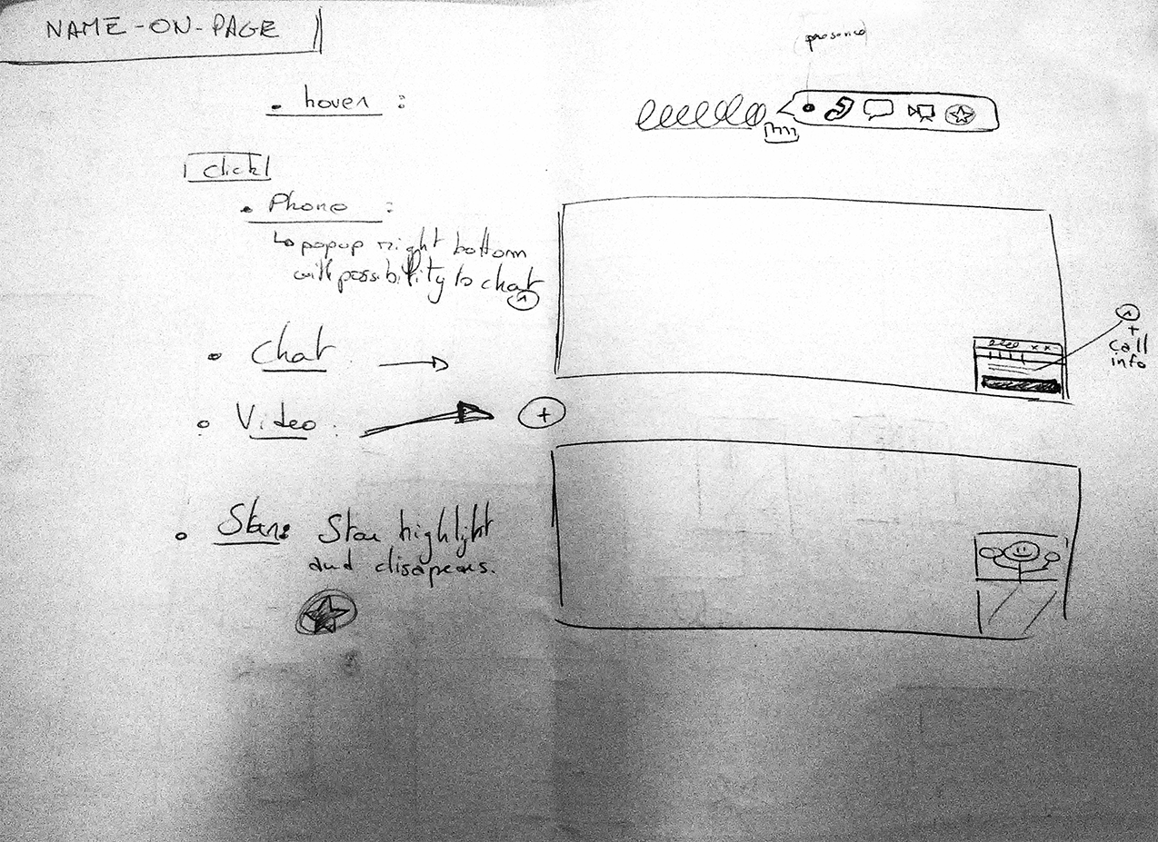
Citi Jabber Collaboration Project – Project Implementation Strategy - Wireframes

Slide 16
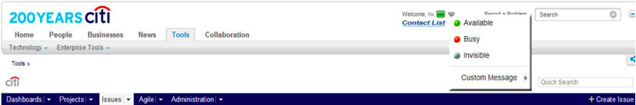
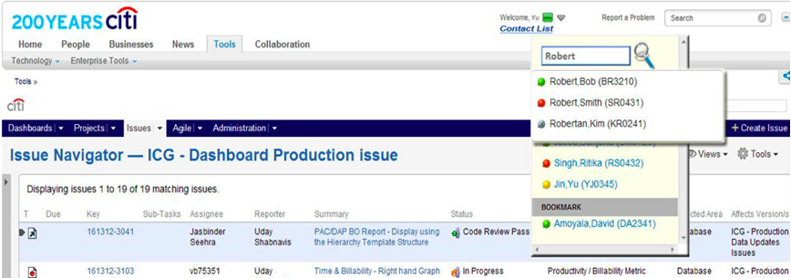
Citi Jabber Collaboration Project – Project Implementation Strategy – HF Mock-ups
Presence
1
2
Contacts

Slide 17
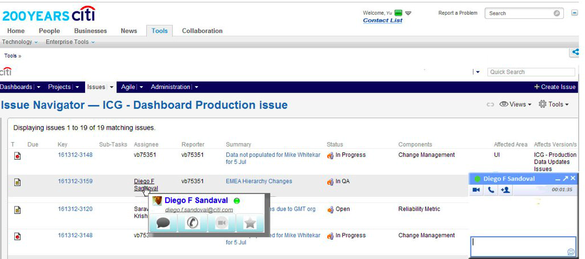
Citi Jabber Collaboration Project – Project Implementation Strategy – HF Mock-ups – Cont.

Slide 18
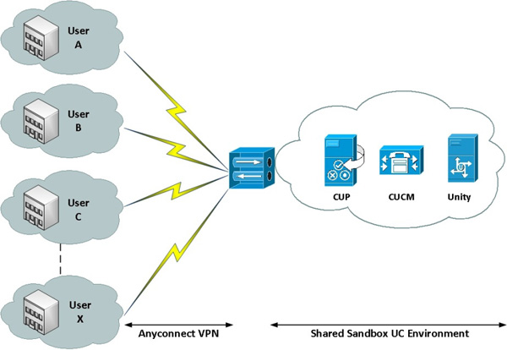
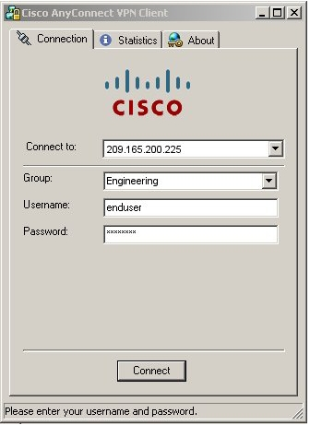
Citi Jabber Collaboration Project – Project Implementation Strategy – Free Shared Jabber Sandbox
offers a hosted installation of Cisco Unified Communications Manager, Cisco Unified Presence and Cisco Unity Connection.
Notes:
Cisco Unified Communications Manager (CUCM)required for Jabber Voice and video functionality.
Cisco Unified Presence (CUP): required for on-premise IM and Presence functionality
Cisco Unity Connection (Unity): required for Voice Mail.

Slide 19
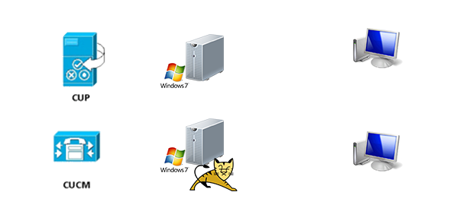
Citi Jabber Collaboration Project – Project Implementation Strategy – Warren Lab
Warren Lab
Jabber Client 2
Citi Client 1
Remote Connection
Remote Connection
Citi Client 2
Jabber Client 1
Running Tomcat App Server

Slide 20


Citi Jabber Collaboration Project – Demo

Slide 21

Citi Jabber Collaboration Project – Future Implementation
Integrate Video and Voice on use cases

Slide 22


Citi Jabber Collaboration Project – What is next?
JavaScript
Citi Jabber Library
DEMO Applications
Future
JIRA App
PTS-W App
TRS App
. . .
More Citi Apps
. . .
. . .
. . .
Jabber Integration Across Many Citi Apps SDK

Slide 23

Citi Jabber Collaboration Project – References
http://developer.cisco.com/web/jabber-developer
http://twitter.github.com/bootstrap/
http://www.aptana.com/

Slide 24

Citi Jabber Collaboration Project – References
Q&A
Thank You

Slide 25
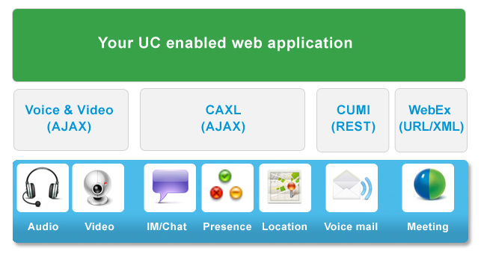
Citi Jabber Collaboration Project – Appendix

