Slide 1
Knowledge graph reasoning challenge 2024

Slide 2
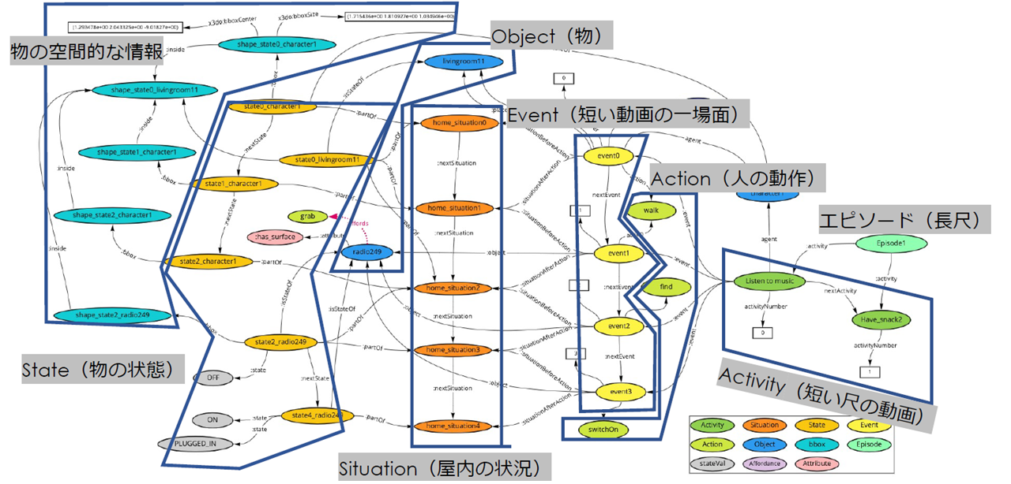
Knowledge graph
The knowledge graph is the graph that consists of the relationship between multiple pieces of information.

Slide 3
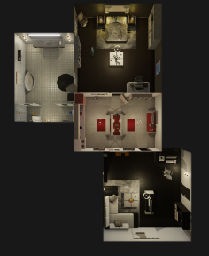
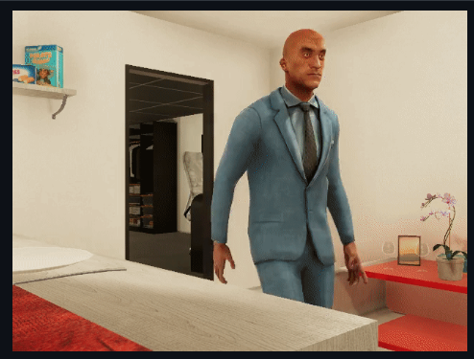
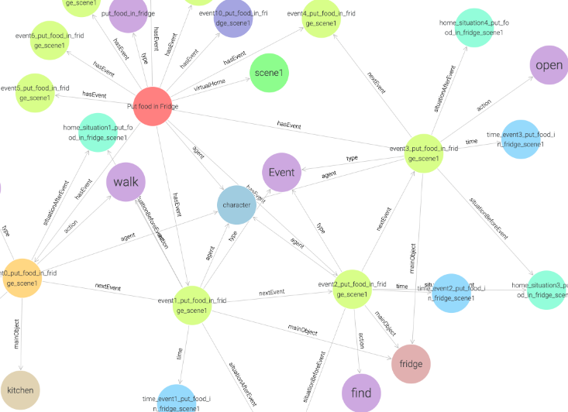
Knowledge graph reasoning challenge
Knowledge graph consists of various daily life actions in the virtual home.
Task
Phase 1: To answer the questions using the complete knowledge graph.
Phase 2: To answer the questions using the partially missing knowledge graph.

Slide 4
Flow of reasoning -Phase1 task-
Question
Questions are categorized into 5 types (Q1~Q5).
Knowledge graph
① Input the question to LLM
LLM (GPT-4o mini)
④ Get information
Analyze the meaning of the question.
Select the appropriate function (F1~F5) prepared for each question type, and extract the keywords for answering the question.
Choose the correct answer.
③ Send query
② Select function
Pre-defined function
The keywords are input into the space of the document, it would be the query.
Extract the answer from the got information.
⑤ Answer
All processing, excluding LLM and KG, is performed using custom-written Python code.

Slide 5

① Extract question details and input them to LLM
Extract the details of the question
Get the information of the question (question sentence, scene id, choices, correct answer).
From the scene id, all activities related to the scene are extracted.
Question file
Extract the detail of the question
Input the detail of questions to LLM
question sentence
scene id
correct answer
choices
The extracted information is entered into LLM (GPT-4o mini).
We used GPT-4o mini twice.
②: select function
⑤: choose correct answer
The prompt is prepared by filling in information in the blanks of the template.
activities
prompt
LLM

Slide 6
② Select function to answer the question
GPT-4o mini selects the pre-defined function prepared for answering the question
prompt
We prepared 5 functions to answer each type question.
Note: Questions are categorized into 5 types
Q1
Q2
Q3
Q4
Q5
Number of times of entering a specific room
Number of times of a specific action was performed during each activity
First action taken upon entering a specific room
Actions taken just before entering a specific room
Actions performed when a specific amount of time has elapsed since the start
Functions
count_total_room_entries
For answering Q1
count_action_occurrence
For answering Q2
select
get_first_action_in_room
For answering Q3
get_last_action_before_entry
For answering Q4
Each function sends the query to get event details.
GPT-4o mini analyzes the meaning of the question, and determine what function to choose to answer this question.
get_action_at_time
For answering Q5

Slide 7
③ Send query and ④ get information
The selected function sends the query to KG and get information
Selected function
Knowledge graph
scene id
activity
In each function, the query is sent to KG to get the details of events (event name, action, location, object, duration).
The query is prepared by filling in the information ‘scene id’ and ‘activity’ in the blanks of the template.
Send
Query
Get info
action
duration
The information about the movements between rooms isn’t stored in KG.
We calculated all possible paths using ‘Breadth-first search’ after getting the information.
elapsed time
event name
object
place
Calculate all passible path between rooms.

Slide 8
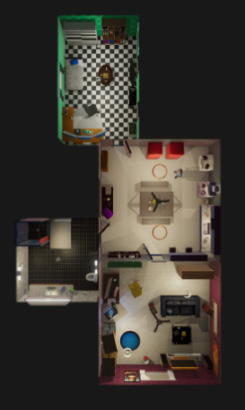
We calculated paths between rooms in each scene.
scene 1
scene 7
Bathroom
Bedroom
Bedroom
・・・
Kitchen
Kitchen
Bathroom
Living room
Living room

Slide 9
⑤ Answer to the question
The returns from the function are input into GPT4-o mini and it chooses the correct answer
The selected function returns the specific number or action depending on the question type.
There are ‘YesNo’ and ‘MultiChoice’ questions.
To answer the question correctly, GPT4-o mini analyzes which type of question (‘YesNo’ or ‘MultiChoice’) and chooses the correct answer.
YesNo question
MultiChoice question
‘Did he enter the bathroom 2 times?’
‘How many times did he enter the bathroom?’
Function
Function
count_total_room_entries
count_total_room_entries
The function doesn’t understand which type of question.
return of function: 2
return of function: 2
Answer: Yes
Answer: 2

Slide 10
Caption Prediction Strategy
Two-stage Inference with LLM
First stage:
Input:
List of event details (action, target, place)
Output:
Scenario reasoning
Detection of anomalies in health status
Second stage:
Input:
Question
Choices
List of event details
First stage outputs
Output:
Caption inference (Top 5)

Slide 11
Caption Prediction Strategy | First Stage
Input:
List of event details (action, target, place)
Output:
Scenario reasoning
Detection of anomalies in health status
Prompt
The following actions describe a sequence of movements of a character.
What might the character be doing?
Please provide a few possible scenarios.
Additionally, determine if there are any signs of health issues based on the actions.
action 1: walk, target: bedroom, place: bedroom
action 2: walk, target: chair, place: bedroom
action 3: sit, target: chair, place: bedroom
action 4: fallsit, target: chair, place: bedroom
ChatGPT Answer
Possible Scenarios:
Tiredness or Fatigue: The character may have …
Health Issues: The character could be …
…
Signs of Health Issues:
Dizziness and Weakness: The character's inability …
Fatigue: The sequence could imply that the …
…

Slide 12
Caption Prediction Strategy | Second stage
Input:
Question, Choices , List of event details, First stage outputs
Output:
Caption inference (Top 5)
Prompt
ChatGPT Answer
Please select the options that best describe the character's actions from the following choices.
Choose up to five options in order of relevance, separated by commas.
Scenarios: {{First stage outputs}}
Character's movement: {{action1: walk, target: …}} Choices: ['Eat cupcake', 'Squats', 'Fall while during getting up or rising', 'Put slippers in closet', 'Shoulder stretch’, … ]
Choice: Fall while sitting down, Fall while standing quietly,
Fall while walking forward, Fall while initiation of walking,
Fall while standing and turning
Correct Answer
Fall while sitting down

Slide 13
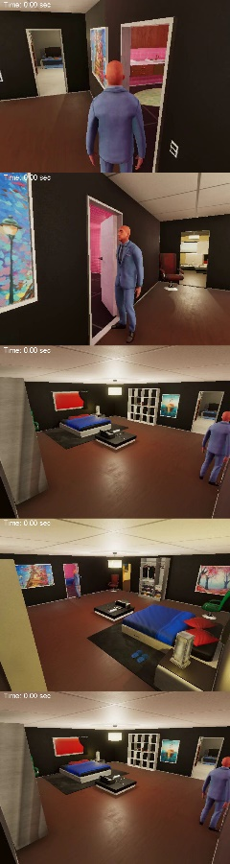
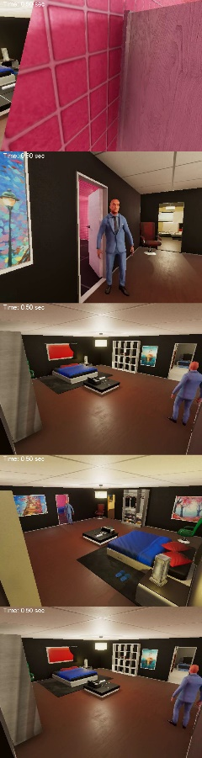
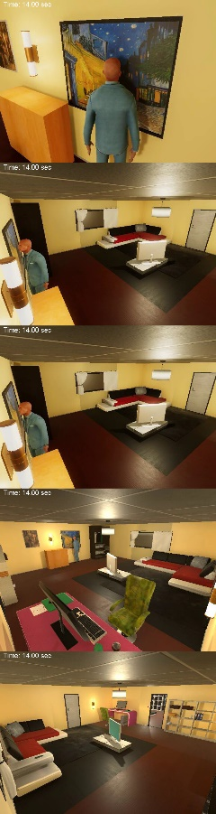
Phase 2 Strategy | Proposed Ideas
Completing missing parts of the KG by providing PDFs to an LLM
Camera1
KG Data
Camera2
Camera3
LLM
Answer
Camera4
Camera5
P1
P2
P29

Slide 14



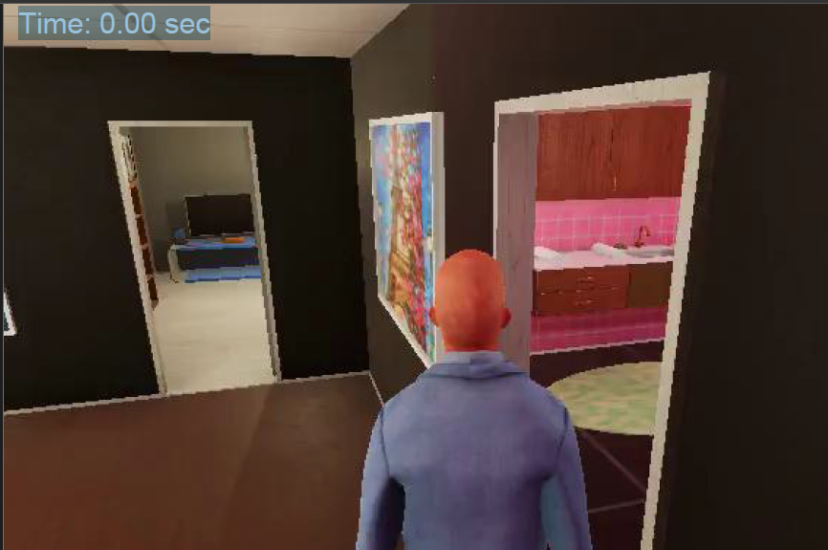
Phase 2 Strategy | Benefits of Providing PDFs
Embed timestamps as text on each page
LLM can search pages based on timestamps
Using pages to represent the timeline
P1 (0.0s)
P2 (0.5s)
P29 (14.0s)

Slide 15
Validation Methods
Purpose
Evaluate the accuracy of QA using a complete KG and LLM-based methods
Identify problems that can and cannot be solved by our approach
QA
Scene: 1, 2
Day: 1~5
Type: Q1~Q5, Caption (Multi, YesNo)
LLM
ChatGPT 4o mini 2024-07-18
One attempt per question
Number of Each Question
Question | Scene1 | Scene2
MultiChoice/Q1 | 20 | 15
MultiChoice/Q2 | 91 | 78
MultiChoice/Q3 | 5 | 5
MultiChoice/Q4 | 5 | 5
MultiChoice/Q5 | 160 | 140
YesNo/Q1 | 20 | 15
YesNo/Q2 | 91 | 78
YesNo/Q3 | 5 | 5
Caption | 133 | -

Slide 16
Validation Results
Scene1
Scene2
Question | Success | Failure | Success rate [%]
MultiChoice/Q1 | 8 | 12 | 40.0
MultiChoice/Q2 | 86 | 5 | 94.5
MultiChoice/Q3 | 5 | 0 | 100.0
MultiChoice/Q4 | 5 | 0 | 100.0
MultiChoice/Q5 | 23 | 137 | 14.4
YesNo/Q1 | 7 | 13 | 35.0
YesNo/Q2 | 86 | 5 | 94.5
YesNo/Q3 | 5 | 0 | 100.0
Caption | 49 | 84 | 36.8
Question | Success | Failure | Success rate [%]
MultiChoice/Q1 | 12 | 3 | 80.0
MultiChoice/Q2 | 74 | 4 | 94.9
MultiChoice/Q3 | 5 | 0 | 100.0
MultiChoice/Q4 | 5 | 0 | 100.0
MultiChoice/Q5 | 24 | 116 | 17.1
YesNo/Q1 | 9 | 6 | 60.0
YesNo/Q2 | 73 | 5 | 93.6
YesNo/Q3 | 5 | 0 | 100.0
Caption | - | - | -
Both Scene1 and Scene2 achieved an accuracy rate of over 90% for Q2, Q3, and Q4
Q5 and Caption resulted in a lower accuracy rate

Slide 17
Discussion | Q1
Scene1 Accuracy: 8 / 20, 40.0%
Issues with the Our Answers and Expected Answers
Mismatch: Our answer and expected answer (including choices) do not align.
Manual Count: 19/20 matches with the function; method for expected answers is inconsistent with videos.
Knowledge Graph Bug: One incorrect due to a bug.
event8_use_phone3_scene1 and event9_use_phone3_scene1: Duration is 0.0, but place changes between kitchen and living room.
event10_use_phone3_scene1: Reports moving from bedroom to living room despite being in the living room.

Slide 18
Expected Answer Generation Issue of Q1
Considerations:
Use from and place of the event (ignore to).
Maintain previous location if from and place are not present.
Consider a transition if two consecutive rooms are different.
Assume passing through intermediate rooms if consecutive rooms are not connected.
All expected answers for Scene1 Day1~Day5 follow this rule.
Problematic Nodes:
Events with no place following a move event.
Move events are endEvent.
Events with no place continue (e.g., workout1_scene1’s stretch, legopp, straddle, squat, jump).

Slide 19
Discussion | Q2
Scene1 Day1~Day5 Accuracy: 86 / 91, 94.5%
Scene2 Day1~Day5 Accuracy: 74 / 78, 94.9%
Incorrect Results:
One instance of walking is missing.
Observation:
Our program correctly identifies room transitions within the knowledge graph and videos, as well as between activities outside the video, except for one walking action.
Accuracy:
100% if excluding this instance.

Slide 20
Discussion | Q3 & Q4
Achieved 100% Accuracy
Complex Questions Across Activities: Successfully answered questions difficult to resolve with SPARQL alone.
Scene1 Day2 Q4: What did he do just before he first entered the kitchen?
This question involves passing through the kitchen between Activity1 and Activity2 and cannot be answered by merely examining startEvent and endEvent.
Our approach detected movements between activities and correctly traced back to provide the right answer.

Slide 21
Discussion | Q5
Results Worse Than Random
Scene1 Accuracy: 23 / 137, 14.4% (Expected Value: 16.7% for complete randomness)
Manual Review: Checked connected videos (28 questions of scene1 day1).
Issues Identified:
Expected answers do not exist: 5
Multiple possible answers (holding two objects) but only one expected answer: 2
Questions where nothing is held in the video but a correct answer exists: 7
Discrepancies between expected answers and human answers: 9
Possible Issue:
Agreement between our approach’s answers for Object5~13 and expected answers for Object4~12 suggests potential discrepancies with the expected answers.2

Slide 22
Discussion | Q5
Accuracy Rates and Issues
Accuracy for Human-generated Expected Answers: 71.4%
Including Actions in Progress (e.g., grabbing objects): 82.1%
Only Location Accuracy: 100%
Items for Improvement:
Missed Considerations: Did not consider actions where another object is targeted after holding an object.
Moving while holding an object.
Performing an action (e.g., rubbing) after holding a towel.
Information Gaps: The knowledge graph does not contain edges indicating whether a character is holding an object.
Required Solution: The program needs to track objects held by characters.

Slide 23
Discussion | Caption
Accuracy of Top 1: 49 / 133, 36.8%
Top 5 Containing the Correct Answer: 91 / 133, 68.4%
Trends in Incorrect Answers:
Different from the expected answer but not incorrect
Challenges with Knowledge Graph
Incorrect Story Generation
Issues with File Paths

Slide 24
Discussion | Caption
Trends in Incorrect Answers:
Different from the expected answer but not incorrect:
Example: Cleaning the sink in the kitchen -> Expected: "clean sink," Ours: "clean kitchen."
Difficult to solve with the knowledge graph alone:
Example: Given only the information "typed on the keyboard," the expected answer is "check social media," but Our approach predicted "do work on computer."

Slide 25
Discussion | Caption
Trends in Incorrect Answers:
Incorrect Story Generation:
Example: For the video where "Drink juice" is the expected answer, ChatGPT mistakenly considered the action as part of a morning routine, resulting in "have morning beverage" being selected.
Issues with File Paths: Access issues due to spaces in file paths on raw.githubusercontent.com (3 cases).
MultiChoice/Caption/Leisure_scene1_movies_Drink_milk_while%20watching_television3.json
MultiChoice/Caption/Leisure_scene1_movies_Drink_wine_while%20watching_television3.json
MultiChoice/Caption/Leisure_scene1_movies_Eat_bread_while%20watching_television3.json (“%20” represents a space character)

Slide 26
Discussion | Caption | Fall Detection
Fall Detection Scores in Caption Inference Task
 |  | “Fall” in Top 1 Candidates |  | Sum
 |  | True | False
“Fall” in Correct Answer | True | 9 | 5 | 14
 | False | 0 | 116 | 116
Sum |  | 9 | 121 | 130
 |  | “Fall” in Top 5 Candidates |  | Sum
 |  | True | False
“Fall” in Correct Answer | True | 14 | 0 | 14
 | False | 2 | 114 | 116
Sum |  | 16 | 114 | 130
Precision: 100.0%, Recall: 64.3%
Precision: 87.5%, Recall: 100.0%
Trends in False Positives
Scenarios Involving Only the Bathroom:
Both cases were scenarios that occurred entirely within the bathroom.
The association with the slippery nature of the bathroom might have led to the selection of "fall."

Slide 27
Summary
We proposed a method combining knowledge graphs and LLMs to address the Knowledge Graph Reasoning Challenge, using our program to fill in missing parts. In Phase 2, we integrated incomplete knowledge graphs with LLMs by providing PDFs with timestamps.
Our results for Q1 to Q4 were excellent compared to the correct answers for Scene1 and Scene2 from Day1 to Day5. For Q5, we needed to consider scenarios where individuals move while holding objects.
We achieved 68% accuracy in captioning, demonstrating that relying solely on the knowledge graph is challenging and highlighting the need for using video data.

