Slide 1
Females’ Dialogue Entropy Analysis
By SunHay Try (Hay)

Slide 2
Purpose
Why?
To investigate the role development of females’ character in movie industry throughout history
To better understand how the social perception toward women, which is reflected through films, has changed throughout history

Slide 3
“Movie Corpus Data” from 1927 to 2010
220,579 conversational exchanges between 10,292 pairs of movie characters
involves 9,035 characters from 617 movies
in total 304,713 utterances
“movie metadata” included:
genres
release year
IMDB rating
number of IMDB votes
“character metadata” included:
- gender (for `3,774` characters)
- position on movie credits (`3,321` characters)

Slide 4
Hypothesis
As women’s involvement has been increasing in various fields, I expect the entropy of female characters’ dialogues in movies to increase over the year.
“Movies are a mirror of society!”, said a wise man.

Slide 5
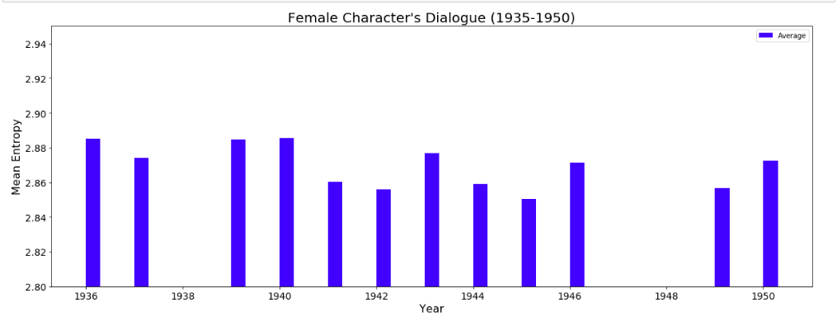
Correlation = -0.514

Slide 6
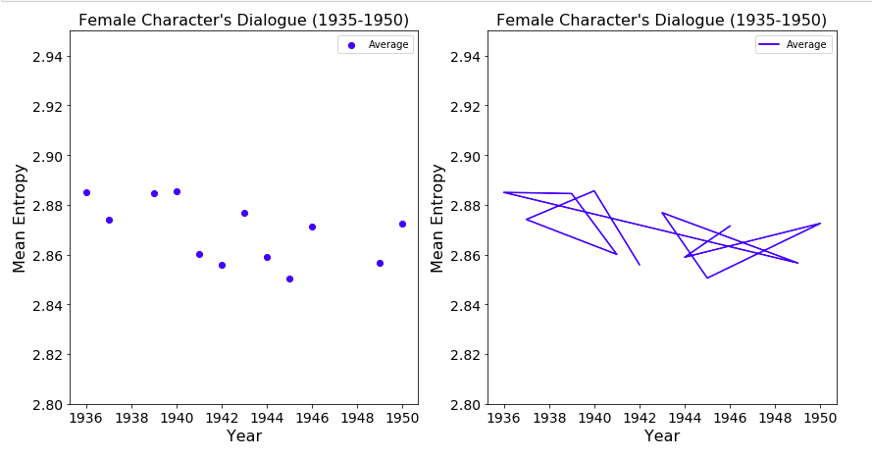

Slide 7
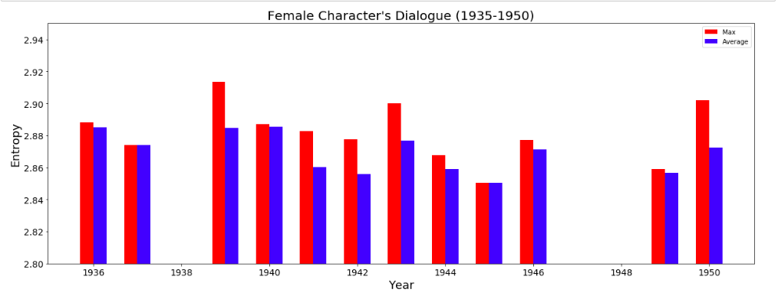

Slide 8
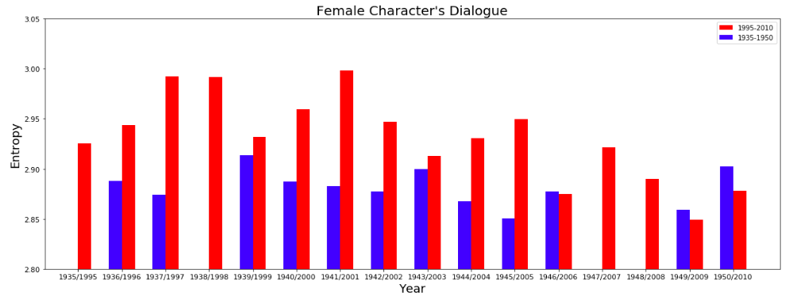
‘1995-2010’ vs. ‘1935-1950’
P = 0.0022

Slide 9
Question?
Thank you!

