Slide 1
Parcel Vue PWA hands-on
Yoshitake Okada

Slide 2
Overview
Share with you about some modern web technologies
Vue
Parcel
PWA
First, I introduce the technologies that will be used in hands-on
Then, in the later part, we do hands-on
create a simple web application by yourself and experience the technologies :)

Slide 3

Relationship between the technologies of this presentation
Source code (Vue)
Application (PWA (html + others))
Cloud
Static website hosting

Slide 4
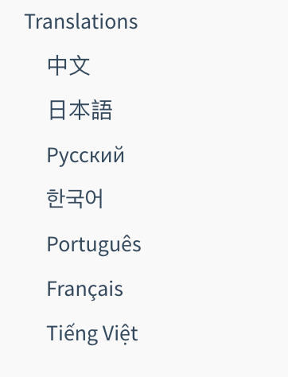
Vue
Vue.js (or just Vue)
A web application front-end JavaScript framework
Made by Evan You
Simple, Light-weight, Sophisticated and New
Official site has good documentation
https://vuejs.org/

Slide 5
Vue
Become more popular, but pretty small market share in comparison with React or Angular
https://www.codeinwp.com/blog/angular-vs-vue-vs-react/#popularity https://www.codeinwp.com/blog/angular-vs-vue-vs-react/#job-market
Nice reference of comparison between Vue, React, and Angular https://www.azilen.com/blog/angular-vs-vue-vs-react-best-javascript-framework-in-2018/
Suitable choice for small~middle project
For larger project, Nuxtjs is good option as a Vue application framework
https://nuxtjs.org/

Slide 6
Parcel
Web application bundler
Blazing fast
Zero configuration!
Suitable choice for small project
For larger project, Webpack is good option as a web application bundler, which can configure detail settings
https://parceljs.org/

Slide 7
PWA
Progressive Web Apps
https://developers.google.com/web/progressive-web-apps/
Enable your website to behave like a single native app
PWA is a hybrid of regular web pages and a mobile application
PWA can be downloaded on local of Smartphone or Desktop
Like Android app, iOS app, or Desktop app
PWAs available on all platforms since March 12th 2019 !
https://www.thurrott.com/google/202844/google-brings-dark-mode-pwa-support-to-chrome-on-mac

Slide 8
PWA
To make your website to PWA, you need
Manifest
Usually named Manifest.json (Manifest.webmanifest is more specific but used rarely)
It contains app information such as app name, author or icon https://developer.mozilla.org/en-US/docs/Web/Manifest
Service Worker
Usually named sw.js or serviceworker.js
Service worker is a programmable network proxy between your app and Internet
It has some features. We don’t focus on Service worker now. For more detail: https://developers.google.com/web/fundamentals/primers/service-workers/
HTTPS
Your webpage must be provided on HTTPS

Slide 9
Let’s start hands-on!

Slide 10
Architecture
Source code (Vue)
Application (PWA (html + others))
Cloud
Static website hosting

Slide 11
Hands-on Flow
Confirm you have node environment. If not, you can install from here
https://github.com/creationix/nvm
Access the following page
https://github.com/yokrh/parcel-vue-training
Clone source code & follow README.md to create a webpage
Deploy your webpage
Try PWA!

