Slide 1

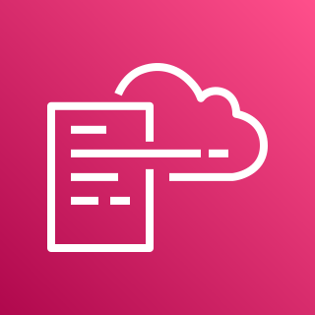







AWS Cloud
Organization Management Account
All Existing and Future
Organization Member Accounts
1.0
2.0
Home-region
1.1
1.5
1.8
Home-region
2.2
DLQ
Alarm Topic
AWS CloudFormation
2.1
S3 Block Account Public Access Role
1.3
1.6
1.10
AWS CloudFormation
2.3
Regional Event Rules
Lambda Function
S3 Account Settings
S3 Account Settings
1.7
1.2
1.9
IAM Roles
CloudWatch Log Group
SNS Topic
Global-region
1.4
Global Event Rules

