Slide 1


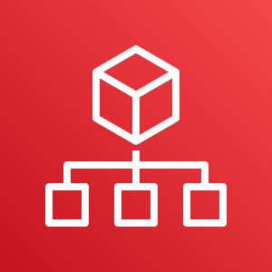



AWS Cloud
Organization Management Account
Log Archive Account
OU: Security
1.0
2.0
Home-region
Home-region
region-1
region-2
region-n
1.1
1.2
2.1
2.2
2.3
AWS CloudFormation
AWS Organizations
AWS CloudFormation
Delivery Bucket
Organization Conformance Pack
Audit Account
OU: Security
All Existing and Future
Organization Member Accounts
3.0
4.0
Home-region
region-1
region-1
region-2
region-2
region-n
4.1
region-n
3.1
3.2
4.2
AWS CloudFormation
Organization Conformance Pack
Service-Linked Role
Organization Conformance Pack

