Slide 1





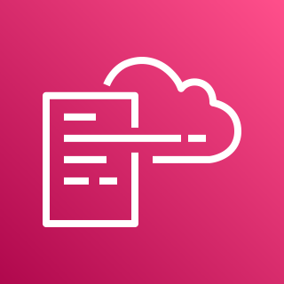





AWS Cloud
Organization Management Account
All Bedrock Accounts
Home Region
1.0
1.5
2.0
1.1
1.4
DLQ
1.3
Region n
CloudWatch Log Group
Region 2
AWS CloudFormation
Bedrock Guardrails Lambda Function
Region 1
Global Region
2.1
1.2
AWS KMS key
Lambda Role
2.2
Audit (Security Tooling) Account
3.0
Home Region
3.1
Amazon Bedrock
Resource
Table

