Slide 1
Monitoring tool IARC 7th
Tutor: Martín molina
Autor: Marcos Bernal, Yolanda de la Hoz.

Slide 2
Prototype A
Graph Image is static just show the graph.
There is a menu bar in left side.
Every window has a determined place in Monitoring tool.
Easier to implement.

Slide 3
Initial Screen

Slide 4
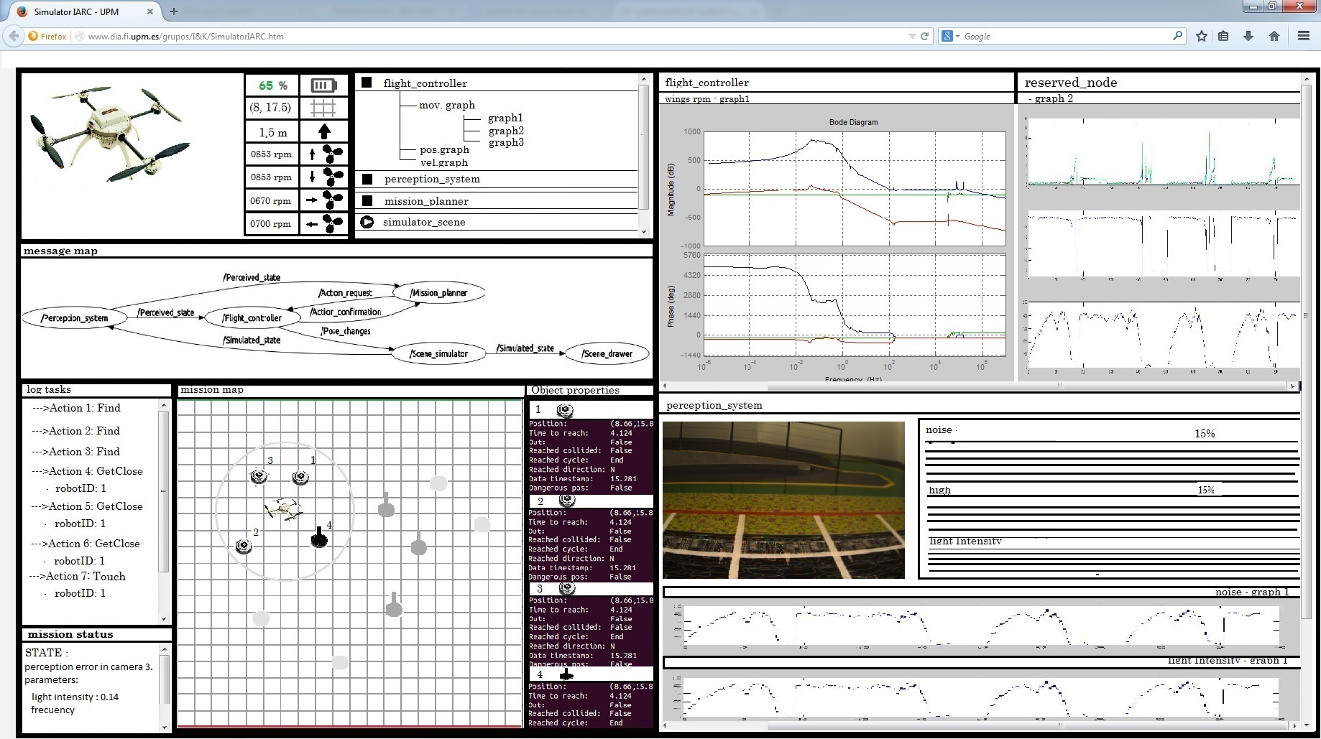
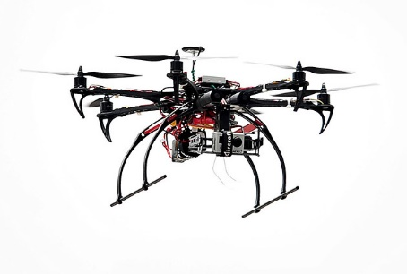



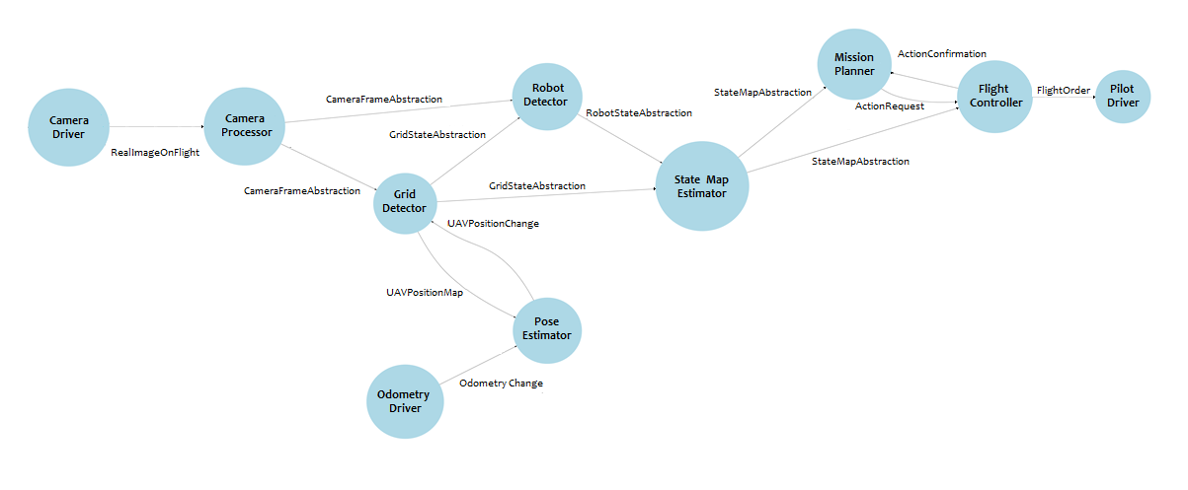
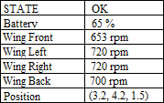
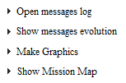
Debug Console
View Pannel
Warm
Error
Debug Console
Status Description
UAV Status
Scence viewer
Error Description
Scence viewer
Mission_Planner
Flight Controller
State_Map_Estimator
Grid_Detector
Robot_Detector
Camera_Processor
Pose_Estimator
Pilot Driver
Odometry Driver
Camera_Driver

Slide 5
Error Case 1a Simulation
Error Scene
UAV is flying over the field and camera detect one position and Pose Estimator another different, creating a wrong position. The distance between the new position and old position can not be reached in the time elapsed.

Slide 6
Debug Console
View Pannel
Warm
Error
UAV Status
Error Description
Error Description
Mission_Planner
Flight Controller
State_Map_Estimator
Grid_Detector
Robot_Detector
Camera_Processor
Pose_Estimator
Pilot Driver
Odometry Driver
Camera_Driver

Slide 7
Debug Console
View Pannel
Warm
Error
UAV Status
Error Description
Error description
Error 1 in Pose Estimator
UAV position estimator has failed.
System cant determine current position due to a big change that exceed velocity limit.
Function: Pose Estimator.
Inputs : position_map(Point),
limit_on_sight(int [])
Outputs: position_changed(Point).
Debug : none
Action: Pose Estimator process abort execution.
Mission_Planner
Flight Controller
State_Map_Estimator
Grid_Detector
Robot_Detector
Camera_Processor
Pose_Estimator
Pilot Driver
Odometry Driver
Camera_Driver

Slide 8



Debug Console
View Pannel
Warm
Error
UAV Status
Error Description
Messages
Error description
Error 1 in Pose Estimator
UAV position estimator has failed.
System cant determine current position due to a big change that exceed velocity limit.
Function: Pose Estimator.
Inputs : position_map(Point),
limit_on_sight(int [])
Outputs: position_changed(Point).
Debug : none
Action: Pose Estimator process abort execution.
Mission_Planner
Flight Controller
State_Map_Estimator
Grid_Detector
Robot_Detector
Camera_Processor
Pose_Estimator
Pilot Driver
Odometry Driver
Camera_Driver

Slide 9
Debug Console
View Pannel
Warm
Error
UAV Status
Error Description
Messages
Error description
Error 1 in Pose Estimator
UAV position estimator has failed.
System cant determine current position due to a big change that exceed velocity limit.
Function: Pose Estimator.
Inputs : position_map(Point),
limit_on_sight(int [])
Outputs: position_changed(Point).
Debug : none
Action: Pose Estimator process abort execution.
Mission_Planner
Flight Controller
State_Map_Estimator
Grid_Detector
Robot_Detector
Camera_Processor
Pose_Estimator
Pilot Driver
Odometry Driver
Camera_Driver

Slide 10
Debug Console
View Pannel
Warm
Error
UAV Status
Error Description
Messages
Error description
Error 1 in Pose Estimator
UAV position estimator has failed.
System cant determine current position due to a big change that exceed velocity limit.
Function: Pose Estimator.
Inputs : position_map(Point),
limit_on_sight(int [])
Outputs: position_changed(Point).
Debug : none
Action: Pose Estimator process abort execution.
Mission_Planner
Flight Controller
State_Map_Estimator
Grid_Detector
Robot_Detector
Camera_Processor
Pose_Estimator
Pilot Driver
Odometry Driver
Camera_Driver

Slide 11
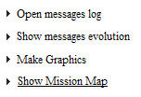
Debug Console
View Pannel
Warm
Error
UAV Status
Error Description
Messages
Error description
Error 1 in Pose Estimator
UAV position estimator has failed.
System cant determine current position due to a big change that exceed velocity limit.
Function: Pose Estimator.
Inputs : position_map(Point),
limit_on_sight(int [])
Outputs: position_changed(Point).
Debug : none
Action: Pose Estimator process abort execution.
Mission_Planner
Flight Controller
State_Map_Estimator
Grid_Detector
Robot_Detector
Camera_Processor
Pose_Estimator
Pilot Driver
Odometry Driver
Camera_Driver

Slide 12

Debug Console
View Pannel
Warm
Error
UAV Status
Error Description
Messages
Error description
Error 1 in Pose Estimator
UAV position estimator has failed.
System cant determine current position due to a big change that exceed velocity limit.
Function: Pose Estimator.
Inputs : position_map(Point),
limit_on_sight(int [])
Outputs: position_changed(Point).
Debug : none
Action: Pose Estimator process abort execution.
Mission_Planner
Flight Controller
State_Map_Estimator
Grid_Detector
Robot_Detector
Camera_Processor
Pose_Estimator
Pilot Driver
Odometry Driver
Camera_Driver

Slide 13
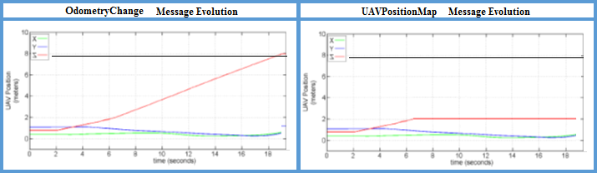
Debug Console
View Pannel
Warm
Error
UAV Status
Error Description
Messages
Message Evolution
Error description
Error 1 in Pose Estimator
UAV position estimator has failed.
System cant determine current position due to a big change that exceed velocity limit.
Function: Pose Estimator.
Inputs : position_map(Point),
limit_on_sight(int [])
Outputs: position_changed(Point).
Debug : none
Action: Pose Estimator process abort execution.
Mission_Planner
Flight Controller
State_Map_Estimator
Grid_Detector
Robot_Detector
Camera_Processor
Pose_Estimator
Pilot Driver
Odometry Driver
Camera_Driver

Slide 14
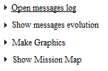
Debug Console
View Pannel
Warm
Error
UAV Status
Error Description
Messages
Message Evolution
Error description
Error 1 in Pose Estimator
UAV position estimator has failed.
System cant determine current position due to a big change that exceed velocity limit.
Function: Pose Estimator.
Inputs : position_map(Point),
limit_on_sight(int [])
Outputs: position_changed(Point).
Debug : none
Action: Pose Estimator process abort execution.
Mission_Planner
Flight Controller
State_Map_Estimator
Grid_Detector
Robot_Detector
Camera_Processor
Pose_Estimator
Pilot Driver
Odometry Driver
Camera_Driver

Slide 15


Debug Console
View Pannel
Warm
Error
UAV Status
Error Description
Messages
Message Evolution
Messages Log
Error description
Error 1 in Pose Estimator
UAV position estimator has failed.
System cant determine current position due to a big change that exceed velocity limit.
Function: Pose Estimator.
Inputs : position_map(Point),
limit_on_sight(int [])
Outputs: position_changed(Point).
Debug : none
Action: Pose Estimator process abort execution.
Mission_Planner
Flight Controller
State_Map_Estimator
Grid_Detector
Robot_Detector
Camera_Processor
Pose_Estimator
Pilot Driver
Odometry Driver
Camera_Driver

Slide 16
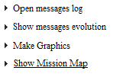
Debug Console
View Pannel
Warm
Error
UAV Status
Error Description
Messages
Message Evolution
Messages Log
Error description
Error 1 in Pose Estimator
UAV position estimator has failed.
System cant determine current position due to a big change that exceed velocity limit.
Function: Pose Estimator.
Inputs : position_map(Point),
limit_on_sight(int [])
Outputs: position_changed(Point).
Debug : none
Action: Pose Estimator process abort execution.
Mission_Planner
Flight Controller
State_Map_Estimator
Grid_Detector
Robot_Detector
Camera_Processor
Pose_Estimator
Pilot Driver
Odometry Driver
Camera_Driver

Slide 17
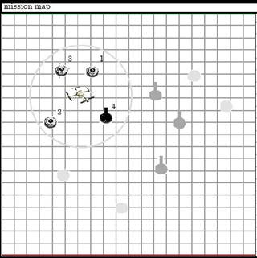


Debug Console
View Pannel
Warm
Error
UAV Status
Error Description
Messages
Message Evolution
Messages Log
Mission Map
Error description
Error 1 in Pose Estimator
UAV position estimator has failed.
System cant determine current position due to a big change that exceed velocity limit.
Function: Pose Estimator.
Inputs : position_map(Point),
limit_on_sight(int [])
Outputs: position_changed(Point).
Debug : none
Action: Pose Estimator process abort execution.
Mission_Planner
Flight Controller
State_Map_Estimator
Grid_Detector
Robot_Detector
Camera_Processor
Pose_Estimator
Time
Mission Map
3:50
Robot1
Pilot Driver
Robot2
Odometry Driver
Camera_Driver
Robot3
Robot4

Slide 18
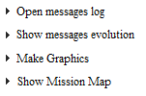
Debug Console
View Pannel
Warm
Error
UAV Status
Error Description
Messages
Message Evolution
Messages Log
Mission Map
Error description
Error 1 in Pose Estimator
UAV position estimator has failed.
System cant determine current position due to a big change that exceed velocity limit.
Function: Pose Estimator.
Inputs : position_map(Point),
limit_on_sight(int [])
Outputs: position_changed(Point).
Debug : none
Action: Pose Estimator process abort execution.
Mission_Planner
Flight Controller
State_Map_Estimator
Grid_Detector
Robot_Detector
Camera_Processor
Pose_Estimator
Time
Mission Map
3:50
Robot1
Pilot Driver
Robot2
Odometry Driver
Camera_Driver
Robot3
Robot4

Slide 19
Debug Console
View Pannel
Warm
Error
UAV Status
Error Description
Messages
Message Evolution
Messages Log
Error description
Error 1 in Pose Estimator
UAV position estimator has failed.
System cant determine current position due to a big change that exceed velocity limit.
Function: Pose Estimator.
Inputs : position_map(Point),
limit_on_sight(int [])
Outputs: position_changed(Point).
Debug : none
Action: Pose Estimator process abort execution.
Mission_Planner
Flight Controller
State_Map_Estimator
Grid_Detector
Robot_Detector
Camera_Processor
Pose_Estimator
Pilot Driver
Odometry Driver
Camera_Driver

Slide 20
Debug Console
View Pannel
Warm
Error
UAV Status
Error Description
Messages
Message Evolution
Messages Log
Error description
Error 1 in Pose Estimator
UAV position estimator has failed.
System cant determine current position due to a big change that exceed velocity limit.
Function: Pose Estimator.
Inputs : position_map(Point),
limit_on_sight(int [])
Outputs: position_changed(Point).
Debug : none
Action: Pose Estimator process abort execution.
Mission_Planner
Flight Controller
State_Map_Estimator
Grid_Detector
Robot_Detector
Camera_Processor
Pose_Estimator
Pilot Driver
Odometry Driver
Camera_Driver

Slide 21
Debug Console
View Pannel
Warm
Error
UAV Status
Error Description
Message Evolution
Messages Log
Error description
Error 1 in Pose Estimator
UAV position estimator has failed.
System cant determine current position due to a big change that exceed velocity limit.
Function: Pose Estimator.
Inputs : position_map(Point),
limit_on_sight(int [])
Outputs: position_changed(Point).
Debug : none
Action: Pose Estimator process abort execution.
Mission_Planner
Flight Controller
State_Map_Estimator
Grid_Detector
Robot_Detector
Camera_Processor
Pose_Estimator
Pilot Driver
Odometry Driver
Camera_Driver

Slide 22
Debug Console
View Pannel
Warm
Error
UAV Status
Error Description
Message Evolution
Messages Log
Error description
Error 1 in Pose Estimator
UAV position estimator has failed.
System cant determine current position due to a big change that exceed velocity limit.
Function: Pose Estimator.
Inputs : position_map(Point),
limit_on_sight(int [])
Outputs: position_changed(Point).
Debug : none
Action: Pose Estimator process abort execution.
Mission_Planner
Flight Controller
State_Map_Estimator
Grid_Detector
Robot_Detector
Camera_Processor
Pose_Estimator
Pilot Driver
Odometry Driver
Camera_Driver

Slide 23
Debug Console
View Pannel
Warm
Error
UAV Status
Error Description
Messages Log
Error description
Error 1 in Pose Estimator
UAV position estimator has failed.
System cant determine current position due to a big change that exceed velocity limit.
Function: Pose Estimator.
Inputs : position_map(Point),
limit_on_sight(int [])
Outputs: position_changed(Point).
Debug : none
Action: Pose Estimator process abort execution.
Mission_Planner
Flight Controller
State_Map_Estimator
Grid_Detector
Robot_Detector
Camera_Processor
Pose_Estimator
Pilot Driver
Odometry Driver
Camera_Driver

Slide 24

Debug Console
View Pannel
Warm
Error
UAV Status
Error Description
Message Evolution
Messages Log
Error description
Error 1 in Pose Estimator
UAV position estimator has failed.
System cant determine current position due to a big change that exceed velocity limit.
Function: Pose Estimator.
Inputs : position_map(Point),
limit_on_sight(int [])
Outputs: position_changed(Point).
Debug : none
Action: Pose Estimator process abort execution.
Mission_Planner
Flight Controller
State_Map_Estimator
Grid_Detector
Robot_Detector
Camera_Processor
Pose_Estimator
Pilot Driver
Odometry Driver
Camera_Driver

Slide 25

Debug Console
View Pannel
Warm
Error
UAV Status
Error Description
Message Evolution
Messages Log
Error description
Error 1 in Pose Estimator
UAV position estimator has failed.
System cant determine current position due to a big change that exceed velocity limit.
Function: Pose Estimator.
Inputs : position_map(Point),
limit_on_sight(int [])
Outputs: position_changed(Point).
Debug : none
Action: Pose Estimator process abort execution.
Mission_Planner
Flight Controller
State_Map_Estimator
Grid_Detector
Robot_Detector
Camera_Processor
Pose_Estimator
Pilot Driver
Odometry Driver
Camera_Driver

Slide 26
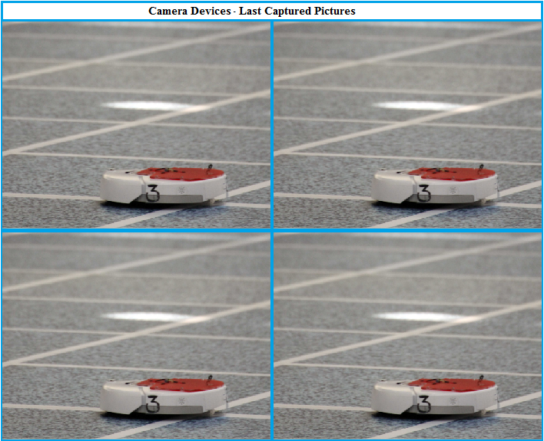
Debug Console
View Pannel
Warm
Error
UAV Status
Error Description
Message Evolution
Messages Log
Captured Pictures
Error description
Error 1 in Pose Estimator
UAV position estimator has failed.
System cant determine current position due to a big change that exceed velocity limit.
Function: Pose Estimator.
Inputs : position_map(Point),
limit_on_sight(int [])
Outputs: position_changed(Point).
Debug : none
Action: Pose Estimator process abort execution.
Mission_Planner
Flight Controller
State_Map_Estimator
Grid_Detector
Robot_Detector
Camera_Processor
Pose_Estimator
Pilot Driver
Odometry Driver
Camera_Driver

Slide 27
Prototype B
Graph Image is dinamic.
There is a inside the picture, is able to interact with picture. Show an option or another depends on the scene.
Every window can be in any place and moved like Windows of Microsoft system.
More difficult to implement.

Slide 28
Initial Screen

Slide 29





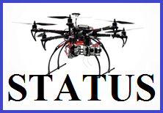
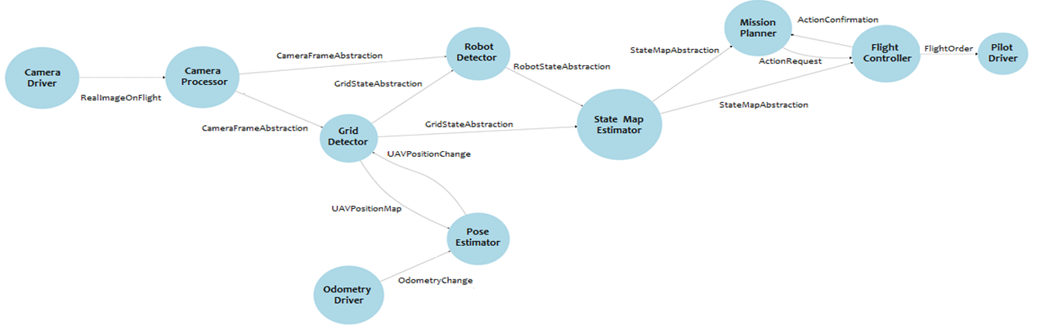
Debug Console
Stopped Process
Debug Errors
Displaying messages
Warm
Error
Fatal

Slide 30
Error Case 1b Simulation
Error Scene
UAV is flying over the field and camera detect one position and Pose Estimator another different, creating a wrong position. The distance between the new position and old position can not be reached in the time elapsed.

Slide 31
Debug Console
Stopped Process
Debug Errors
Displaying messages
Warm
Error
Fatal

Slide 32
Debug Console
Stopped Process
Debug Errors
Displaying messages
Warm
Error
Fatal
Error : UAV position estimator has failed.
mission status
Error: UAV position estimator has failed.
System cant determine current position due to a big
change that exceed velocity limit.
Function: Pose Estimator.
Inputs : position_map(Point), limit_on_sight(int [])
Outputs : position_changed(Point).
Debug : none
Action: Pose Estimator process abort execution.

Slide 33
Debug Console
Stopped Process
Debug Errors
Displaying messages
Warm
Error
Fatal
- PositionChanged: (0.5,0.2,0)
Error : UAV position estimator has failed.
- PositionMap: (4.5,6,1,5)
- LimitOnsight: none
-Accelerometer Change: +1.4
-Gyroscope Changeso : 0.1
mission status
Error: UAV position estimator has failed.
System cant determine current position due to a big
change that exceed velocity limit.
Function: Pose Estimator.
Inputs : position_map(Point), limit_on_sight(int [])
Outputs : position_changed(Point).
Debug : none
Action: Pose Estimator process abort execution.

Slide 34
Debug Console
Stopped Process
Debug Errors
Displaying messages
Warm
Error
Fatal
- Image: none
- Frame: 25/30
- Image: none
- Frame: 25/30
- PositionChanged: (0.5,0.2,0)
Error : UAV position estimator has failed.
- PositionMap: (4.5,6,1,5)
- LimitOnsight: none
-Accelerometer Change: +1.4
-Gyroscope Changeso : 0.1
mission status
Error: UAV position estimator has failed.
System cant determine current position due to a big
change that exceed velocity limit.
Function: Pose Estimator.
Inputs : position_map(Point), limit_on_sight(int [])
Outputs : position_changed(Point).
Debug : none
Action: Pose Estimator process abort execution.

Slide 35
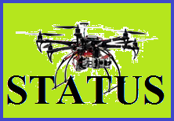

Debug Console
Stopped Process
Debug Errors
Displaying messages
Warm
Error
Fatal
- Image: none
- Frame: 25/30
- Image: none
- Frame: 25/30
- PositionChanged: (0.5,0.2,0)
Error : UAV position estimator has failed.
- PositionMap: (4.5,6,1,5)
- LimitOnsight: none
-Accelerometer Change: +1.4
-Gyroscope Changeso : 0.1
mission status
Drone Status
Error: UAV position estimator has failed.
System cant determine current position due to a big
change that exceed velocity limit.
Function: Pose Estimator.
Inputs : position_map(Point), limit_on_sight(int [])
Outputs : position_changed(Point).
Debug : none
Action: Pose Estimator process abort execution.

Slide 36
Debug Console
Stopped Process
Debug Errors
Displaying messages
Warm
Error
Fatal
- Image: none
- Frame: 25/30
- Image: none
- Frame: 25/30
- PositionChanged: (0.5,0.2,0)
Error : UAV position estimator has failed.
- PositionMap: (4.5,6,1,5)
- LimitOnsight: none
-Accelerometer Change: +1.4
-Gyroscope Changeso : 0.1
mission status
Drone Status
Error: UAV position estimator has failed.
System cant determine current position due to a big
change that exceed velocity limit.
Function: Pose Estimator.
Inputs : position_map(Point), limit_on_sight(int [])
Outputs : position_changed(Point).
Debug : none
Action: Pose Estimator process abort execution.

Slide 37
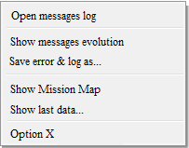
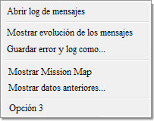
Debug Console
Stopped Process
Debug Errors
Displaying messages
Warm
Error
Fatal
- Image: none
- Frame: 25/30
- Image: none
- Frame: 25/30
- PositionChanged: (0.5,0.2,0)
Error : UAV position estimator has failed.
- PositionMap: (4.5,6,1,5)
- LimitOnsight: none
-Accelerometer Change: +1.4
-Gyroscope Changeso : 0.1
mission status
Drone Status
Error: UAV position estimator has failed.
System cant determine current position due to a big
change that exceed velocity limit.
Function: Pose Estimator.
Inputs : position_map(Point), limit_on_sight(int [])
Outputs : position_changed(Point).
Debug : none
Action: Pose Estimator process abort execution.

Slide 38
Debug Console
Stopped Process
Debug Errors
Displaying messages
Warm
Error
Fatal
- Image: none
- Frame: 25/30
- Image: none
- Frame: 25/30
- PositionChanged: (0.5,0.2,0)
Error : UAV position estimator has failed.
- PositionMap: (4.5,6,1,5)
- LimitOnsight: none
-Accelerometer Change: +1.4
-Gyroscope Changeso : 0.1
mission status
Drone Status
Error: UAV position estimator has failed.
System cant determine current position due to a big
change that exceed velocity limit.
Function: Pose Estimator.
Inputs : position_map(Point), limit_on_sight(int [])
Outputs : position_changed(Point).
Debug : none
Action: Pose Estimator process abort execution.

Slide 39
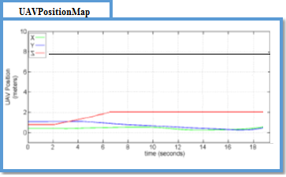
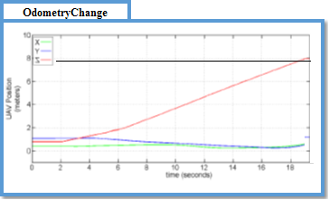
Debug Console
Stopped Process
Debug Errors
Displaying messages
Warm
Error
Fatal
- Image: none
- Frame: 25/30
- Image: none
- Frame: 25/30
- PositionChanged: (0.5,0.2,0)
Error : UAV position estimator has failed.
- PositionMap: (4.5,6,1,5)
- LimitOnsight: none
-Accelerometer Change: +1.4
-Gyroscope Changeso : 0.1
mission status
Drone Status
Error: UAV position estimator has failed.
System cant determine current position due to a big
change that exceed velocity limit.
Function: Pose Estimator.
Inputs : position_map(Point), limit_on_sight(int [])
Outputs : position_changed(Point).
Debug : none
Action: Pose Estimator process abort execution.

Slide 40
Debug Console
Stopped Process
Debug Errors
Displaying messages
Warm
Error
Fatal
- Image: none
- Frame: 25/30
- Image: none
- Frame: 25/30
- PositionChanged: (0.5,0.2,0)
Error : UAV position estimator has failed.
- PositionMap: (4.5,6,1,5)
- LimitOnsight: none
-Accelerometer Change: +1.4
-Gyroscope Changeso : 0.1
mission status
Drone Status
Error: UAV position estimator has failed.
System cant determine current position due to a big
change that exceed velocity limit.
Function: Pose Estimator.
Inputs : position_map(Point), limit_on_sight(int [])
Outputs : position_changed(Point).
Debug : none
Action: Pose Estimator process abort execution.

Slide 41
Debug Console
Stopped Process
Debug Errors
Displaying messages
Warm
Error
Fatal
- Image: none
- Frame: 25/30
- Image: none
- Frame: 25/30
- PositionChanged: (0.5,0.2,0)
Error : UAV position estimator has failed.
- PositionMap: (4.5,6,1,5)
- LimitOnsight: none
-Accelerometer Change: +1.4
-Gyroscope Changeso : 0.1
mission status
Drone Status
Error: UAV position estimator has failed.
System cant determine current position due to a big
change that exceed velocity limit.
Function: Pose Estimator.
Inputs : position_map(Point), limit_on_sight(int [])
Outputs : position_changed(Point).
Debug : none
Action: Pose Estimator process abort execution.

Slide 42
Debug Console
Stopped Process
Debug Errors
Displaying messages
Warm
Error
Fatal
- Image: none
- Frame: 25/30
- Image: none
- Frame: 25/30
- PositionChanged: (0.5,0.2,0)
Error : UAV position estimator has failed.
- PositionMap: (4.5,6,1,5)
- LimitOnsight: none
-Accelerometer Change: +1.4
-Gyroscope Changeso : 0.1
mission status
Drone Status
Error: UAV position estimator has failed.
System cant determine current position due to a big
change that exceed velocity limit.
Function: Pose Estimator.
Inputs : position_map(Point), limit_on_sight(int [])
Outputs : position_changed(Point).
Debug : none
Action: Pose Estimator process abort execution.

Slide 43
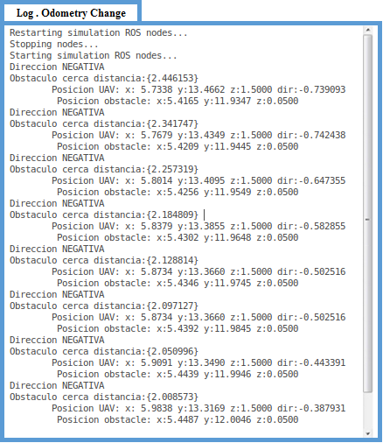
Debug Console
Stopped Process
Debug Errors
Displaying messages
Warm
Error
Fatal
- Image: none
- Frame: 25/30
- Image: none
- Frame: 25/30
- PositionChanged: (0.5,0.2,0)
Error : UAV position estimator has failed.
- PositionMap: (4.5,6,1,5)
- LimitOnsight: none
-Accelerometer Change: +1.4
-Gyroscope Changeso : 0.1
mission status
Drone Status
.
System cant determine current position due to a big
change that exceed velocity limit.
Function: Pose Estimator.
Inputs : position_map(Point), limit_on_sight(int [])
Outputs : position_changed(Point).
Debug : none
Action: Pose Estimator process abort execution.

Slide 44
Debug Console
Stopped Process
Debug Errors
Displaying messages
Warm
Error
Fatal
- Image: none
- Frame: 25/30
- Image: none
- Frame: 25/30
- PositionChanged: (0.5,0.2,0)
Error : UAV position estimator has failed.
- PositionMap: (4.5,6,1,5)
- LimitOnsight: none
-Accelerometer Change: +1.4
-Gyroscope Changeso : 0.1
mission status
Drone Status
Error: UAV position estimator has failed.
System cant determine current position due to a big
change that exceed velocity limit.
Function: Pose Estimator.
Inputs : position_map(Point), limit_on_sight(int [])
Outputs : position_changed(Point).
Debug : none
Action: Pose Estimator process abort execution.

Slide 45
Debug Console
Stopped Process
Debug Errors
Displaying messages
Warm
Error
Fatal
- Image: none
- Frame: 25/30
- Image: none
- Frame: 25/30
- PositionChanged: (0.5,0.2,0)
Error : UAV position estimator has failed.
- PositionMap: (4.5,6,1,5)
- LimitOnsight: none
-Accelerometer Change: +1.4
-Gyroscope Changeso : 0.1
mission status
Drone Status
Error: UAV position estimator has failed.
System cant determine current position due to a big
change that exceed velocity limit.
Function: Pose Estimator.
Inputs : position_map(Point), limit_on_sight(int [])
Outputs : position_changed(Point).
Debug : none
Action: Pose Estimator process abort execution.

Slide 46
Error 1b: UAV position estimator has failed.
Possible Similar list Errors:
Odometry Driver could not be initializated.
Odometry Driver has been restarted without permision.
Odometry Driver process abort execution.
OdometryChange is an empty message.
Pose Estimator is a stop process and it has been restarted.
Pose Estimator could not be initializated.

Slide 47
Error Case 2b Simulation
Error Scene
UAV is tracking a robot and suddenly UAV stop and take other way due to a robot detector input failure.

Slide 48
Debug Console
Stopped Process
Debug Errors
Displaying messages
Warm
Error
Fatal

Slide 49
Debug Console
Stopped Process
Debug Errors
Displaying messages
Warm
Error
Fatal
Error : Tracked Robot X has disappear.
mission status
Error: Tracked Robot X has disappear.
System cant determine where is tracked robot X due to there aren’t enough data.
Function: detect_colors.
Inputs : position_map(Point), limit_on_sight(int [])
Outputs : position_changed(Point).
Debug : none
Action: Exception was throw.

Slide 50
Debug Console
Stopped Process
Debug Errors
Displaying messages
Warm
Error
Fatal
Error : Tracked Robot X has disappear.
- Image: none
- Frame: 25/30
- UAVPosition: (5,6.2,1.5)
- SegmentetionVect: none
mission status
Error: Tracked Robot X has disappear.
System cant determine where is tracked robot X due to there aren’t enough data.
Function: detect_colors.
Inputs : position_map(Point), limit_on_sight(int [])
Outputs : position_changed(Point).
Debug : none
Action: Exception was throw.

Slide 51
Debug Console
Stopped Process
Debug Errors
Displaying messages
Warm
Error
Fatal
Error : Tracked Robot X has disappear.
- Image: none
- Frame: 25/30
- UAVPosition: (5,6.2,1.5)
- SegmentetionVect: none
mission status
Error: Tracked Robot X has disappear.
System cant determine where is tracked robot X due to there aren’t enough data.
Function: detect_colors.
Inputs : position_map(Point), limit_on_sight(int [])
Outputs : position_changed(Point).
Debug : none
Action: Exception was throw.

Slide 52
Debug Console
Stopped Process
Debug Errors
Displaying messages
Warm
Error
Fatal
Error : Tracked Robot X has disappear.
- Image: none
- Frame: 25/30
- UAVPosition: (5,6.2,1.5)
- SegmentetionVect: none
mission status
Drone Status
Error: Tracked Robot X has disappear.
System cant determine where is tracked robot X due to there aren’t enough data.
Function: detect_colors.
Inputs : position_map(Point), limit_on_sight(int [])
Outputs : position_changed(Point).
Debug : none
Action: Exception was throw.

Slide 53
Debug Console
Stopped Process
Debug Errors
Displaying messages
Warm
Error
Fatal
Error : Tracked Robot X has disappear.
- Image: none
- Frame: 25/30
- Image: none
- Time: 2:23:1234
- UAVPosition: (5,6.2,1.5)
- SegmentetionVect: none
- Image: none
- Frame: 25/30
- PositionChanged: (0.5,0.2,0)
mission status
Drone Status
Error: Tracked Robot X has disappear.
System cant determine where is tracked robot X due to there aren’t enough data.
Function: detect_colors.
Inputs : position_map(Point), limit_on_sight(int [])
Outputs : position_changed(Point).
Debug : none
Action: Exception was throw.

Slide 54
Debug Console
Stopped Process
Debug Errors
Displaying messages
Warm
Error
Fatal
Error : Tracked Robot X has disappear.
- Image: none
- Frame: 25/30
- Image: none
- Time: 2:23:1234
- UAVPosition: (5,6.2,1.5)
- SegmentetionVect: none
- Image: none
- Frame: 25/30
- PositionChanged: (0.5,0.2,0)
mission status
Drone Status
Error: Tracked Robot X has disappear.
System cant determine where is tracked robot X due to there aren’t enough data.
Function: detect_colors.
Inputs : position_map(Point), limit_on_sight(int [])
Outputs : position_changed(Point).
Debug : none
Action: Exception was throw.

Slide 55
Debug Console
Stopped Process
Debug Errors
Displaying messages
Warm
Error
Fatal
Error : Tracked Robot X has disappear.
- Image: none
- Frame: 25/30
- Image: none
- Time: 2:23:1234
- UAVPosition: (5,6.2,1.5)
- SegmentetionVect: none
- Image: none
- Frame: 25/30
- PositionChanged: (0.5,0.2,0)
mission status
Drone Status
Error: Tracked Robot X has disappear.
System cant determine where is tracked robot X due to there aren’t enough data.
Function: detect_colors.
Inputs : position_map(Point), limit_on_sight(int [])
Outputs : position_changed(Point).
Debug : none
Action: Exception was throw.

Slide 56
Debug Console
Stopped Process
Debug Errors
Displaying messages
Warm
Error
Fatal
Error : Tracked Robot X has disappear.
- Image: none
- Frame: 25/30
- Image: none
- Time: 2:23:1234
- UAVPosition: (5,6.2,1.5)
- SegmentetionVect: none
- Image: none
- Frame: 25/30
- PositionChanged: (0.5,0.2,0)
mission status
Drone Status
Error: Tracked Robot X has disappear.
System cant determine where is tracked robot X due to there aren’t enough data.
Function: detect_colors.
Inputs : position_map(Point), limit_on_sight(int [])
Outputs : position_changed(Point).
Debug : none
Action: Exception was throw.

Slide 57
Debug Console
Stopped Process
Debug Errors
Displaying messages
Warm
Error
Fatal
Error : Tracked Robot X has disappear.
- Image: none
- Frame: 25/30
- Image: none
- Time: 2:23:1234
- UAVPosition: (5,6.2,1.5)
- SegmentetionVect: none
- Image: none
- Frame: 25/30
- PositionChanged: (0.5,0.2,0)
Mission Map
3:50
Robot1
mission status
Drone Status
Robot2
Error: Tracked Robot X has disappear.
System cant determine where is tracked robot X due to there aren’t enough data.
Function: detect_colors.
Inputs : position_map(Point), limit_on_sight(int [])
Outputs : position_changed(Point).
Debug : none
Action: Exception was throw.
Robot3
Robot4

Slide 58
Debug Console
Stopped Process
Debug Errors
Displaying messages
Warm
Error
Fatal
Error : Tracked Robot X has disappear.
- Image: none
- Frame: 25/30
- Image: none
- Time: 2:23:1234
- UAVPosition: (5,6.2,1.5)
- SegmentetionVect: none
- Image: none
- Frame: 25/30
- PositionChanged: (0.5,0.2,0)
Mission Map
3:50
Robot1
mission status
Drone Status
Robot2
Error: Tracked Robot X has disappear.
System cant determine where is tracked robot X due to there aren’t enough data.
Function: detect_colors.
Inputs : position_map(Point), limit_on_sight(int [])
Outputs : position_changed(Point).
Debug : none
Action: Exception was throw.
Robot3
Robot4

Slide 59
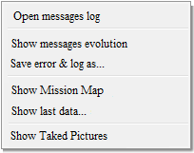
Debug Console
Stopped Process
Debug Errors
Displaying messages
Warm
Error
Fatal
Error : Tracked Robot X has disappear.
- Image: none
- Frame: 25/30
- Image: none
- Time: 2:23:1234
- UAVPosition: (5,6.2,1.5)
- SegmentetionVect: none
- Image: none
- Frame: 25/30
- PositionChanged: (0.5,0.2,0)
Mission Map
3:50
Robot1
mission status
Drone Status
Robot2
Error: Tracked Robot X has disappear.
System cant determine where is tracked robot X due to there aren’t enough data.
Function: detect_colors.
Inputs : position_map(Point), limit_on_sight(int [])
Outputs : position_changed(Point).
Debug : none
Action: Exception was throw.
Robot3
Robot4

Slide 60
Debug Console
Stopped Process
Debug Errors
Displaying messages
Warm
Error
Fatal
Error : Tracked Robot X has disappear.
- Image: none
- Frame: 25/30
- Image: none
- Time: 2:23:1234
- UAVPosition: (5,6.2,1.5)
- SegmentetionVect: none
- Image: none
- Frame: 25/30
- PositionChanged: (0.5,0.2,0)
Mission Map
3:50
Robot1
mission status
Drone Status
Robot2
Error: Tracked Robot X has disappear.
System cant determine where is tracked robot X due to there aren’t enough data.
Function: detect_colors.
Inputs : position_map(Point), limit_on_sight(int [])
Outputs : position_changed(Point).
Debug : none
Action: Exception was throw.
Robot3
Robot4

Slide 61
Debug Console
Stopped Process
Debug Errors
Displaying messages
Warm
Error
Fatal
Error : Tracked Robot X has disappear.
- Image: none
- Frame: 25/30
- Image: none
- Time: 2:23:1234
- UAVPosition: (5,6.2,1.5)
- SegmentetionVect: none
- Image: none
- Frame: 25/30
- PositionChanged: (0.5,0.2,0)
Mission Map
3:50
Robot1
mission status
Drone Status
Robot2
Error: Tracked Robot X has disappear.
System cant determine where is tracked robot X due to there aren’t enough data.
Function: detect_colors.
Inputs : position_map(Point), limit_on_sight(int [])
Outputs : position_changed(Point).
Debug : none
Action: Exception was throw.
Robot3
Robot4

Slide 62
Error 2b: Tracked Robot X has disappear.
Possible Similar list Errors:
CameraFrameAbstraction is an empty message.
No CameraFrameAbstraction has been sent.
RobotDetector can not determine any robot in the frame.
RobotDetector can not mark tracked robot in the map.
RobotDetector algorithm has failed.

Slide 63
Error Case 3b Simulation
Error Scene
UAV is flying over the field and suddenly is going down or staying in a hover position without change or response. This is produced by a ROS failure in one or more nodes.

Slide 64
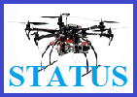
Debug Console
Stopped Process
Debug Errors
Displaying messages
Warm
Error
Fatal
Drone Status

Slide 65
Debug Console
Stopped Process
Debug Errors
Displaying messages
Warm
Error
Fatal
Error : Unexpected critical exception has been throw.
mission status
Drone Status
Critical Error: Unexpected exception has been throw.
ROS runtime environment did not respond and limit time has been reached.
Function: act.
Inputs : uav (uavState), targets (TargetRobotState[]), obstacles(ObstacleRobotState[]) ()perception_state, limit_on_sight(int [])
Outputs : status(int).
Debug : none
Action: All processes haveare died.

Slide 66
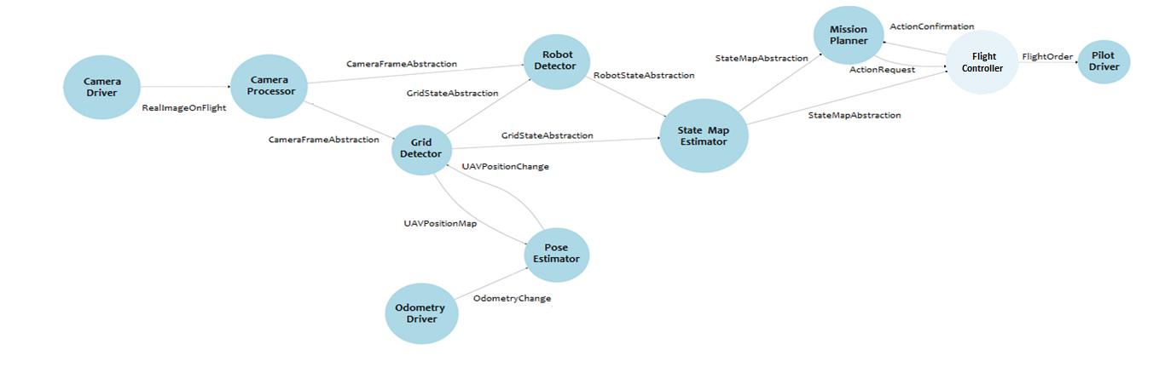
Debug Console
Stopped Process
Debug Errors
Displaying messages
Warm
Error
Fatal
Error : Unexpected critical exception has been throw.
mission status
Drone Status
Critical Error: Unexpected exception has been throw.
ROS runtime environment did not respond and limit time has been reached.
Function: act.
Inputs : uav (uavState), targets (TargetRobotState[]), obstacles(ObstacleRobotState[]) ()perception_state, limit_on_sight(int [])
Outputs : status(int).
Debug : none
Action: All processes haveare died.

Slide 67
Debug Console
Stopped Process
Debug Errors
Displaying messages
Warm
Error
Fatal
Error : Unexpected critical exception has been throw.
mission status
Drone Status
Critical Error: Unexpected exception has been throw.
ROS runtime environment did not respond and limit time has been reached.
Function: act.
Inputs : uav (uavState), targets (TargetRobotState[]), obstacles(ObstacleRobotState[]) ()perception_state, limit_on_sight(int [])
Outputs : status(int).
Debug : none
Action: All processes haveare died.

Slide 68
Error 3b: Unexpected exception has been throw.
Possible Similar list Errors:
ROSSystem has been stoped.
ROSSystem can not send or receive any message on port X.
ROSCore has already been lanched and just can be once at same time.
ROSSystem was killed by user.

Slide 69
Error Case 4b Simulation
Error Scene
UAV is flying over the field and suddenly go up and exceeds the high limit. High Sensor failed and produced an unespected action.

Slide 70
Debug Console
Stopped Process
Debug Errors
Displaying messages
Warm
Error
Fatal

Slide 71
Debug Console
Stopped Process
Debug Errors
Displaying messages
Warm
Error
Fatal
mission status
Error : High Limit has been exceeded.
Error: High Limit has been exceeded.
System has detected the high field limit and UAV have to go down immediatly ROS runtime environment did not respond and limit time has been reached.
Function: receiveRay.
Inputs : double time
Outputs : status(int).
Debug : none
Action: UAV force to land.

Slide 72
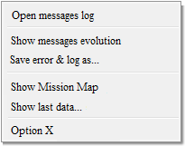
Debug Console
Stopped Process
Debug Errors
Displaying messages
Warm
Error
Fatal
mission status
Error : High Limit has been exceeded.
Error: High Limit has been exceeded.
System has detected the high field limit and UAV have to go down immediatly ROS runtime environment did not respond and limit time has been reached.
Function: receiveRay.
Inputs : double time
Outputs : status(int).
Debug : none
Action: UAV force to land.

Slide 73
Debug Console
Stopped Process
Debug Errors
Displaying messages
Warm
Error
Fatal
mission status
Error : High Limit has been exceeded.
Error: High Limit has been exceeded.
System has detected the high field limit and UAV have to go down immediatly ROS runtime environment did not respond and limit time has been reached.
Function: receiveRay.
Inputs : double time
Outputs : status(int).
Debug : none
Action: UAV force to land.

Slide 74
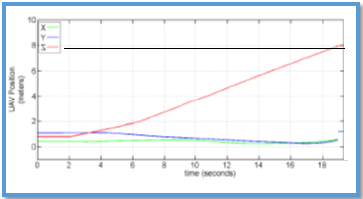
Debug Console
Stopped Process
Debug Errors
Displaying messages
Warm
Error
Fatal
mission status
Error : High Limit has been exceeded.
Error: High Limit has been exceeded.
System has detected the high field limit and UAV have to go down immediatly ROS runtime environment did not respond and limit time has been reached.
Function: receiveRay.
Inputs : double time
Outputs : status(int).
Debug : none
Action: UAV force to land.

Slide 75
Error 4b: High Limit has been exceeded.
Possible Similar list Errors:
Odometry Driver has lost the high reference.
Odometry Driver has receive date out of range.
Odometry Driver can not determine current position.

Slide 76
Questions We have
How uav CPU and assistant CPU distribute workload.
Size of final messages and size of uav memory (if it have).
CPU power can we use in uav and commucation WIFI.
Tools used in Vision4AUV.
Other uses that you will need.

Slide 77
ANNEX: Others Designes

Slide 78
First Design

Slide 80
Second Design

Slide 81
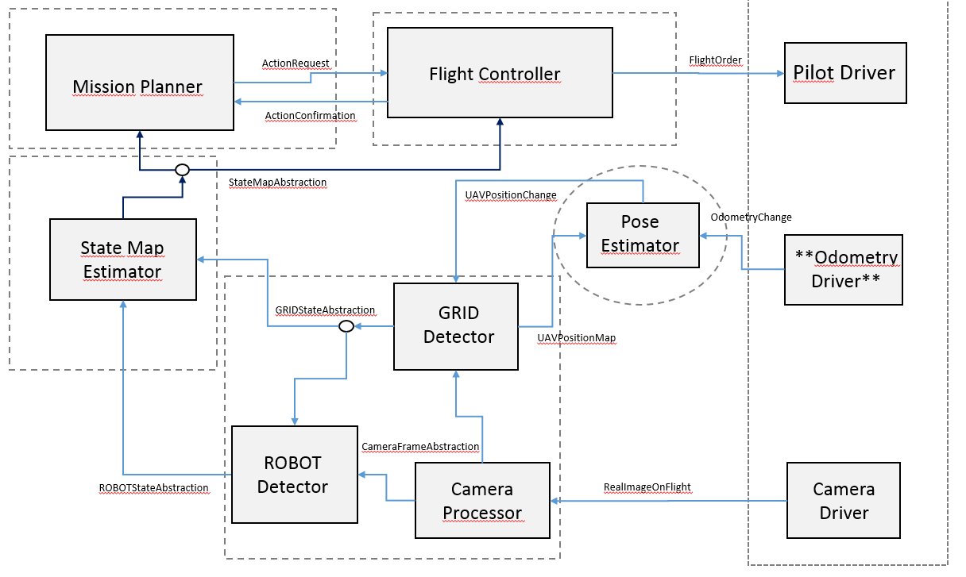
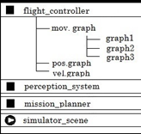



mission status
Error 1: Camera X could not be initialized.
System do not be able to obtain an initial camera data.
Function: Camera undistortion initialization.
Inputs : camera_matrix (Mat), distorsion_coefficients (Mat)
Outputs : none
Debug : none
Function: Color segmentation initialization
Inputs : working_size (Size), svm_model_file(string), svm_scale_values_file(string), svm_type (int), colorspace (int)
Outputs : none
Debug : valid_model (bool), svm_scale_values (<<double>>)
Action: Driver Camera process abort execution.
Mission_Planner
Flight Controller
State_Map_Estimator
Grid_Detector
Error 1: Camera X could not be initialized.
Robot_Detector
Camera_Processor
Pose_Estimator
Pilot Driver
Odometry Driver
Camera_Driver
Log Tasks
Messages
Mission Map
→Action1 : Find
Position = (8.66,15).
TimeToReach = 4.11.
Dangerous pos = False.
→Action2 Find
Position = (8.66,15).
TimeToReach = 4.11.
Dangerous pos = False.
→Action3 : Find
Position = (8.66,15).
TimeToReach = 4.11.
Dangerous pos = False.
→Action4
→Action5
→Action6
uint64 id # ID Copy of ActionRequest
#State of the flight control system
uint8 OK = 0
uint8 STATIC = 1
uint8 ROTATING = 2
uint8 UNREACHABLE = 3
uint8 status
#Copy of Resquest asked
#---------------------------------------------
uint8 typeReq #value in message ActionRequest.msg
#Number of the robot to be moved or controled
uint16 robotidReq
geometry_msgs/Point positionReq
Float64 time# Targets statecommon/TargetRobotState[]
targets# Obstacles statecommon/ObstacleRobotState[]
obstacles#
UAV statecommon/UAVState uav
robot1
robot2
robot3
robot4

Slide 82
Third Design

Slide 83
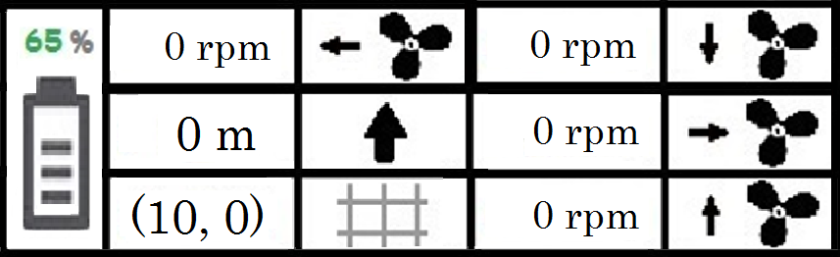
Debug Console
Warm
Error
Fatal
Stopped Process
Debug Errors
Displaying messages
Drone Status
Log Tasks
mission status
Mission Map
TIME
→Action1 : Find
Position = (8.66,15).
TimeToReach = 4.11.
Dangerous pos = False.
→Action2 Find
Position = (8.66,15).
TimeToReach = 4.11.
Dangerous pos = False.
→Action3 : Find
Position = (8.66,15).
TimeToReach = 4.11.
Dangerous pos = False.
→Action4
→Action5
→Action6
0:00
Robot 1
Robot 2
Robot 3
Robot 4

Slide 84
Vision System Errors and Example Monitor Performance in Real Environment

Slide 85
Simulated Environment | Real Environment
+ We can select the process that we want to initialise. + We can stop and restart process in execution time. + Programmers could visualize message in order to respond and identify themself errors. | + We can select the process that we want to initialise. We can stop and restart process in execution time. Programmers could not have enough time to visualize message in order to respond and identify themself errors. Solution1: Save in a file messages and errors. But with this solution we can not solve errors in execution time…. Solution2: Monitoring tool could have predefinite actions to solve basic errors. → Difficulty: Monitoring tool should be able to make difference between several errors and act accordingly.

