Slide 1



The NLP and ML Implanted into
HSBC surveillance
'Let's do it' Group

Slide 2

Group
Project
Design
Realisation
Key tech

Slide 3

Group

Slide 4



Part 1
Yu DUAN
Yanqing ZENG
Yifan ZHENG

Slide 5
Project introduction
Demand analysis
Background analysis
Object

Slide 6

Part 2
2.1 Demand analysis
IS the bank safe？
Fishing emails！
Financial crime！
……
……
Illegal operation！
“Inside-SPY”！
improper operation！
……

Slide 7
Part 2
2.2 Background analysis
Bank crime case
Humain source waste
Operation repeated
needed
Human Factors
machine learning days
……

Slide 8
Part 2
2.3 Object
Update dataset
make it more suitable to HSBC
Machine Learning
make it easy
SAFE and EASY
A new morden HSBC system
surveillance system
make it accurate

Slide 9
Design
Process Design
Page Design

Slide 10
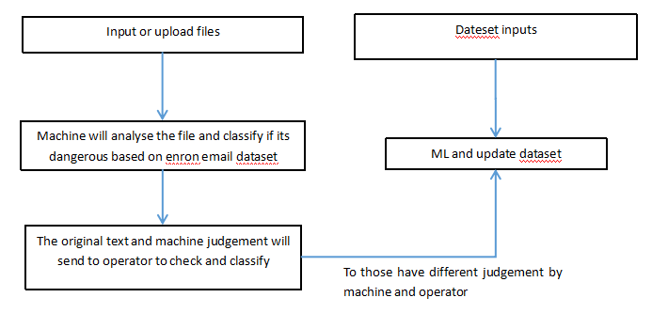
Part 3
3.1 Process Design

Slide 11
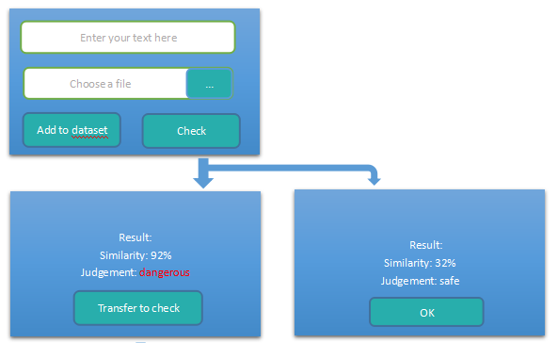
Part 3
3.2 Page Design

Slide 12
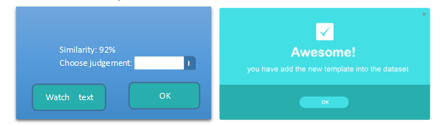
Part 3
3.2 Page Design

Slide 13
Realisation
UI pages
Command lines

Slide 14
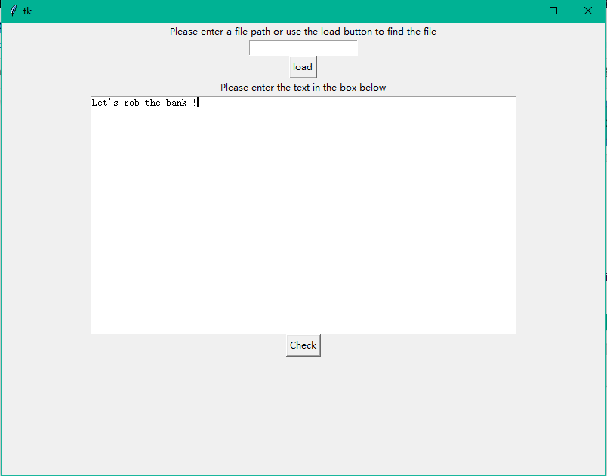
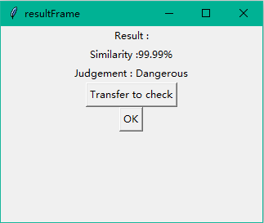
Part 4
4.1 UI pages
Check
Result
If the judgement is Dangerous or By check :
Please press Transfer to check to go to the manual check page
File entry

Slide 15
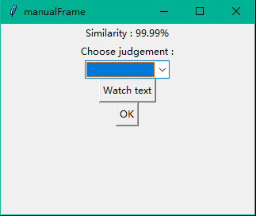
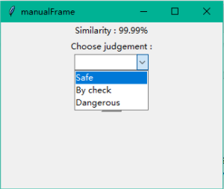

Part 4
4.1 UI pages
Review the text & Give a judgement
Here at the manual check page, we can review the suspect text and give a correct decision of dangerous level.

Slide 16
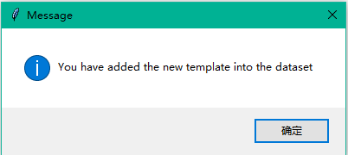

Part 4
4.1 UI pages
Succes !
With the double check by the operator, we ensure the veracity of the classification of the target file.
By adding the text into the dataset, we can increase the veracity of the next judgement made by computer.

Slide 17
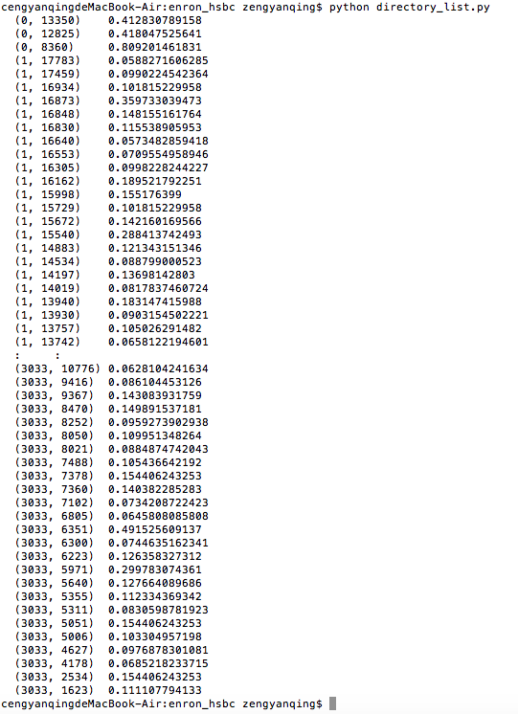
Part 4
4.2 Command lines
Transform the text into a matrix of word frequency by parsing the stop words.
We realize the Natural Language Processing with the Python package sklearn.

Slide 18
Key technology
Natural Language Processing
Machine Learning

Slide 19
Part 5
5.1 Possible analysis with machine learning
Detect potential persons of interest
SVM
Clustering
Decision Tree
Neuron Network
Bayes Classifier
Detect other potential risk and danger
Detect
money
laundering
Sentiment Analysis

Slide 20
Part 5
5.2 NLP and Machine Learning process
Parsing the stop words
Using bag-of-words
Text
Parsing
Transfor-mation
AI
Automatically detect the potential danger and risk
Transform the text into the matrix
Frequency of words
Model
Fitting
Different models
Supervised and unsupervised learning
SVM, Decision Tree, Neuron Network

Slide 21
THANK YOU
'Let's do it' Group

Slide 22
备 用 图 标

