Slide 1
LAPORAN TUGAS BESAR PBO GUI
TRAVELIN AJA
KELILING DUNIA BERSAMA KAMI
Yolando Asri Erbenca Gegeh

Slide 2
01
Tujuan

Slide 3
Tujuan
Aplikasi ini dibuat untuk mempermudah agent travel dalam menjual tiketnyaa.

Slide 4
02
ERD

Slide 5
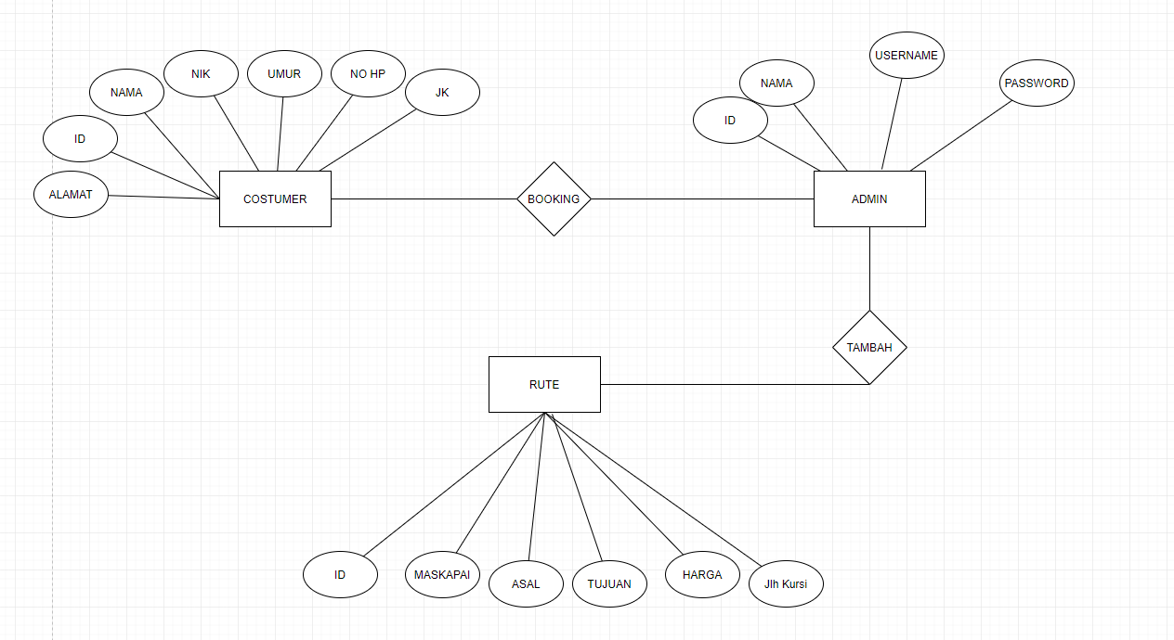
AWESOME WORDS

Slide 6
03
UI/UX

Slide 7
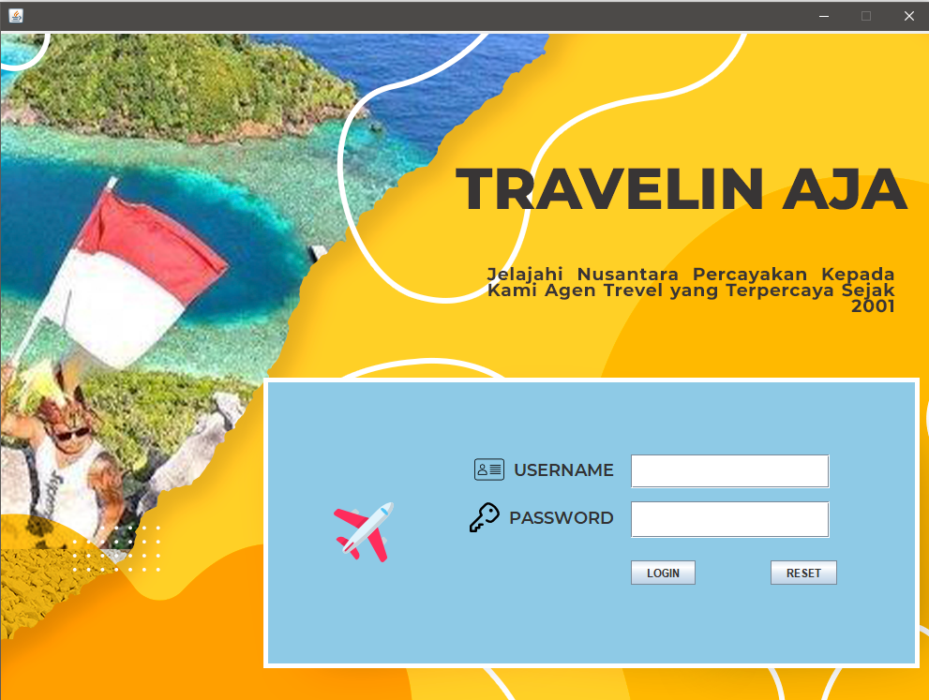
AWESOME WORDS

Slide 8
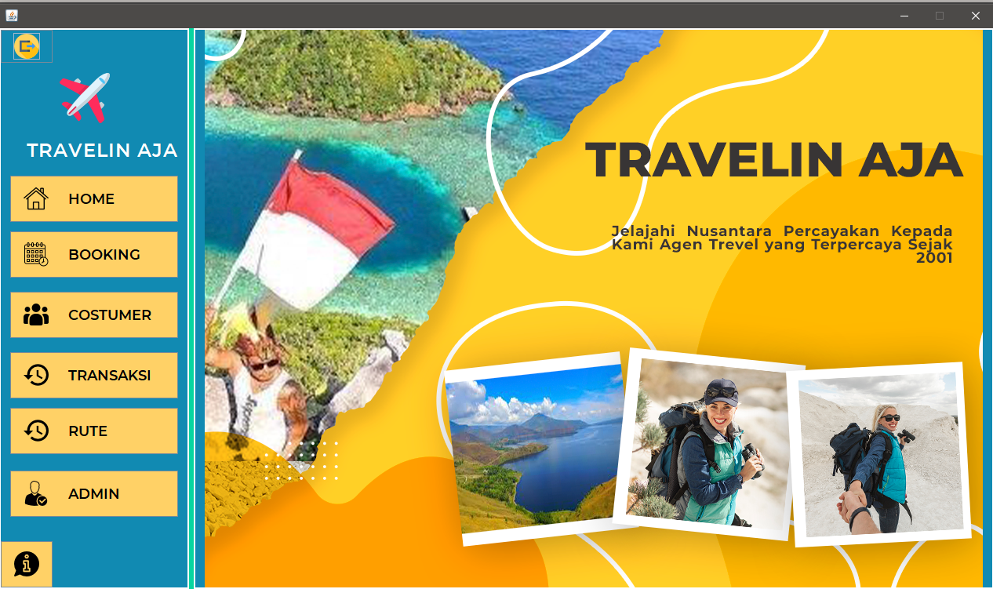
AWESOME WORDS

Slide 9
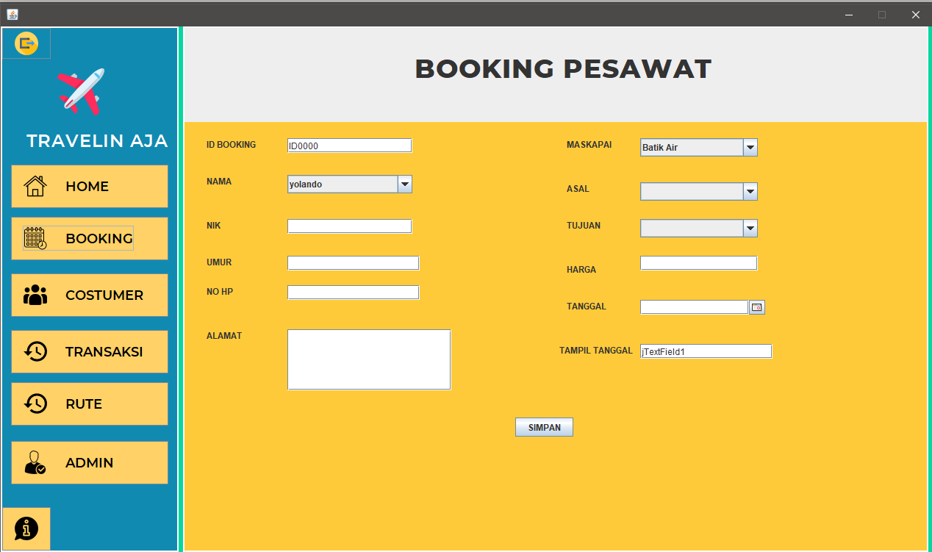
AWESOME WORDS

Slide 10
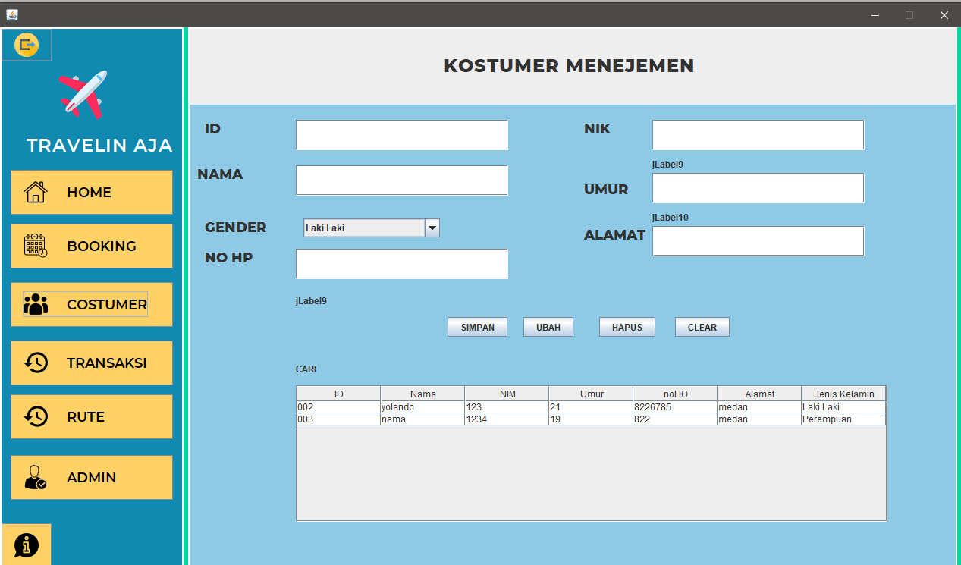
AWESOME WORDS

Slide 11
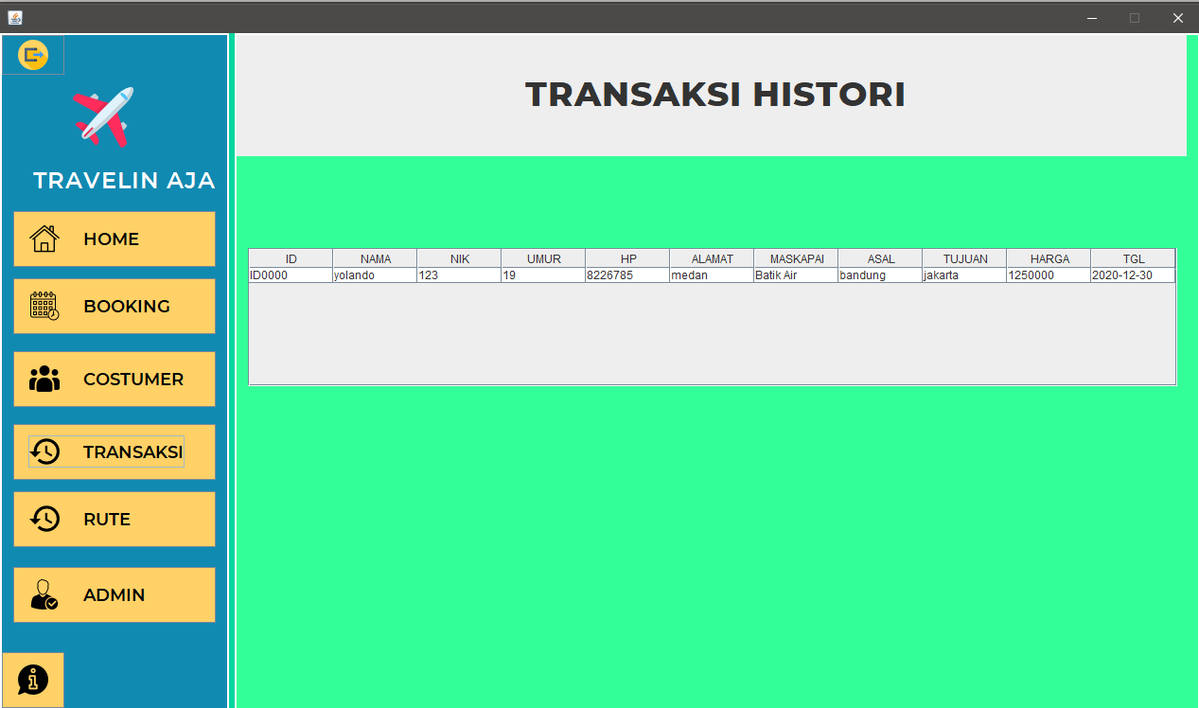
AWESOME WORDS

Slide 12
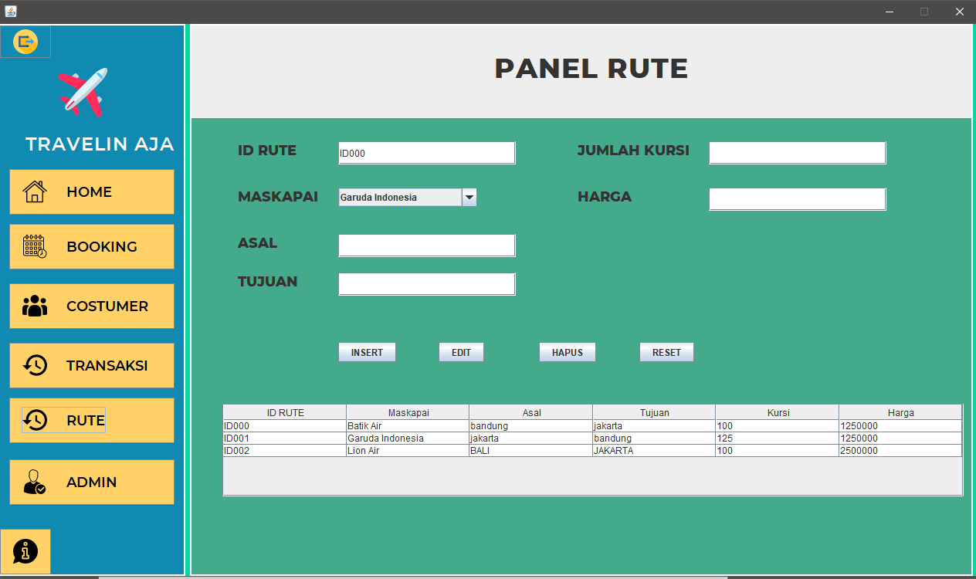
AWESOME WORDS

Slide 13
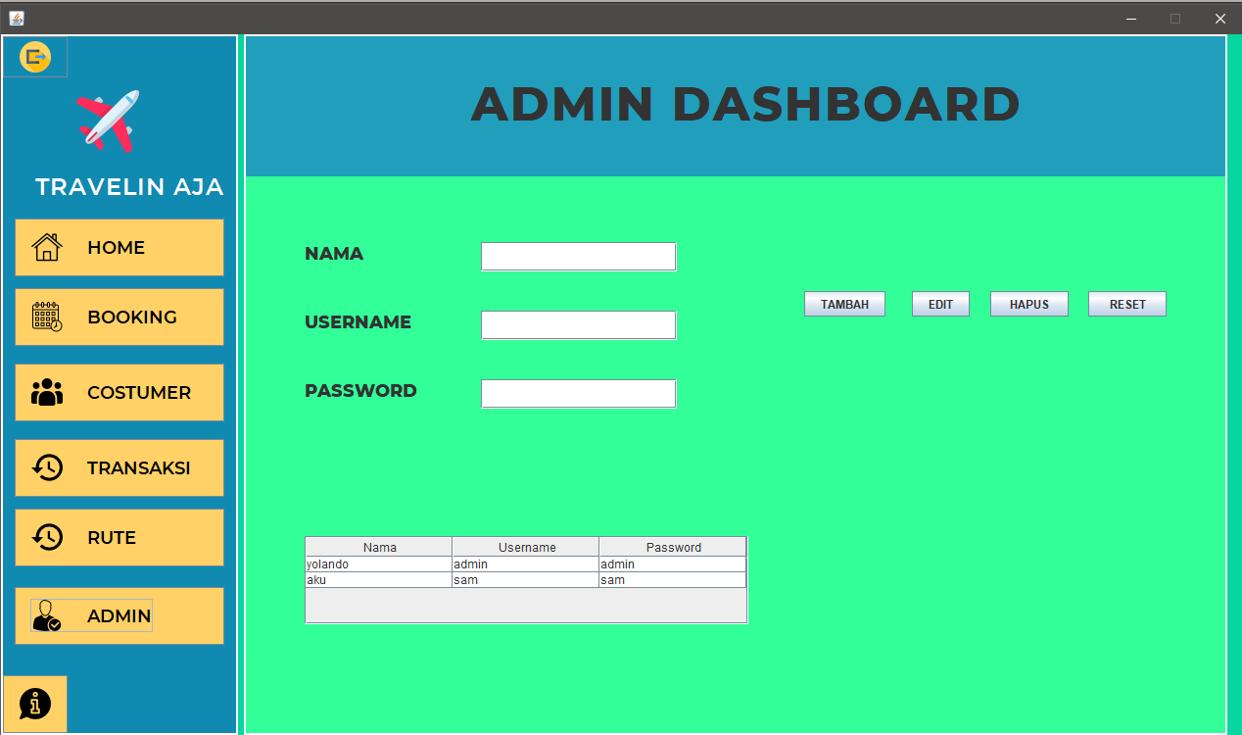
AWESOME WORDS

Slide 14
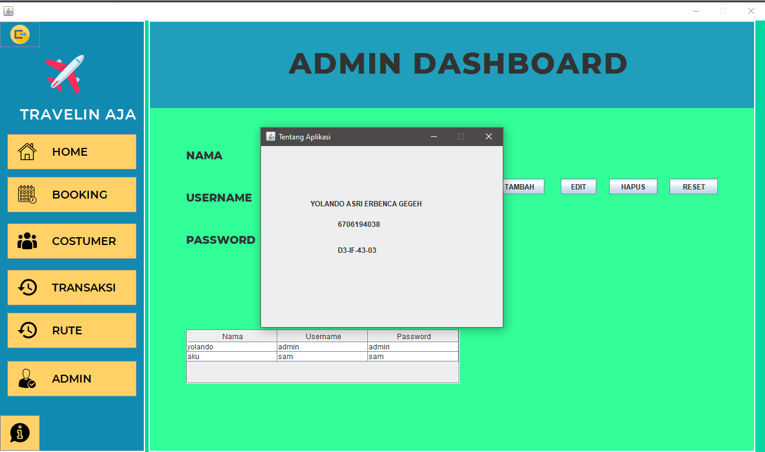
WHAT IS THIS TOPIC ABOUT?
JUPITER
NEPTUNE
Jupiter is a gas giant and the biggest planet
Neptune is the farthest planet from the Sun
VENUS
MARS
Venus has a beautiful name, but it is hot
Despite being red, Mars is actually a cold place

Slide 15
04
STRUKTUR DATABASE

Slide 16
