Slide 1

SUMMER PROGRAM 2026 · FINAL DEFENSE
Modelling ammonia
volatilization
Across seven cropping systems of the Trajectoire
experimental platform (2018–2025)
Daniela Zúñiga-Jiménez
July 2026

Slide 2




Background
94%
> 50%
×273
of atmospheric NH₃
from agriculture
of PM₂.₅ mass
formed from NH₃
GWP₁₀₀ of N₂O
(indirect NH₃ pathway)
Seven systems
The transition
CTR → COM crop-oriented methanization
MF → LOM livestock-oriented methanization
SCA · GHG · HYP · CTR · LI · OF · MF
152 events over two rotations (2018–2025)
Contrasted objectives: yield, GHG, low-input, organic, mixed
Digestate replaces conventional inputs in rotation 2
Sources: EEA (2023). EMEP/EEA Guidebook · Gu et al. (2021). Science, 374, 758–762 · IPCC (2019). 2019 Refinement to the 2006 Guidelines, Vol. 4, Ch. 11.
Trajectoire NH₃ · AgroParisTech · INRAE

Slide 3
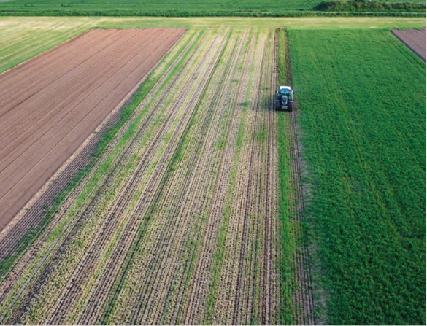
The Trajectoire platform
Grignon, Île-de-France
Key figures
Seven contrasting systems
Each strip ≈ 1.4 ha · same soil (silt-loam, pH 7.66) · same climate
10 ha
SCA
Soil conservation agriculture
No tillage · permanent soil cover
Experimental platform surface
GHG
Low carbon
Nitrification inhibitors · low fossil fuel use
7
HYP
High yield performance
Maximize yield · conventional practices
Cropping systems on parallel strips
CTR
Control
HVE-3 certified reference practices
LI
Low input
Reduce fertilizer & plant-protection inputs
5 yr
OF
Organic farming
Organic inputs only · mechanical weeding
Duration of each crop rotation
MF
Mixed farming
Livestock effluents · slurry, solid manure
2 000
Field measurements per year
Common 5-year rotation: wheat → second cereal → rapeseed (faba bean in OF) → wheat → maize · R1 (2017–2022) → R2 (2022–2027, in progress)
Source: AgroParisTech (2024). Trajectoire · Review of the first crop rotation 2017–2022.
Trajectoire NH₃ · AgroParisTech · INRAE

Slide 4

Research question & objectives
How much ammonia is lost across the seven cropping systems of Trajectoire, and how much does it change after the transition to anaerobic digestion?
Objectives
1
Quantify NH₃-N emissions from all 152 fertilization events across the seven cropping systems
2
Measure the change in emissions after two systems transition to anaerobic digestion
3
Translate volatilized N into an indirect-N₂O climate cost (IPCC 2019 methodology)
4
Trajectoire NH₃ · AgroParisTech · INRAE

Slide 5


Methods
Emission-factor model
Process-oriented dynamic model
EMEP Tier 2
ALFAM2
How it works
Emission = N applied × EF(product, pH)
Strengths
✓ Complete inventory (all 152 events)
✓ Simple, reproducible, comparable
✓ Policy-standard method
Limits
✗ Fixed factor per product
✗ No weather sensitivity
How it works
First-order transfer from TAN pools, hourly
Strengths
✓ Resolves weather (T, wind, rain)
✓ Differentiates slurry vs digestate
✓ Calibrated on >700 field plots
Limits
✗ Only liquid organic (11 events)
✗ Extrapolation at calibration edges
Trajectoire NH₃ · AgroParisTech · INRAE

Slide 6
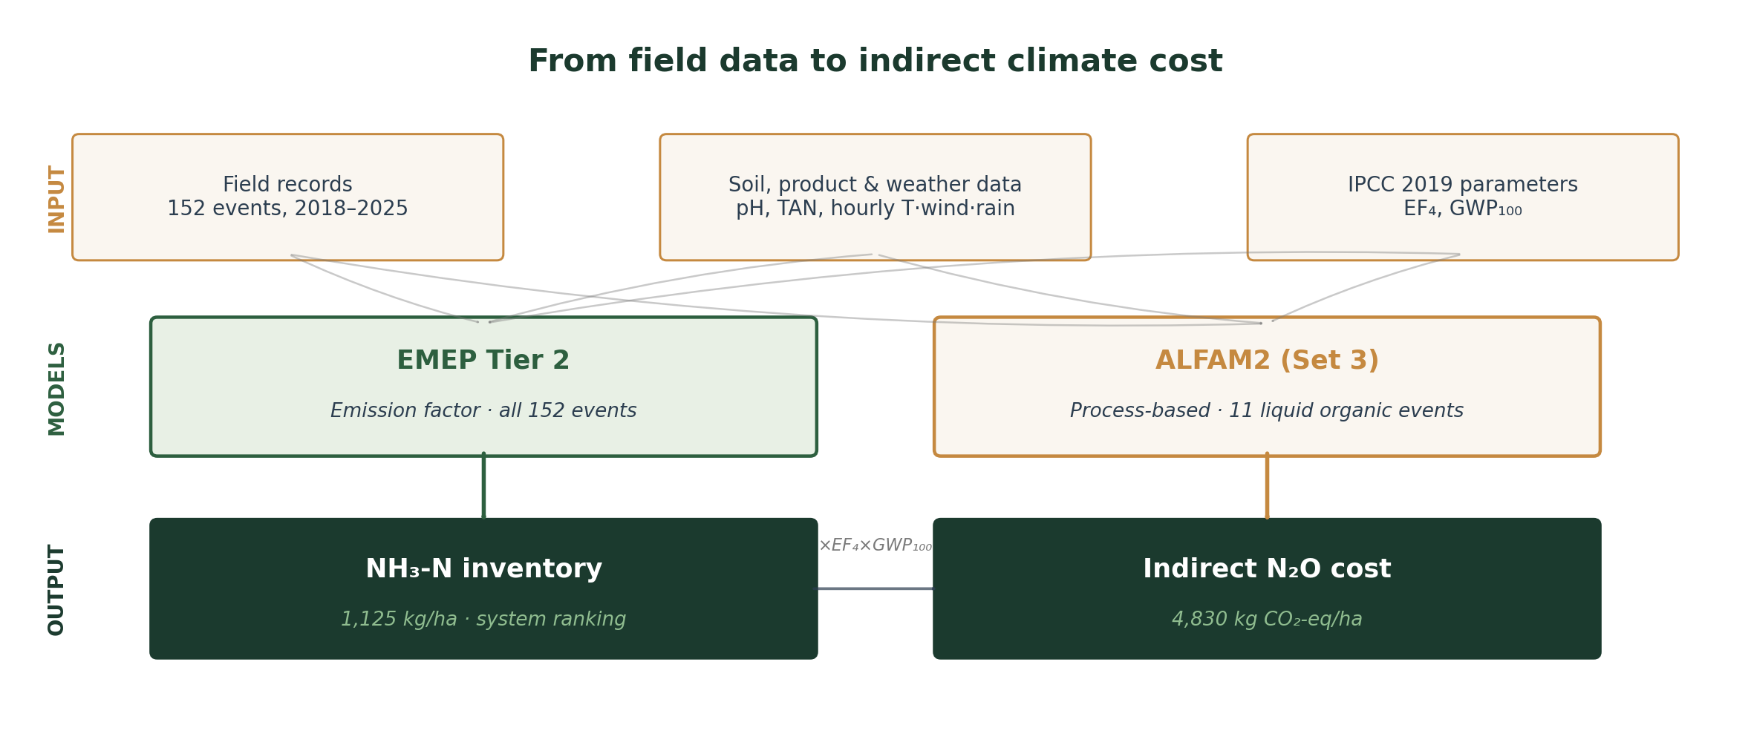
Workflow
Trajectoire NH₃ · AgroParisTech · INRAE

Slide 7
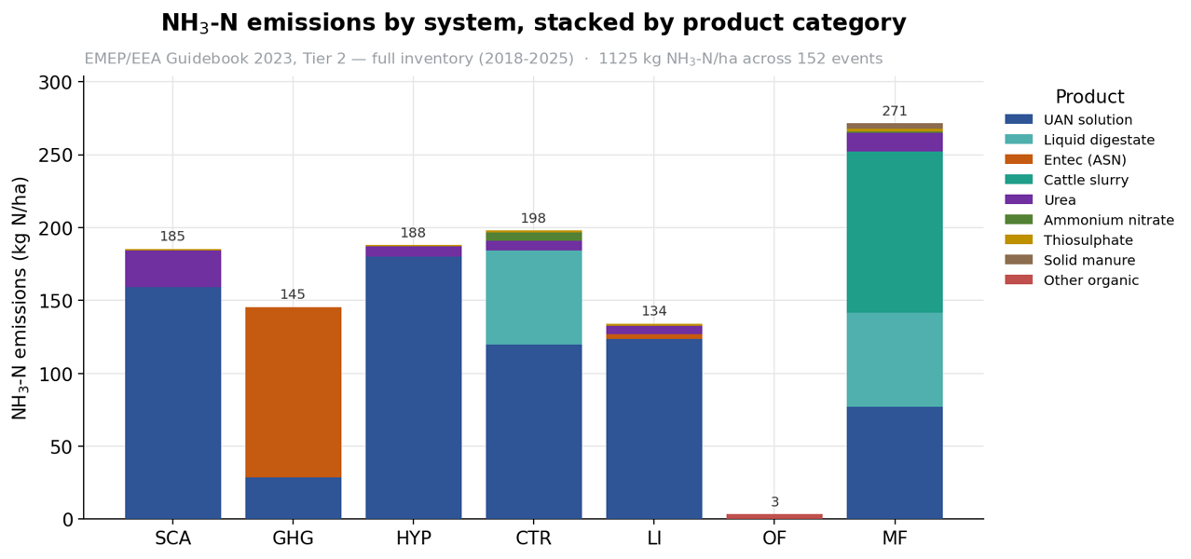
Result 1 — EMEP inventory
1,125.5
kg NH₃-N ha⁻¹
Full inventory (2018–2025)
667.2
R1 · 87 events
458.3
R2 · 65 events
Top intensities
MF 16.1% · CTR 14.7%
GHG 9.6% · OF 1.0%
Trajectoire NH₃ · AgroParisTech · INRAE

Slide 8
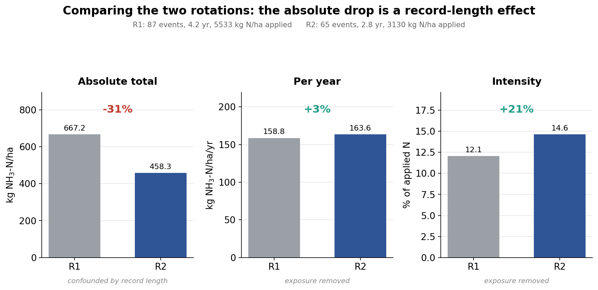
Result 2 — The methanization paradox
Trajectoire NH₃ · AgroParisTech · INRAE

Slide 9
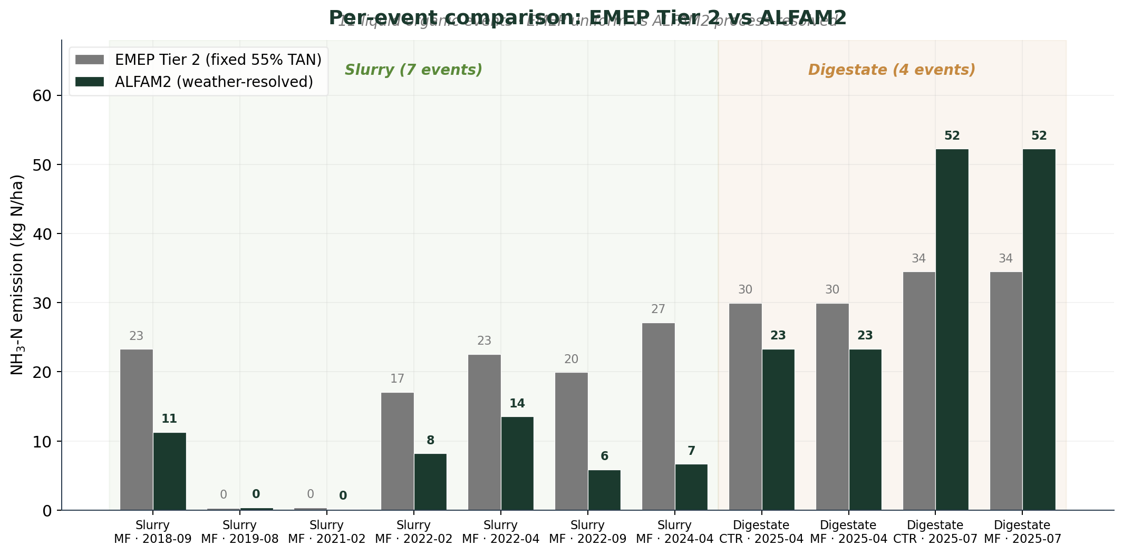
Result 5 — EMEP vs ALFAM2 per event
Where the fixed factor over- or undershoots
Slurry events
ALFAM2 < EMEP
EMEP's 55% factor overestimates slurry, which volatilizes less due to lower pH and TAN
Digestate events
ALFAM2 > EMEP (summer)
For warm-season digestate, ALFAM2 predicts ~52 kg N/ha versus EMEP's 34 — the fixed factor underestimates the actual risk
Trajectoire NH₃ · AgroParisTech · INRAE

Slide 10
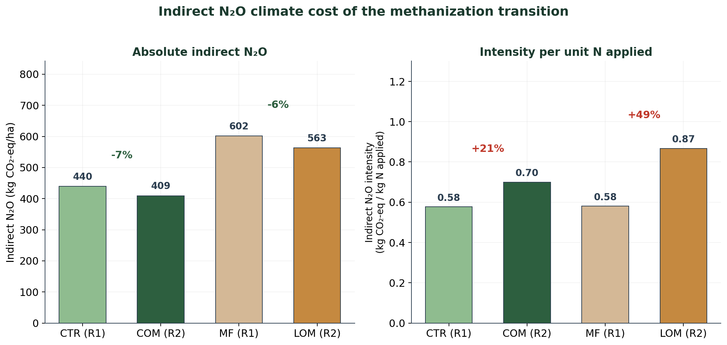
Result 6 — Indirect N₂O climate cost
NH₃ loss returns as N₂O · closing the nitrogen cascade
4,830
kg CO₂-eq ha⁻¹
platform total indirect N₂O
range: 966 – 8,691 (EF₄ uncertainty)
The chain
N₂O = NH₃-N × EF₄
× 44/28 × GWP₁₀₀
EF₄ = 0.010 (IPCC 2019)
GWP₁₀₀ = 273 (AR6)
Transition intensity:
CTR→COM: +21%
MF→LOM: +49%
Trajectoire NH₃ · AgroParisTech · INRAE

Slide 11

Conclusions
1
2
3
4
Complete inventory
1,125.5 kg NH₃-N/ha
Transition raises intensity
+21% (COM), +49% (LOM)
Digestate drives risk
~2× slurry, same technique
Climate cost is real
~4,830 kg CO₂-eq/ha
Perspectives
Pre-treatment
Application timing
Direct measurement
Acidification of digestate reduces pH and TAN, cutting volatilization at source
Prefer cool seasons — spring/autumn instead of summer to reduce warm-weather peaks
Validate high-risk events (summer digestate) with field NH₃ measurements
Fangueiro et al. (2015)
Sommer & Hutchings (2001)
Hafner et al. (2025)
Trajectoire NH₃ · AgroParisTech · INRAE

Slide 12
Part 2 · Personal experience
Expectations & first impressions
Before arriving
What I found
My goals
• Contribute to a real environmental problem
• Learn how European research is organised
• Improve my English scientific writing
What I hoped to gain
• Hands-on modelling experience
• A network in the agri-environmental field
• A clearer sense of my next steps
The research unit
• A collaborative, open working culture
• Access to a real field platform
• Freedom to shape my project
The country
• Different rhythm: slower mornings, longer lunches
• Public transport made everything feel close
• Language: not knowing French forced me out of my comfort zone
Trajectoire NH₃ · AgroParisTech · INRAE

Slide 13
Part 2 · Personal experience
Cultural & academic differences
Everyday culture
Research culture
Working style
• Meals are social, long shared lunches at the lab
• Small talk is short, direct opinions are welcome
• Public spaces (markets, parks) shape social life
• Regular seminars, open discussion of results
• Interdisciplinary teams: agronomy, chemistry, modelling
• Clear separation between work and personal life
• Reproducibility and traceability strongly valued
• Version control, shared drives, documented workflows
Trajectoire NH₃ · AgroParisTech · INRAE

Slide 14


Part 2 · Personal experience
Skills, challenges & lessons
Skills I gained
Challenges I faced
• Running two very different models on the same dataset
• Building an auditable database with reversible corrections
• Communicating results clearly in English
• Language barrier, much of the day in French
• Discovering a data classification error mid-project
• Managing a long analysis without losing the main thread
• Being far from home for the first extended period
Lessons I carry forward
→ Scientific integrity is a habit: correcting an error strengthens the work, not weakens it
→ Framing matters as much as data: absolute vs intensity told opposite stories from the same numbers
→ Being uncomfortable in a new culture is where growth happens
→ I want to keep working at the interface between environmental modelling and applied agronomy
Trajectoire NH₃ · AgroParisTech · INRAE

Slide 15
References
European Environment Agency (2023). EMEP/EEA air pollutant emission inventory guidebook 2023. Publications Office of the European Union. https://www.eea.europa.eu/publications/emep-eea-guidebook-2023 Baojing Gu et al. ,Abating ammonia is more cost-effective than nitrogen oxides for mitigating PM2.5 air pollution.Science374,758-762(2021).DOI:10.1126/science.abf8623 Hafner, S. D., Pacholski, A., Bittman, S., et al. The ALFAM2 database on ammonia emission from field-applied manure: Description and illustrative analysis, Agricultural and Forest Meteorology, Volume 258, Pages 66-79, ISSN 0168-1923, https://doi.org/10.1016/j.agrformet.2017.11.027
Hafner, S. D., Pacholski, A., Bittman, S., Carozzi, M., et al. (2019). A flexible semi-empirical model for estimating ammonia volatilization from field-applied slurry. Atmospheric Environment, Volume 199, Pages 474-484, ISSN 1352-2310, https://doi.org/10.1016/j.atmosenv.2018.11.034 Hafner, S. D., Pedersen, J., Fuß, R., et al. (2025). Improved tools for estimation of ammonia emission from field-applied animal slurry: refinement of the ALFAM2 model and database. Atmospheric Environment, Volume 340, 120910, ISSN 1352-2310, https://doi.org/10.1016/j.atmosenv.2024.120910
Intergovernmental Panel on Climate Change (2019). 2019 Refinement to the 2006 IPCC Guidelines for National Greenhouse Gas Inventories: Vol. 4, Ch. 11. IPCC, Geneva. https://www.ipcc-nggip.iges.or.jp/public/2019rf/pdf/4_Volume4/19R_V4_Ch11_Soils_N2O_CO2.pdf Möller, K. and Müller, T. (2012), Effects of anaerobic digestion on digestate nutrient availability and crop growth: A review. Eng. Life Sci., 12: 242-257. https://doi.org/10.1002/elsc.201100085 Sommer, S. G., & Hutchings, N. J. (2001). Ammonia emission from field applied manure and its reduction. European Journal of Agronomy, Volume 15, Issue 1, Pages 1-15, ISSN 1161-0301, https://doi.org/10.1016/S1161-0301(01)00112-5.
Fangueiro D, Hjorth M, Gioelli F. Acidification of animal slurry--a review. J Environ Manage. 2015 Feb 1;149:46-56. doi: 10.1016/j.jenvman.2014.10.001. Epub 2014 Oct 29. PMID: 25463570. AgroParisTech (2024). Trajectoire — Review of the first crop rotation 2017–2022. Experimental farm of AgroParisTech, Grignon.
Trajectoire NH₃ · AgroParisTech · INRAE

Slide 16
Thank you
Daniela Zúñiga-Jiménez · AgroParisTech · UMR ECOSYS (INRAE)

