Slide 1

EPIDEMIC BROADCAST
Biagio Cornacchia
Gianluca Gemini
Matteo Abaterusso

Slide 2
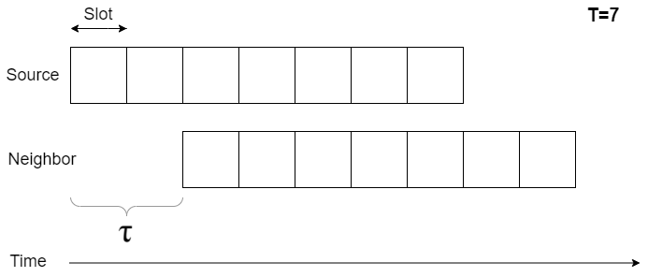
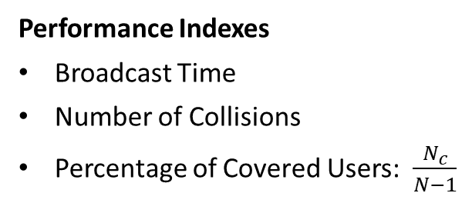
Modeling
Parameters
Radius R
Number of Slots T
Number of Copies m
Number of Users N
General Assumptions
Communications are slotted
Message transmission last one slot
No transmission delay
Collided messages will be dropped
Trickle Relaying policy
Time Windows misaligned for a factor of τ
Users’ positions and τ are uniformly distributed
Performance Indexes
Broadcast Time
Number of Collisions
Percentage of Covered Users: $\frac{N_{c}}{N−1}$

Slide 3
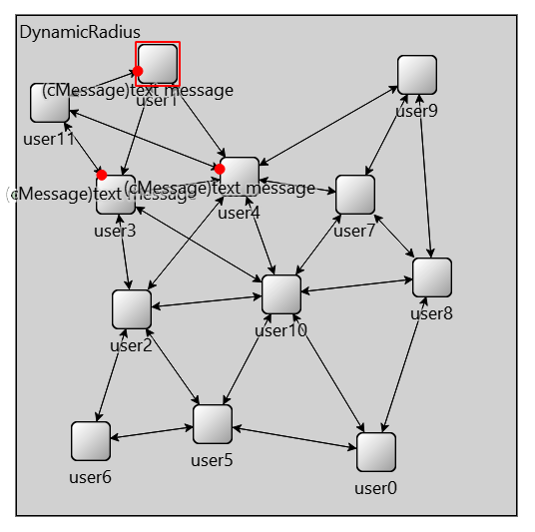
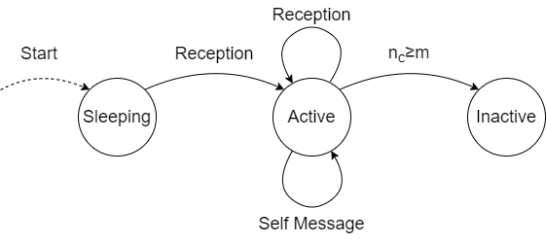
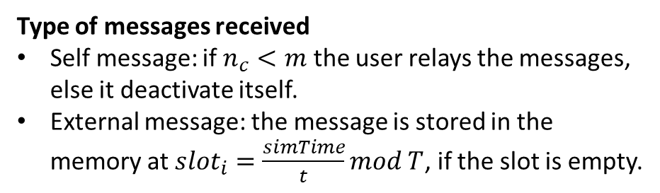
Implementation
Users memory
Messages received (without collisions)
Timestamp receptions
Collisions counter
Network generation
Dynamic Radius
Dynamic Positions
User Module Behavior
Type of messages received
Self message: if $n_{c}<m$ the user relays the messages, else it deactivate itself.
External message: the message is stored in the memory at ${slot}_{i}=\frac{simTime}{t}mod T$, if the slot is empty.

Slide 4
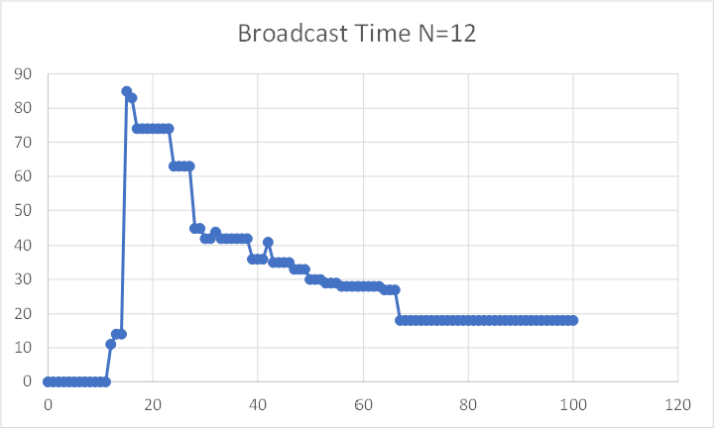
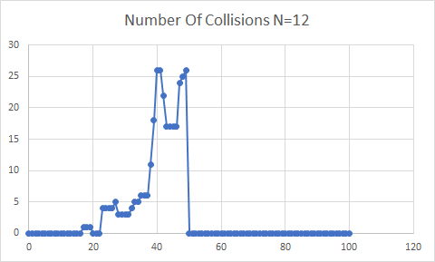
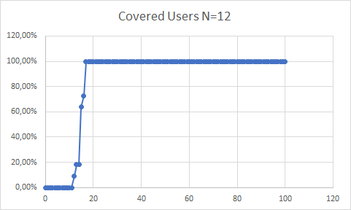
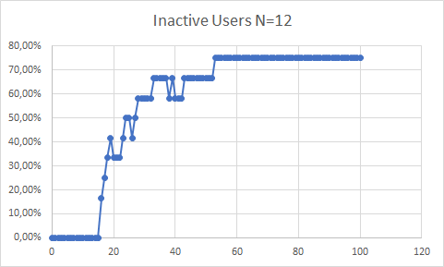
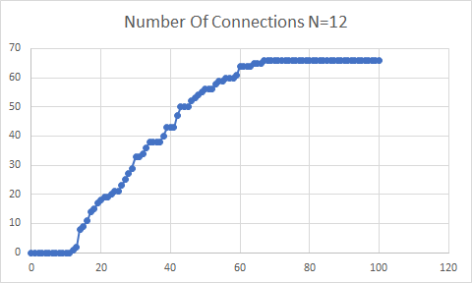


Study on R (1)
$$x_{R}=\frac{R}{d} x_{R}∊[0\%,100\%]$$
R = [0,986] T = 10 m = 3 N = 12
$$x_{R}∈[20\%,70\%]$$

Slide 5
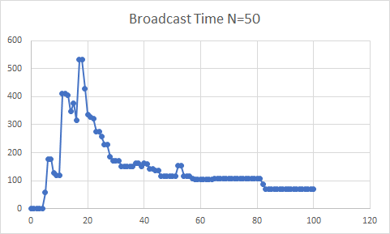
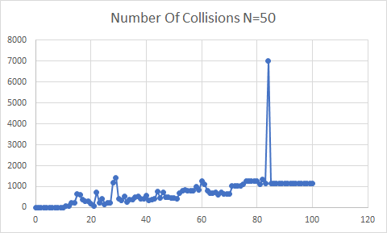
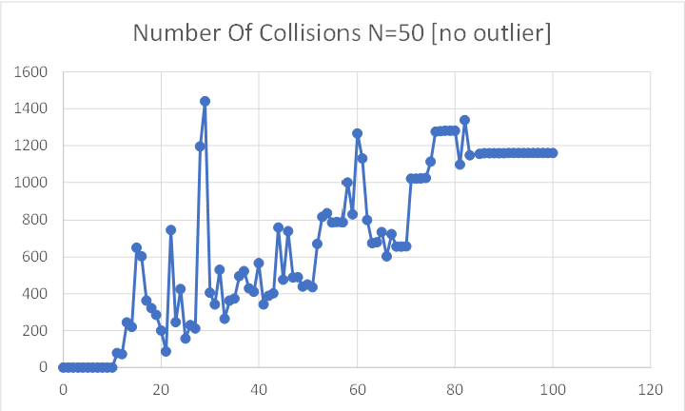
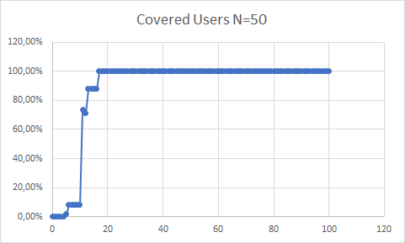
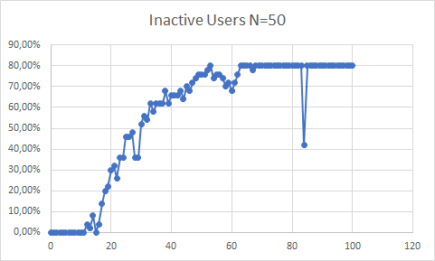
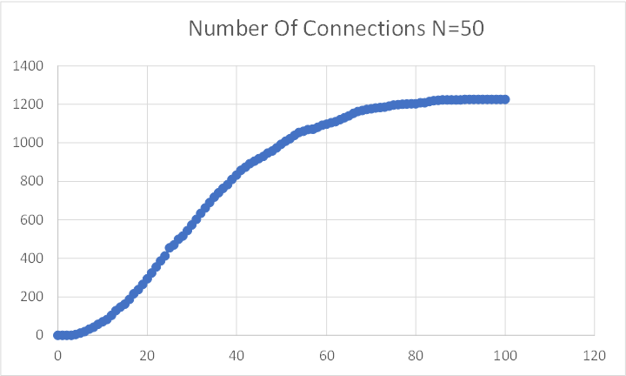


Study on R (2)
$$x_{R}=\frac{R}{d} x_{R}∊[0\%,100\%]$$
R = [0,1118] T = 35 m = 10 N = 50
$$x_{R}∈[20\%,70\%]$$

Slide 6
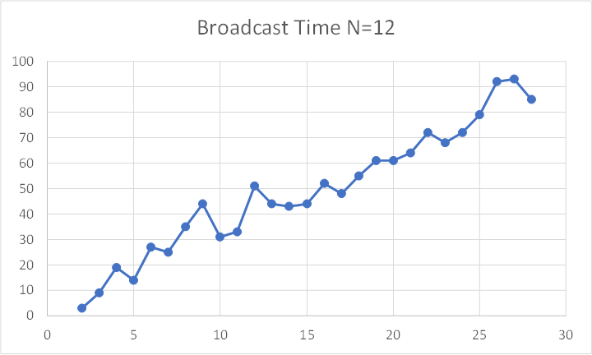
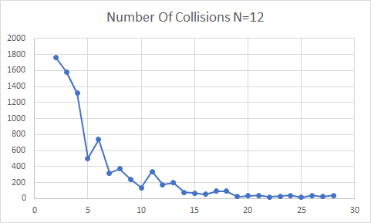
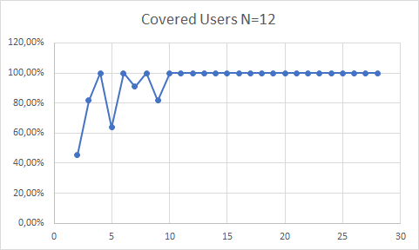
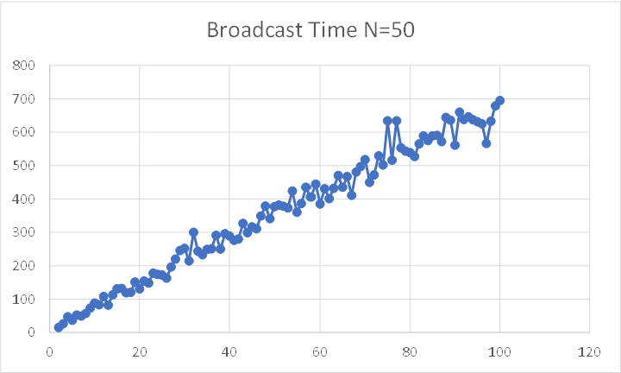
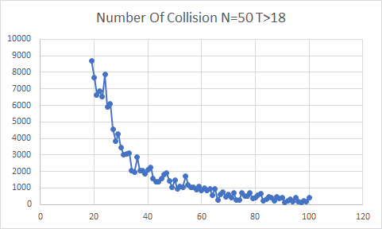
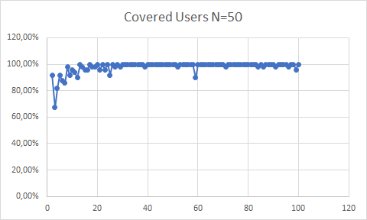



Study on T (1)
$$x_{T}=\frac{T}{D} x_{T}≥0$$
R = 425 T = [2,28] m = 12 N = 12
$$x_{T}∈[35,67]$$
R = 250 T = [2,100] m = 50 N = 50
$$x_{T}∈[40,80]$$

Slide 7
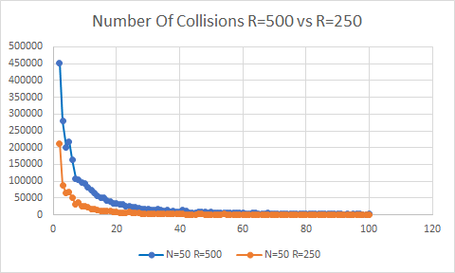
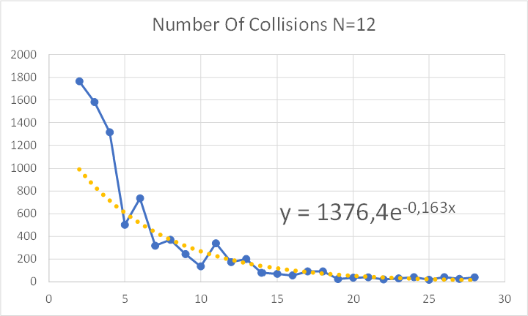
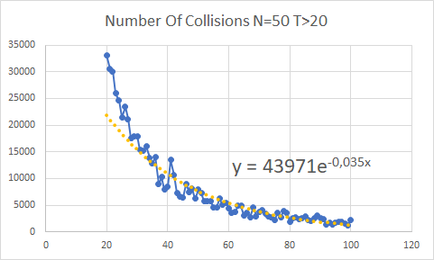
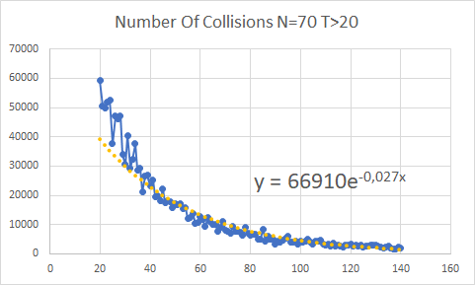

Study on T (2)
$$x_{T}=\frac{T}{D} x_{T}≥0$$
R = 500 T = [2,100] m = 50 N = 50
The translation is mainly influenced by the radius.
increasing N, the velocity at which collisions tend to 0 decreases.
Comparison with increasing of N:

Slide 8
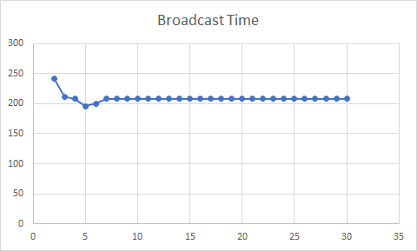
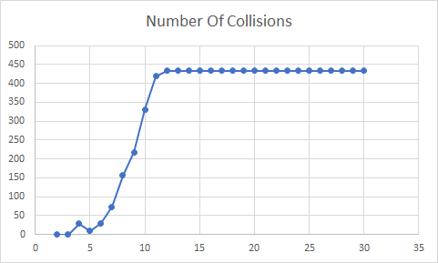
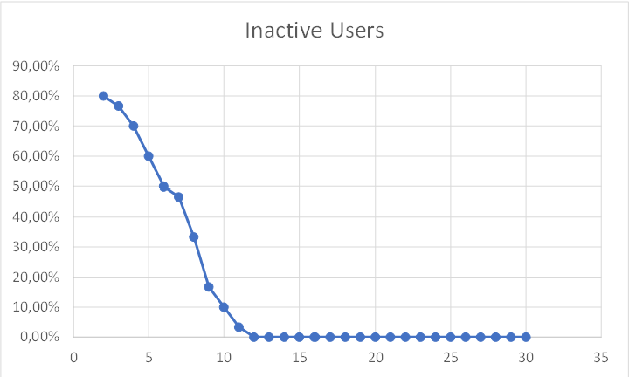
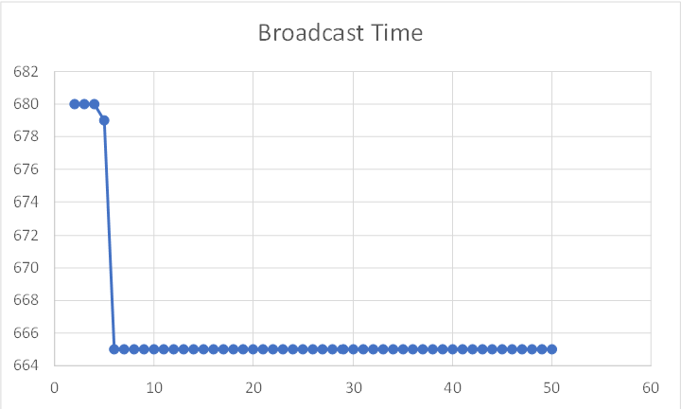
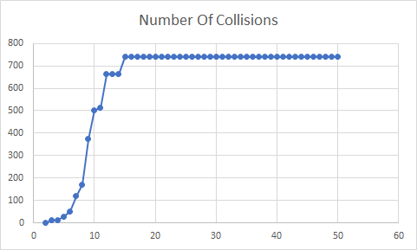
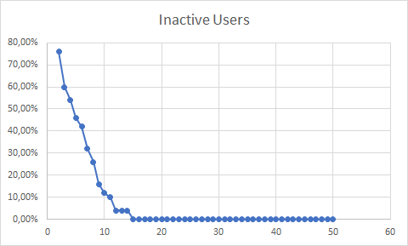



Study on m
$$x_{m}=\frac{m}{min⁡\{N_{n}, N\}}{ N}_{n}=DR^{2}π$$
R = 300 T = 30 m = [2,T] N = 30 (Coverage 100%)
$$x_{m}∈[23\%,71\%]$$
R = 200 T = 50 m = [2,T] N = 50 (Coverage 100%)
$$x_{m}∈[46\%,115\%]$$

Slide 9
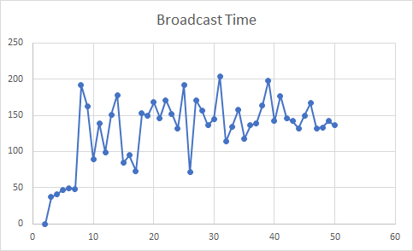
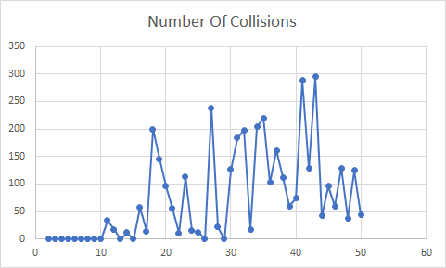
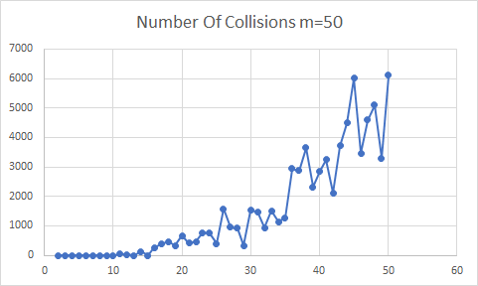
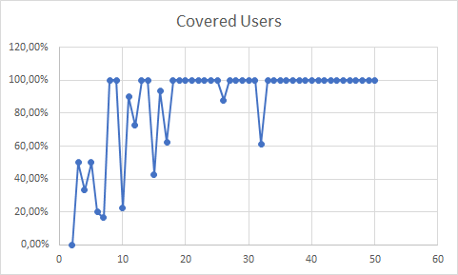
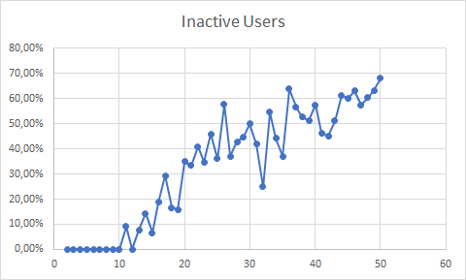
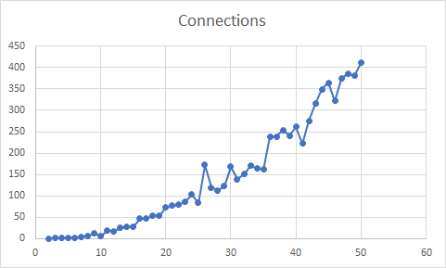



Study on N
$$D=\frac{N}{A} A=floorplan area$$
R = 300 T = $\frac{N_{max}}{2}$ m = $\frac{T}{4}$ N = [2,50]
$$D∈[\frac{2}{5};1]$$

Slide 10
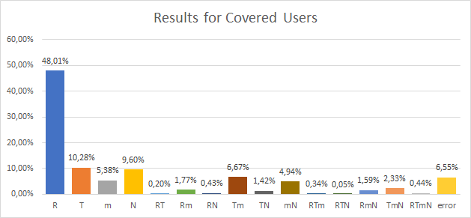
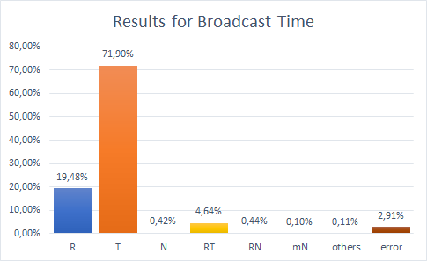
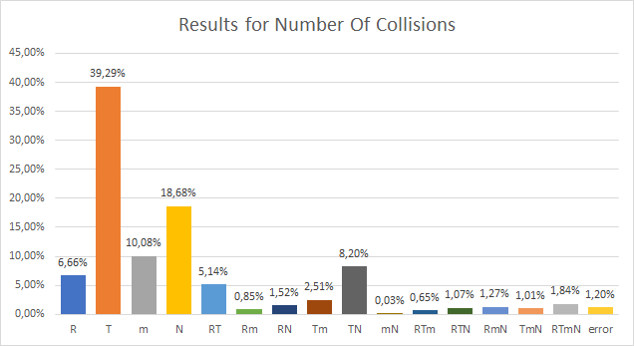
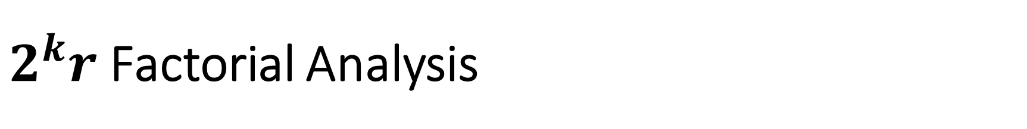
$2^{k}r$ Factorial Analysis
Broadcast Time and Collisions
R = {300, 650}
T = {6, 20}
m = {3, 6}
N = {12, 30}
Covered Users
R = {650, 800}
T = {10, 20}
m = {4, 9}
N = {200, 300}

Slide 11
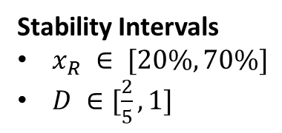
Conclusions
From the results obtained in the measurements can be stated that the choice of the parameters, which influences the broadcast working, has to be weighted respect to the requirements wanted.
Main trade-off
Broadcast time
Number of Collisions
Stability Intervals
$x_{R} ∈ [20\%,70\%]$
$D ∈[\frac{2}{5}, 1]$
Strong dependency between connections and collisions, the increasing of connections:
Allows to reach a better coverage.
Can cause an higher value of collisions, which can imply a lower coverage.
For a low consumption network, it is important the parameter m:
too low m can early block the network, due to the massive deactivation of the users.
too high can cause a low number of deactivations, so a waste of resources.
T allows to:
keep down the number of collisions
increase the number of deactivated users.

