Slide 1
BACKWARD
Nguyễn Văn Dũng

Slide 2
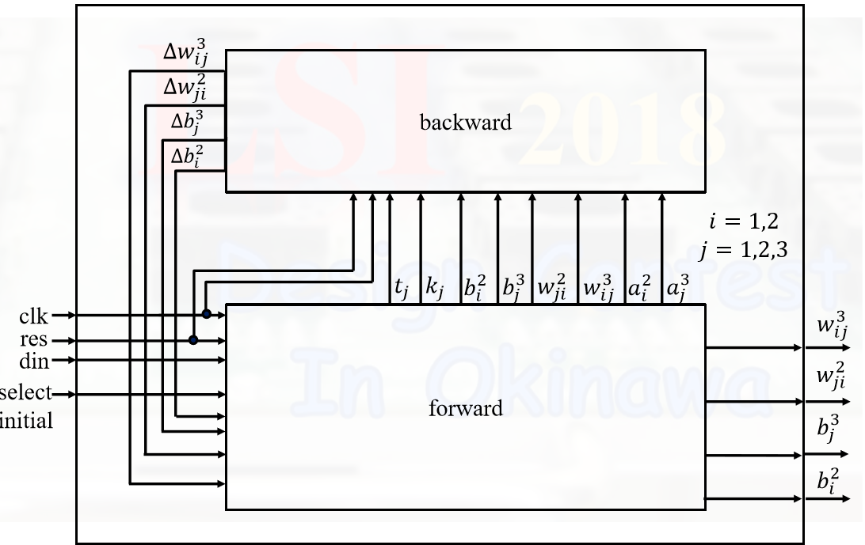
Architecture
Samba: documents/ general infos
SVN: code
Redmine: project management
Gantt: working progress

Slide 3
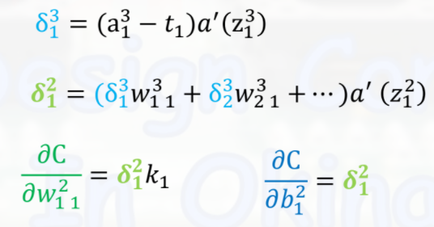
Back propagation

Slide 4
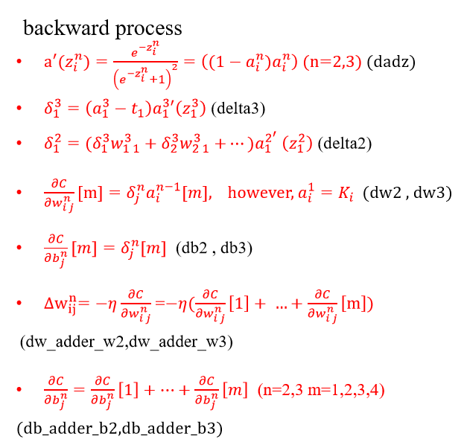
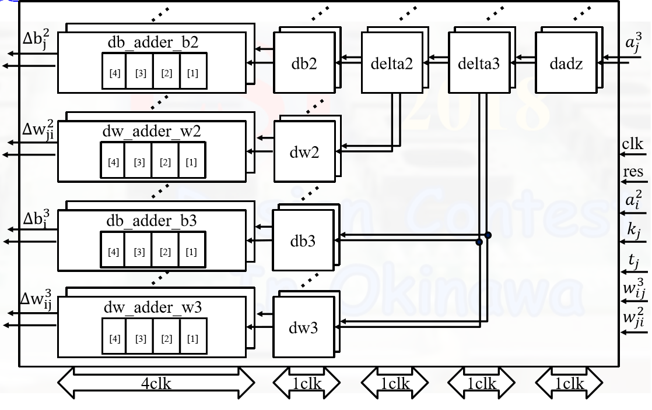
Backward

