Slide 1
Run-Time Power Gating of On-Chip Routers Using Look-Ahead Routing
Hiroki Matsutani - Michihiro Koibuchi
Daihan Wang - Hideharu Amano
(Keio Univ, Japan)

Slide 2
Outline
On-Chip Router
  Architecture
  Power consumption
Runtime power gating of routers
  Overheads
  Look-Ahead sleep control
Evaluations
  Performance penalty
  Compensated sleep cycles
  Leakage reduction

Slide 3
On-Chip Router: Architecture
5-input 5-output router (data width is 64-bit)
Two virtual channels
(64-bit x 4 x 2)
ARBITER
X+
FIFO
X+
X-
FIFO
X-
Y+
FIFO
Y+
Y-
FIFO
Y-
5x5 XBAR
CORE
FIFO
CORE
HW amount is 34 kilo gates and 64% of area is used for FIFO

Slide 4
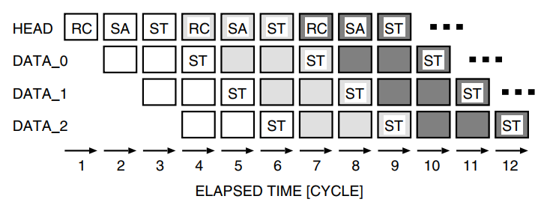
On-Chip Router: Pipeline
A header flit goes through a router in 3 cycles
  RC (Routing Computation)
  SA (Switch Allocation)
  ST (Switch Traversal)
E.g., Packet transfer from router A to C

Slide 5
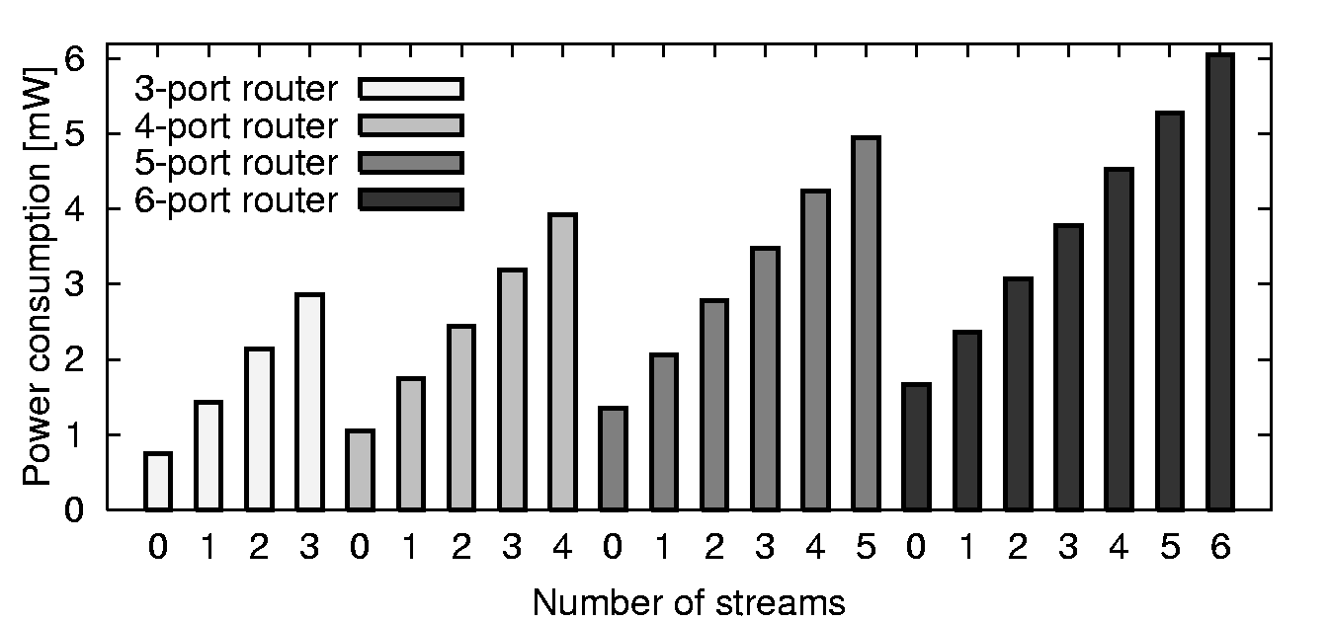
On-Chip Router: Power consumption
Place-and-routed with 90nm CMOS
Post layout simulation at 200MHz
Power consumption of a router when n ports are used [mW]
Notes:
A router consumes more power as the router processes more packets

Slide 6
Outline
Network-on-Chip (NoC)
On-Chip Router
  Architecture
  Power consumption
Runtime power gating of routers
  Basic sleep control
  Look-Ahead sleep control
Evaluations
  Performance penalty
  Compensated sleep cycles
  Leakage reduction

Slide 7
Basic Sleep Control
Basic Routing:
  Router i calculates the output port of Router i
Basic Sleep Control
=> performance penalty due to the wake-up delay
depends on how early the new requests can be detected

Slide 8
Look-Ahead Sleep Control
Look-ahead Routing:
  - Router i calculates the output port of Router i+1
  => To mitigate the wakeup delay and short-term sleeps
Five-cycle margin until packet arrival
R0
R1
R2
RC
SA
ST
RC
SA
ST
RC
Look-Ahead:
R2 detects a packet arrival when the packet arrives at R4
ST
ST
R3
R4
R5
ST
Packet will arrive after two hops
R6
R7
R8
ST
Router 4
Router 5
Router 2
Look-ahead can eliminate a wakeup delay of less than 5-cycle

Slide 9
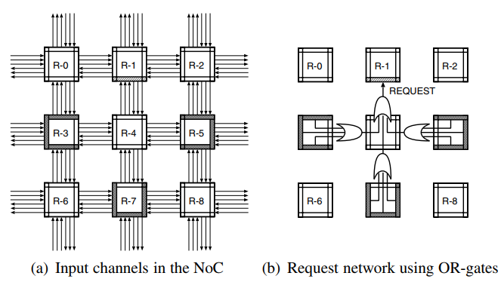
Look-Ahead Sleep Control
Call South channel of router 1 is “target”. The target channel monitor request signal from input channel in router 3, 5, 7 to make decision.
The colored input channel assert their request signal for the target channel when packet destined for router 1.
Critical path twice long, so can using 2 clock cycle to transfer for target channel

Slide 10
Outline
On-Chip Router
  Architecture
  Power consumption
Runtime power gating of routers
  Overheads
  Look-Ahead sleep control
Evaluations
  Performance penalty
  Leakage reduction

Slide 11
Evaluations: Sleep control methods
Evaluation items
  Network throughput
  Leakage reduction
Parameters
Ideal method
  Ideal case
  No wakeup delay
Look-ahead method
  Detects packet arrival 5-cycles ahead
Naïve method
  No look-ahead
Topology | 2-D Mesh (4x4)
Routing | DOR (XY routing)
Packet size | 5-flit (1-flit header)
Buffer size | 4-flit (WH switching)
# of VCs | 2 VCs
Latency | 3-cycle per 1-hop

Slide 12
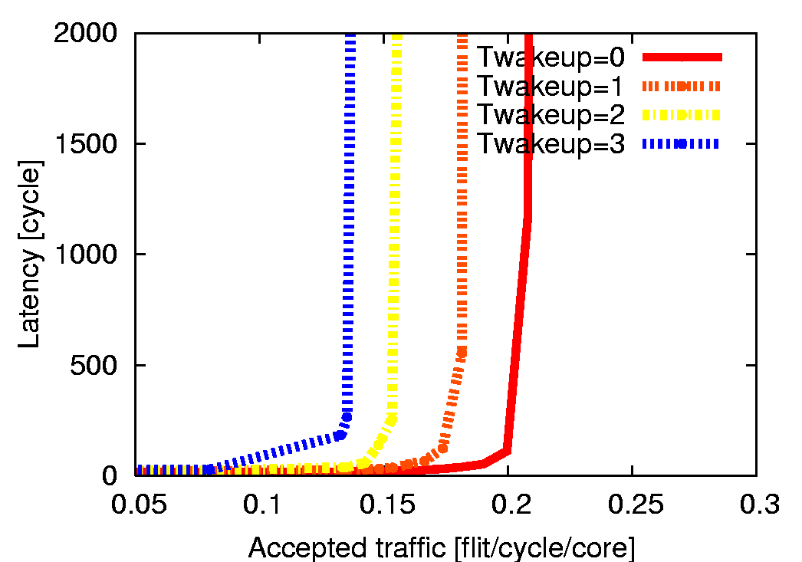
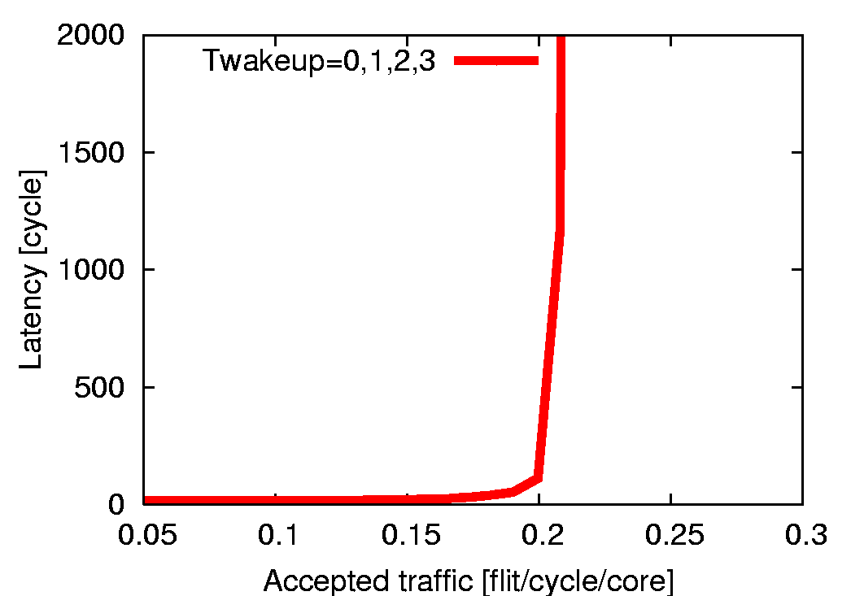
Evaluations: Performance of “lookahead”
Throughput on various wakeup delays (e.g., 0,1,2,3 cycles)
  Naive: Performance is degraded as Twakeup increases
  Ideal: Same
  Look-ahead: Same if Twakeup is less than 5

Slide 13
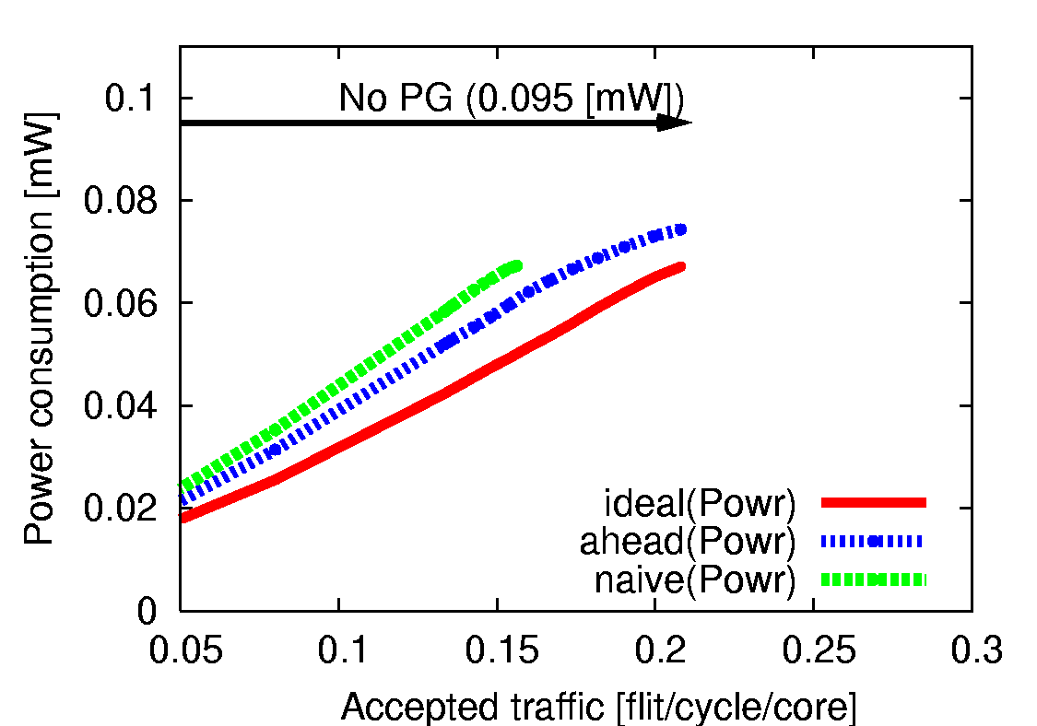
Evaluations: Leakage power reduction
Leakage power at each channel Tbreakeven = 6
  No power gating consumes 95 [uW]
  Leakage reduction of PG with 3 sleep control methods
- Leak increases as traffic increases
=> Ideal <Look-ahead < Naive
Leakage reduction
Uniform traffic (16-core)

Slide 14
Summary: Look-ahead sleep control
Runtime power gating of router channels
  Wakeup delay introduces pipeline stalls of routers
  Short-term sleeps overwhelm the leakage reduction
Look-ahead sleep control
  An extension of “look-ahead routing”
  Detects the arrival of packets five cycles ahead
Evaluation results
  Look-ahead conceals the wakeup delay of less than 5
  Look-ahead reduces more leakage compared with naive

Slide 15
Thank you for your attention

Slide 16
Backup slides

Slide 17
Look-ahead method: HW resources
Routing computation of next router
  Just changing the routing function
  Area overhead is very small
Wakeup signals are needed
  Sender asserts “wakeup” signal
  to receiver
  Wakeup signals becomes long
  Negative impact of
  multi-cycle or repeater buffers
NRC stage: Next Routing Computation
HEAD
NRC
SA
ST
NRC
SA
ST
NRC
SA
ST
DATA 1
ST
ST
ST
DATA 2
ST
ST
ST
0
1
2
3
4
5
6
7
8
Wakeup signals to router 1

Slide 18
Look-ahead method: the 1st hop?
Look-ahead for Router 3, Router 4, Router 5, …
Look-ahead for Router 1 and Router 2
Network interface (NI) performs look-ahead
  Packet construction takes several clock cycles
  NI of source node can perform “look-ahead”
Look-ahead!!
Look-ahead!!
Src
Router (1)
Router (2)
Router (3)
Router (4)
Dst
Look-ahead!!
Src
Router (1)
Router (2)
Router (3)
Router (4)
Dst

