Slide 1
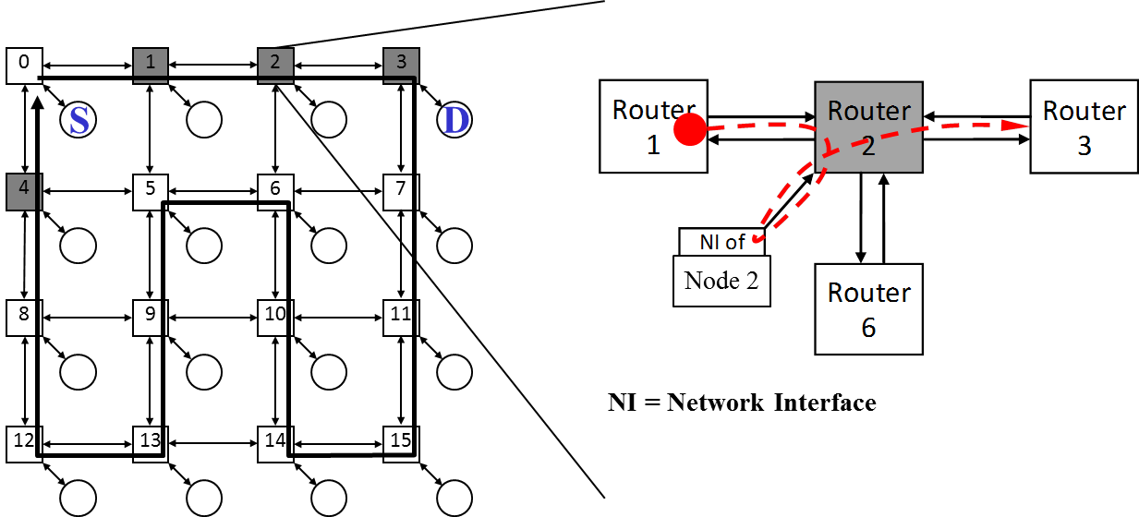
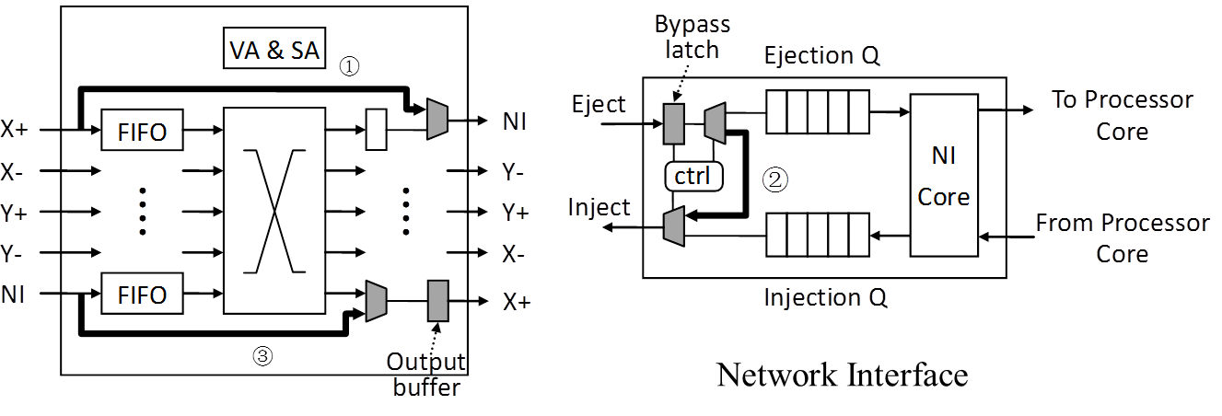
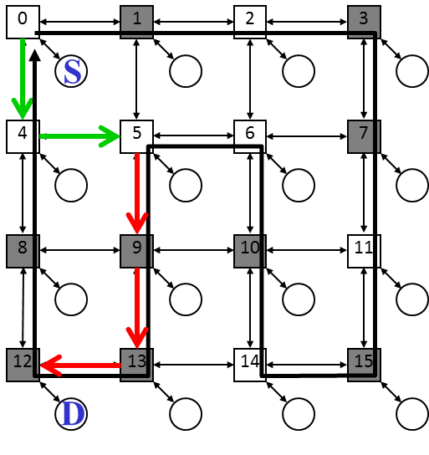
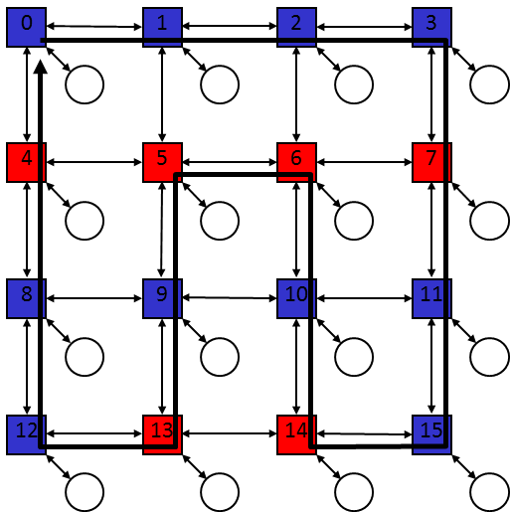
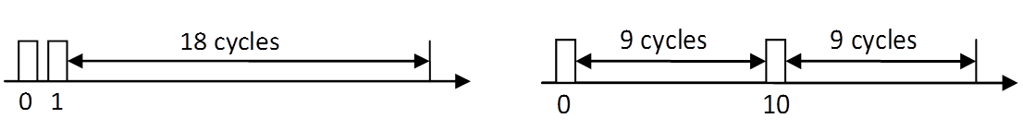
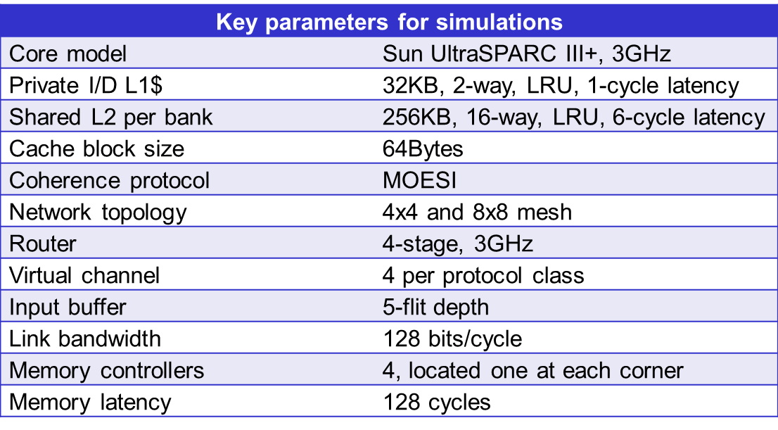
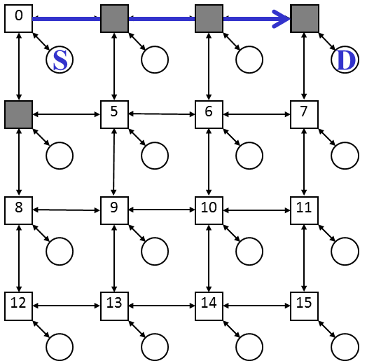
NoRD: Node-Router Decoupling for Effective Power-gating of On-Chip Routers
Lizhong Chen, Timothy M. Pinkston
University of Southern California {lizhongc, tpink}@usc.edu
Abstract
Node-Router Decoupling
Results
While power-gating is a promising technique to mitigate the increasing static power of a chip, a fundamental requirement is for the idle periods to be sufficiently long to compensate for the power-gating and performance overhead. On-chip routers are potentially good targets for power optimizations, but few works have explored effective ways of power-gating them due to the intrinsic dependence between the node and router – any packet (sent, received or forwarded) must wakeup the router before being transferred, thus breaking the potentially long idle period into fragmented intervals. Simulation shows that directly applying conventional power-gating techniques would cause frequent state-transitions and significant energy and performance overhead. In this work, we propose NoRD (Node-Router Decoupling), a novel power-aware on-chip network approach that provides for power-gating bypass to decouple the node’s ability for transferring packets from the powered-on/off status of the associated router, thereby maximizing the length of router idle periods. Full system evaluation using PARSEC benchmarks shows that the proposed approach can substantially reduce the number of state-transitions, completely hide wakeup latency from the critical path of packet transport and eliminate node-network disconnection problems. Compared to an optimized conventional power-gating technique applied to on-chip routers, NoRD can further reduce the router static energy by 29.9% and improve the average packet latency by 26.3%, with only 3% additional area overhead.
Basic Idea:
Breaks the node-router dependence via decoupling bypass paths
Static Energy Savings:
Conv_PG: 51.2%, Conv_PG_OPT : 47.0%, NoRD: 62.9%
Relative improvement of NoRD: 23.9% and 29.9%
Power-gating Overhead Reduction:
NoRD reduces power-gating overhead by over 80%
Overall NoC Energy Savings:
Conv_PG: 9.1%, Conv_PG_OPT: 9.4%, NoRD: 20.6%
Static energy savings vs. dynamic energy losses
Performance:
Average packet latency penalty
- Conv_PG: 63.8%, Conv_PG_OPT: 41.5%, NoRD: 15.2%
Execution time penalty
- Conv_PG: 11.7%, Conv_PG_OPT: 8.1%, NoRD: 3.9%
Chip-level:
A bypass ring connecting all nodes
Receiving : add a bypass path from Bypass Inport to the NI ejection
Sending: add a bypass path from the NI injection to Bypass Outport
Forwarding: packets bypass a gated-off router by using the above two bypass paths together
Router/NI-level:
Two bypass paths and control logic are added
Router is power-gated off when its datapath is empty
Router is turned on when the wakeup metric exceeds a threshold
- VC request rate at the local NI
Low implementation cost (3.1% of router area)
NoC Power Consumption
Routing:
Based on Duato’s Protocol
- Escape resources are comprised of escape VCs of the bypass ring formed by (Bypass Inport, Bypass Outport) pairs
- Other VCs are adaptive resources
Packets on adaptive VCs
- First routed minimally
- If not possible, detoured by one
May still routed on adaptive VCs
- If misrouted hops reach threshold
Forced to enter escape VCs
Packets on escape VCs
- Confined to bypass ring until destination
Increasing NoRD Efficiency:
Routers have different impact on performance based on their location
Classify routers in to performance-centric class and power-centric class
Wake up early a few performance-critical routers to improve performance by adding “shortcuts” in routing
Wake up late the rest (majority) of the routers to save more static power by allowing those routers to stay in gated-off state for a longer time
Use an off-line program based on Floyd-Warshall all-pair shortest path algorithm to classify routers in this work; further exploration can be done for future work
Issue of high NoC power consumption
The increasing static power of on-chip routers
Two Concerns:
Breakeven-time (BET): the minimum number of gated-off idle cycles to offset power-gating energy overhead (~10 cycles for router)
Wakeup latency: around 10 to 15 cycles for router
Problems in Applying Power-gating to Routers:
Intensified BET limitation
- Intermittent packet arrivals break long idle periods into fragments
- For PARSEC, 61% of total number of idle periods is below BET
Cumulative wakeup latency in multi-hop NoCs
- Worse for larger networks
Disconnection problem
- Idle period is upper bounded by
local node’s traffic
- Disconnected network
Canonical router at 45nm and 1.0V
The left figures shows the classification of routers:
The red ones are performance-centric routers
The blue ones are
power-centric routers
Power-gating Challenges
Advantages of NoRD: Solving All Three Problems:
Mitigate BET limitation: use bypass paths instead of waking up routers
Hide wakeup latency: use bypass paths while routers are waking up
Eliminate disconnection: all nodes are always connected by bypass ring
Evaluation Methodology
Simulation Platform:
Platform: Simics + Gems (Garnet+Orion2.0)
Workloads: PARSEC 2.0 + Synthetic traffic
Schemes Under Comparison:
No power-gating (No_PG)
Conventional power-gating (Conv_PG)
- Apply power-gating technique conventionally to routers
Optimized conventional power-gating (Conv_PG_OPT)
- Conv_PG + early wakeup (hide some wakeup latency)
Node-router decoupling (NoRD)
Acknowledgements
We thank the anonymous reviewers for their helpful comments and suggestions. We especially acknowledge the efforts of Yuho Jin in creating Simics checkpoints prior to this work. We also thank Li-Shiuan Peh’s research group for their assistance in Orion 2.0. This research was supported, in part, by the National Science Foundation (NSF), grant CCF-0946388.

