Slide 1

Network on Chip (NoC)
ClubNet - November 2003
EE Department, Technion, Israel
Evgeny Bolotin
Supervisors:
Israel Cidon, Ran Ginosar and Avinoam Kolodny

Slide 2
Outline
Motivation – SoC Communication
Current Solutions
NoC Concept
QNoC Arch. & Design Process
QNoC Example
NoC Cost
Summary

Slide 3
Growing Chip Density
1998
Asic - 0.35 μm
2003
SoC - 0.1 μm
Memory, I/O
P
Design complexity - high IP reuse
Efficient high performance interconnect
Scalability of communication architecture

Slide 4
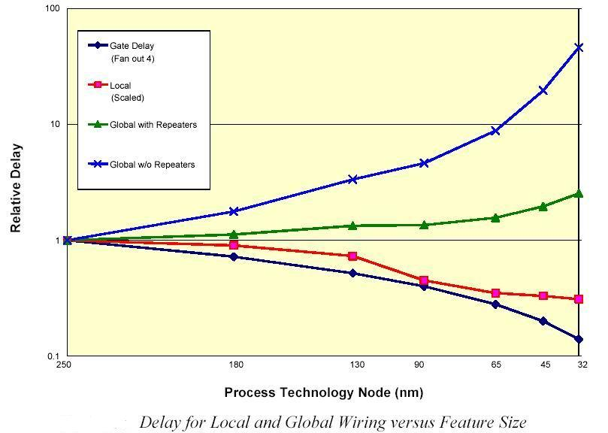
The Growing Gap:
Computation vs. Communication
Taken From ITRS, 2001

Slide 5

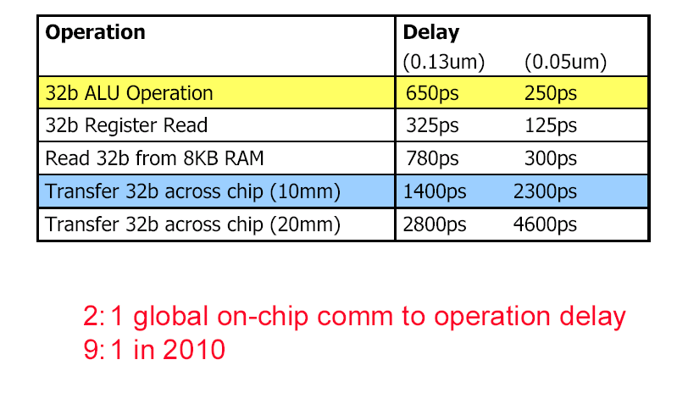
The Gap: Something to think about
Taken from W.J. Dally presentation: Computer architecture is all about interconnect (it is now and it will be more so in 2010) HPCA Panel February 4, 2002

Slide 6
SoC Interconnect
Interconnect Dominates Delay and Power in VDSM
Doesn’t Scale with Technology:
  interconnect power + delay more dominant as the technology improves
Globally Asynchronous Locally Synchronous (GALS ) Systems
  distributed systems on single silicon substrate

Slide 7
“Bus Inheritance”
P
P
From Board level into Chip level…

Slide 8
Typical Solution-Bus
Shared Bus
B
Segmented Bus
B

Slide 9
Typical Solution-Bus
Multi-Level
Segmented
Bus
B
Segmented Bus
B
B
B
Original bus features:
One transaction at a time
Central Arbiter
Limited bandwidth
Synchronous
Low cost
New features:
Versatile bus architectures
Pipelining capability
Burst transfer
Split transactions
Transaction preemption and resume
Transaction reordering…
Is it still?

Slide 10
Well-known Industry Solutions
AMBA (Advanced Microcontroller Bus Architecture)
Ownership: ARM
SiliconBackplane μNetwork
Ownership: Sonics
Core-Connect
Ownership: IBM

Slide 11
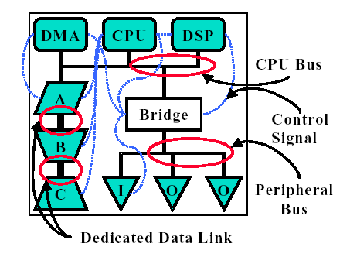
Traditional SoC Nightmare
Variety of dedicated interfaces
Poor separation between computation and communication.
Design Complexity
Unpredictable performance

Slide 12
Solution – Network on Chip
Networks are preferred over buses:
Higher bandwidth
Concurrency, effective spatial reuse of resources
Higher levels of abstraction
Modularity - Design Productivity Improvement
Scalability

Slide 13
Solution – Network on Chip
Requirements:
Different QoS must be supported
  Bandwidth
  Latency
Distributed deadlock free routing
Distributed congestion/flow control
Low VLSI Cost

Slide 14
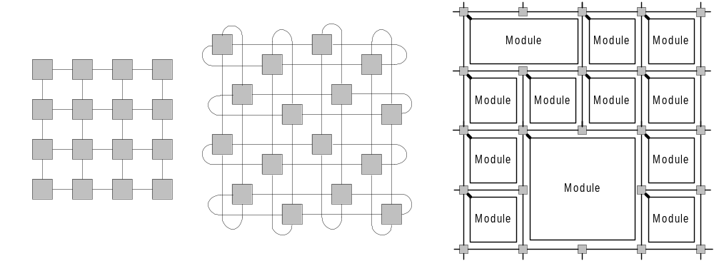
NoC vs. “Off-Chip” Networks
What is Different?
Routers on Planar Grid Topology
Short PTP Links between routers
Unique VLSI Cost Sensitivity:
    Area-Routers and Links
    Power

Slide 15
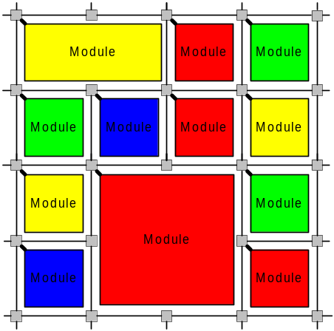
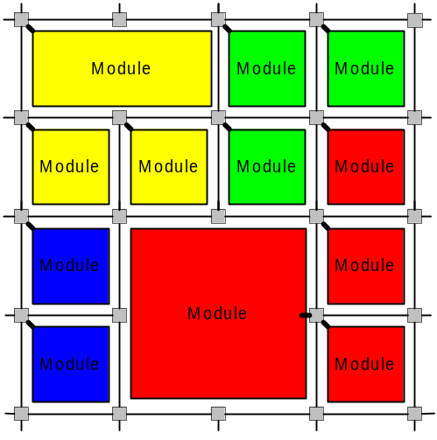
NoC vs. “Off-Chip Networks”
No legacy protocols to be compliant with …
No software → simple and hardware efficient protocols
Different operating env. (no dynamic changes and failures)
Custom Network Design – You design what you need!
Example1: Replace modules
Replace

Slide 16
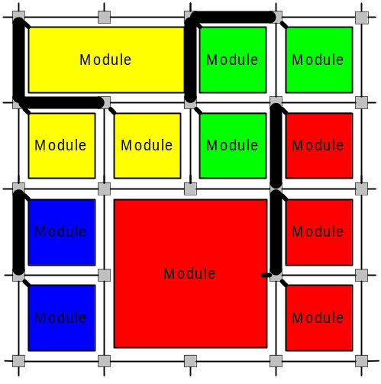
NoC vs. “Off-Chip Networks”
Example2: Adapt Links
Adapt Links
Example3: Trim Unnecessary (ports, buffers, routers, links)

Slide 17
QNoC: QoS NoC
Define Service Levels (SLs):
Signaling
Real-Time
Read/Write (RD/WR)
Block-Transfer
Different QoS for each SL

Slide 18
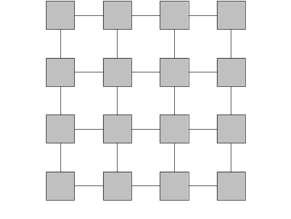
QNoC Architecture
Mesh Topology
Fixed shortest path routing (X-Y)
  Simple Router (no tables, simple logic)
  Power efficient communication
  No deadlock scenario

Slide 19
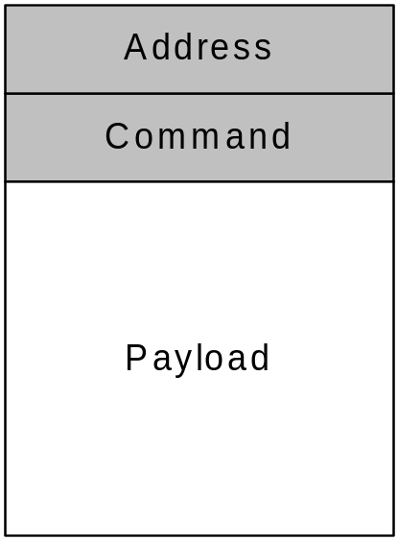
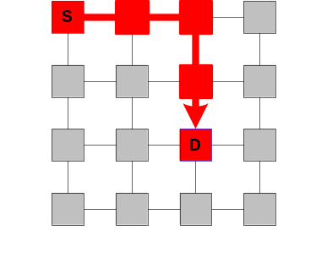
QNoC Architecture
Wormhole Routing
  For reduced buffering
Wormhole Packet:
Flit (routing info)
Flit
Flit
Flit
Flit
Flit

Slide 20
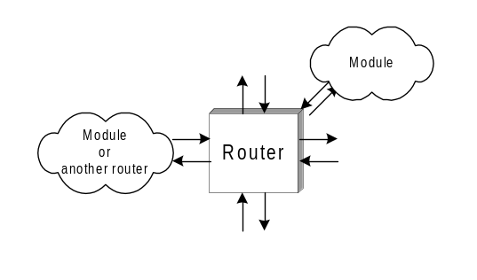
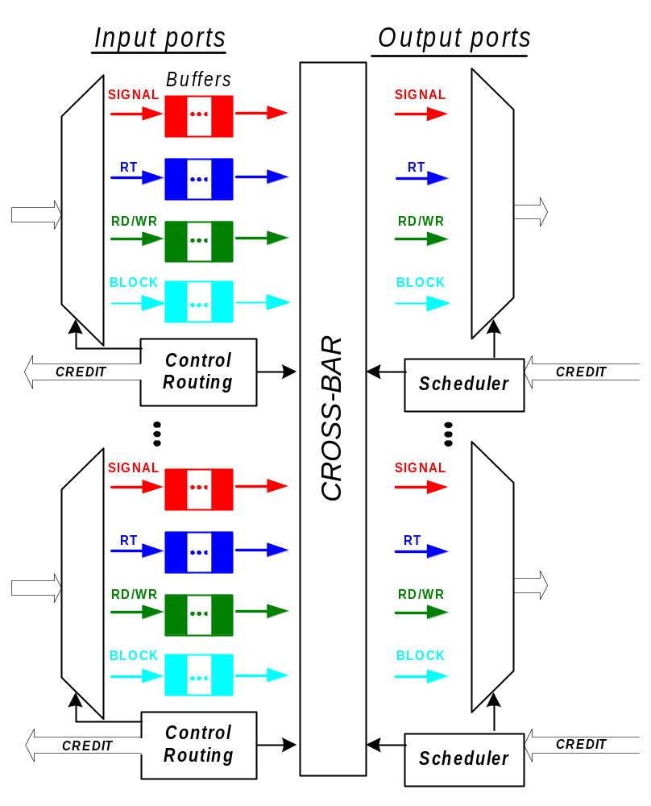
QNoC Wormhole Router

Slide 21
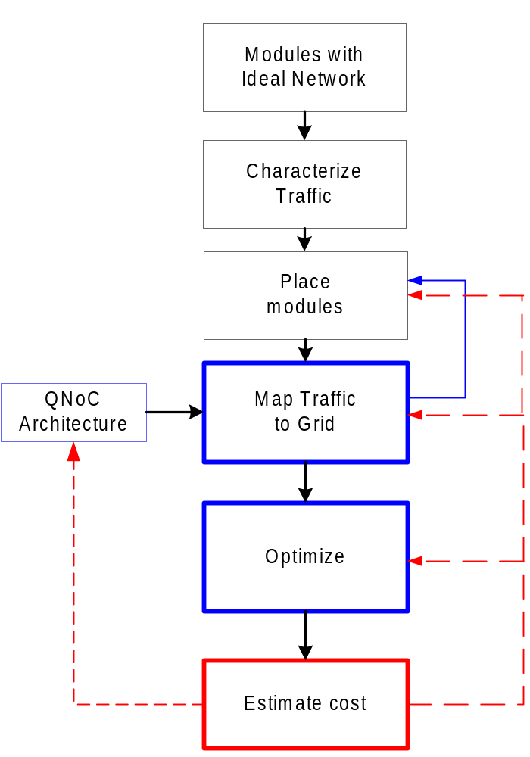
QNoC Design Process
Take full network and customize
using a-priori known parameters

Slide 22
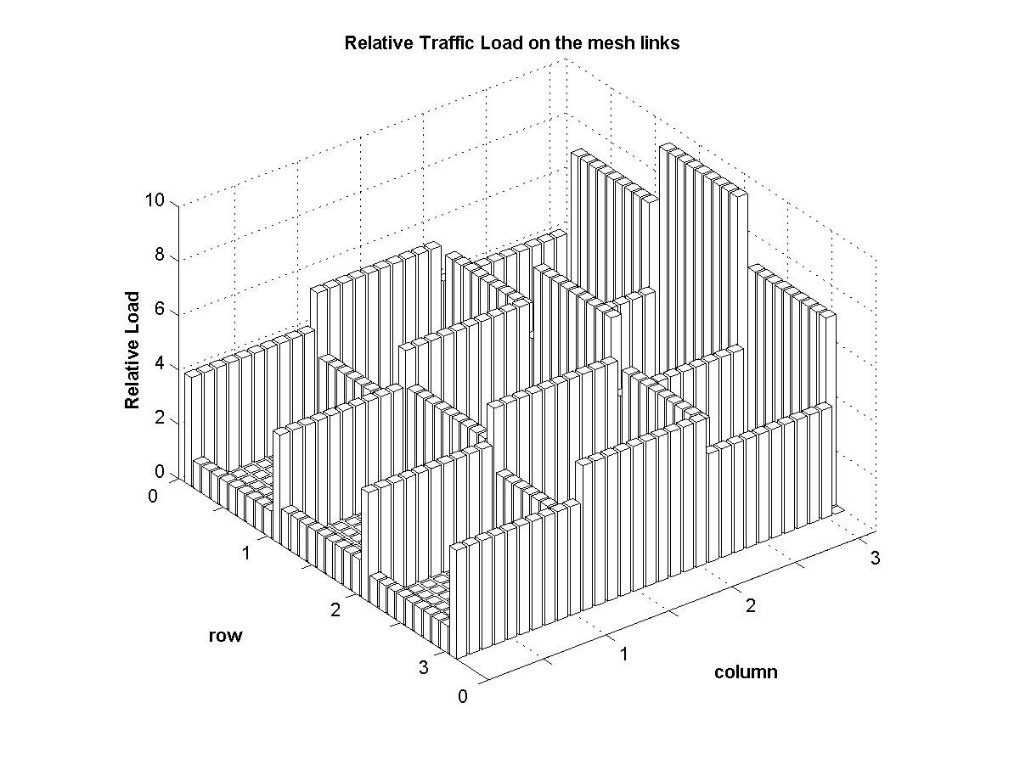
QNoC Design Process - Optimization
Trim Unnecessary Resources
Adjust each link capacity according to its load
  Equal link utilization across the chip
Example: (Uniform mesh)

Slide 23
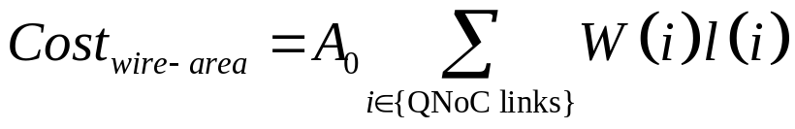
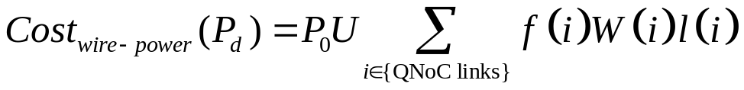
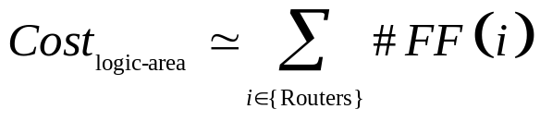
QNoC Design Process - Cost est.
QNoC Cost : Total wire-length and FF-count
Wire cost ~ wire-length
Dynamic Power ~ wire-length and U
Logic Cost ~ FF-count

Slide 24
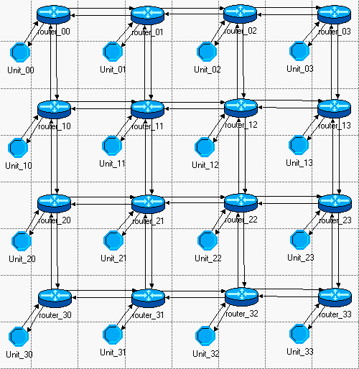
Design Example

Slide 25
Design Example
Representative Design Example, each module contains 4 traffic sources:
Traffic Source | Traffic interpretation | Average Packet Length [flits] | Average Inter-arrival time [ns] | Total Load per Module | ETE requirements For 99.9% of packets
Signaling | Every 100 cycles each module sends interrupt to a random target | 2 | 100 | 320 Mbps | 20 ns (several cycles)
Real-Time | Periodic connection from each module: 320 voice channels of 64 Kb/s | 40 | 2 000 | 320 Mbps | 125 μs (Voice-8 KHz frame)
RD/WR | Random target RD/WR transaction every ~25 cycles. | 4 | 25 | 2.56 Gbps | ~150 ns (tens of cycles)
Block-Transfer | Random target Block-Transfer transaction every ~12 500 cycles . | 2 000 | 12 500 | 2.56 Gbps | 50 µs (Several tx. delays on typ. bus)

Slide 26
Uniform Scenario - Observations
Calculated Link Load Relations:

Slide 27
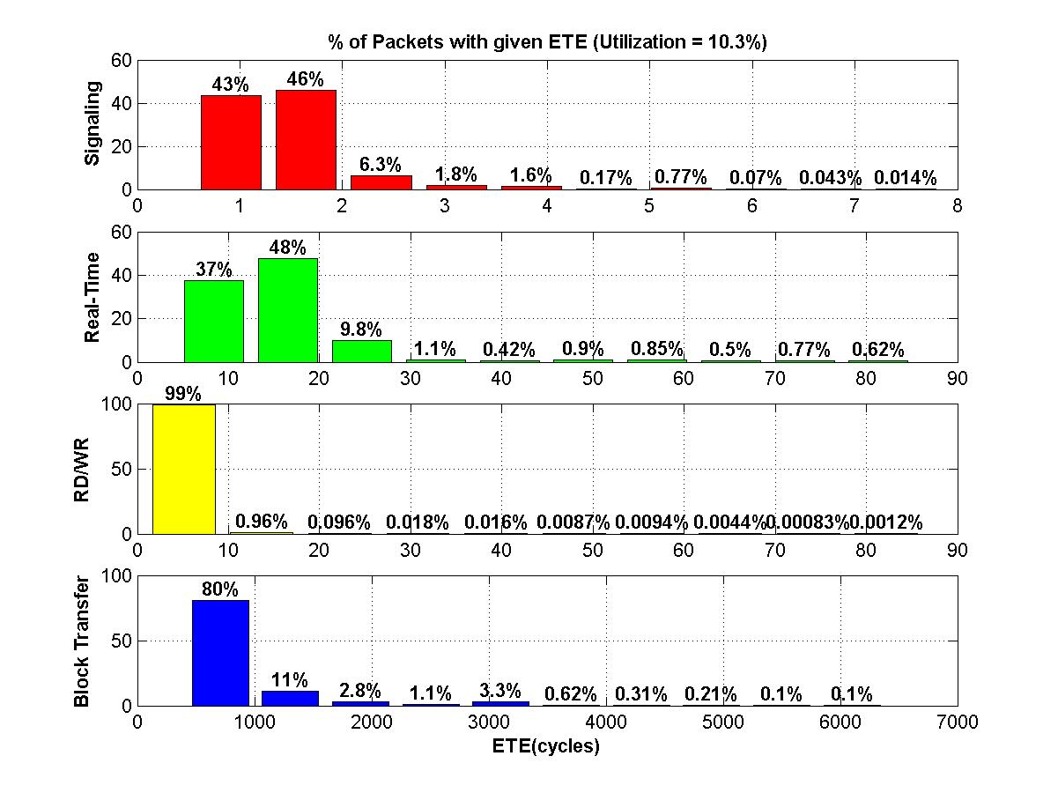
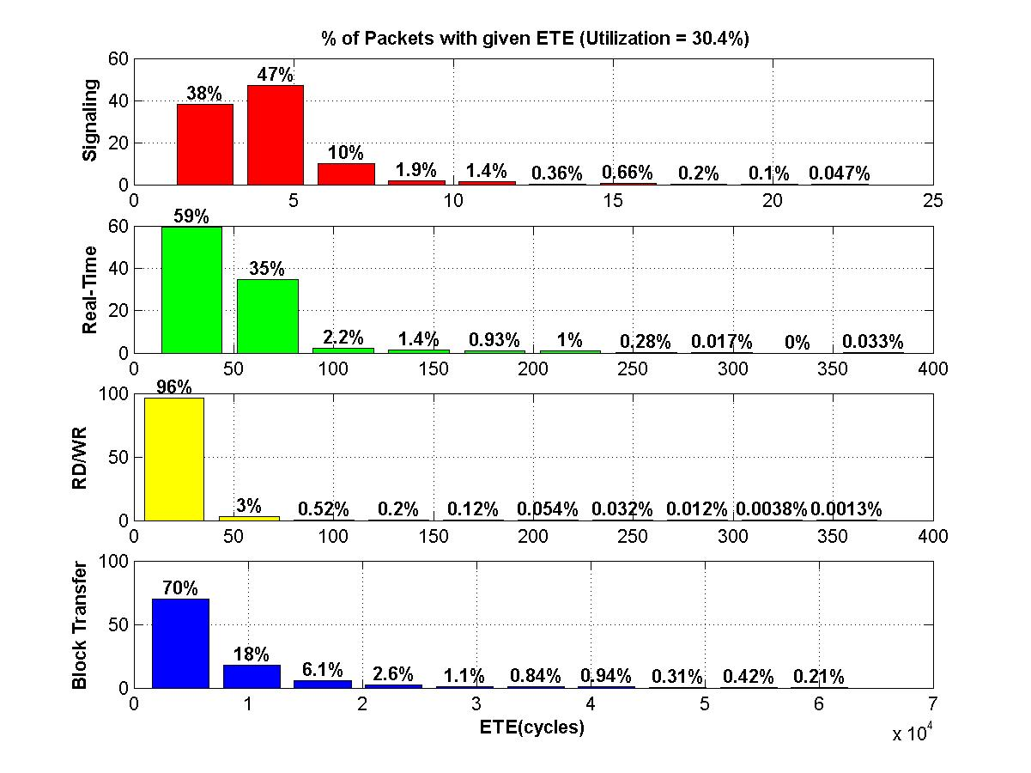
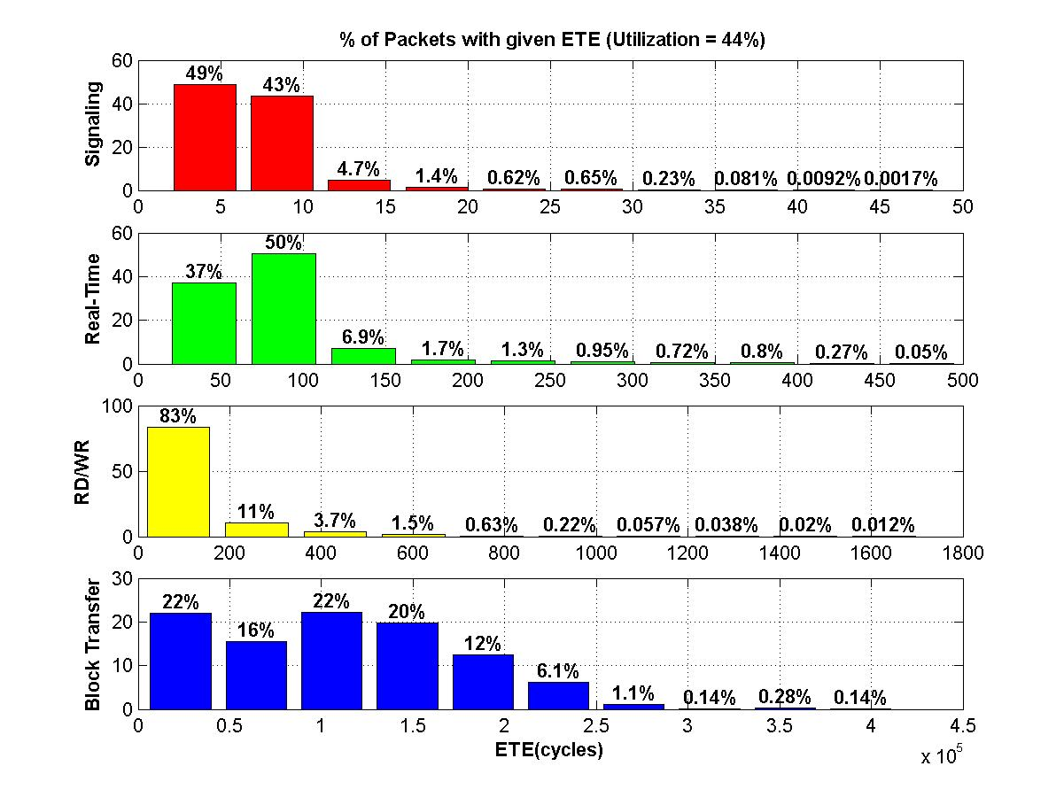
Uniform Scenario - Observations
Various Link BW allocations:
Allocated Link BW [Gbps] | Average Link Utilization [%] | Packet ETE delay of packets [ns or cycles]
 |  | Signaling (99.9%) | Real-Time (99.9%) | RD/WR (99%) | Block-Transfer (99%)
2560Gbps | 10.3 | 6 | 80 | 20 | 4 000
850Gbps | 30.4 | 20 | 250 | 80 | 50 000
512Gbps | 44 | 35 | 450 | 1 000 | 300 000
Desired QoS

Slide 28
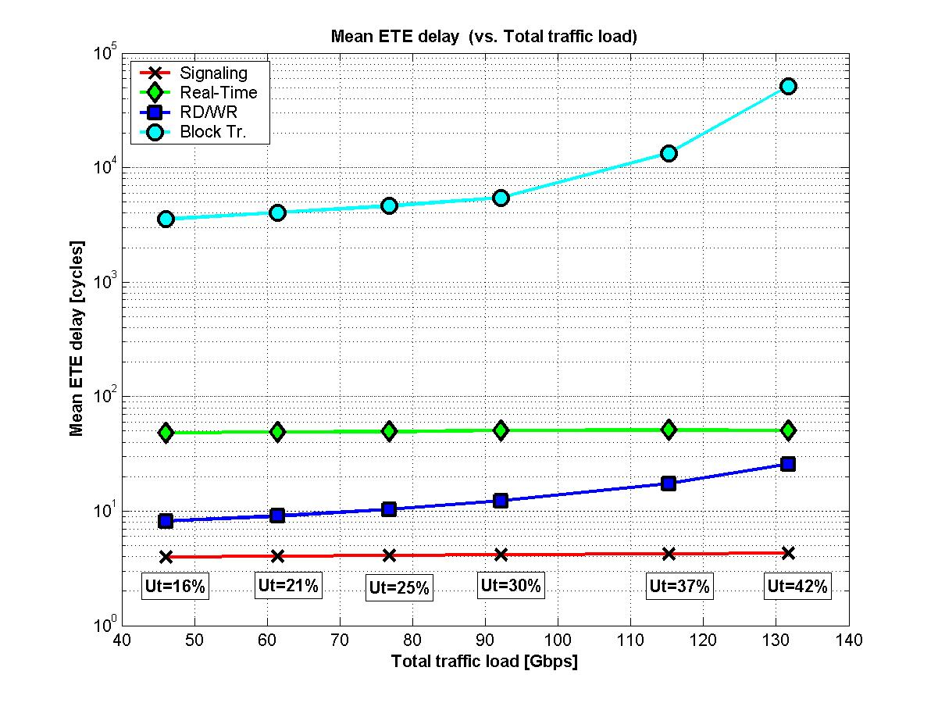
Uniform Scenario - Observations
Fixed Network Configuration -Uniform Traffic
Network behavior under different traffic loads?
BLOCK
ETE
Delay
Real-Time
RD/WR
Signaling
Traffic Load

Slide 29
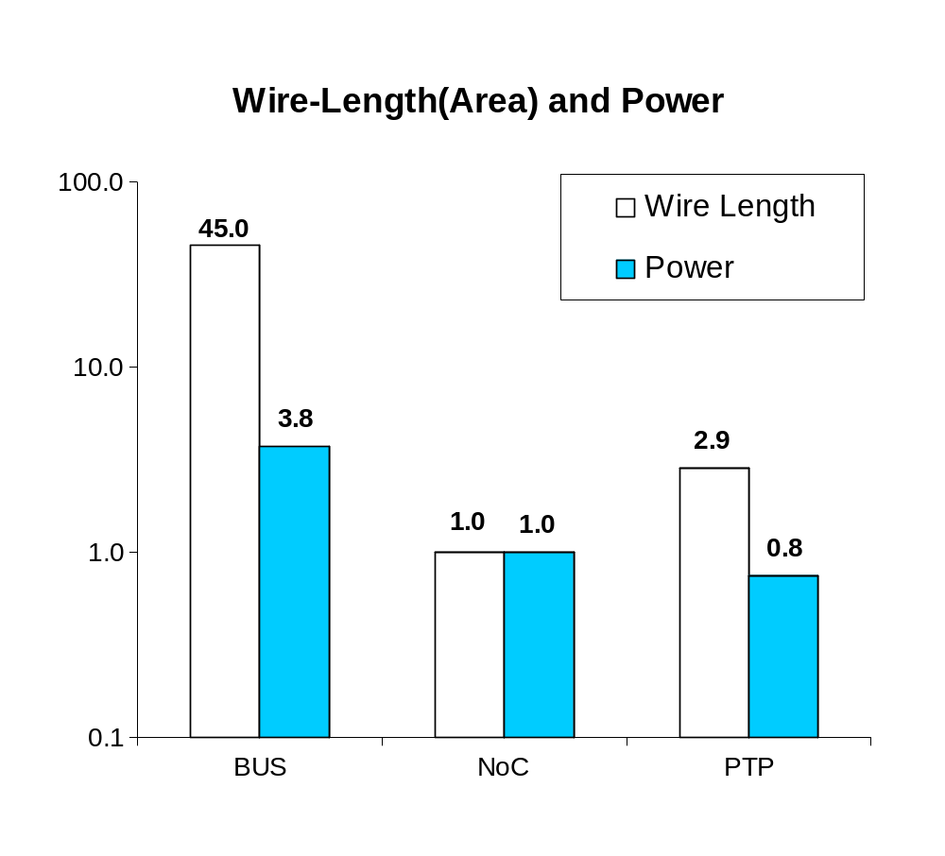
QNoC vs. Alternative Solutions
(4x4 mesh, uniform traffic)
Uniform scenario (Same QoS):
Arch. | Frequency | Utilization | Av. Link Width
QNoC | 1GHz | 30% | 28
Bus | 50 MHz | 50% | 3 700
PTP | 100MHz | 80% | 6
Cost
BUS
QNoC
PTP

Slide 30


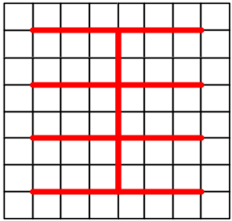
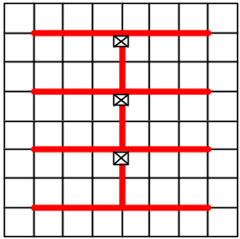
NoC Cost Scalability vs. Alternatives
Compare the cost of:
NoC
Non-Segmented Bus (NS-Bus)
Segmented Bus (S-Bus)
Point-To-Point (PTP)

Slide 31
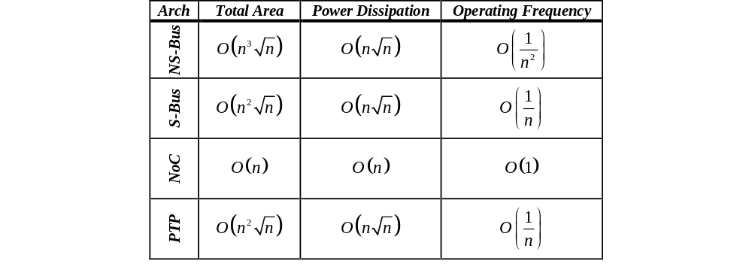
NoC Cost Scalability vs. Alternatives

Slide 32
Summary
Why NoC?
What is Different in NoC
QNoC
NoC is Best

