Slide 1
Networks on Chip : a very quick introduction!
Jeremy Chan
11 May 2005

Slide 2
Overview of Talk
Introduction
  SoC Design Trends (communication centric design)
Communication Centric Design
  Application Modeling
  Energy Modeling
  NoC Optimization
Conclusions

Slide 3
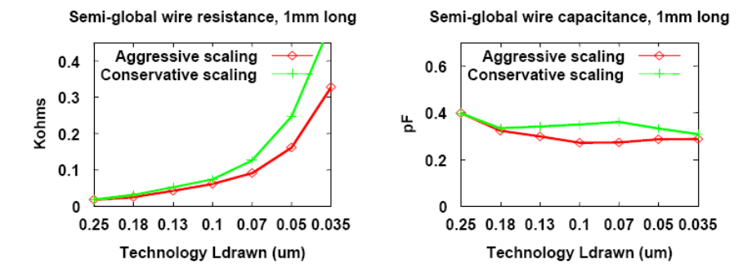
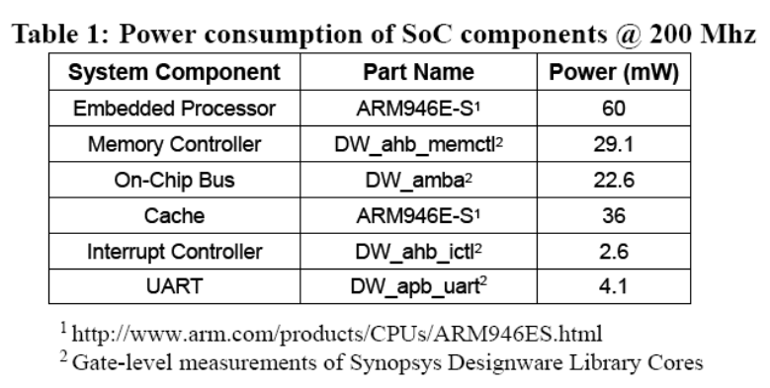
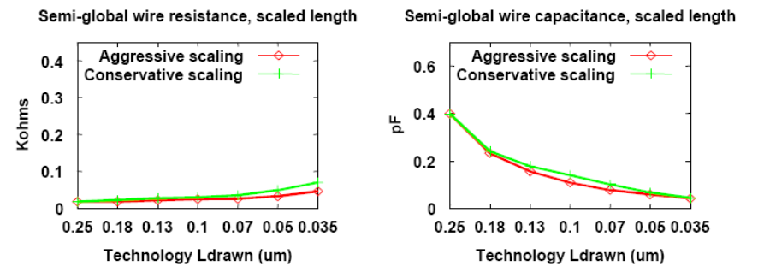
SoC Design Trends
Source: Ron Ho, Stanford 1999
Source: Kanishka Lahiri 2004
Focus on communication-centric design
  Poor wire scaling
  High Performance
  Energy efficiency
    Communication architecture large proportion of energy budget

Slide 4
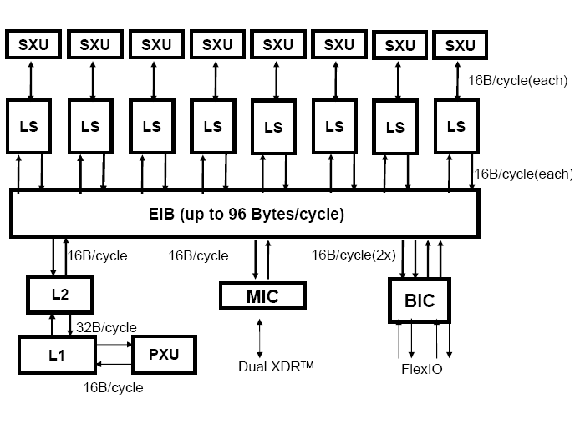
SoC Design Trends
MPSoC: STI Cell
  Eight Synergistic Processing Elements
  Ring-based Element Interconnect Bus
    128-bit, 4 concentric rings
Interconnect delays becoming important
  Pentium 4 has two dedicated drive stages to transport signals across chip
Source: Pham et al ISSCC 2005

Slide 5
The SoC nightmare
System Bus
DMA
CPU
DSP
Mem
Ctrl.
Bridge
The “Board-on-a-Chip”
Approach
The architecture is tightly coupled
MPEG
I
o
o
C
Control Wires
Peripheral Bus
Source: Prof Jan Rabaey CS-252-2000 UC Berkeley

Slide 6
On-chip Communication
Bus-based architectures
Irregular architectures
Regular Architectures
Bus based interconnect
  Low cost
  Easier to Implement
  Flexible
Networks on Chip
  Layered Approach
  Buses replaced with Networked architectures
    Better electrical properties
    Higher bandwidth
    Energy efficiency
    Scalable

Slide 7
Network on Chip
Traffic Modeling
Queuing
Theory
Software
Architectures
Transport
Network
Separation of concerns
Wiring
Networking
Networks on Chip
  Layered Approach
  Buses replaced with Networked architectures
    Better electrical properties
    Higher bandwidth
    Energy efficiency
    Scalable

Slide 8
Regular Network on Chip
PE
PE
PE
Router
PE
PE
PE
PE
PE
PE
PE

Slide 9
Typical NoC Router
Crossbar Switch
FC
LC
LC
FC
FC
LC
LC
FC
FC
LC
LC
FC
Routing
Arbitration

Slide 10
NoC Issues
Crossbar
Switch
FC
LC
LC
FC
LC
FC
FC
LC
LC
FC
FC
LC
Routing
Arbitration
Irregular architectures
Regular Architectures
Application Specific Optimization
  Buffers
  Routing
  Topology
  Mapping to topology
  Implementation and Reuse

Slide 11
NoC Issues
Architecture
  QoS Support
  What topology will suit a particular application?
Fault tolerance
  Gossiping architectures
o1 | o2 | o3 | o4
- | - | - | -
- | I1 | - | -
- | I1 | - | -
- | - | - | -
o1 | o2 | o3 | o4
- | I1 | - | -
- | I3 | - | I1
- | - | - | -
- | - | - | -
BQ
X
GQ
…
BQ
GQ
slot table
arbiter

Slide 12
Communication Centric Design
Application
Architecture Library
Architecture / Application Model
NoC Optimisation
Configure
Refine
Evaluate
Analyse / Profile
Good?
No
Optimized
NoC
Synthesis

Slide 13
How are application described?
ARM:2.5ms
PPC: 2.2ms
Few multiprocessor embedded benchmarks
Task graphs
  Extensively used in scheduling research
    Each node has computation properties
    Directed edge describes task dependences
    Edge properties has communication volume
SRC
15000
FFT
4000
15000
FIR
matrix
82500
IFFT
4000
angle
40000
15000
SINK

Slide 14
Simplifying Application Model
With simple energy model,
  E_{bit} = n_{hops} x E_{Sbit} + (n_{hops} – 1) x E_{Lbit}
  n_{hops} proportional to energy consumption
  Can abstract communication design problem to
PE1
PE2
PE3

Slide 15
Simple Router Energy Models
Hu et al assume:
E_{bit} = E_{Sbit} + E_{Bbit} + E_{Wbit} + E_{Lbit}
Simplifying assumptions:
  Buffer implemented using latches and flip-flops
  Negligible Internal wire energy
  => E_{bit} = E_{Sbit} + E_{Bbit} + E_{Wbit} + E_{Lbit}
Router to Router Energy (minimal routing)
  E_{bit}= n_{hops} x E_{Sbit} + (n_{hops} – 1) x E_{Lbit}

Slide 16
Energy-Aware Task mapping
Reduce Energy Consumption by placing
Addressed by Hu et al 2002:
  Given a CTG and a heterogenous NoC
Find:
  A mapping function M : tasks(T) => PEs (P)
  Assuming the tasks are already scheduled and partitioned
Solution formulated as a quadratic assignment problem and solved using Branch and Bound with heuristics

Slide 17
Energy Model Limitations
Ignore:
  Static energy i.e. leakage power
  Clock energy – flip flops, latches need to be clocked
Buffering Energy is not free
  can consume 50-80% of total communication architecture depending on size and depth of FIFOs

Slide 18
NoC Generation
H
H
HDL Libraries
Graph
Representation
R
R
Routing
Algorithm
R
H
Arbiters
NoC
Generation
Flow
Control
Communication
Architecture
(VHDL)
Given a parameterized NoC architecture and library of NoC components, generate a synthesizable HDL model.

Slide 19
NoC Generation
Most packet switched routers contain similar components that are connected
Can be easily modularized to allow automatic generation

Slide 20
Typical NoC Router
Crossbar Switch
FC
LC
LC
FC
FC
LC
LC
FC
FC
LC
LC
FC
Routing
Arbitration

Slide 21
Current Research
Irregular Topology Generation
  Formulated as MILP problems
  Genetic algorithm Solution
Buffer Allocation Problem
  Assumed Poisson Distributed Traffic
  Used Queuing Theory to Determine Ideal Buffering for Ports => non uniform buffering depths
Integrated solution to optimization problems

Slide 22
Summary
NoC is an exciting research area that will lead to an paradigm shift in SoC design.
NoC research is still in infancy
  Many open research problems
  Need better application and traffic models, new optimization techniques
New Power, Performance, Traffic Models being developed

Slide 23
Thank You

