Slide 1
Networks on Chip : a quick introduction
Abelardo Jara
Jared Bevis
Abraham Sanchez
March 23rd, 2009

Slide 2
Outline - NoC Introduction
NoC Introduction & properties
  NoC buffered flow control
  Routing algorithms
  Application specialization
Using Virtex 4 configuration network as a high-speed MetaWire data network.
  What is MetaWire and why use it?
  Architecture of MetaWire
  MetaWire performance
Implementation And Application Exploration
For Network on Chip
  DES Algorithm
  NoC Implementation
  DES key Search Architectural Details
  Results

Slide 3
Today’s heterogeneous SOCs
The System-on-Chip (SoC) today
  Heterogeneous ~10 IP’s
  Homogeneous (MP-SoC) ~ 10 uP (with exceptions)
  On-Chip BUS (AMBA, Core Connect, Wishbone, …)
  IP and uP are sold with proprietary Bus IF
Near and long-term forecast
  ≥ 100 IP/uP: Busses are non scalable!
  Physical Design issues: signal integrity, power consumption, timing closure
  Clock issues: Is time for the Globally Asynchronous, Locally Synchronous paradigm (GALS)? (Still locally synchronous)
  Need for “more regular” design
CPU
DMA
DSP
MEM
Interconnection network (BUS)
DSP
Dedicated
IP (MPEG)
I/O
Locally synchronous clock domains

Slide 4
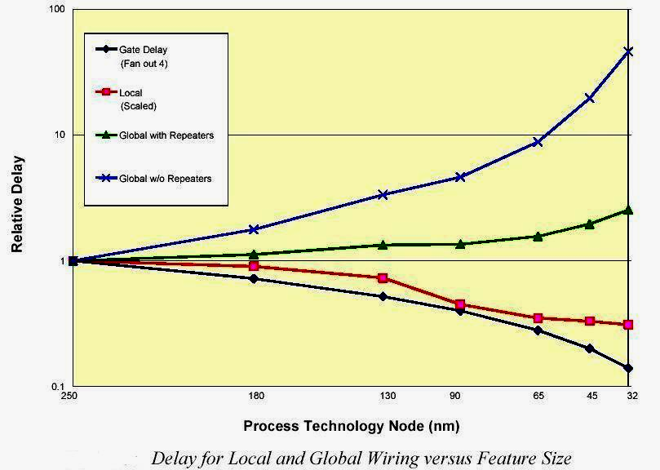
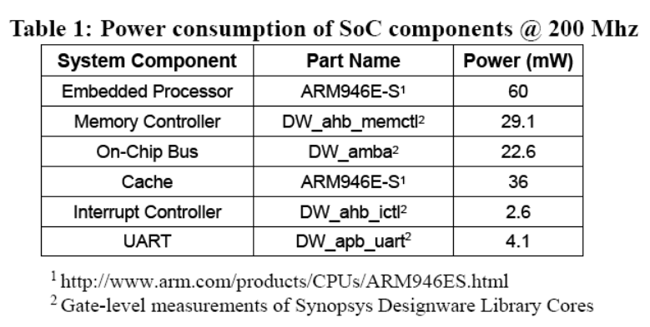
Computation vs Communication: A growing gap
Source: Kanishka Lahiri 2004
Focus on communication-centric design
  Poor wire scaling
    Interconnect power + delay more dominant as the technology improves
  High Performance
  Energy efficiency
    Communication architecture large proportion of energy budget

Slide 5
The SoC nightmare
System Bus
DMA
CPU
DSP
Mem
Ctrl.
Bridge
The “Board-on-a-Chip”
Approach
The architecture is tightly coupled
MPEG
I
o
o
C
Control Wires
Peripheral Bus
Source: Prof Jan Rabaey CS-252-2000 UC Berkeley

Slide 6
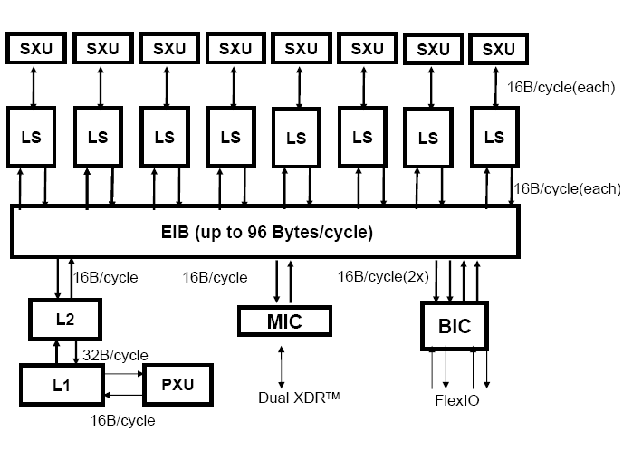
SoC Design Trends
MPSoC: STI Cell
  Eight Synergistic Processing Elements
  Ring-based Element Interconnect Bus
    128-bit, 4 concentric rings
Interconnect delays have become important
  Pentium 4 had two dedicated drive stages to transport signals across chip
Source: Pham et al ISSCC 2005

Slide 7
Evolution or Paradigm Shift?
Network
link
Network
router
Computing
module
Bus
Architectural paradigm shift
  Replace wire spaghetti by an intelligent network infrastructure
Design paradigm shift
  Busses and signals replaced by packets
Organizational paradigm shift
  Create a new discipline, a new infrastructure responsibility

Slide 8
Bus vs Networks-on-Chip (NoCs)
Bus-based architectures
Irregular architectures
Regular Architectures
Bus based interconnect
  Low cost
  Easier to Implement
  Flexible
Networks on Chip
  Layered Approach
  Buses replaced with Networked architectures
    Better electrical properties
    Higher bandwidth
    Energy efficiency
    Scalable

Slide 9
Better electrical properties and System Integration
1) Efficient interconnect:
delay, power, noise, scalability, reliability
Module
Module
Module
2) Increase system
integration productivity
Module
Module
Module
Module
Module
Module
Module
Module
Module
3) Enable Multi Processors for SoCs

Slide 10


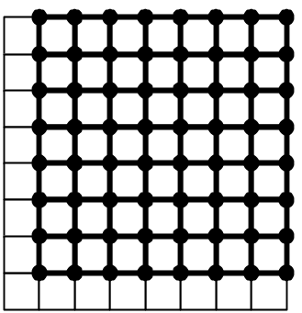
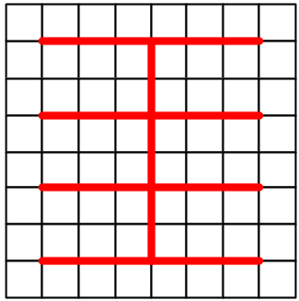
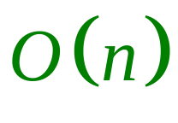
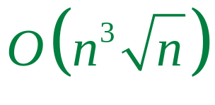
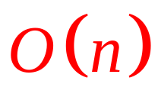
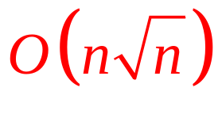
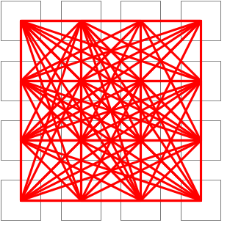
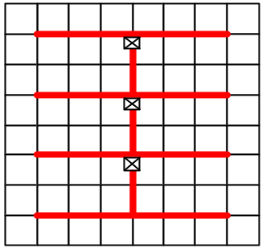


Scalability – Area and Power in NoCs
For Same Performance, compare the:
Wire-area
and power:
NoC:
Simple Bus:
Point-to Point:
Segmented Bus:
E. Bolotin at al. , “Cost Considerations in Network on Chip”, Integration, special issue on Network on Chip, October 2004

Slide 11
Layered approach
Traffic Modeling
Queuing
Theory
Software
Architectures
Transport
Network
Separation of concerns
Wiring
Networking

Slide 12
Regular Network on Chip
PE
PE
PE
Router
PE
PE
PE
PE
PE
PE
PE

Slide 13
Typical NoC Router
Crossbar Switch
H
Buffer
Buffer
H
H
Buffer
Buffer
H
H
Buffer
Buffer
H
Routing
Arbitration
This example uses a centralized arbitrer for all I/O ports
  Distributed arbitration can also be used

Slide 14
Routing Algorithms
NoC routing algorithms should be simple
  Complex routing schemes consume more device area (complex routing/arbitration logic)
  Additional latency for channel setup/release
  Deadlocks must be avoided
Deadlock can occur if it is impossible for any messages to move (without discarding one).
  Buffer deadlock occurs when all buffers are full in a store and forward network. This leads to a circular wait condition, each node waiting for space to receive the next message.
  Channel deadlock is similar, but will result if all channels around a circular path in a wormhole-based network are busy (recall that each “node” has a single buffer used for both input and output).
Some additional features are highly desirable
  QoS, fault-tolerance

Slide 15
Routing in a 2D-mesh NoC – XY routing
X-Y routing is determined completely from their addresses.
In X-Y routing, the message travels “horizontally” (in the X-dimension) from the source node to the “column” containing the destination, where the message travels vertically.
  X direction is determined first, next Y direction
There are four possible direction pairs, east-north, east-south, west-north, and west-south.
Advantages for X-Y routing:
  Very simple to implement
  Deterministic
  Deadlock-free

Slide 16
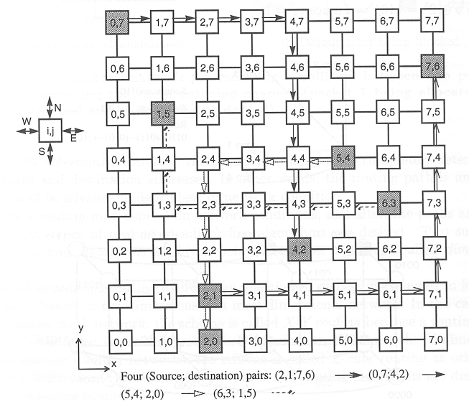
X-Y Routing Example

Slide 17
NoC Buffered Flow Control
1. Store & Forward
2. Cut-through
3. Wormhole
4. Virtual Channel

Slide 18
Store & Forward
1. Store & Forward Flow Control:
Each node receives a packet and then sends it out.
Buffers
0 | H | B | B | B | T
1 |  |  |  |  |  | H | B | B | B | T
2 |  |  |  |  |  |  |  |  |  |  | H | B | B | B | T
3 |  |  |  |  |  |  |  |  |  |  |  |  |  |  |  | H | B | B | B | T
T₀ = H(Tr + L/b)

Slide 19
Cut-through
2. Cut-through Flow Control:
Each node starts to send the packet without waiting for the whole packet to arrive.
Cut-through is more efficient approach.
1) Good performance
2) Large buffer sizes, consumes more power
Suppose in the middle, we get stuck
0 | H | B | B | B | T
1 |  | H | B | B | B | T
2 |  |  | H | B | B | B | T
3 |  |  |  | H | B | B | B | T
0 | H | B | B | B | T
1 |  | H | B | B | B | T
2 |  |  | |---- Not Ready ----| |  |  |  |  | H | B | B | B | T
3 |  |  |  |  |  |  |  |  | H | B | B | B | T
T₀ = HxTr + L/b

Slide 20
Flits and Wormhole Routing
Wormhole routing divides a packet into smaller fixed-sized pieces called flits (flow control digits).
The first flit in the packet must contain (at least) the destination address. Thus the size of a flit must be at least log₂ N in an N-cores SOC
Each flit is transmitted as a separate entity, but all flits belonging to a single packet must be transmitted in sequence, one immediately after the other, in a pipeline through intermediate routers.

Slide 21
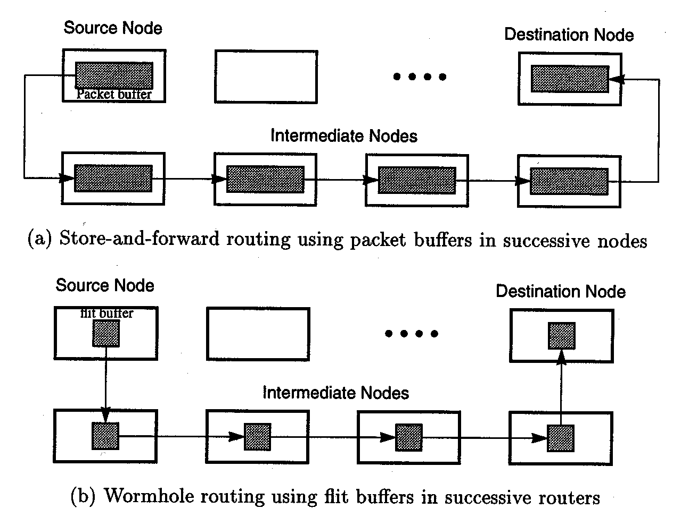
Store and Forward vs. Wormhole

Slide 22
Blocking condition – Wormhole router
IP
(HM)
Interface
No “fairness” is guarantied since routers’ arbitration is based on local state
The further is the source from the destination, its worm has to win more arbitrations
The hot module (HM) bandwidth isn’t fairly shared

Slide 23
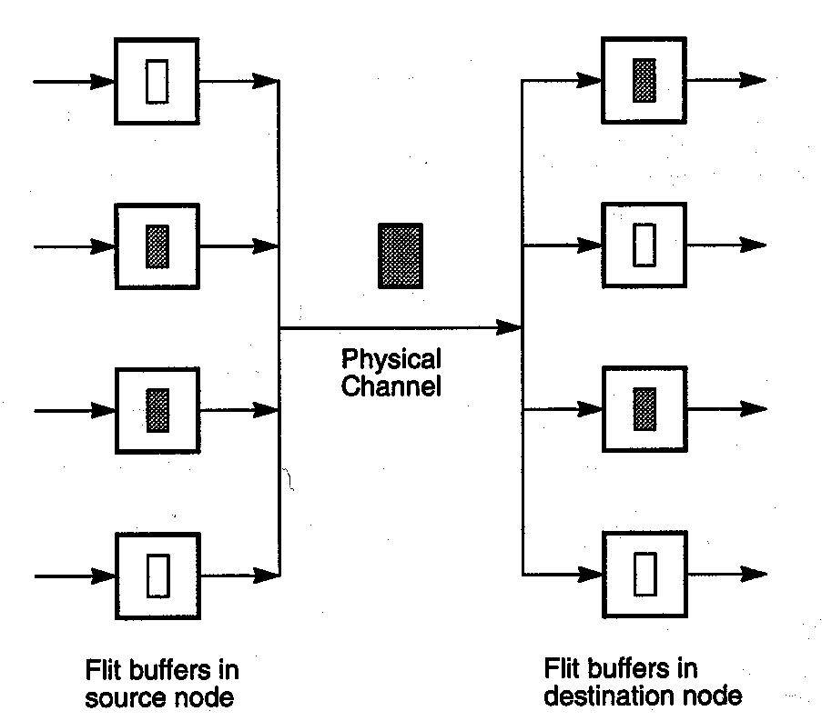
A simple solution: Virtual Channels
1
2
A
B
3
4
Solution 1: Time multiplexing
Solution 2: Additional I/O ports
Input a a_{n} a₁ a₂ a₃ a₄
Input b b_{n} b₁ b₂ b₃ b₄
Interleaved a_{n} b_{n} a₁ b₁ a₂ b₂ a₃ b₃ a₄ b₄
Winner Takes All a_{n} a₁ a₂ a₃ a₄ b_{n} b₁ b₂ b₃ b₄

Slide 24

Optimizing a NoC for a particular application
Given a particular application, can we optimize a NoC for it?
  NoC architecture has to flexible and parametric
    Parameters allow customization
    Parameters: Buffers depth, number of virtual channels, NoC size, etc
Application Specific Optimization
  Buffers
  Routing
  Topology
  Mapping to topology
  Implementation and Reuse
Architecture Optimization
  QoS Support
  Topology
Fault tolerance
  Gossiping architectures

Slide 25
But how an application is described?
SRC
ARM:2.5ms
PPC: 2.2ms
Few multiprocessor embedded benchmarks
Task graphs
  Extensively used in scheduling research
    Each node has computation properties
    Directed edge describes task dependences
    Edge properties has communication volume
15000
FFT
4000
15000
FIR
matrix
82500
IFFT
4000
angle
40000
15000
SINK

Slide 26
Communication Centric Design
Application
Architecture Library
Architecture / Application Model
NoC Optimisation
Configure
Refine
Evaluate
Analyse / Profile
Good?
No
Optimized
NoC
Synthesis

Slide 27
NoC Design Flow
Extract inter-module traffic
Place modules
Allocate link capacities
Verify QoS and cost

Slide 28
NoC Design Flow
R
R
R
R
R
R
R
Extract inter-module traffic
Module
R
R
Module
Module
Module
Module
R
R
R
R
R
R
R
Module
Module
Place modules
R
R
R
R
R
Module
R
R
R
R
Module
Module
Module
Module
R
R
R
R
R
R
R
Module
Allocate link capacities
Module
Module
R
R
R
R
R
R
R
R
Module
Module
Verify QoS and cost

Slide 29

NoC Design Flow
R
R
R
R
R
R
R
Extract inter-module traffic
Module
R
Module
Module
Module
Module
Module
Module
Module
R
R
R
R
Module
Module
Module
Module
Place modules
R
R
R
R
R
R
R
R
R
Module
R
Module
Module
Module
Module
Module
Module
Module
Module
Module
R
R
R
R
R
R
R
R
Module
Module
Allocate link capacities
Module
Module
R
R
R
R
Module
Module
Module
Module
Verify QoS and cost
Optimize capacity for performance/power tradeoff
Capacity allocation is a traditional WAN optimization problem, however:

Slide 30
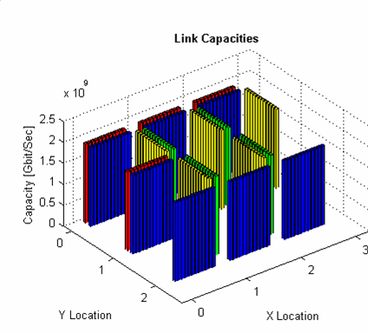
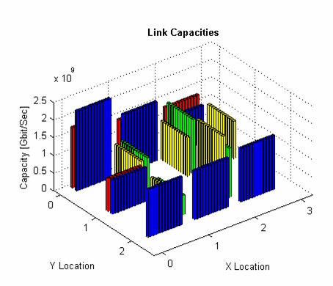
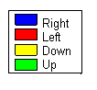
Capacity Allocation – Realistic Example
A SoC-like system with realistic traffic demands and delay requirements
“Classic” design: 41.8Gbit/sec
Using developed NOCs algorithm: 28.7Gbit/sec
Total capacity reduced by 30%
03
02
13
Before optimization
01
12
00
23
11
22
After optimization
10
21
20

Slide 31
Energy Model Limitations – Buffering energy
Some components
  Static energy i.e. leakage power (it is becoming a increasing importance problem)
  Clock energy – flip flops, latches need to be clocked
Buffering Energy is not free
  Can consume 50-80% of total communication architecture depending on size and depth of FIFOs
  Great problem in NOCs

Slide 32
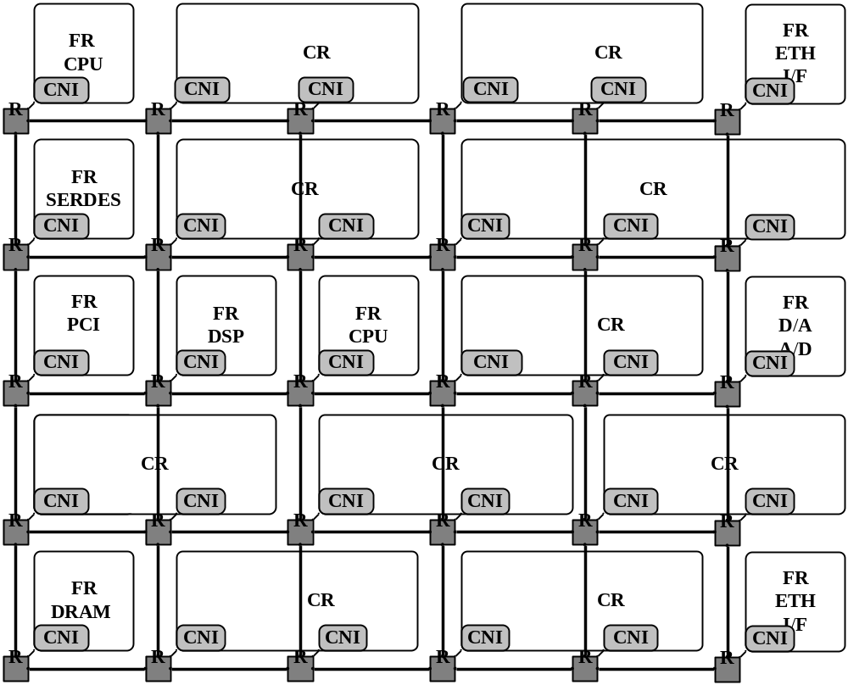
NoC Based FPGA Architecture
Functional unit
NoC for inter-routing
Routers
Configurable region – User logic
Configurable network interface
Notes:
(1) future FPGA will be NoC-based
and (2) the design will be 2-tiered, or hierarchical.

Slide 33
MetaWire: Using FPGA Configuration Circuitry to Emulate a Network-On-Chip
Jared Bevis

Slide 34
When Should I Consider This?
Many FPGAs have reconfigurable architectures.
  There is an advanced wiring network present whose only purpose is to download configuration information.
For static designs, this network is unused after initial configuration.

Slide 35
What Resources are Required?
This presentation topic is centered on the Xilinx Virtex-4 FPGA which is a reconfigurable device.
Theoretically, any reconfigurable device can use these concepts as long as there is a link between the configuration circuitry and the logic level.
  Caveat: gaining access to low-level FPGA functions may not be supported by development software.

Slide 36
Architecture Basics
FPGAs are volatile devices which are composed of many RAM elements known as Look Up Tables (LUT).
  Various combinations form what are known as logic blocks.
Many FPGAs also have built in specialized blocks such as multipliers and floating point units.

Slide 37
These components are connected as specified in a programming language.
  VHDL
  Verilog
Nearly any digital circuit can be synthesized by specifying the architecture.
The required logic gates (logic blocks in the FPGA) are connected with on-chip interconnects via the configuration network.

Slide 38
Why use the configuration network if there is already an interconnect network?
Synthesizing time on the development system can be greatly reduced for large designs.
This may help alleviate bottlenecks in the interconnecting grid.
Reduces extra buffers, latches, etc. as these are already built into the configuration network thus saving area for additional logic.

Slide 39
Additional Features of
MetaWire Network
The configuration network is already fully addressable and synchronous across the chip.
  Addressing scheme already has NoC written all over it.
  Synchronous feature allows data to be sent in single cycles with guaranteed minimal race condition effects.

Slide 40
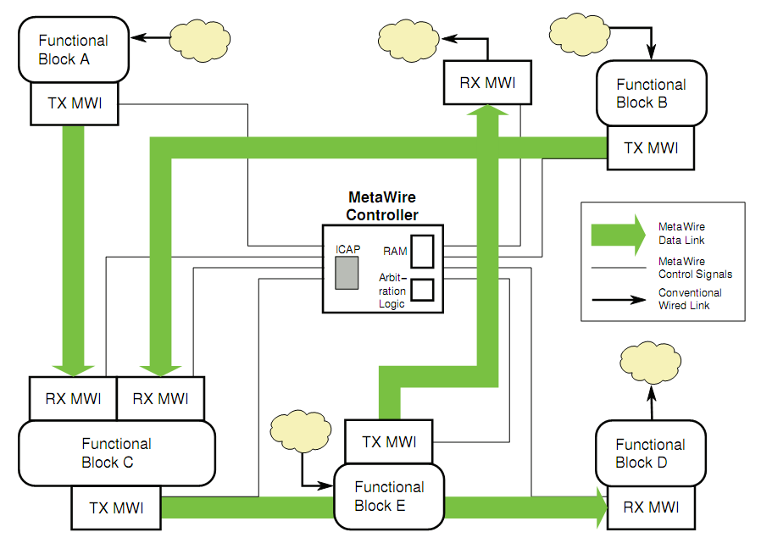
Structure of the MetaWire Network

Slide 41
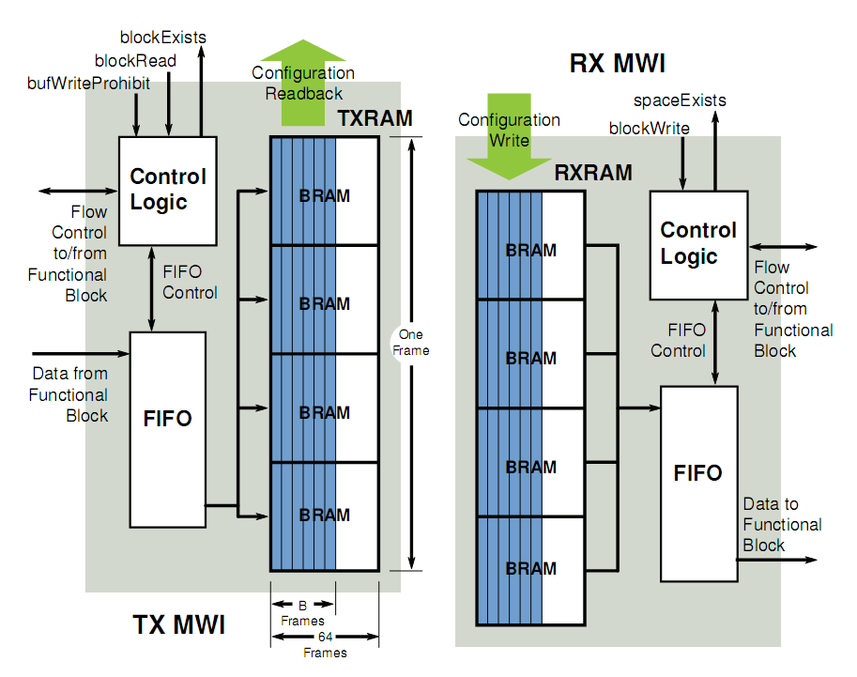
MWI TX and RX Details

Slide 42
MetaWire Controller
Single purpose controller for arbitrating data transfers.
Somewhat similar to a DMA controller.
  Executes a round-robin scheme of servicing data transfer requests.
Consists of address tables, logic control, and ICAP core.

Slide 43


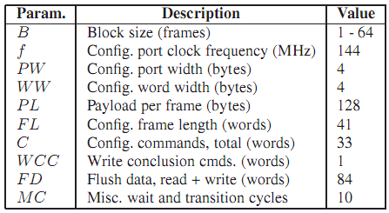
Performance
Both throughput and latency equations are derived from timing diagrams.

Slide 44
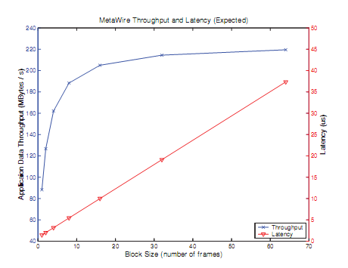
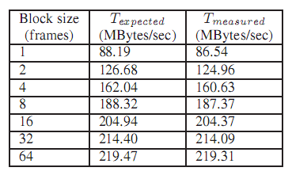
Actual Testing Data

Slide 45
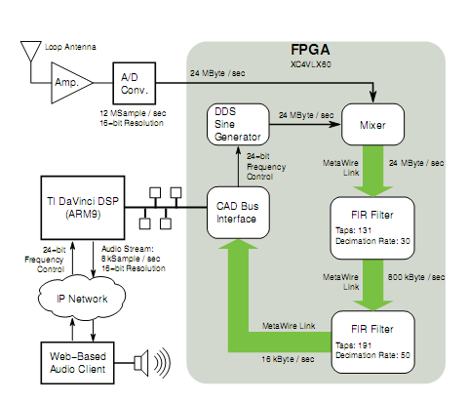
Final Verification

Slide 46
Implementation And Application Exploration
For Network on Chip
Abraham Sanchez
Paper:
Exploring FPGA Network on Chip Implementations Across Various Application and Network Loads.
Graham Schelle and Dirk Grunwald.
University of Colorado

Slide 47
Outline
Application
  Brute Force DES key Search
DES Algorithm
NoC Implementation.
  Virtual Channel NoC
  Simple NoC
DES key Search Architectural Details
  NoC Layout
  DES key Search Engine
Results.

Slide 48
DES and Brute Force Key search
Data Encryption Standard (DES)
  Designed by IBM 1977.
  Uses a 56 bit key and block of 64 bit with 8 bit for parity error check.
  Encrypt pain text in blocks of 64 bit
  Replace by TripleDES
Brute Force Key Search
  Give a known plaintext-ciphertext pair (P,C), find the DES key or keys which encrypt P and produce C
  For DES there would be 2^56 key in the search space

Slide 49
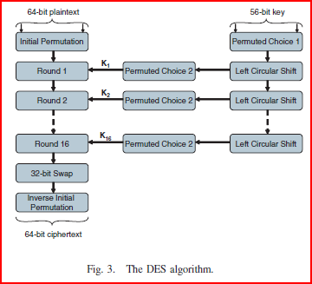
DES Algorithm
Sixteen 48-bit from original 56-bit
  56-bit key is permute (PC1)
  Then divided into two 28-bit treated separately thereafter.
  28-bit are rotated left by 1 or 2 bits (specified for each round).
  Two 28-bit are combine and permutated and a subkey of 48 bit is selected
Plaintext is passed thru 16 rounds of permuting key resulting in a cipher text.
  There is a initial permutation applied at the beginning
  An a Inverse initial permutation and 32-bit swap at the end.
Source: Exploring FPGA Network on Chip Implementations Across Various Application and Network Loads Graham Schelle and Dirk Grunwald. Department of Computer Science University of Colorado at Boulder Boulder, CO

Slide 50
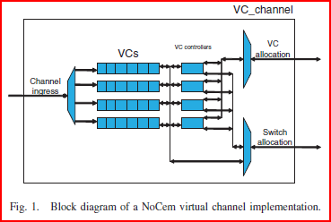
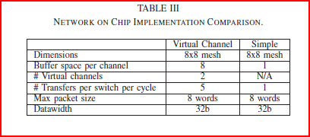
NoC Implementation.
  Virtual Channel NoC
    Used by must NoC today
    Basic Network Components
      Physical Channel
        Multiple lanes so that packets can by pass one another
      Node arbitration
        Arbitration for outgoing virtual channel allocation and switch allocation
      Node Switch
        Multiple paths of communication simultaneously
  Simple NoC
    Basic Network Components
      Shrinking the Physical Channel
        Simple one-word FIFO
      Shrinking the Node arbitration
        No virtual channel allocation
        Less side band state and signaling
      Shrinking the Node Switch
        1 switching decision
    Deadlocks: avoided using deterministic XY Routing
Source: Exploring FPGA Network on Chip Implementations Across Various Application and Network Loads Graham Schelle and Dirk Grunwald. Department of Computer Science University of Colorado at Boulder Boulder, CO

Slide 51
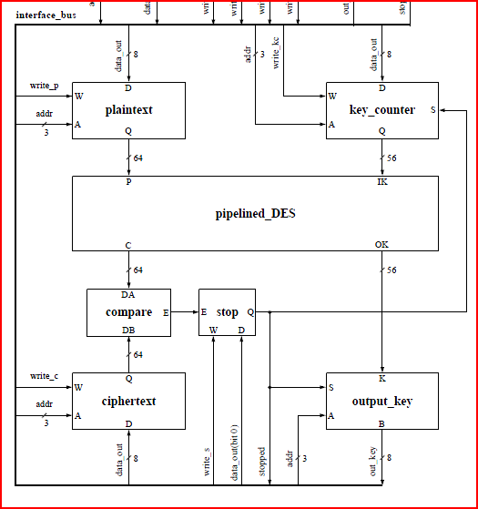
DES key Search Architectural Details
  NoC Layout
Master
uP
Slave
uP
DES Engine
Hierarchy of controllers
  Master Microprocessor
    Assigns a plaintext-ciphertext pair
    And assigns Range of keys to each slave microcontroller.
  Slave Microprocessor
    Subdivide the range of keys
    Assigns tasks DES Engine
    Polls for found keys
DES search engine
  Takes a plaintext-ciphertext pair (P,C), a starting key K, and searches through keys until one is found that encrypts P to produce C
Controllers are implemented as Microblaze that communicate with the DES Engine located in the NoC.
Slave
uP
DES Engine
DES Engine
DES Engine
DES Engine
DES Engine
DES search engine
Source: Exploring FPGA Network on Chip Implementations Across Various Application and Network Loads Graham Schelle and Dirk Grunwald. Department of Computer Science University of Colorado at Boulder Boulder, CO

Slide 52
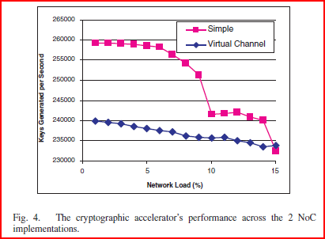
Results
The application performance metric:
  Keys generated per second.
Implementation Performance
  Simple has better performance when Network load is less than 15%
Performance degradation
  virtual channel is more graceful
  while the simple has a rapid slope
Source: Exploring FPGA Network on Chip Implementations Across Various Application and Network Loads Graham Schelle and Dirk Grunwald. Department of Computer Science University of Colorado at Boulder Boulder, CO

Slide 53


