Slide 1
UI案

Slide 2
route
USA
date
airplane
distance
time
Canada
date
type
start
stop
distance
time
date
date
airplane
distance
time
Mexcico

Slide 3
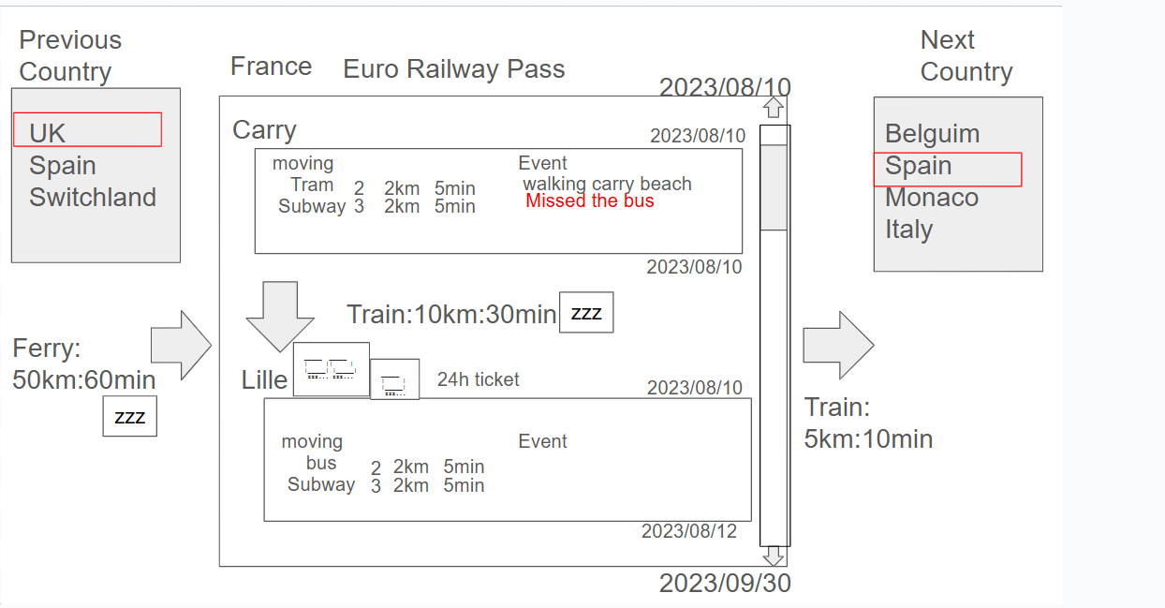

Slide 4
Sydny
2022/05/16-2022/06/10
Event
Bus
200km,600min
???
Merborn

Slide 5
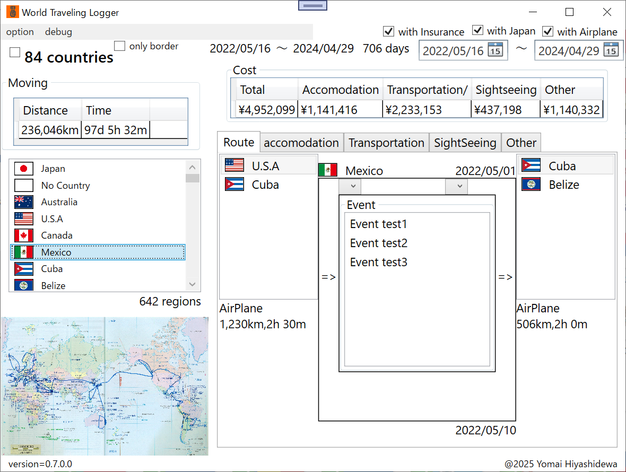

Slide 6
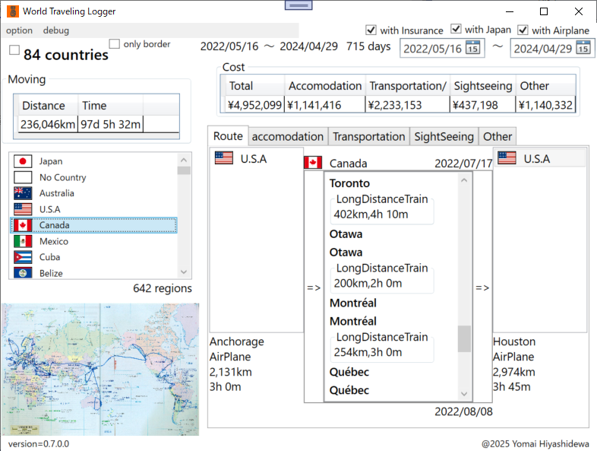

Slide 7
List
open
Accomodation.csv
Transportation.csv
Sightseeing.csv
Exchangerate.csv
Load
image
open
xxx.Png
xxs.png
Load

Slide 8
✔
world
With airplane
With japan
〇〇〇〇/□□/△△
〇〇〇〇/□□/△△
〇〇〇〇/□□/△△
～
〇〇〇〇/□□/△△
XXdays

Slide 9
✔
world
With airplane
〇〇〇〇/□□/△△
～
〇〇〇〇/□□/△△
〇〇〇〇/□□/△△
～
〇〇〇〇/□□/△△
XXdays
Xx countries
image
all
rate
Total cost:
Totatl accomodation:
Totatl transportation:
Totatl distance:
Totatl sightseeing:
Totatl other:
Totatl Time:

Slide 10
world
With airplane
〇〇〇〇/□□/△△
～
〇〇〇〇/□□/△△
Xx countries
〇〇〇〇/□□/△△
～
〇〇〇〇/□□/△△
XXdays
Japan
With cross boder
region
xx
image
all
rate
Total cost:
Totatl accomodation:
Totatl transportation:
Totatl distance:
Totatl sightseeing:
Totatl other:
Totatl Time:

Slide 11
world
accommodation
transportation
sightseeing
other
Japan
Total:xxxxxx円
〇〇〇〇/□□/△△
～
〇〇〇〇/□□/△△
Type | Count | currency | JPY
Domitory | 100 | 400 | 3000
Single room | 200 | 500 | 5000
…
JPY
USD
EUR
XX日
XXカ国
Single room
Total:xxxxxx円
date | country | region | price | JPY | memo
2022/11/1 | japan | tokyo | 4000 | 4000 | -
2022/11/2 | japan | tokyo | 5000 | 5000 | -

Slide 12
World
East Asia
Europe
Africa
South America
Japan
USA
Canada
…
accommodation
transportation
sightseeing
other
world
Total:xxxxxx円
〇〇〇〇/□□/△△
～
〇〇〇〇/□□/△△
Type | Count | currency | JPY
Domitory | 100 | 400 | 3000
Single room | 200 | 500 | 5000
…
JPY
USD
EUR
XXカ国
Single room
Total:xxxxxx円
date | country | region | price | JPY | memo
2022/11/1 | japan | tokyo | 4000 | 4000 | -
2022/11/2 | japan | tokyo | 5000 | 5000 | -

Slide 13
world
accommodation
transportation
sightseeing
other
Japan
Total:xxxxxx円
Total distance:
xxxxxx km
Total time:
xxxxxx min
With airplane
〇〇〇〇/□□/△△
Cross border
～
〇〇〇〇/□□/△△
Type | Count | currency | JPY | distance | time
train | 100 | 400 | 3000 | 5000 | 500
bus | 200 | 500 | 5000 | 6000 | 100
…
JPY
USD
EUR
XXカ国
train
Total:xxxxxx円
time
price
JPY
date
start
end
distance
memo
Japan Tokyo Airport
Japan Tokyo Station
60km
50min
5000JPY
5000JPY
…

Slide 14
world
accommodation
transportation
sightseeing
other
Japan
Total:xxxxxx円
〇〇〇〇/□□/△△
～
Type | Count | currency | JPY
Domitory | 100 | 400 | 3000
Single room | 200 | 500 | 5000
…
〇〇〇〇/□□/△△
JPY
USD
EUR
XXカ国
Visiting
Total:xxxxxx円
date | context | country | region | price | JPY | memo
2022/11/2 | Mt.Fuji | Japan | Shizuoka | 5000 | 5000 | -
2022/11/2 | Mt.Fuji | Japan | Shizuoka | 6000 | 1000 | -
…

Slide 15
world
accommodation
transportation
sightseeing
other
Japan
Total:xxxxxx円
With insurance
〇〇〇〇/□□/△△
～
Type | Count | currency | JPY
Domitory | 100 | 400 | 3000
Single room | 200 | 500 | 5000
…
〇〇〇〇/□□/△△
JPY
USD
EUR
XXカ国
Accident
Total:xxxxxx円
date | context | country | region | price | JPY | memo
2022/11/2 | Mt.Fuji | Japan | Shizuoka | 5000 | 5000 | -
2022/11/2 | Mt.Fuji | Japan | Shizuoka | 6000 | 1000 | -
…

Slide 16
apendix

Slide 17
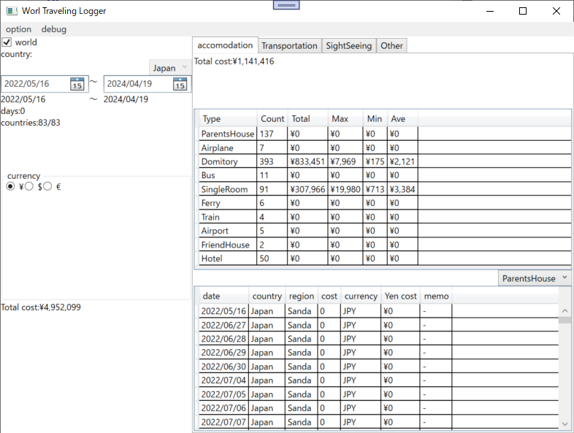

Slide 18
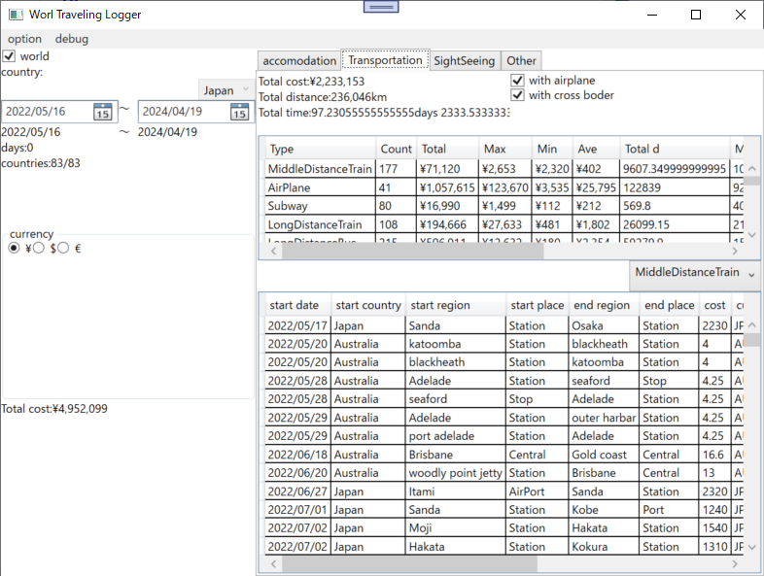

Slide 19
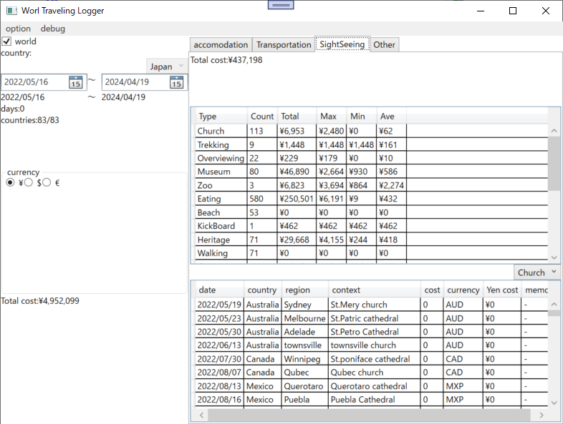

Slide 20
