Slide 1
BPH
DR M D P PINTO
REGISTRAR IN UROLOGY
22-03-2018

Slide 2
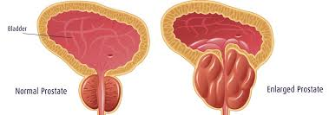
Terminology
Benign prostatic hyperplasia
Hyperplasia of epithelial and stromal components of prostate
Benign prostatic enlargement
Enlargement of the prostate due to BPH
Occurs in about 50% of BPH
Benign prostatic obstruction
Occurs in about 50% of BPE

Slide 3
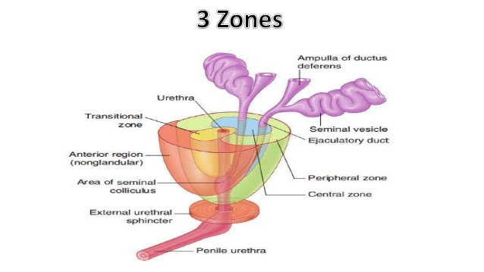
Epidemiology
BPH starts around 30y
Almost >90% by age 80y
BPH starts in transition zone
BPH does not lead to cancer

Slide 4
CASE
A 60 years old male presents to the GU clinic complaining of LUTS for the last 2 months duration.
He is ASA-1 otherwise.
How do you approach this patient?

Slide 5
Objectives
To identify if due to a GU malignancy
To assess severity of symptoms, disease
To layout a patient-tailored plan of management and follow up

Slide 6
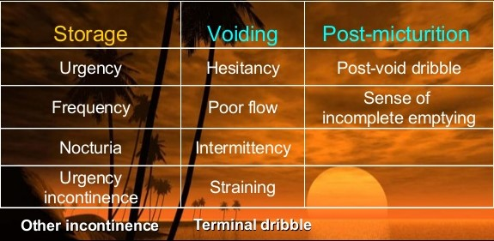
What are the symptoms identified as LUTS? How to know we are dealing with BOO?

Slide 7
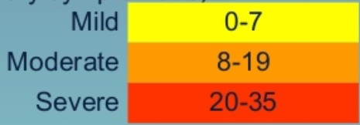
How to assess symptom severity of BOO due to BPH?
International Prostate Symptom Score (I-PSS)
Symptoms assessed during the last month
7 symptoms given marks from 0-5
1 question on quality of life

Slide 8
Is this simple or complicated BOO?
UTI – episodes of fever with chills, rigors and positive culture
Bladder stones – history of stones, passed stones
Incontinence – overflow
Obstructive uropathy – treatment taken for CKD
AUR - history of AUR
Haematuria
EXCLUDE PROSTATIC MALIGNANCY
Sinister lower backache
Haemoptysis
Complete history with previous or current medical, surgical problems, medication and allergies.

Slide 9
Targeted examination?
Exclude prostatic malignancy?
DRE (CA)
Basic neurologic examination of lower limbs
Auscultate lung fields
Palpable bladder
Meatal stenosis
 | DRE
BPH | Firm nodular prostate Rectal mucosa can be swept over prostate Median groove palpable Assess volume Tenderness?
Prostate CA sensitivity-60% specificity-94% | Hard nodules Mucosa fixed Groove obliterated Blood on finger

Slide 10
How to investigate?
PSA
Glycoprotein by prostatic epithelial cells
Cut-off <4ng/ml
For prostate cancer
Sensitivity 51%
Specificity 91%
Half life 2.2 days
Increased in;
After DRE
After prostatic biopsy
Prostatitis
Post ejaculation (48h – normalize)
Reduced after Finasteride use
Safe to do after 2/52 of above factors
Important in diagnosis and follow up
Normal in 20% of prostate cancers
UFR - infection
S. Creatinine – renal status
USS KUBP
Bladder
Pre/post-voidal volume
Wall thickness
Stones
Prostate
Volume
Nodules
Renal status – CKD
Ureters - ? dilated
Bladder diary
24h fluid intake, urine production

Slide 11
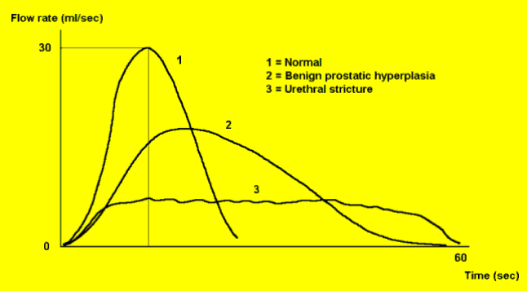
Secondary investigations?
Uroflowmetry
BOO shows maximal flow rate of 15ml/s

Slide 12
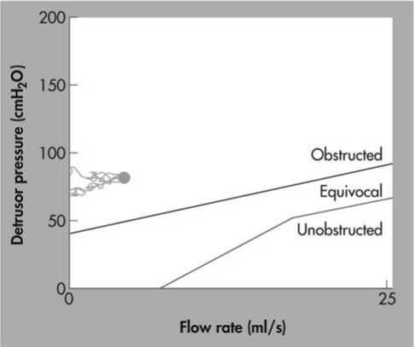
Secondary investigations?
Urodynamic studies (UDS)
When
LUTS <50y
LUTS >80y
LUTS in neurologic disease
LUTS following bladder outflow tracr surgery
Cannot void 150ml
Will show high pressure and low flow in BOO (Abraham-Griffith normogram)
BOO can only be diagnosed by UDS, other Ix only infer BOO
Cystoscopy
Occasionally
Ex- haematuria
CT/MRI not indicated in BPH

Slide 13
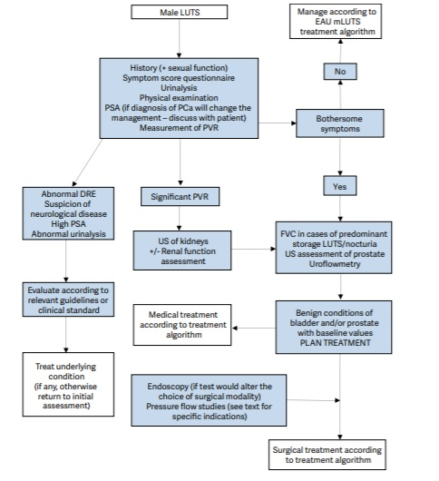
Management algorhythm

Slide 14
Investigations found to have a 40ml benign looking prostate with a PSA of 5ng/ml. His IPSS is of moderate severity. He refuses surgery, what options can you offer him?
Life style modifications
Reducing fluid intake for convenient time periods
Double voiding
Avoid caffeine/alcohol
Medications
Selective alpha blockers (Tamsulosin)
5alpha reductase inhibitor (Finasteride)
Phosphodiesterase 5 inhibitors (Tadalafil)
Plant extracts – not recommended
Beta3 agonists for detrusor over activity (storage symptoms)

Slide 15
Medications
Selective alpha blockers (Tamsulosin)
Selective block of bladder neck and prostatic smooth muscle (alpha 1A)
AE- anejaculation, dizziness, asthenia, floppy iris syndrome
Well tolerated in elderly population
Reasonable symptomatic improvement(I-PSS by 35%)
ALFAUR study – success of TWOC improved with 3 day Tamsulosin
5-alpha reductase inhibitor (Finasteride)
Reduce formation of dihydrotestosterone and reduce prostate size→6/12
AE – lost libido/erectile dysfunction – short-lived
Usually for PSA>1.4 or volume >40ml
Do PSA before onset of therapy
Combination therapy had shown better results
TADALAFIL – improves LUTS due to better bladder activity than changes in BPH

Slide 16
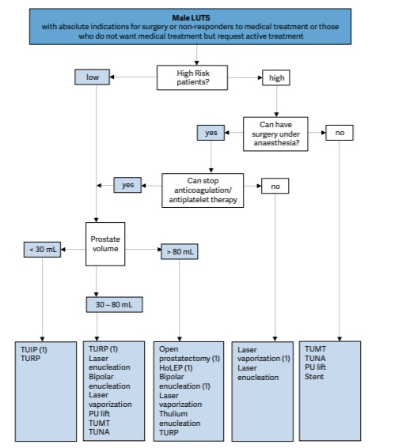
6/12 after patient presents with similar symptoms and wishes surgery. What options does he has?
Indications for surgery
Moderate-severe I-PSS
AUR
Recurrent UTI
Obstructive uropathy
Recurrent haematuria

Slide 17
While undergoing TURP under SAB, patient started to speak inappropriately. Why?
Trans-Urethral Resection (TUR) syndrome
Dilutional hyponatremia
Due to water absorption from opened up vessels of prostate in to system
Solutions used are distilled water or 5% dextrose
Avoid TUR syndrome
Select stable patient/confirm stable SE and renal function pre-operatively
Correct SE pre-operatively
Do surgery quickly (don’t exceed 1h)
Solution – hypo-osmolar glycine is best
Keep fluid barrel at minimal height for adequate flow
Don’t go near capsule, early in the surgery
Haemostasis
Early detection

Slide 18
Surgical options available for BPH

Slide 19
Indications for open simple prostatectomy
Medically fit and prostate >80ml
Too much time taken for TURP
Laser is also an option
2 pathologies to be treated
Large bladder stone + BPH

Slide 20
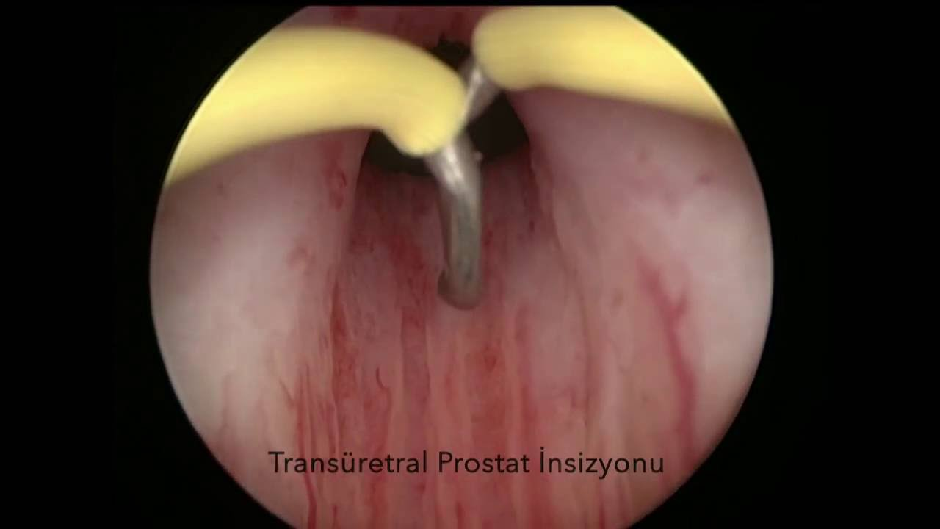
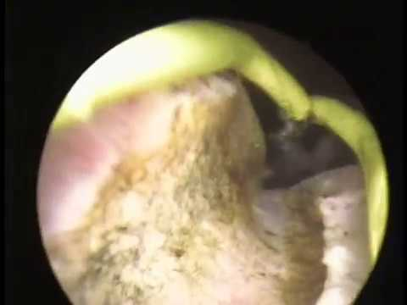
A 40y old male has a symptomatic 30ml prostate. He wishes surgery.
Trans-urethral incision of prostate (TUIP)
5 to 7 o clock incision

Slide 21
Thank you

