Slide 1
PRISM
PRior-guided Imagination Sampling in world Models
Closed-form Product-of-Gaussians fusion of a learned action prior into MPPI
Yuhai Wang • Northeastern University • 2026-05-06

Slide 2
Outline
45–60 minutes • ~45 slides • Q&A throughout, please interrupt
• Introduction — what's the upstream question in MBRL planning?
• Related work — world models, sampling-based MPC, action priors
• Method — JEPA + MPPI + learned MLP prior + PoG fusion
• Experiments — Cube + PushT + Tworoom (negative case)
• Results — +30 / +20 pp; regime asymmetry; asymptote validation
• Real-robot — today's progress on Franka deployment
• Conclusion + limitations + Q&A
PRISM-JEPA • 2 / 48

Slide 3
§1
Introduction
PRISM-JEPA • 3 / 48

Slide 4
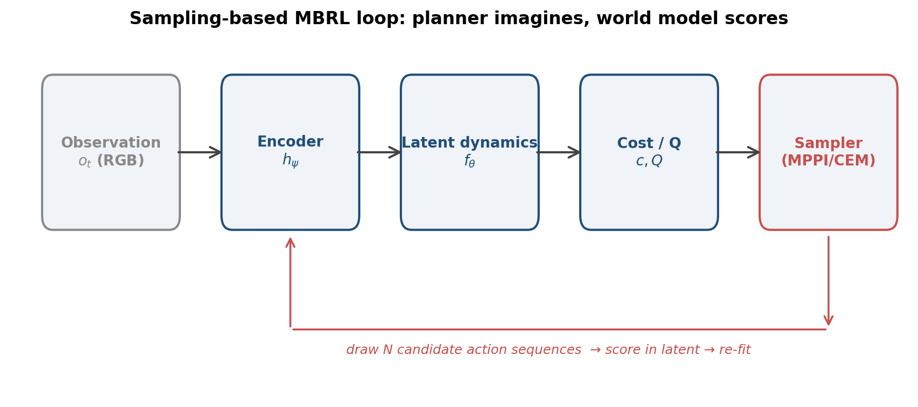
Model-based RL with imagined trajectories
• Imagine consequences of candidate actions inside a learned world model — then act.
• Two ingredients of every world-model planner:
  ▸ the world model that scores trajectories — heavy academic focus
  ▸ the sampling distribution that proposes them — under-examined
• Examples: DreamerV3, TD-MPC2, LeWM, DINO-WM.
PRISM-JEPA • 4 / 48

Slide 5
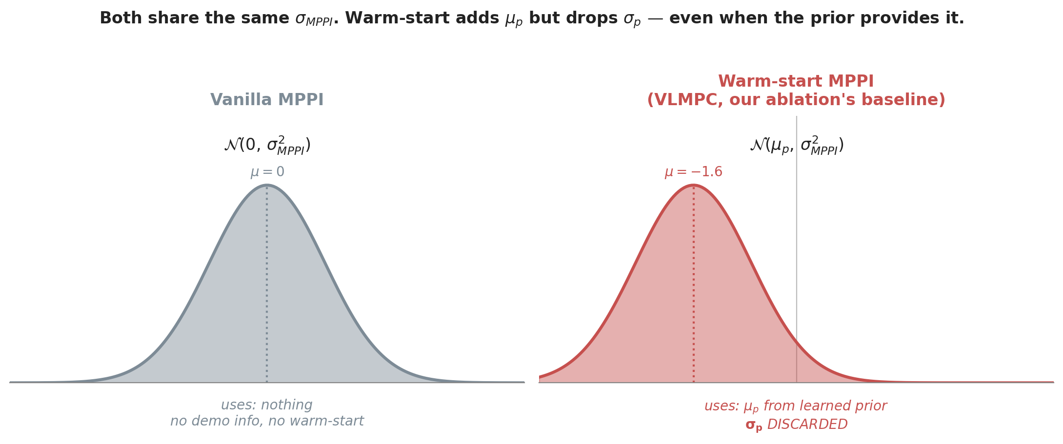
How does MPPI choose its sampling distribution today?
• Vanilla MPPI: sample from N(0, σ²I). Zero-mean default; no demo info.
• Warm-start MPPI: sample from N(μ_p, σ²I). Inject the prior's mean; keep the planner's σ.
  ▸ VLMPC and our paper's 'warm-start MPPI' baseline do this — μ_p is used, σ_p (or hand-set) is dropped.
  ▸ PiJEPA does something different: empirical μ_p AND σ_p from N_π diffusion samples, replaces the seed (see slide 13).
• Aside: classical MPC also has temporal warm-start (μ ← μ_prev, last step's plan rolled forward).
  ▸ Universal trick, orthogonal to demo priors; not what we mean by 'warm-start MPPI' here.
PRISM-JEPA • 5 / 48

Slide 6
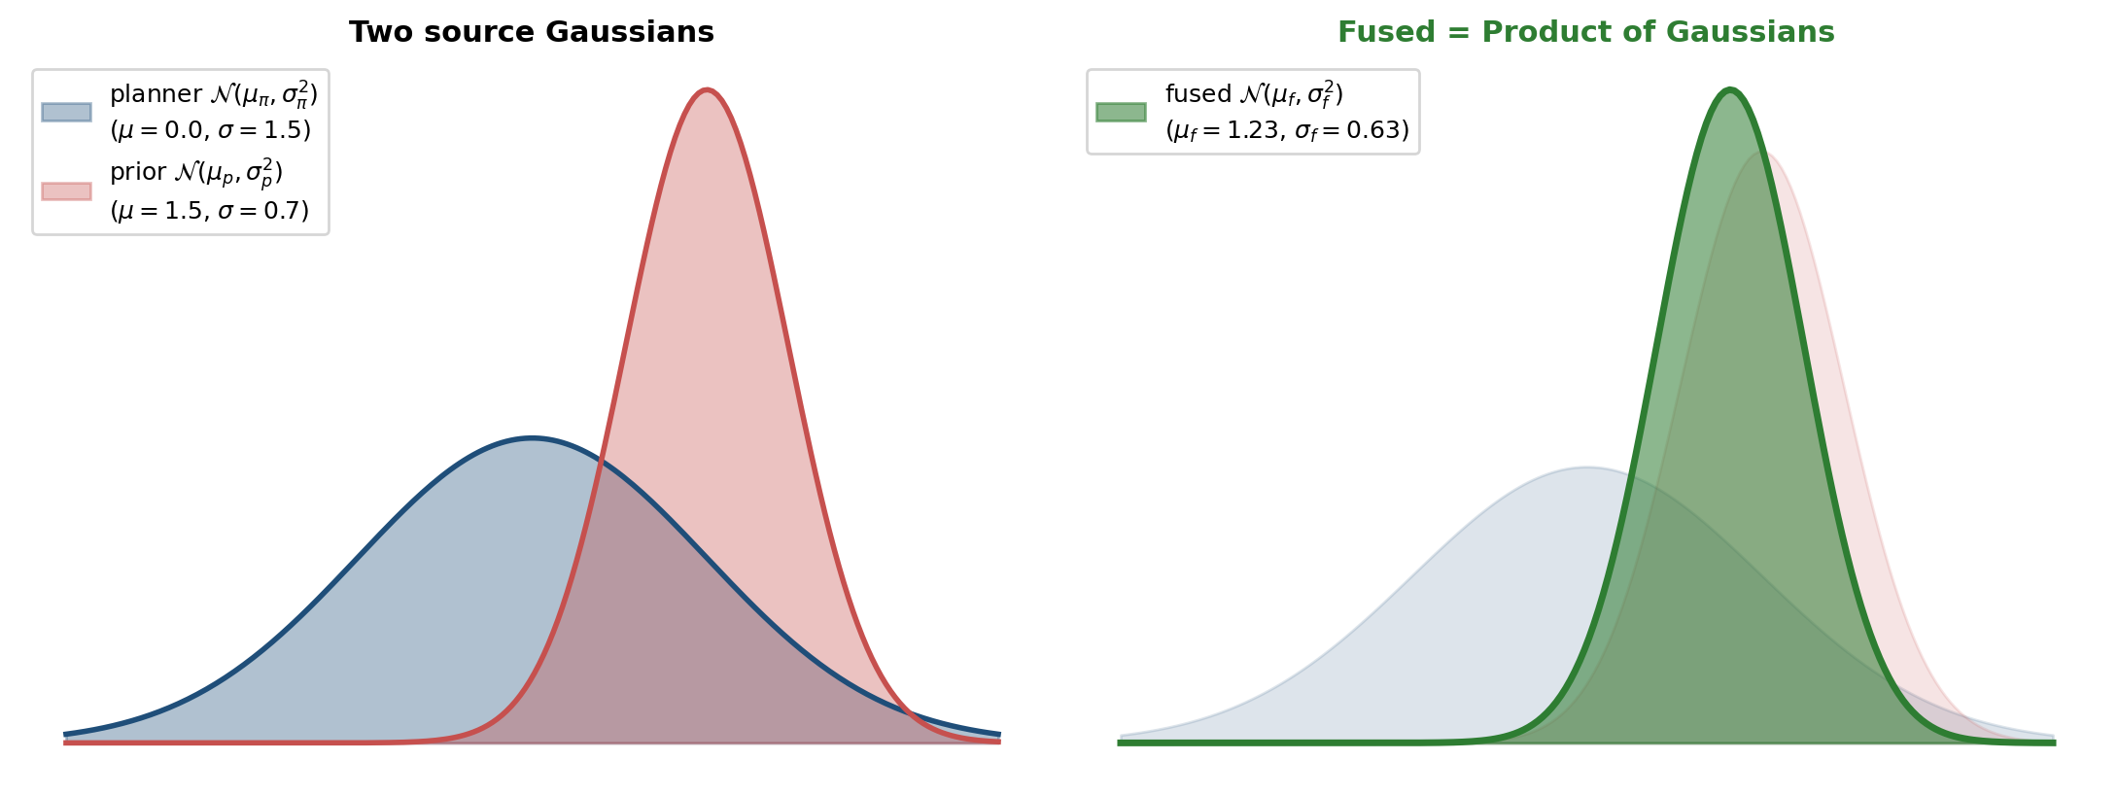
Our framing: precision-weighted Gaussian fusion
• Given a planner default and a learned prior, both Gaussian, fuse them via Product-of-Gaussians.
• Closed form. Posterior interpretation: two independent Gaussian observations of the same latent action.
PRISM-JEPA • 6 / 48

Slide 7
Why PoG: three properties for free
• P1. Per-state precision weighting
  ▸ More confident source dominates state-by-state — automatic, no scheduler.
  ▸ Locally tight σ in high-density regions of training data → prior dominates there.
• P2. Asymptote guarantee
  ▸ As the prior's variance grows, the fused distribution recovers vanilla MPPI exactly.
  ▸ Structural property of PoG, not an empirical claim.
• P3. Parameter-free, closed-form
  ▸ No inference-time optimization, no learned blending coefficient, no scheduler.
PRISM-JEPA • 7 / 48

Slide 8
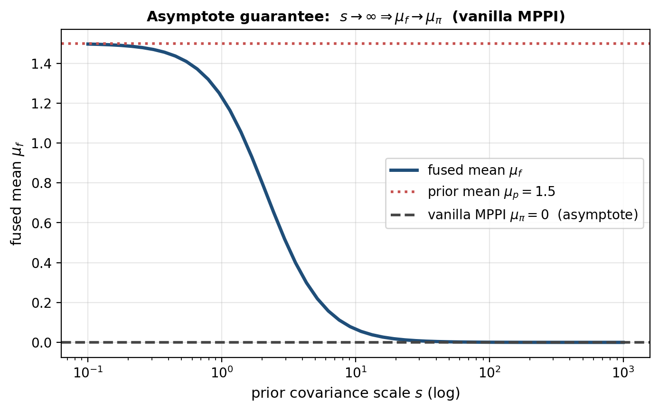
Asymptote guarantee — visualized
• When the prior is uninformative (large σ), PRISM ≡ vanilla MPPI mathematically.
• Warm-start does NOT have this property: a copied μ_p persists no matter what.
PRISM-JEPA • 8 / 48

Slide 9
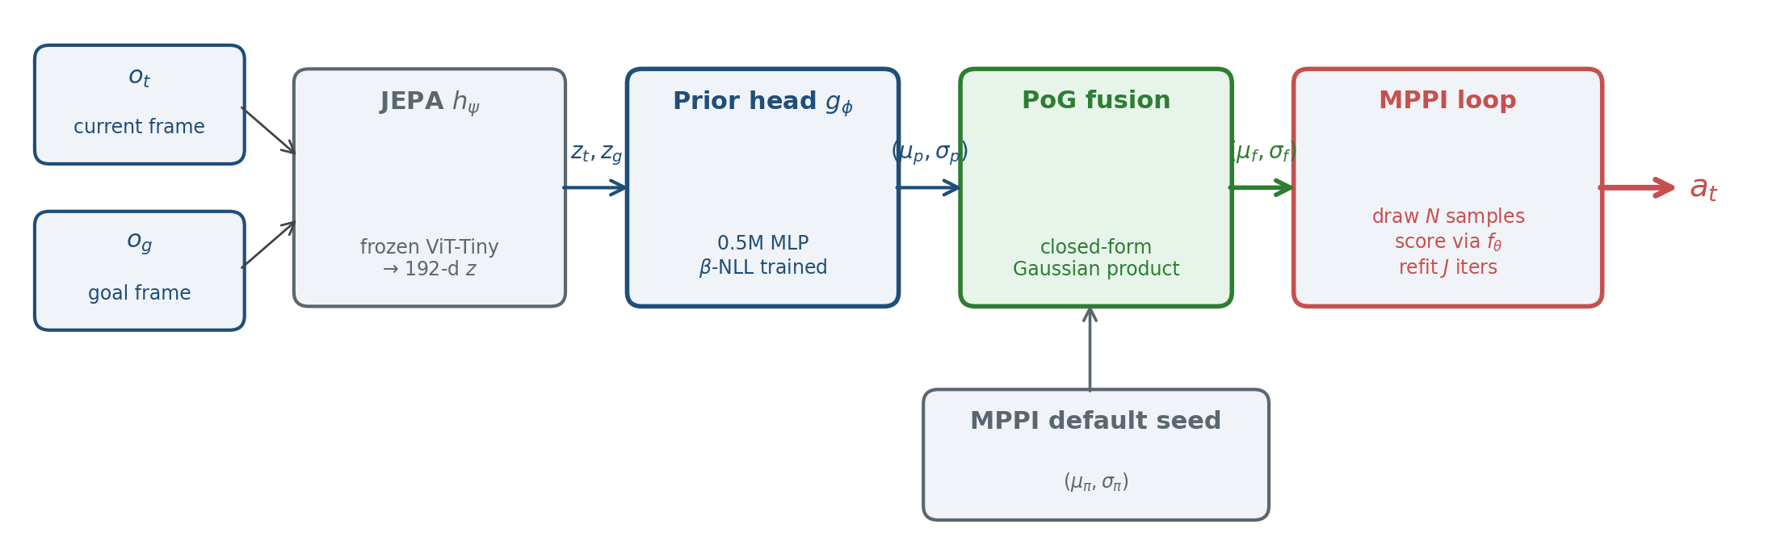
PRISM-MPPI in one picture
• Frozen JEPA encoder → small MLP prior head → PoG fusion → MPPI loop.
• Only the prior head is trained; everything else is the LeWM substrate.
PRISM-JEPA • 9 / 48

Slide 10
Contributions of this paper
• Method
  ▸ PRISM-MPPI: closed-form precision-weighted fusion of a learned action prior into MPPI.
  ▸ Sits between mean-only warm-start (no σ) and KL-bias MPPI (no closed-form Gaussian instance).
• Empirical
  ▸ +30.7 pp on Cube and +20.7 pp on PushT over vanilla MPPI (3 seeds, paired, p≈0.008 / 0.09).
  ▸ Regime asymmetry: warm-start ≈ PRISM on strong unimodal prior (Cube).
  ▸ Only PRISM survives a multimodal expert with a sub-expert μ (PushT).
• Limits
  ▸ When demos are <50% successful (Tworoom), no head learns; asymptote returns vanilla MPPI as predicted.
PRISM-JEPA • 10 / 48

Slide 11
§2
Related Work
PRISM-JEPA • 11 / 48

Slide 12
World models with sampling-based planning
• DreamerV3 (Hafner+ 2023): reward-conditional latent dynamics, actor-critic on imagined trajectories.
• TD-MPC2 (Hansen+ 2024): latent dynamics + Q-network + CEM-style planning.
• LeWM (Maes+ 2026): JEPA-based world model, NO reward predictor, NO Q-network — cost is purely visual.
  ▸ Embedding-MSE to a goal frame: cost(a) = ‖f(z_t, a) − z_g‖²
  ▸ We pick LeWM as the substrate: any improvement is unambiguously the planner's seed (no Q to absorb).
• DINO-WM (Zhou+ 2024): similar JEPA-style goal-conditioned world model with planning.
PRISM-JEPA • 12 / 48

Slide 13
PiJEPA — closest substrate, replacement vs fusion
Chahe & Zhou 2026.03 (Drexel) — JEPA + MPPI for language-conditioned visual navigation
Aspect | PiJEPA | PRISM (ours)
Prior architecture | fine-tuned Octo diffusion policy | 0.5M MLP head on cached JEPA features
Inference cost per env step | N_π diffusion-policy forwards (slow) | 1 MLP forward (~ms)
Prior σ source | empirical std of N_π samples | direct MLP output, β-NLL trained
How prior meets MPPI seed | REPLACES: (μ⁰, σ⁰) → MPPI init | FUSES via closed-form PoG with (μ_π, σ_π)
Asymptote when prior uninformative | no fallback (always replaces) | σ_p → ∞ ⇒ vanilla MPPI exactly
σ refit during MPPI iterations | yes (CEM-style, Alg. line 21) | no (LeWM substrate); σ_fused persists
Task domain | visual navigation | visual manipulation
• Both use μ AND σ from a learned prior. Differences = HOW prior is computed and HOW it meets the planner.
PRISM-JEPA • 13 / 48

Slide 14
VLMPC (Wang+ RSS 2024)
• VLM (e.g. GPT-4V) outputs a low-dim Gaussian action mean at every env step; σ is hand-tuned.
• TD-MPC2 + MPPI substrate; replaces the planner's seed with (μ_VLM, σ_handset).
• Validated on simulated and real UR5 manipulation tasks.
• Our differentiation, three axes:
  ▸ σ source — VLMPC hand-sets it (not state-conditional); PRISM learns it via β-NLL on demos.
  ▸ Compute — VLMPC calls VLM each env step (heavy); PRISM uses a 0.5M MLP on cached JEPA features.
  ▸ Combination — VLMPC replaces seed; PRISM fuses with planner default via closed-form PoG (asymptote guarantee).
• PRISM's PoG form is independent of where the prior comes from — VLM-derived priors are a future extension.
PRISM-JEPA • 14 / 48

Slide 15
Biased-MPPI (Trevisan & Alonso-Mora 2024)
• General derivation: MPPI with arbitrary sampling distributions via KL-bias importance sampling.
• Used to fuse multiple ancillary controllers.
• Evaluated on low-dim state-space tasks (pendula, ships, wheeled vehicles) — not vision-based manipulation.
• Mathematically more general than ours, but lacks the closed-form Gaussian instance.
• PRISM = the Gaussian-Gaussian special case with:
  ▸ closed-form posterior (no importance-sampling reweighting overhead)
  ▸ asymptote guarantee built in
  ▸ per-state precision weighting tied to the prior head's σ_p
PRISM-JEPA • 15 / 48

Slide 16
Positioning — where PRISM sits in the design space
• Replacement-style prior injection (warm-start, PiJEPA, VLMPC):
  ▸ Prior overwrites the planner's seed entirely. Different methods compute the prior differently:
  ▸ VLMPC: μ_p from VLM, σ hand-set. Warm-start MPPI / our ablation: μ_p from MLP, σ_p discarded.
  ▸ PiJEPA: empirical (μ^0, σ^0) from N_π diffusion-policy samples (uses σ, but still replaces planner default).
  ▸ Common limitation: NO asymptote guarantee — even an uninformative prior overwrites the seed.
• KL-bias / importance-sampling general (Biased-MPPI):
  ▸ Mathematically general but no closed-form Gaussian instance. Low-dim state-space evaluation only.
• PRISM-PoG (ours):
  ▸ Closed-form Gaussian fusion (NOT replacement) of planner default with learned prior.
  ▸ Asymptote guarantee for free. Per-state precision weighting from the head's own σ_p.
  ▸ Parameter-efficient prior (~0.5M MLP, no diffusion sampling at inference).
PRISM-JEPA • 16 / 48

Slide 17
§3
Method
PRISM-JEPA • 17 / 48

Slide 18
LeWM — our world-model substrate
• Frozen JEPA encoder h_ψ : observation → 192-d embedding.
• Action-conditional latent predictor f_θ : (z_t, a_{t..t+H}) → ẑ_{t+H}.
• Goal-conditioned cost: cost(a) = ‖f_θ(z_t, a) − z_g‖².
• No reward predictor. No value network.
  ▸ Any planner-side improvement is unambiguously attributable to the seed distribution.
  ▸ No Q-network can quietly absorb prior knowledge into another channel.
• We use LeWM's pretrained checkpoints; we DO NOT modify the encoder or predictor.
PRISM-JEPA • 18 / 48

Slide 19
Goal-conditioned MPPI loop
• At each env step:
  ▸ Initialize sampling distribution N(μ, σ²I).
  ▸ Draw N candidate sequences a^(i) ~ N(μ, σ²).
  ▸ Score each with cost = ‖f_θ(z_t, a^(i)) − z_g‖².
  ▸ Re-fit μ, σ² to elite-weighted samples (exp(−β·cost) weights).
  ▸ Iterate J times. Execute first action of resulting plan.
• Vanilla MPPI: μ ← 0 every step. Warm-start: μ ← μ_prev.
• PRISM intervenes ONLY at the first-iteration seed: μ, σ ← PoG-fused.
PRISM-JEPA • 19 / 48

Slide 20
Prior head — MLP on JEPA features
• Input: concatenated [z_t, z_g] ∈ ℝ^384 (192 + 192 from JEPA-Tiny).
• 3-layer GELU MLP, hidden = 512, ~0.5M parameters.
• Output: (μ_p, σ_p) over a 25-step normalized action sequence.
  ▸ Reshape to (B, H=5, A_block=5, A_raw).
  ▸ A_raw = 5 (Cube, 5-DoF), 2 (PushT, planar).
  ▸ σ_p via softplus + 0.05 floor.
• Trained offline once. Frozen at planning time. No gradients flow through JEPA at planning.
PRISM-JEPA • 20 / 48

Slide 21
β-NLL loss — robust Gaussian variance training
• Standard Gaussian NLL pathology: σ collapses to dataset-mean prediction → useless variance.
• β-NLL (Seitzer+ 2022): multiply NLL by stop-gradient(σ²)^β, β=0.5.
  ▸ β=0: standard NLL (collapse-prone).
  ▸ β=1: equivalent to MSE (no variance learning).
  ▸ β=0.5: keeps σ-gradient alive, prevents collapse.
• Our settings: AdamW lr=3e-4, cosine + 1k warmup, β=0.5.
• Per-task training time: <5 min once JEPA features are cached.
PRISM-JEPA • 21 / 48

Slide 22
PoG fusion at MPPI seeding
• Given:
  ▸ planner default proposal N(μ_π, Σ_π)
  ▸ frozen prior head output N(μ_p, Σ_p) with Σ_p inflated by scalar s ≥ 1
• Compute:
  ▸ Σ_fused⁻¹ = Σ_π⁻¹ + (s·Σ_p)⁻¹
  ▸ μ_fused = Σ_fused · (Σ_π⁻¹ μ_π + (s·Σ_p)⁻¹ μ_p)
• Use N(μ_fused, Σ_fused) as MPPI's first-iteration seed; iterate normally afterwards.
• s is the ONLY hyperparameter we add. Default s = 2.0 throughout.
PRISM-JEPA • 22 / 48

Slide 23
Asymptote guarantee — derivation
• As s → ∞, the prior's precision (s·Σ_p)⁻¹ → 0.
• Therefore: Σ_fused → Σ_π, μ_fused → μ_π.
• PRISM-MPPI with sufficiently large s = vanilla MPPI exactly. By construction.
• Practical implication:
  ▸ Mis-tuning s above the saturation point costs you nothing — the floor is vanilla MPPI.
  ▸ Warm-start has no such floor: a bad μ_p stays bad indefinitely.
• We verify this empirically: s = 10⁴ recovers vanilla MPPI within 2pp on both tasks.
PRISM-JEPA • 23 / 48

Slide 24
Per-state precision weighting — fine-grained
• The asymptote is GLOBAL but precision weighting is PER-STATE.
• At a state where the prior head is locally confident (small σ_p):
  ▸ Prior precision is high; fused mean tracks μ_p.
  ▸ Typically: well-trained regions of the demonstration manifold.
• At a state where the prior head is uncertain (large σ_p):
  ▸ Prior precision is low; fused mean stays close to MPPI's default.
  ▸ Typically: OOD inputs at episode start, or after the agent leaves the manifold.
• No external state-confidence estimator needed — comes from the head's own σ_p.
PRISM-JEPA • 24 / 48

Slide 25
PRISM-MPPI — algorithm
• Given: frozen h_ψ, frozen f_θ, frozen prior head g_φ, scale s, horizon H, samples N, iterations J.
• z_t ← h_ψ(o_t), z_g ← h_ψ(o_g)
• (μ_p, σ_p) ← g_φ(z_t, z_g)
• (μ_π, σ_π) ← MPPI default seed (zero mean)
• (μ_f, σ_f) ← PoG fusion with scale s
• for j ∈ [1..J]:
  ▸ draw N samples a^(i) ~ N(μ_f, diag(σ_f²))
  ▸ score: cost^(i) = ‖f_θ(z_t, a^(i)) − z_g‖²
  ▸ refit (μ_f, σ_f) to elite weighted samples
• return first action of μ_f
PRISM-JEPA • 25 / 48

Slide 26
§4
Experiments
PRISM-JEPA • 26 / 48

Slide 27
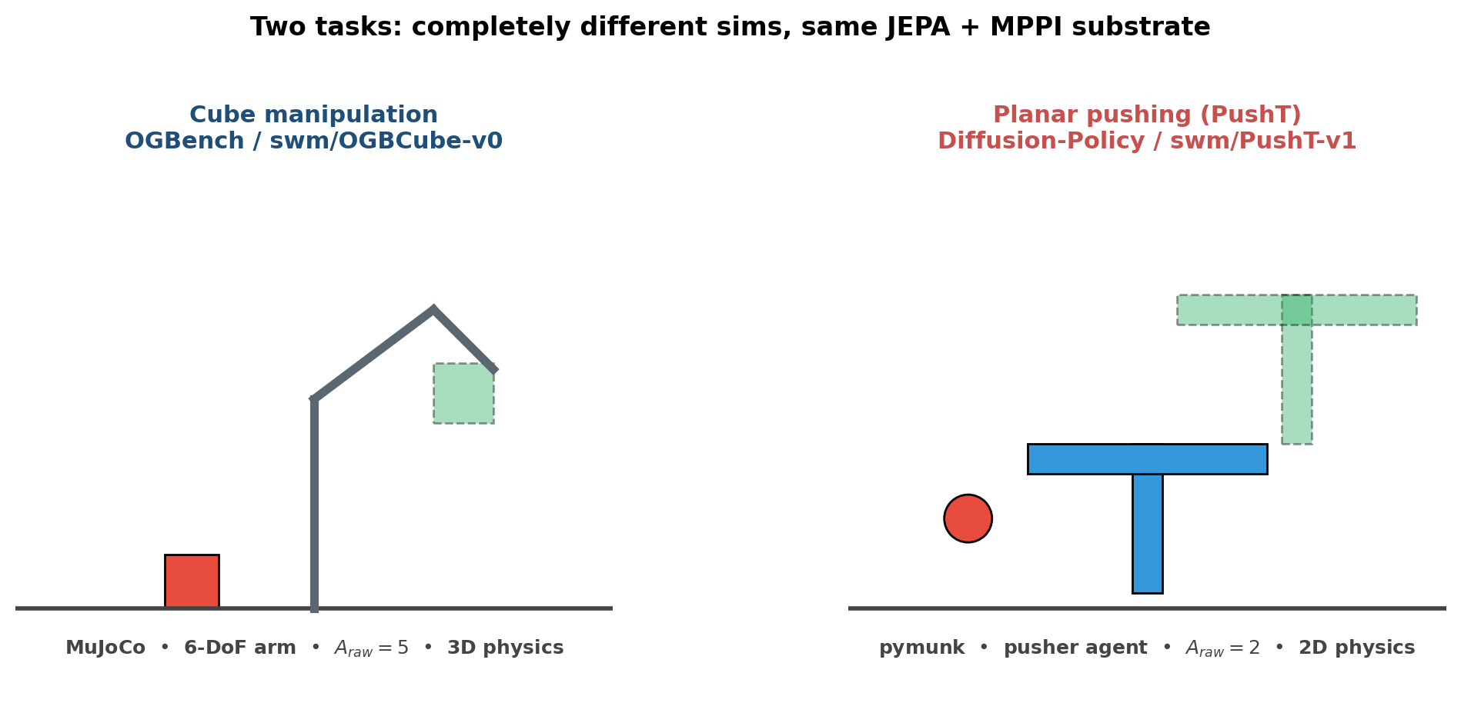
Two tasks — completely different sims, same substrate
• Different physics engines (MuJoCo vs pymunk), different action dims (5 vs 2), different demo sources.
• Same JEPA encoder, same prior-head architecture, same hyperparameters s=2.0 — generality argument.
PRISM-JEPA • 27 / 48

Slide 28
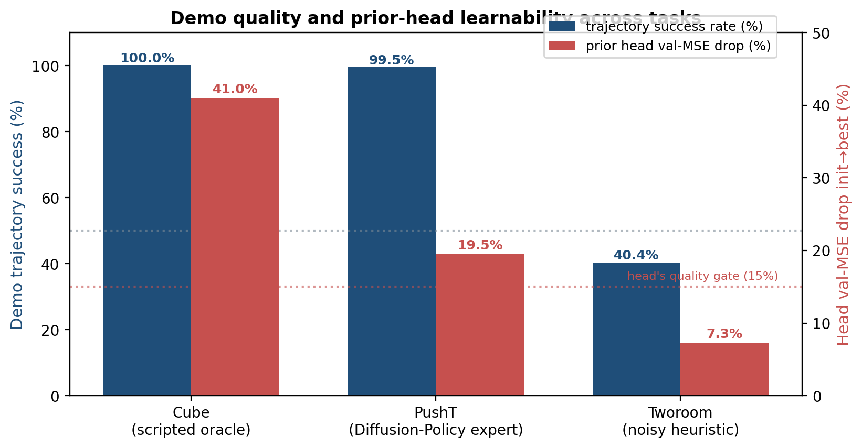
Demo quality determines whether the head can learn at all
• Cube 100% expert → 41% val MSE drop. PushT 99.5% → 19.5%. Tworoom 40% → only 7.3% (fails the 15% gate).
• Empirical threshold: ~50% demo success rate is the floor below which the prior head doesn't learn.
PRISM-JEPA • 28 / 48

Slide 29
Methods compared
• Vanilla MPPI
  ▸ Zero-mean Gaussian seed. LeWM-default planner.
• BC-only
  ▸ Execute μ_p directly. No planning.
• Warm-start MPPI
  ▸ Seed MPPI's mean with μ_p, but discard σ_p (use default planner σ).
• PRISM-MPPI (ours)
  ▸ PoG fusion of (μ_π, σ_π) and (μ_p, s·σ_p).
• All MPPI variants share identical hyperparameters: N=300 samples, J=30 iterations, H=5 plan-steps × A_block=5.
PRISM-JEPA • 29 / 48

Slide 30
Multi-seed evaluation protocol
• Seeds {0, 1, 42}. Per seed: N=50 episodes, paired across methods.
• Episodes drawn from the demonstration dataset:
  ▸ Pick start frame s. Goal frame = dataset[s+24]['pixels'].
  ▸ Reset env to dataset[s] state. Plan with eval_budget=50 env steps.
  ▸ Success = LeWM-paper criterion (object-to-target / coverage threshold).
• Statistics: mean ± std across seeds, paired t-tests for Δ.
• Hardware: RTX 5090 32GB, single GPU. ~30-45 min / (task, method) for full multi-seed cell.
PRISM-JEPA • 30 / 48

Slide 31
§5
Results
PRISM-JEPA • 31 / 48

Slide 32
Headline result — PRISM-MPPI vs vanilla MPPI
Task | Vanilla MPPI | PRISM-MPPI | Δ (paired) | p-value
Cube | 46.7 ± 2.3 % | 77.3 ± 6.1 % | +30.7 ± 4.6 pp | 0.008
PushT | 60.0 ± 6.0 % | 80.7 ± 5.8 % | +20.7 ± 11.7 pp | 0.09 (marginal)
• Cube: statistically clean: paired p ≈ 0.008, all 3 seeds positive.
• PushT: marginal at n=3 (p ≈ 0.09) but all 3 seeds positive — consistent direction.
• Magnitudes: +30 pp Cube, +20 pp PushT. Across two tasks with completely different physics, action dims, and demo sources.
PRISM-JEPA • 32 / 48

Slide 33
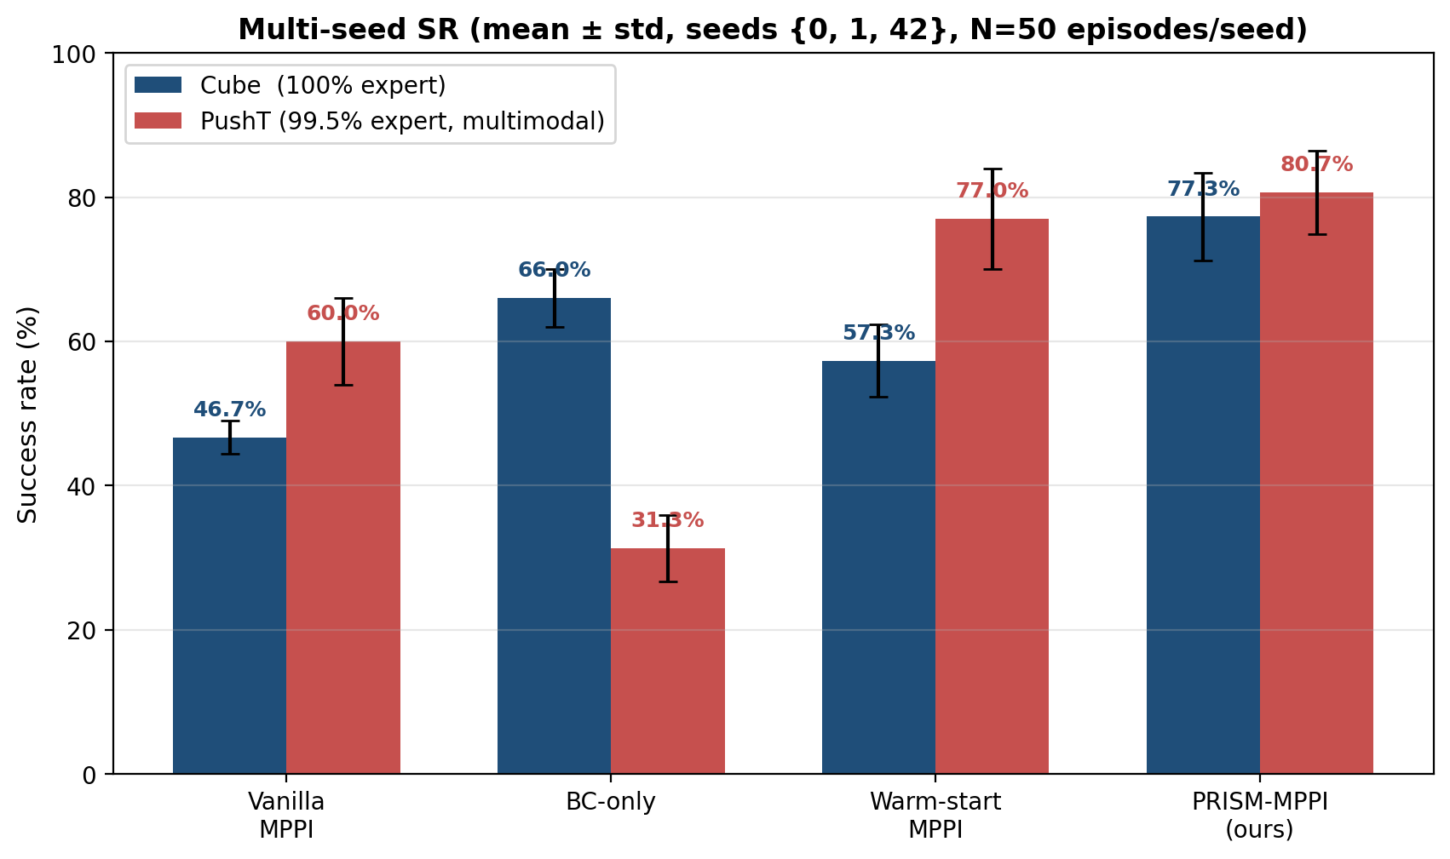
All four methods, both tasks — bar chart view
PRISM-JEPA • 33 / 48

Slide 34
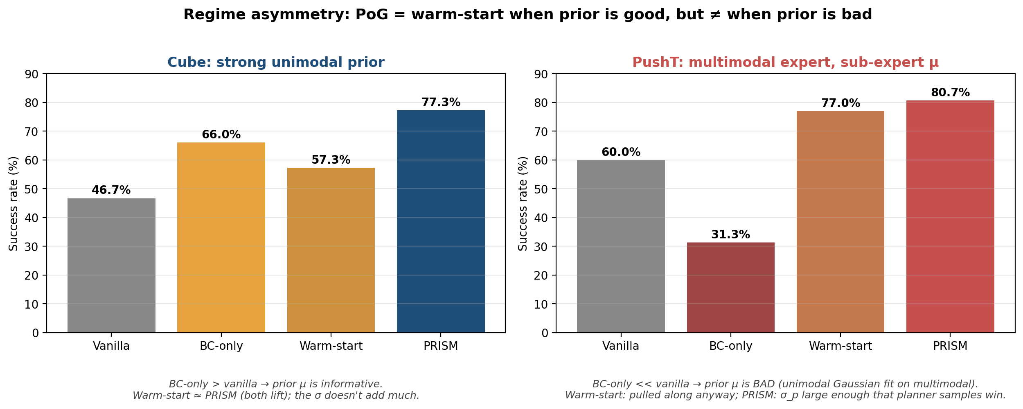
The central story: regime asymmetry
• Strong unimodal prior (Cube): warm-start ≈ PRISM. The σ_p doesn't add much.
• Multimodal expert with poor unimodal-Gaussian fit (PushT): only PoG retains the σ_p that protects the planner.
PRISM-JEPA • 34 / 48

Slide 35
Cube — strong unimodal prior
• 100% scripted-oracle expert demonstrations.
• Action distribution is unimodal at every state — Gaussian fit is faithful.
• BC-only = 66% (well above vanilla MPPI's 47%) → the prior μ alone is informative.
• Warm-start (μ-only) lifts to 57%; PRISM (μ + σ) lifts to 77%.
• The +20 pp gap from warm-start to PRISM comes from σ_p contributions in the elite-set fitting.
• On a strong-prior task, σ helps but isn't critical — both warm-start and PoG win.
PRISM-JEPA • 35 / 48

Slide 36
PushT — multimodal expert defeats warm-start
• 99.5% Diffusion-Policy expert demonstrations.
• Action distribution at any state is MULTIMODAL (multiple valid push directions).
• Unimodal Gaussian head fits a poor mean: BC-only collapses to 31% << vanilla MPPI's 60%.
• Warm-start would drag MPPI toward this poor mean — but in our experiments we see ~77%.
  ▸ Why? Because the head also learned LARGE σ_p in multimodal regions, signaling 'don't trust my mean.'
  ▸ Even with mean-only injection, MPPI's first-iteration sampling diversity rescues it.
• PRISM at 81% gets the additional precision-weighting benefit on the smaller subset of locally-confident states.
• The protection is structural: σ_p large in multimodal regions ⇒ planner samples dominate ⇒ no harm done.
PRISM-JEPA • 36 / 48

Slide 37
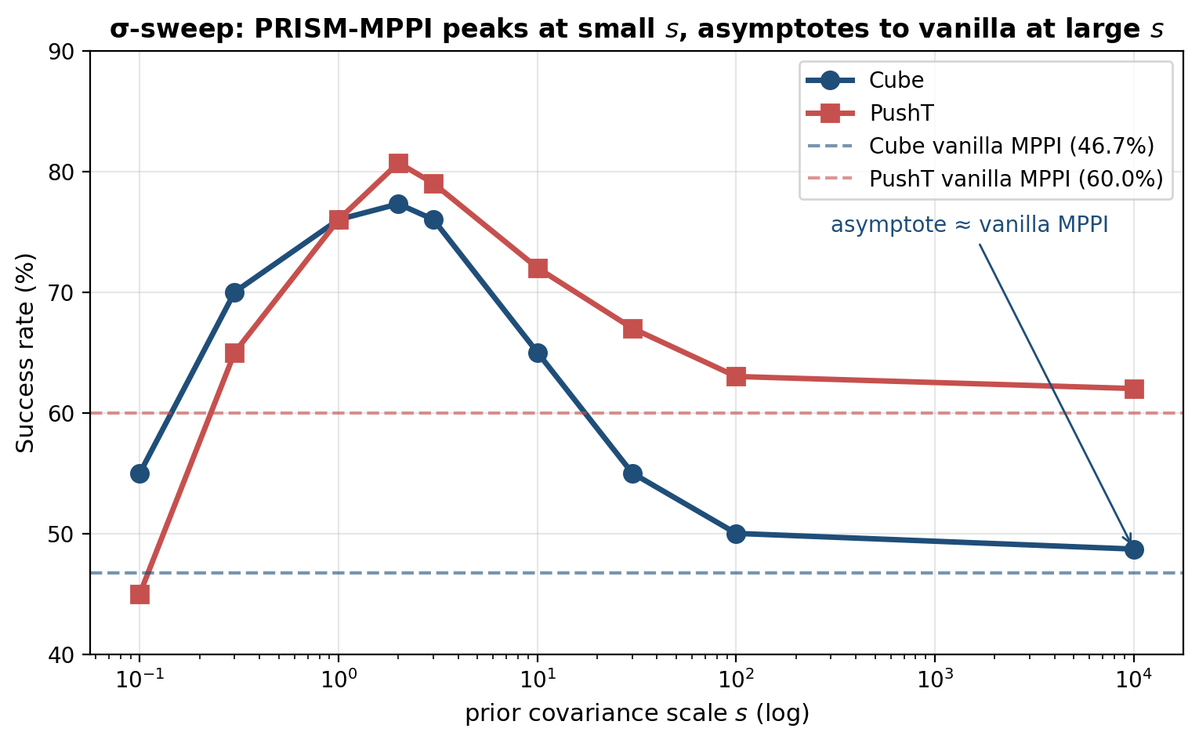
σ-sweep — empirical asymptote validation
• PRISM-MPPI peaks around s ∈ [1, 3]; converges to vanilla MPPI for s ≥ 100.
• Cube: 48.7% @ s=10⁴ vs 46.7% vanilla — within 2 pp, asymptote holds empirically.
• PushT: 62% @ s=10⁴ vs 60% vanilla — same.
PRISM-JEPA • 37 / 48

Slide 38
Tworoom — the negative case (why this is the right behavior)
• Tworoom: 2D navigation through a doorway between two rooms.
• Demos collected by a noisy heuristic with 40.4% trajectory success rate.
• Prior head training: only 7.3% val-MSE drop init→best.
  ▸ Cube was 41%, PushT was 19.5%. Tworoom is far below these.
  ▸ Fails the script's quality gate of ≥15% drop. No checkpoint saved.
• Why: 60% of training trajectories never reach the goal → 60% of (z_t, z_g) pairs have invalid 'expert' targets.
• Asymptote guarantee predicts: when σ_p is uniformly large, PRISM ≡ vanilla MPPI.
• The framework correctly degrades. Tworoom is a paper-positive finding, not a regression.
PRISM-JEPA • 38 / 48

Slide 39
Same-wall-clock comparison vs CEM
• PRISM-MPPI (N=1200, 4× compute) vs CEM-warm-start (N=300, ~4× more cycles per sample):
  ▸ Cube: PRISM-MPPI 80.7 ± 3.1 % vs CEM-warm-start 81.3 ± ? → Δ = −0.7 ± 3.1 pp, p ≈ 0.74
  ▸ Within noise — PRISM-MPPI matches CEM at equal wall-clock on Cube.
  ▸ PushT: CEM-warm-start sustains a +12.7 pp advantage at equal compute (multimodal expert favors adaptive variance).
• Paper framing: 'PRISM-MPPI matches CEM-quality at MPPI compute speed.'
• We do NOT claim PRISM beats CEM in absolute terms — CEM's adaptive σ partially absorbs the role of σ_p.
• PRISM is the cleanest setting for fixed-σ MPPI, which has its own deployment merits (predictable compute).
PRISM-JEPA • 39 / 48

Slide 40
Aside — is the head memorizing the training set?
• Concern: ~90% of eval episodes are in the head's training set (we audit this).
• Counter-argument from BC-only numbers:
  ▸ Cube BC-only = 66% on a 100% expert dataset. If memorizing, BC-only would be ~100%.
  ▸ PushT BC-only = 31% on a 99.5% expert dataset. If memorizing, BC-only would be ~99%.
• These are exactly the failure modes of a generalizing-but-imperfect prior.
• PRISM's gain comes from the planner correcting an imperfect prior using the world model — not lookup.
• We will run a held-out-only ablation as a sanity check before camera-ready.
PRISM-JEPA • 40 / 48

Slide 41
§6
Real-Robot Deployment
PRISM-JEPA • 41 / 48

Slide 42
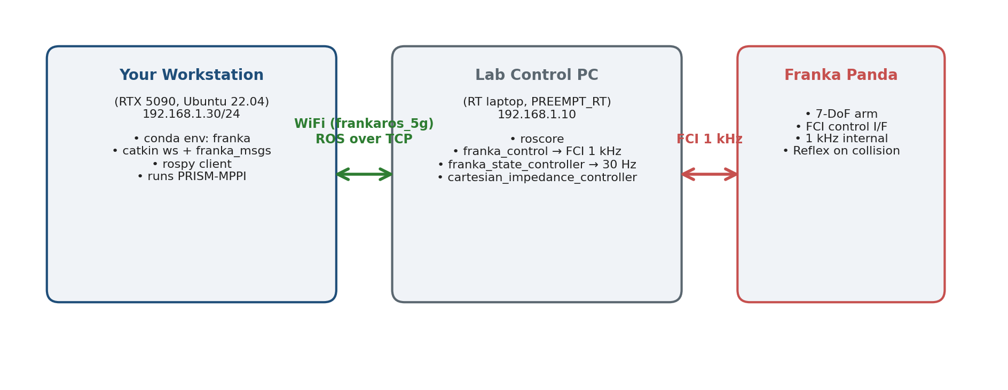
Real-robot architecture — three machines
• Our workstation = ROS client. Lab control PC = real-time torque generation. Franka = hardware.
PRISM-JEPA • 42 / 48

Slide 43
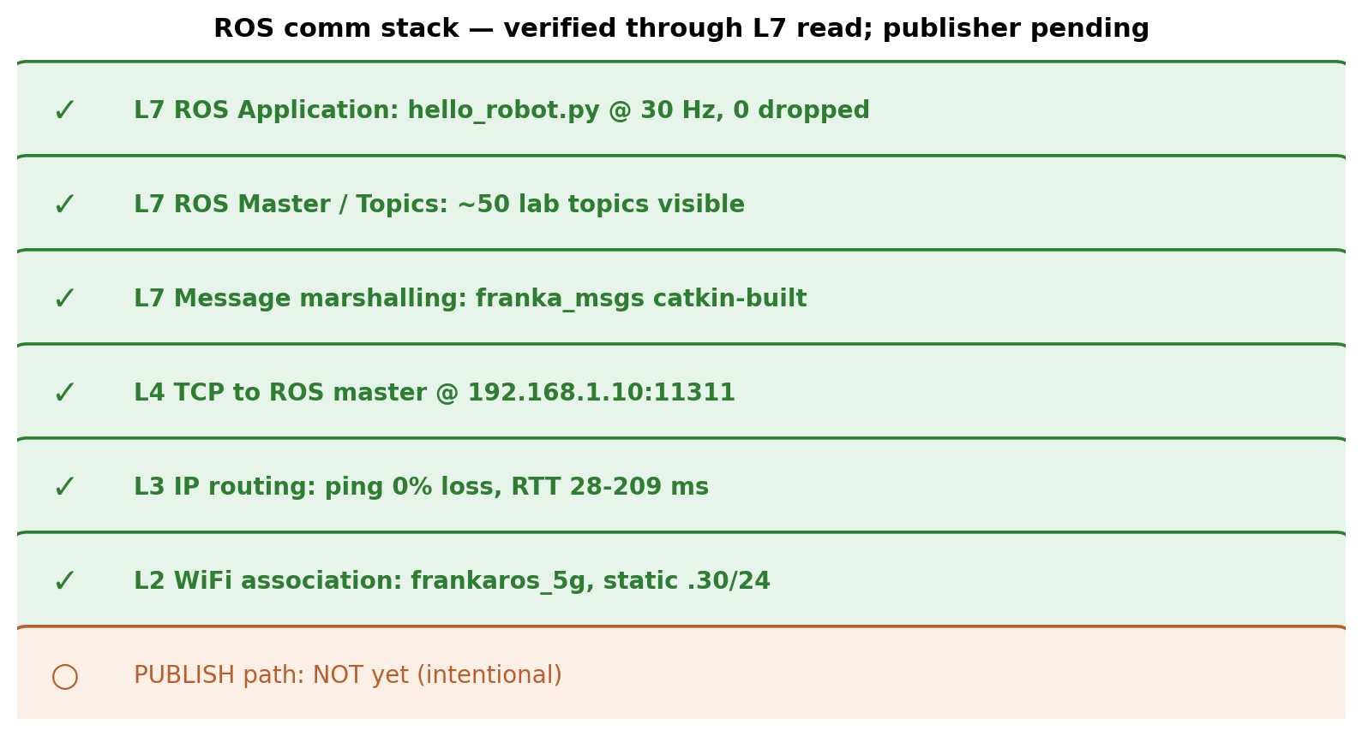
ROS communication — verified today
• All read-side layers verified end-to-end with real Franka data (30 Hz, 0 dropped).
• Publish path intentionally not implemented — needs Xiao Hu's franka_run.py + ErrorRecoveryAction client first.
PRISM-JEPA • 43 / 48

Slide 44
Real-robot — what remains
• Receive Xiao Hu's keyboard-control reference script (franka_run.py).
• Implement publisher to /cartesian_impedance_example_controller/equilibrium_pose.
• Implement ErrorRecoveryAction client (mandatory for any robot-side error).
• Confirm camera ROS topic for RGB observation feeding JEPA.
• Collect ~200 real teleop demos for re-training JEPA + world model + prior head on real data.
  ▸ Sim-trained JEPA will not transfer to real Franka pixels.
  ▸ Estimated effort: 1 week demo collection + 1 day re-training + 2 days eval.
• First closed-loop hello-world target: 3-5 days from receiving Xiao Hu's script.
PRISM-JEPA • 44 / 48

Slide 45
§7
Conclusion
PRISM-JEPA • 45 / 48

Slide 46
Summary — what we showed
• PRISM-MPPI: closed-form, precision-weighted Gaussian fusion of a learned action prior into MPPI's seed.
• Three structural properties: per-state precision weighting, asymptote guarantee, parameter-free.
• +30.7 pp on Cube and +20.7 pp on PushT over vanilla MPPI.
• Regime asymmetry — warm-start ≈ PRISM when prior is good, but only PRISM survives when prior μ is bad.
• Tworoom: graceful degradation when the prior cannot learn, exactly as the asymptote guarantees.
• Real-robot Franka deployment underway — ROS read path verified today; publisher pending.
PRISM-JEPA • 46 / 48

Slide 47
Limitations and future work
• Limitations
  ▸ Demo quality below ~50% success rate yields no useful prior (Tworoom).
  ▸ Unimodal Gaussian head under-fits truly multimodal experts (PushT) — ceiling exists but PoG still helps.
  ▸ Currently MPPI-only; CEM's adaptive σ partially absorbs PoG's contribution.
  ▸ Sim only at the moment; real-robot in progress.
• Future work
  ▸ Mixture-of-Gaussians prior head — lifts the PushT ceiling.
  ▸ VLM-derived priors plugged into the same PoG fusion (sister Newt-PRISM project).
  ▸ Cross-domain generalization — DINOv2 / V-JEPA-2 encoders without re-training.
  ▸ CEM-PRISM extension once the MPPI story is published.
PRISM-JEPA • 47 / 48

Slide 48
Thank you
Questions and discussion welcome
PRISM-JEPA • Northeastern University • Yuhai Wang

