Slide 1
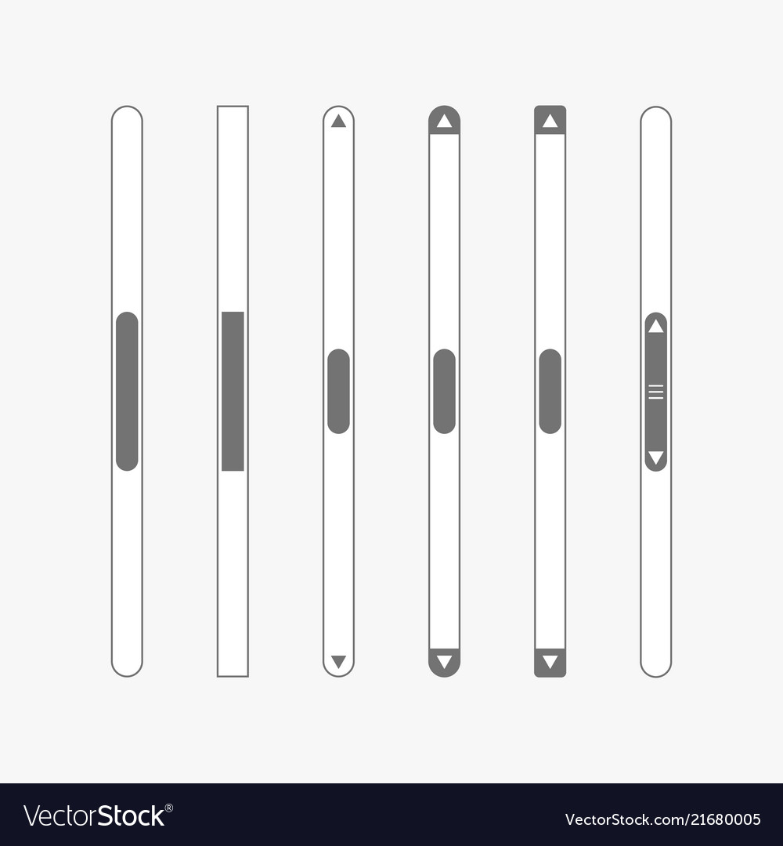





Bench press
Train mainly: 70% chest
Material: Dumbell, bench
Time for 10 reps: 60
Weight for 10 reps: 56 kg Type: Main
Rest time multiplified by: 1.7
First launch ! Welcome to the app. Chose you level. It will affect weight recommandation. You can ulteriorly modify the weight.
Bench press bis
Train mainly: 70% chest
Material: Dumbell, bench
Time for 10 reps: 60
Weight for 10 reps: 56 kg Type: Main
Rest time multiplified by: 1.7
Bench press ter
Train mainly: 70% chest
Material: Dumbell, bench
Time for 10 reps: 60
Weight for 10 reps: 56 kg Type: Main
Rest time multiplified by: 1.7
casual
Bench press
Train mainly: 70% chest
Material: Dumbell, bench
List
New
Edit
Saved

Slide 2
Bench press
Train mainly: 70% chest
Material: Dumbell, bench
Time for 10 reps: 60
Weight for 10 reps: 56 kg Type: Main
Rest time multiplified by: 1.7
Bench press bis
Train mainly: 70% chest
Material: Dumbell, bench
Time for 10 reps: 60
Weight for 10 reps: 56 kg Type: Main
Rest time multiplified by: 1.7
Bench press ter
Train mainly: 70% chest
Material: Dumbell, bench
Time for 10 reps: 60
Weight for 10 reps: 56 kg Type: Main
Rest time multiplified by: 1.7
Bench press
Train mainly: 70% chest
Material: Dumbell, bench
List
New
Edit
Saved

Slide 3
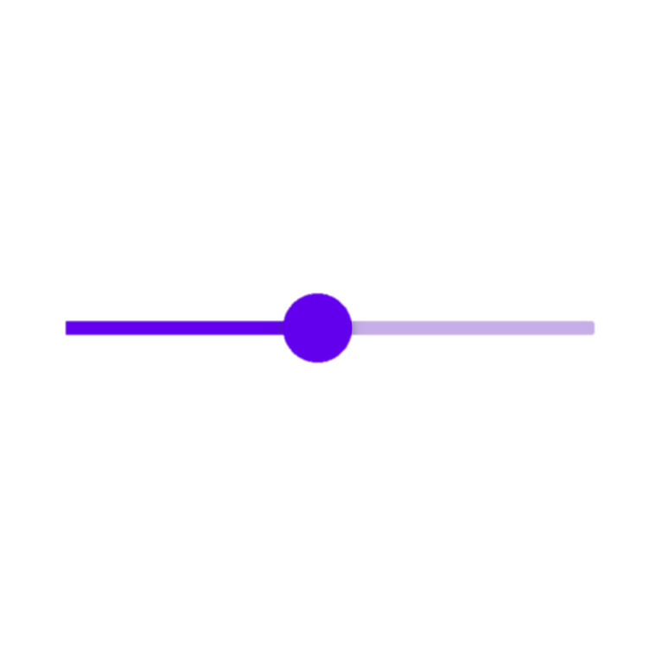


Chest
Value: 0.49
Lats
Value: 0.47
’Others sliders go there (13 sliders in total, total sum can’t exceed 1)
.
.’
Choose focus
Strength
Hypertrophy
Endurance
’Click on one of the three only’
Total training time (minutes)
Rest time (seconds)
Number of exercises
’enter integer, you can use a slider if you want’
Choose Equipment
Dumbbells
Bench
’you can use a dropdown list if you want. There are 10 equipment’
Warmup ?
Cooldown ?
No
Yes
List
New
Edit
Saved

Slide 4
Chest
Value: 0.49
Lats
Value: 0.47
Choose focus
Strength
Hypertrophy
Endurance
’Click on one of the three only’
Total training time (minutes)
Rest time (seconds)
Number of exercises
’enter integer, you can use a slider if you want’
Choose Equipment
Dumbbells
Bench
’you can use a dropdown list if you want. There are 10 equipment’
Warmup ?
Cooldown ?
No
Yes
None
Abs
Stretching
Generate training
List
New
Edit
Saved

Slide 5
Exercise 1:
Bench press
Jpg
Kg reps sec
Set 1/5
Rest 1
Set 2/5
Rest 2
….
50
10
42
60
+
Your input: 70 0 0 0 22 0 8 0 0 0 0 0 0
Outcome: 62 0 0 2 24 0 11 0 1 0 0 0 0
Match: 82.5 %
Training duration (updated): 1:32:12
Start
Save
List
New
Edit
Saved

Slide 6
Exercise 1:
Bench press
Jpg
Leave
50 kg
10 reps
37:98s
Decreasing with sound at the end
Previous
Next exercise

Slide 7
Training 1> 1:32:12, 5 exercises, 60s rest time, focusing on strength.
Vector: 62 0 0 2 24 0 11 0 1 0 0 0 0
Start
List
New
Edit
Saved

