Slide 1

ADAMA SCIENCE AND TECHNOLOGY UNIVERSITY(ASTU)
PROGRAM OF COMPUTER SCIENCE AND ENGINEERING(CSE)

Slide 2
PROJECT TITLE:
TEFF SOWING AGROBOT(TSA)

Slide 3
LAY OUT
  Introduction
  Problem Statement.
  Objectives.
  Functional Requirement
  Development tools
  Agrobot Design
  Simulation Results.
  Conclusions.
  Recommendation.

Slide 4
Introduction
Seeding Agrobot is an automation robot used in farming to sow seed in row manner and helps to improve efficiency and reduce reliance on manual labor by automating manual row seeding mechanism.

Slide 5
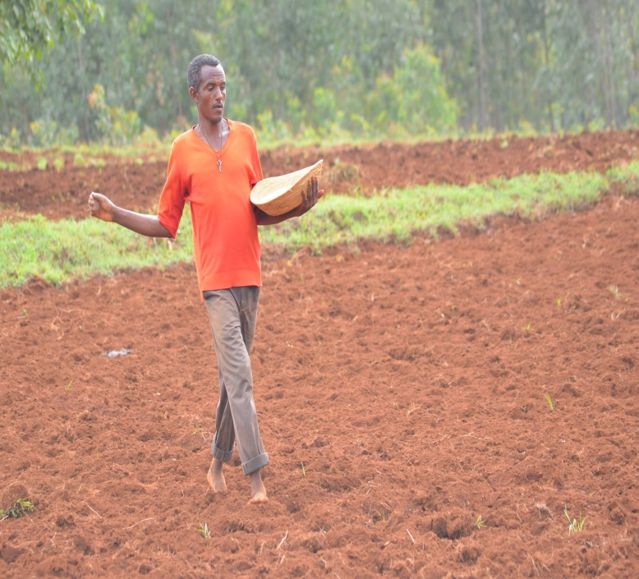
Statement of the problem
it does not give proper row spacing
it needs more labor force
Requires more Teff.

Slide 6
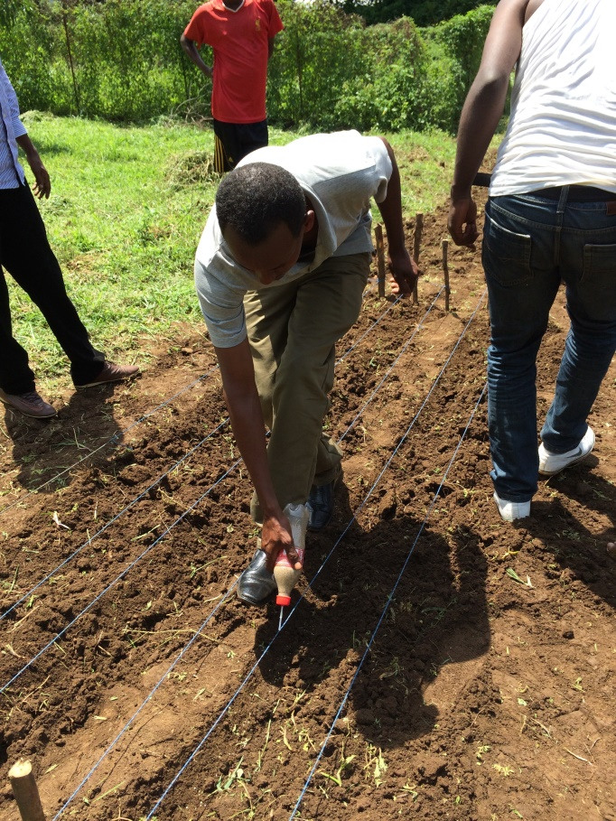
it results in a back ache
requires more time

Slide 7
General Objective
The general objective of this system is to sow Teff in agricultural field with row manner controlled by mobile app.

Slide 8
Specific Objective
✓ Study the existing systems
✓ Design Agrobot
✓ Implement using the selected tools
✓ Test the system
✓ Deploy the system

Slide 9
Scope
sow on prepared land.
user can manipulate the robot by application or using keys on it.

Slide 10
Limitation
✓ The bar on which the robot moves is controlled or moved by the person.
✓ Life time of battery is limited.

Slide 11
Significance of the project
✓ increase productivity.
✓proper row spacing.
✓ Seed rate controlling.
✓ is portable
✓ Cost efficient and saves energy
✓ saves seed.

Slide 12
Functional Requirement
    agrobot side
Control movement
Notify critical level
Farmland coverage
Determine seed level
Row spacing

Slide 13
continued
    software side
    Registration
    Login
    View details
    Generate report
    Control movement
    Manage input

Slide 14
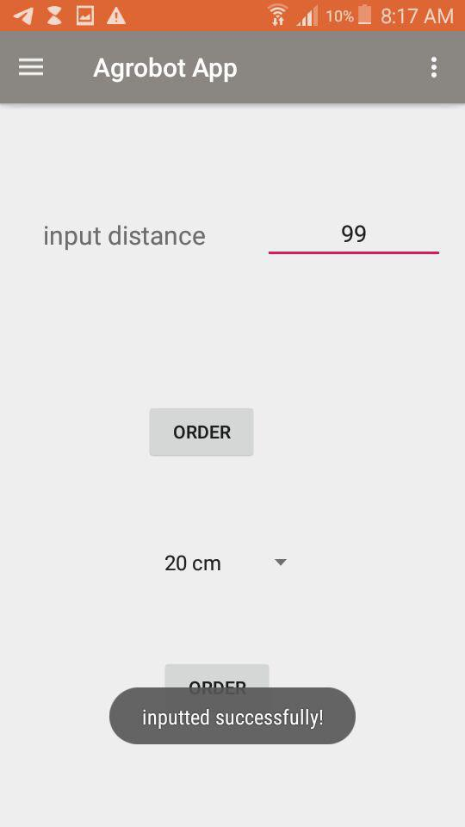
The UI part of input distance to sow

Slide 15
Development tools
Mechanical tools
Electrical tools
Software tools

Slide 16
Mechanical tools
Wood
Belt
Bearing
Plastic bottle
Plastic tube

Slide 17
Electrical tools
Key pad
LCD
Push button Arduino
NodMCU esp 8266
Wires
Stepper motors
Etc…

Slide 18
Agrobot Design
our main task was
To design the Agrobot
Mechanical parts
Electrical parts
Software parts

Slide 19
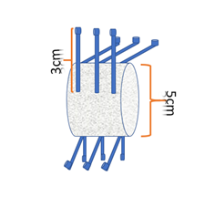
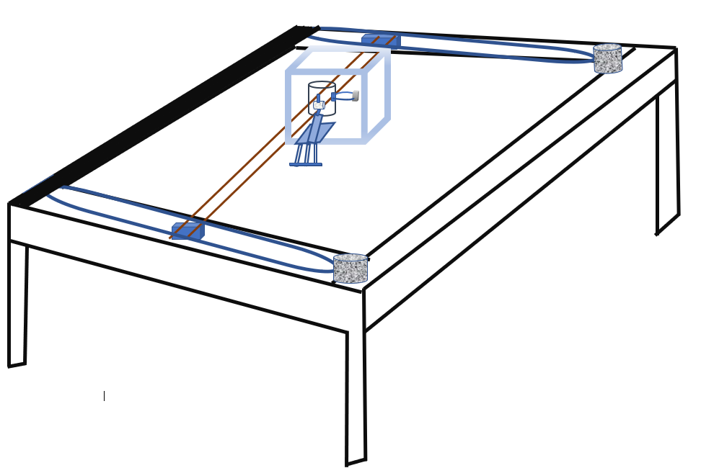
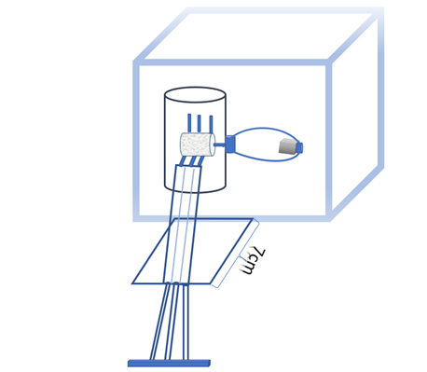
Mechanical parts

Slide 20
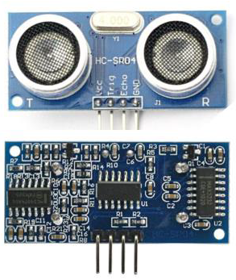
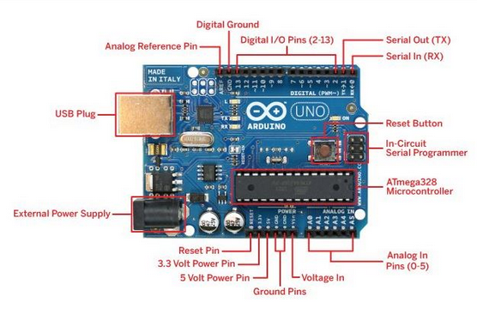
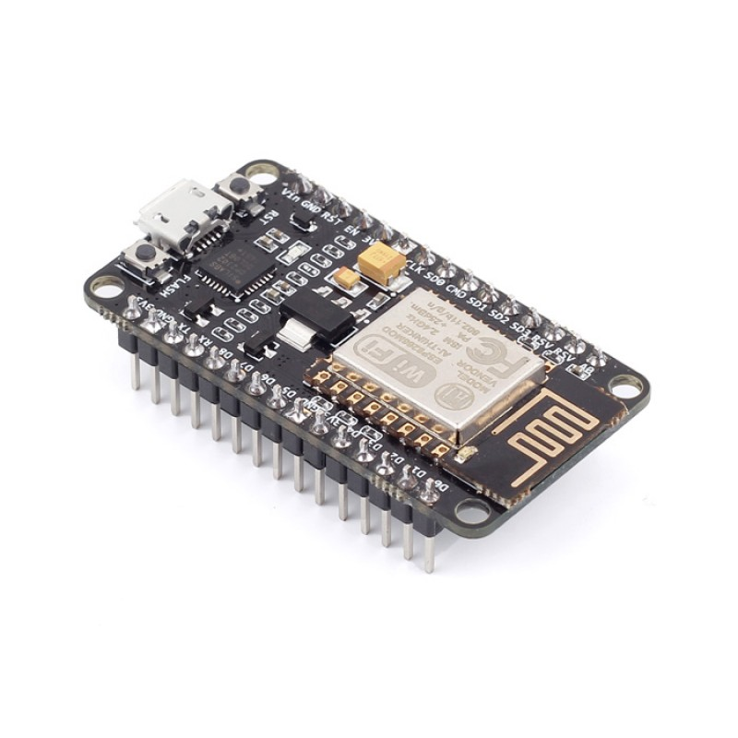
Electrical parts

Slide 21
Software parts
Software tools hardware tools
Android java embedded c language
Php json
Json
MySQL
Apache
hardware tools User interface
Push button xml
LCD
keypad

Slide 22
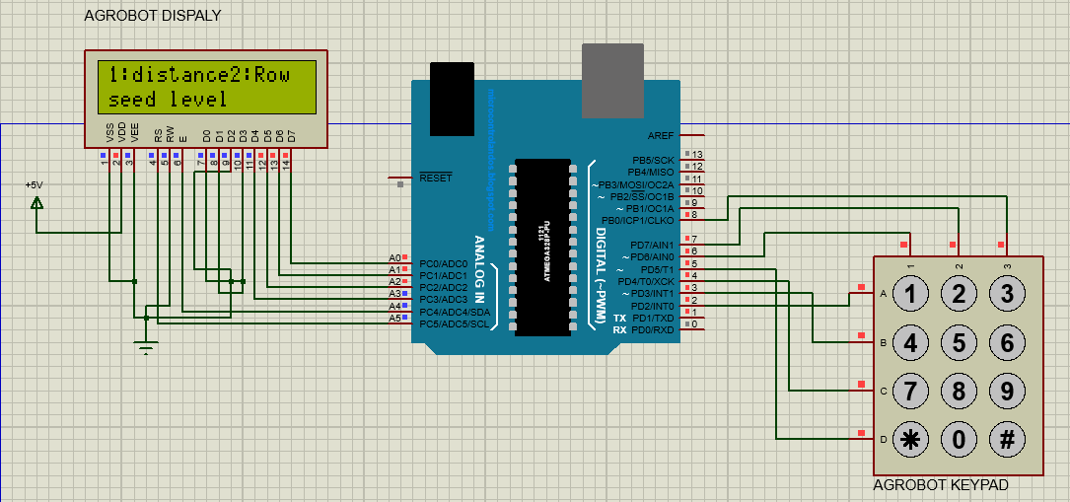
Simulation results

Slide 23
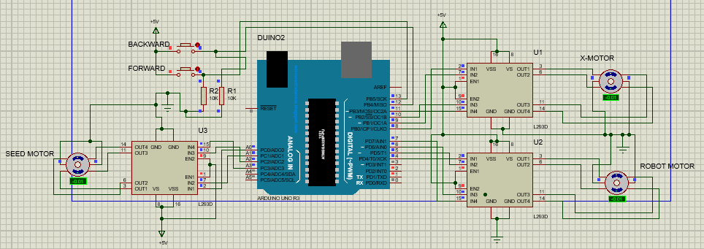
Continued

Slide 24
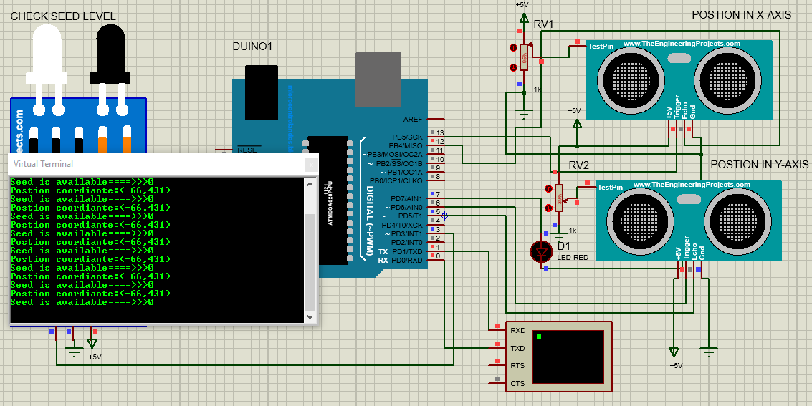
Continued

Slide 25
Conclusion
The benefit of our system is that the robot is small and electrically operated .
there is no need of mechanical support from human or animal.
It also provides row spacing, and coverage calculation mechanism and mainly it increases productivity, minimize the work of farmer and also reduces the time for seed sowing operation.

Slide 26
Recommendation
➢ The battery of the agrobot can be replaced with solar system.
➢ The number of rows sowed at a time can be increased.
➢ Using drone for sowing.
➢Using memory slots to store data.

Slide 27

If any Question you are welcome

