Slide 1
Predictive analysis on the impact of robot adoption in the manufacturing sector
Adam Abdellaoui, Lead Developer
Brandon McLean, Leada Researcher

Slide 2
Background
Predictive analytics is a useful tool in forecasting across many sectors: economics, healthcare, logistics, sciences, & manufacturing. Often used to support government policy
Robot adoption worldwide is on the rise, with 500,000+ installed annually
Industrial robots have become more advanced, efficient, and diverse over recent years
Supported by Industry 4.0 (Fourth Industrial Revolution), Internet of Things, and increased demand for automation

Slide 3
Research Questions
How can machine learning models improve the accuracy of GDP forecasting compared to traditional econometric approaches when incorporating high-dimensional macroeconomic and technological variables?
To what extent does industrial robotics adoption in manufacturing contribute to productivity gains and GDP growth in national economies?
Can ML-forecasting models capture the macroeconomic impact of automation and robotics adoption across economic sectors

Slide 4
Robotics and automation
Automation & robotics technology in the construction industry increased productivity, safety, & operational efficiency (T. Patel, Bapat & D. Patel, 2024 )
Adoption barriers include: high implementation cost, lack of technical expertise, interoperability challenges with legacy systems and existing infrastructure. (F. Zhang, Deng, C. Zhang, Liu, Zou, Wang & Guo, 2025)
Globally annual installations surpassed 500,000 units in 2020 (Urrea & Kern, 2025). China is a large supporter of the use of industrial robots and increased domestic stock to 3 million units in 2025 (Cui, Yao, Meng, Zao & Liu, 2026)

Slide 5
Econometric modeling
Information and Communication Technologies (ICT) development measured and modeled to asses the relationship between ICT advancement and economic performance (Elbatal, Sarwar, Daniyal, Hussain, & Ghorbal)
Commonly leveraged ML techniques — Linear Regression, Decision Trees, Random Forest, and XGBoost
Predictive accuracy varies significantly across sectors and geographic regions

Slide 6
Research Gaps
Country specific datasets limits generalizability
Lack of standardized processes

Slide 7
How our project builds upon these works
Using predictive analysis models as our base we modify and customize our model to focus on a specific sector and predict scenarios of increased automation
Previous works have provided necessary categorization of features (Domestic Value in Exports, Foreign Value added in Exports, Global Value Chain Participation, etc.)
Utilizes established data on industrial robot adoption as a key feature

Slide 8

Data Flow
OWID
IMF database
OECD
Training set
Preprocessing
World Bank
Testing set

Slide 9
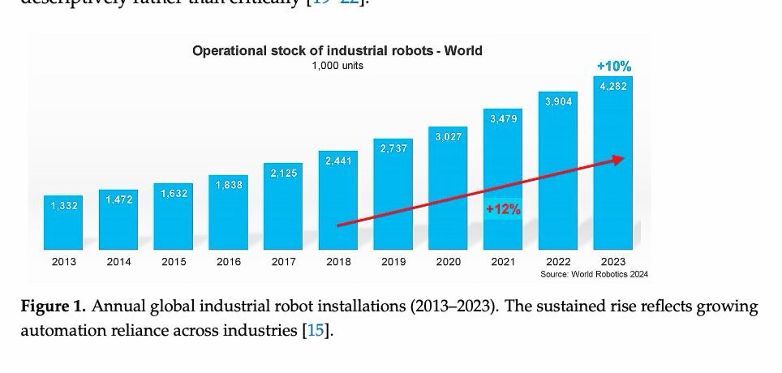

Slide 13
Conclusion
Robot adoption is on the rise globally
High input costs for small and medium organizations serve as a barrier to adoption
Predictive analysis enables proactive action and discussion, helpful in public and private policy
Many macroeconomic models are designed for single countries

Slide 14
References
Muth, M., Lingenfelder, M., & Nufer, G. (2024). The application of machine learning for demand prediction under macroeconomic volatility: a systematic literature review. Management Review Quarterly. https://doi.org/10.1007/s11301-024-00447-8
‌Oh, J. (2025). Economics of long jump: Growth trajectories of South Korea, Japan, and China, and lessons to emerging economies. Asia Pacific Management Review, 30(3), 100370. https://doi.org/10.1016/j.apmrv.2025.100370
Adewale, M. D., Ebem, D. U., Awodele, O., Sambo-Magaji, A., Aggrey, E. M., Okechalu, E. A., Donatus, R. E., Olayanju, K. A., Owolabi, A. F., Oju, J. U., Ubadike, O. C., Otu, G. A., Muhammed, U. I., Danjuma, O. R., & Oluyide, O. P. (2024). Predicting gross domestic product using the ensemble machine learning method. Systems and Soft Computing, 6, 200132. https://doi.org/10.1016/j.sasc.2024.200132
Elbatal, I., Sarwar, M., Jamal, F., Daniyal, M., Hussain, Z., & Ben Ghorbal, A. (2025). Modelling on gross domestic product annual growth rate data by using time series, machine learning, and probability models. Journal of Radiation Research and Applied Sciences, 18(2), 101481. https://doi.org/10.1016/j.jrras.2025.101481
Shaker, M. T., Hadeer El-Batanouny, Abdelsalam, M., & Helmy, Y. (2024). Systematic Review of Machine Learning Approaches in Forecasting Economic Growth and Enhancing Decent Work Opportunities: A Comprehensive Analysis. 377–392. https://doi.org/10.1109/icci61671.2024.10485171
Birigozzi, A., Silva, C. D., & Luitel, P. (2025). Digital payments and GDP growth: A behavioral quantitative analysis. Research in International Business and Finance, 75, 102768–102768. https://doi.org/10.1016/j.ribaf.2025.102768

Slide 15
References
Magoutas, A. I., Chaideftou, M., Skandali, D., & Chountalas, P. T. (2024). Digital Progression and Economic Growth: Analyzing the Impact of ICT Advancements on the GDP of European Union Countries. Economies, 12(3), 63. https://doi.org/10.3390/economies12030063
Edquist, H., Goodridge, P., & Haskel, J. (2021). The Economic Impact of Streaming beyond GDP. Applied Economics Letters, 29(5), 1–6. https://doi.org/10.1080/13504851.2020.1869158
Guarino, I., Montieri, A., Ciuonzo, D., & Pescapè, A. (2025). Explainable Predictive Analysis of the Economic and Financial Performance of Italian Publicly Owned Companies. 2025 International Conference on Artificial Intelligence in Information and Communication (ICAIIC), 0087–0092. https://doi.org/10.1109/icaiic64266.2025.10920689
Vasenska, I. (2025). Comparative Analysis of Machine Learning and Deep Learning Models for Tourism Demand Forecasting with Economic Indicators. FinTech, 4(3), 46. https://doi.org/10.3390/fintech4030046
Richardson, A., van Florenstein Mulder, T., & Vehbi, T. (2020). Nowcasting GDP using machine-learning algorithms: A real-time assessment. International Journal of Forecasting. https://doi.org/10.1016/j.ijforecast.2020.10.005
‌
‌

Slide 16
References
Urrea, C., & Kern, J. (2025). Recent Advances and Challenges in Industrial Robotics: A Systematic Review of Technological Trends and Emerging Applications. Processes, 13(3), 832. https://doi.org/10.3390/pr13030832
Obosu, M., & Frimpong, S. (2025). Advances in Automation and Robotics: The State of the Emerging Future Mining Industry. Journal of Safety and Sustainability. https://doi.org/10.1016/j.jsasus.2025.05.003

