Slide 1
Network Intrusion Detection Systems (NIDS)
Group 4:
1. Yomna Mohamed Sayed Ahmed 300327217
2. Khaled Mohamed Mohamed Mahmoud 300327242
3. Marwa Hamdi Boraie Mahmoud 300327267

Slide 2
Problem’s overview
Attacker
PC 1
DDoS
Port scan
Flow Table Overflow
Router/Switch
PC 2
X
Blackhole
X
Traffic Diversion
PC 3
X

Slide 3
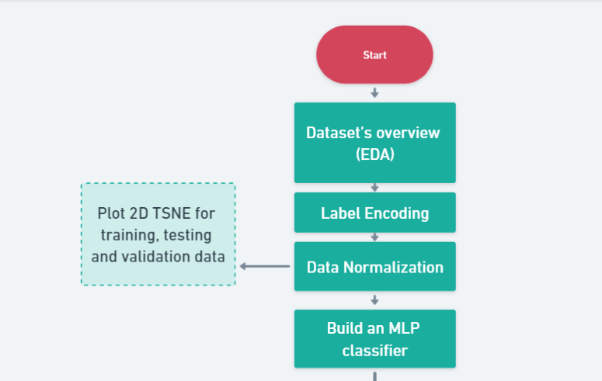
Project Flow
https://whimsical.com/ml-project-flow-QET8JpXTdwPbvxBarMWFga

Slide 4
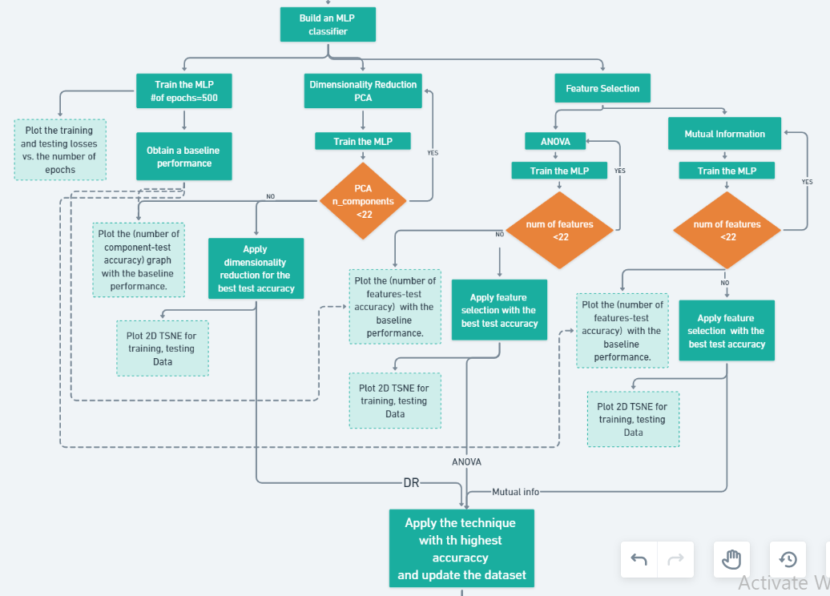

Slide 5
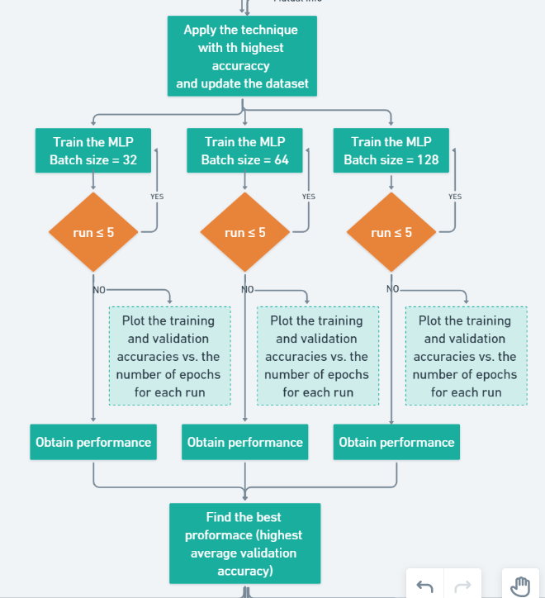

Slide 6
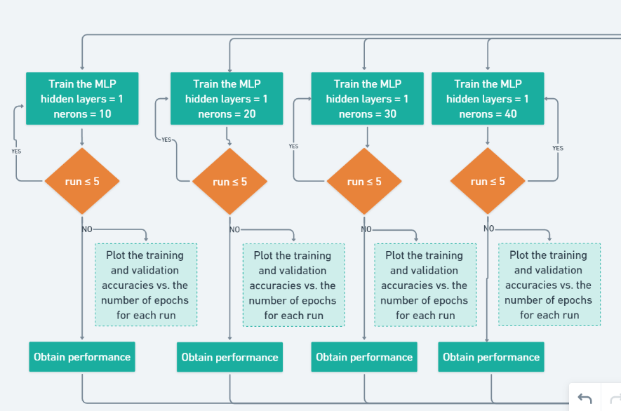
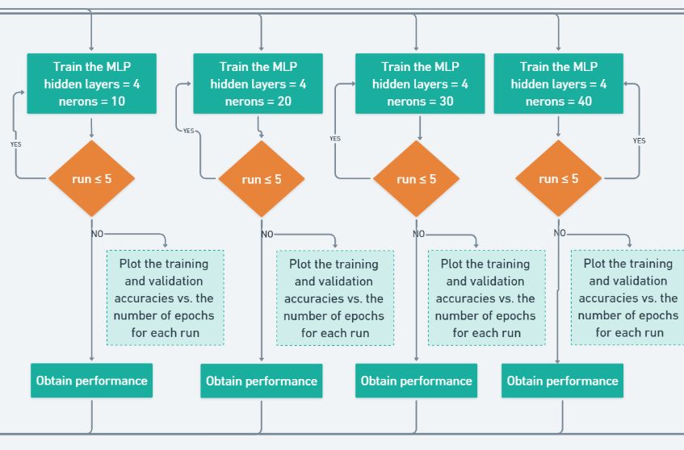
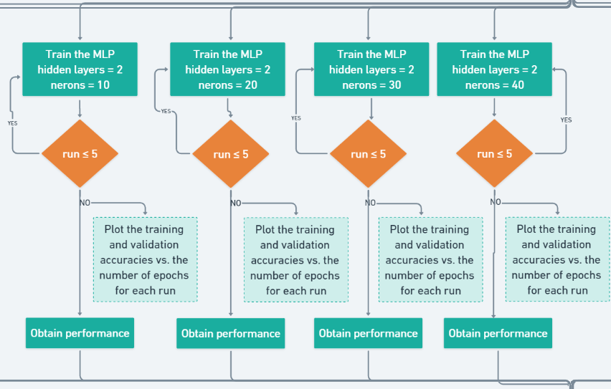
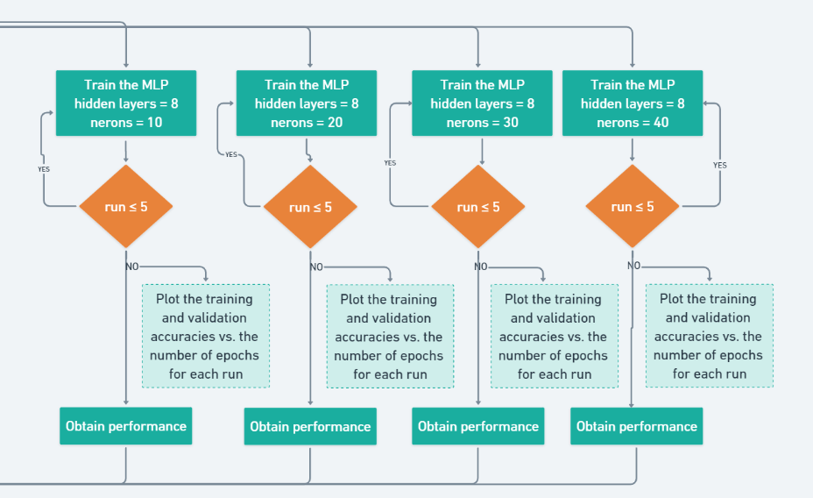

Slide 7
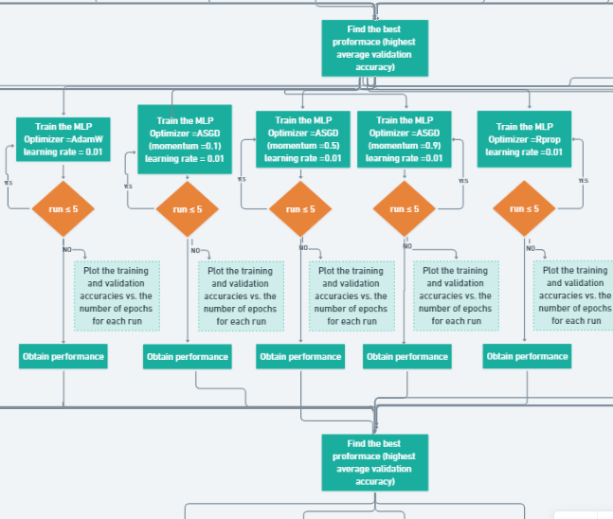

Slide 8
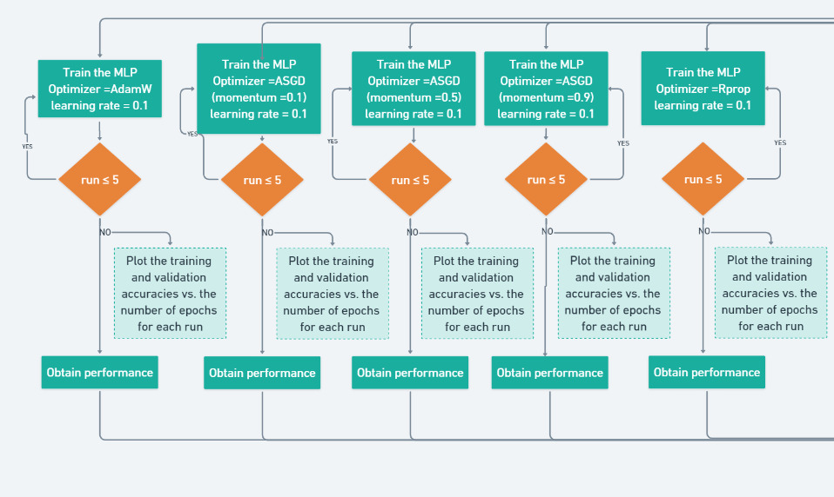
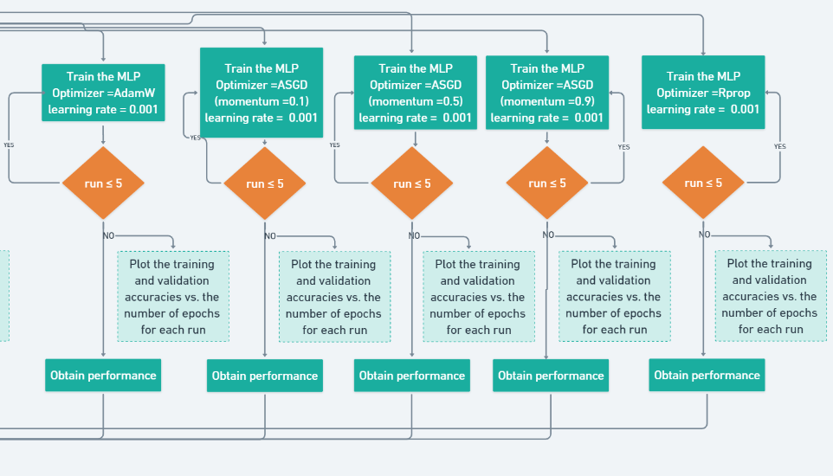

Slide 9
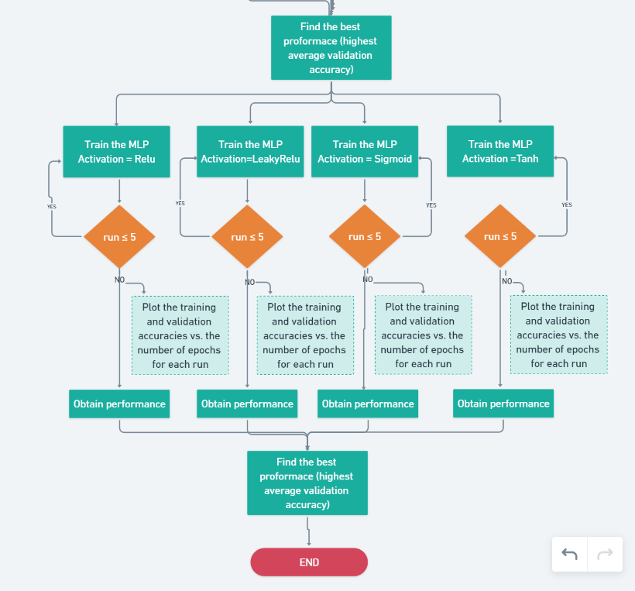

Slide 10
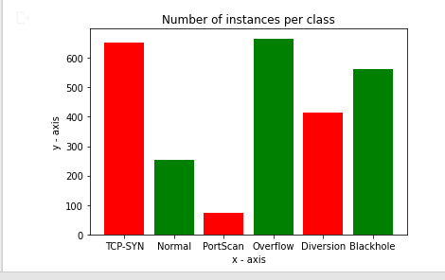
Dataset’s overview (EDA)
Number of instances per class

Slide 11
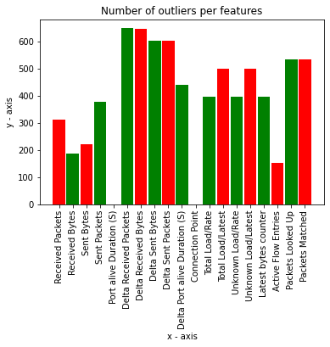
Number of possible outliers

Slide 12
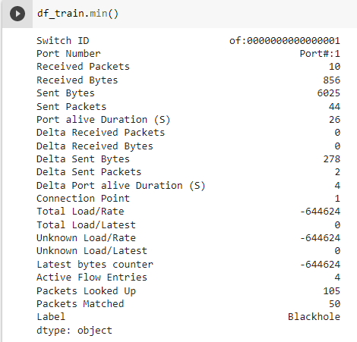
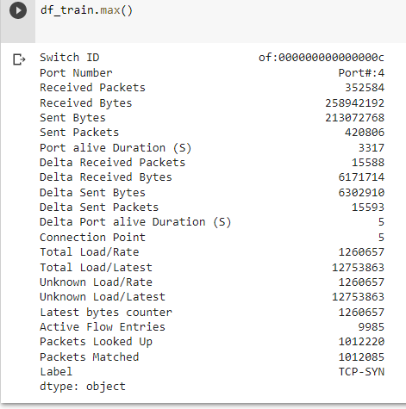
Basic statistical analysis for every feature (mean, std, min, max)

Slide 13
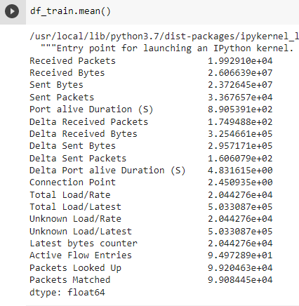
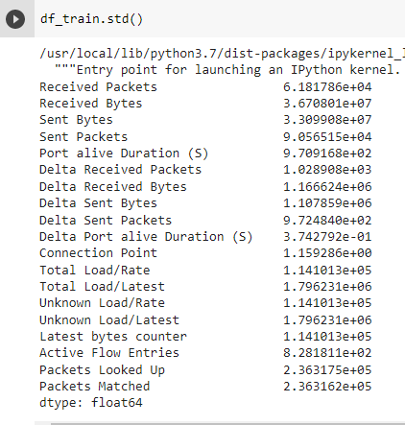

Slide 14
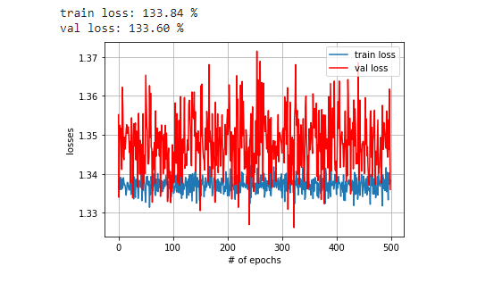
Plot the training and testing losses vs. the number of epochs
Max training acc | Max test acc | Min training acc | Min test acc | Avg training acc | Avg test acc
60.323% | 65.78% | 49.789 % | 45.81 % | 51.5% | 49.946%

Slide 15
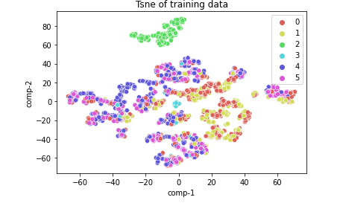
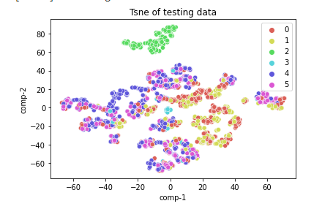
Provide 2D TSNE plots, one for the training set, one for the test set, and one for the validation
2D TSNE for training set
2D TSNE for testing set

Slide 16
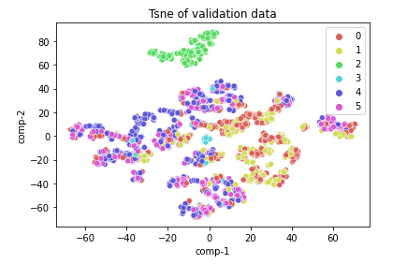
2D TSNE for validation set

Slide 17
Q2) Compre dimensionality reduction to feature selection
Q2.1) Dimensionality reduction
• Firstly using the dimensionality reduction by PCA,
•To get the best number of features based on the MLP test accuracy ,we apply the PCA on features by loop and we got when the n_component=17 that give us the highest test accuracy
•The best value for n_components =17 , that given 73 % accuracy based on the test accuracy of the MLP classifier, using Principal Component Analysis( PCA)

Slide 18
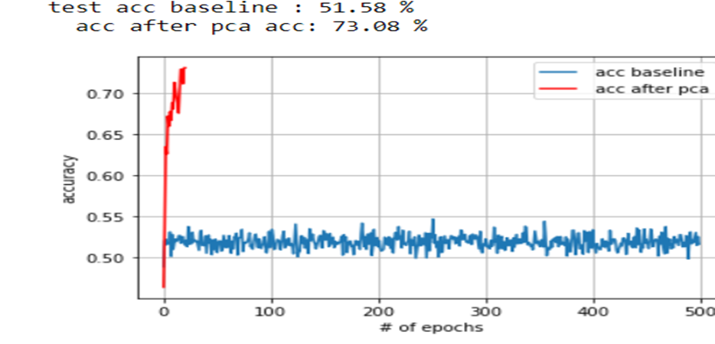
Plot the (number of component-test accuracy) graph with the baseline performance

Slide 19
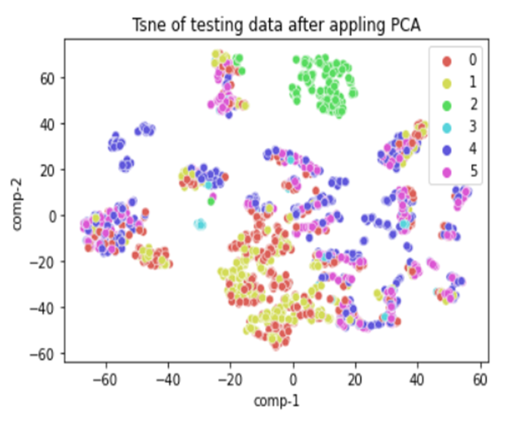
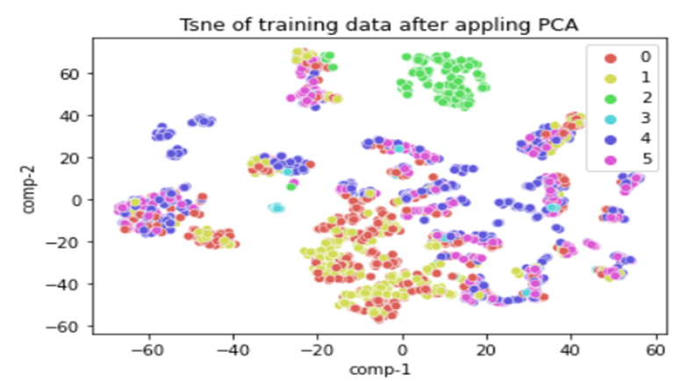
Apply TSNE(n_components=2, random_state=0) to visualise the training and test datasets after DR
Apply TSNE on the training set
Apply TSNE on the testing set

Slide 20
•Q2.2) Feature selection
•Find the best number of features based on the MLP test accuracy, using the feature selection methods:
–ANOVA
–Mutual Information
• Firstly using the feature selection by ANOVA,
To get the best number of features based on the MLP test accuracy ,we applied the an ANOVA by loop and we got when the n_component=11 it give us the highest accuracy

Slide 21
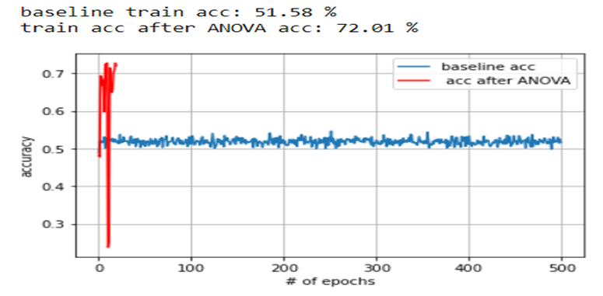
•Plot the (number of component-test accuracy) after appling ANOVA feature selection graph with the baseline performance

Slide 22
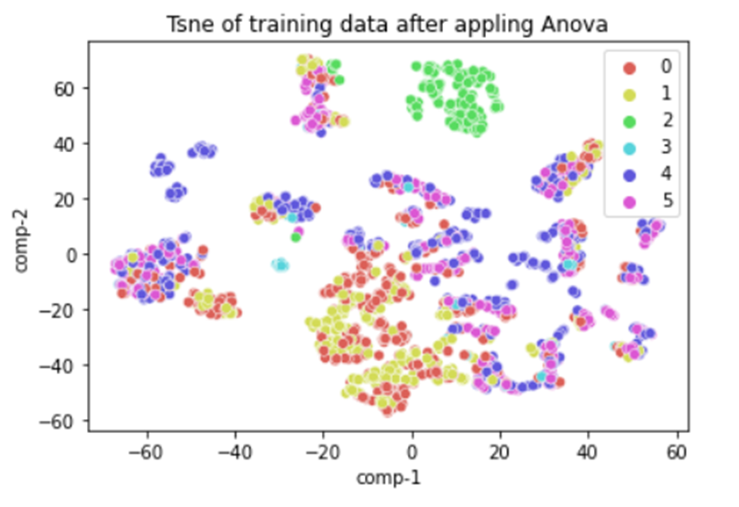
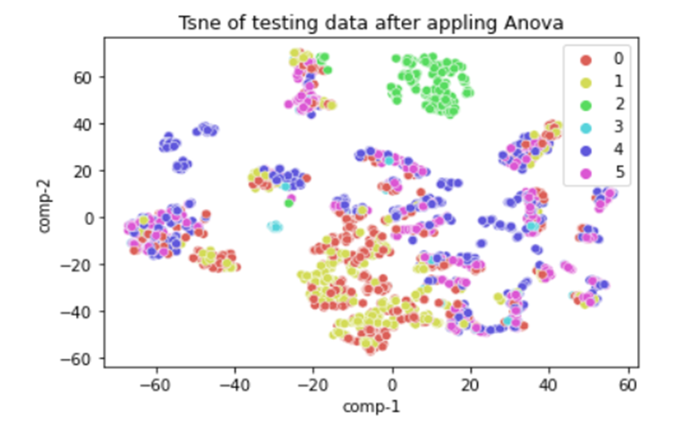
•Apply TSNE on the training set after Apply ANOVA
•Apply TSNE on the testing set after Apply ANOVA

Slide 23
•Secondly using the feature selection by Mutual Information
•To get the best number of features based on the MLP test accuracy ,we apply the Mutual Information feature selection technique on features by loop and we got when the n_component=13 that give us the highest accuracy

Slide 24
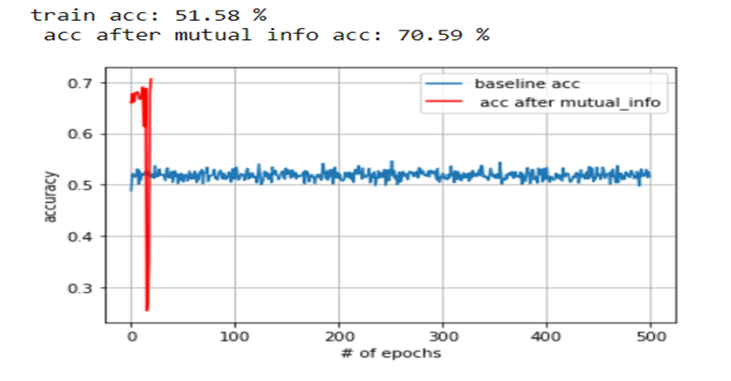
•Plot the (number of component-test accuracy) graph after apply Mutual Information with the baseline performance

Slide 25
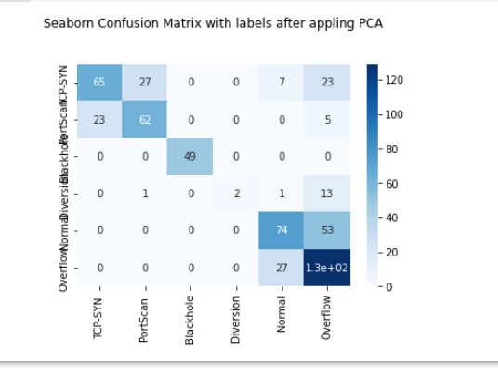
•The technique that provides you with highest validation accuracy (either dimensionality reduction or feature selection) is PCA and this the confusion matrix after PCA

Slide 26
Q3) Vary the MLP parameters
Q3.1) Batch size
Batch size= 32 |  |  |  |  |  | Batch size= 64 |  |  |  |  |  | Batch size= 128
Max train acc | Max test acc | Min train acc | Min test acc | Avg train acc | Avg test acc | Max train acc | Max test acc | Min train acc | Min test acc | Avg train acc | Avg test acc | Max train acc | Max test acc | Min train acc | Min test acc | Avg train acc | Avg test acc
72.6% | 72.9% | 0.9 % | 71.4% | 70% | 72.3% | 73.1 % | 73.4 % | 72% | 1% | 72% | 72 % | 73.2 % | 73.6% | 0.9% | 72.7 % | 72.4% | 73.1%
there is no combination that achieves the highest average accuracy for both training and test accuracies at the same time. Batch size=128 that achieves the highest average test accuracy =73.1%

Slide 27
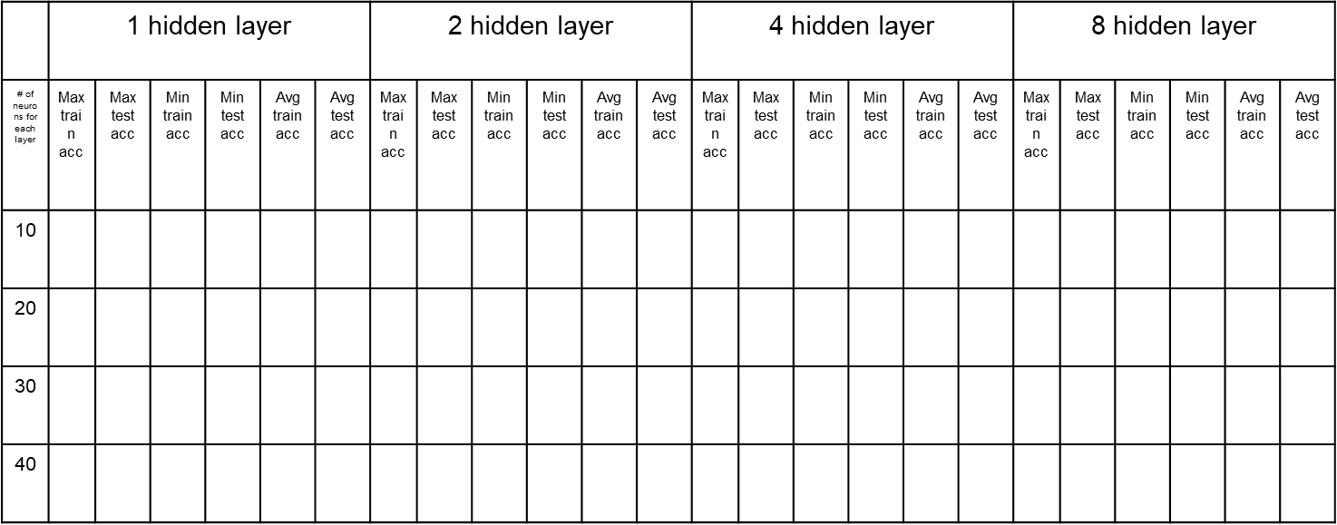
Q3.2) Hidden layers vs. neurons/layer
0.7327 | 0.736 | 0.719 | 0.727 | 0.7239 | 0.7312 | 0.7479 | 0.754 | 0.727 | 0.7344 | 0.737 | 0.7447 | 0.7689 | 0.7629 | 0.739 | 0.7468 | 0.749 | 0.7540 | 0.7598 | 0.7665
0.7479 | 0.754 | 0.7385 | 0.7379 | 0.7412 | 0.745 | 0.7449 | 0.7629 | 0.725 | 0.7361 | 0.7346 | 0.7461 | 0.7945 | 0.7896 | 0.776 | 0.7629 | 0.783 | 0.7772 | 0.7598 | 0.7932
0.7396 | 0.7415 | 0.729 | 0.7344 | 0.735 | 0.7383 | 0.7873 | 0.7825 | 0.776 | 0.770 | 0.7824 | 0.7775 | 0.8224 | 0.7986 | 0.8055 | 0.7558 | 0.8079 | 0.7765 | 0.8297 | 0.8164
0.7495 | 0.7504 | 0.7389 | 0.7255 | 0.7398 | 0.7433 | 0.8029 | 0.7896 | 0.792 | 0.7664 | 0.7939 | 0.7772 | 0.8316 | 0.7986 | 0.808 | 0.7772 | 0.817 | 0.7878 | 0.8431 | 0.8164
0.69 | 0.6952 | 0.725 | 0.7262
0.765 | 0.7665 | 0.792 | 0.7811
0.812 | 0.7593 | 0.818 | 0.7911
0.811 | 0.7807 | 0.823 | 0.7964

Slide 28
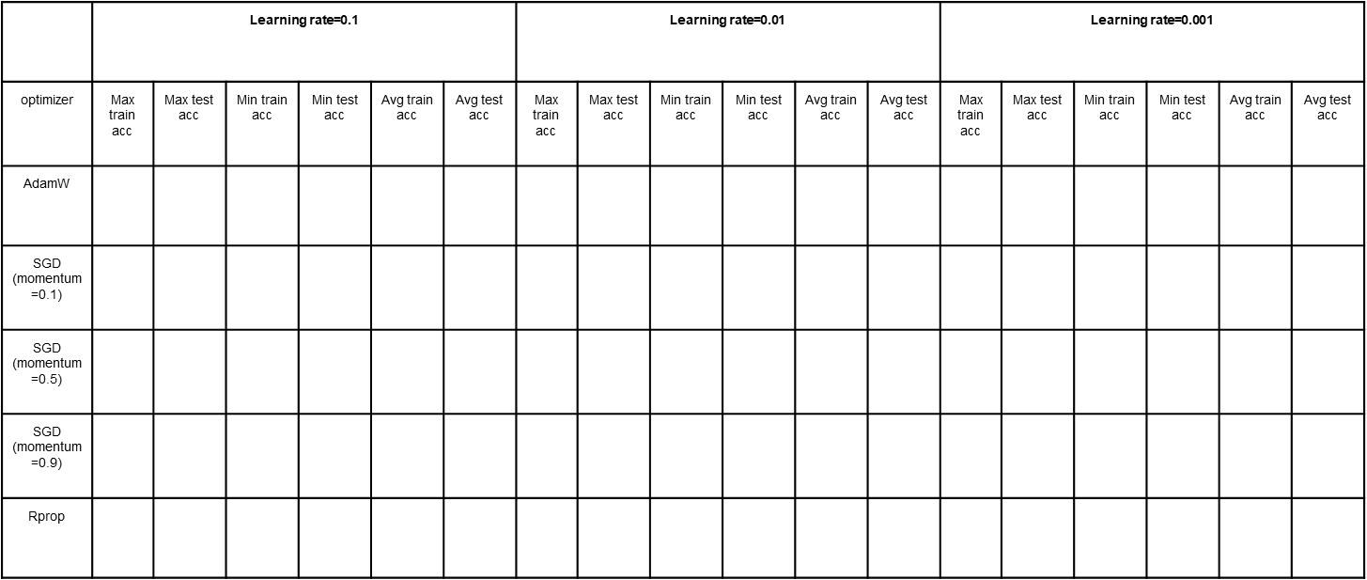
Q3.3) Learning rate and different optimizers
0.2676 | 0.2781 | 0.245 | 0.2263 | 0.249 | 0.2471 | 0.57197 | 0.4207 | 0.240 | 0.2263 | 0.308 | 0.2962 | 0.8431 | 0.8164 | 0.811 | 0.7807 | 0.823 | 0.7964
0.8942 | 0.8021 | 0.819 | 0.7237 | 0.859 | 0.7558 | 0.8102 | 0.7843 | 0.789 | 0.6506 | 0.800 | 0.7412 | 0.5120 | 0.5241 | 0.349 | 0.3279 | 0.408 | 0.4146
0.9114 | 0.7807 | 0.881 | 0.7219 | 0.891 | 0.7483 | 0.8480 | 0.7825 | 0.827 | 0.7575 | 0.836 | 0.7689 | 0.6399 | 0.6274 | 0.54 | 0.5526 | 0.60 | 0.5996
0.8117 | 0.2263 | 0.215 | 0.2174 | 0.223 | 0.2192 | 0.9099 | 0.7879 | 0.885 | 0.7469 | 0.894 | 0.7665 | 0.8232 | 0.7825 | 0.803 | 0.7415 | 0.808 | 0.7672
0.3772 | 0.278 | 0.245 | 0.2264 | 0.249 | 0.2395 | 0.9068 | 0.8164 | 0.850 | 0.7362 | 0.874 | 0.7772 | 0.9209 | 0.8039 | 0.897 | 0.729 | 0.901 | 0.7629

Slide 29
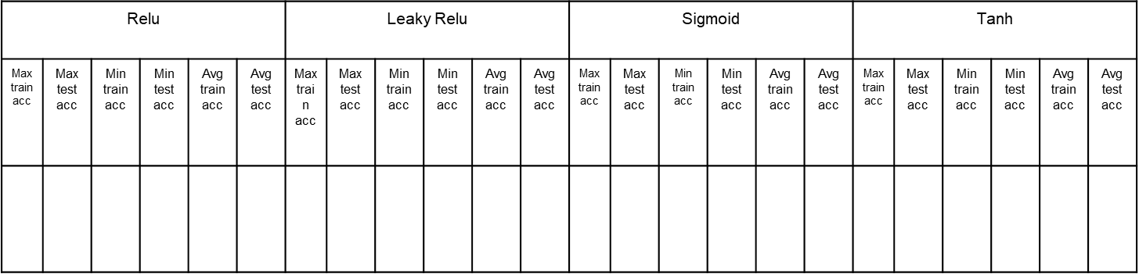
Q3.3) Activation functions
0.8484 | 0.795 | 0.828 | 0.7504 | 0.8339 | 0.7779 | 0.8327 | 0.8074 | 0.803 | 0.7825 | 0.778 | 0.7982 | 0.6399 | 0.6381 | 0.468 | 0.3992 | 0.508 | 0.4802 | 0.7953 | 0.8057 | 0.768 | 0.7522 | 0.775 | 0.7828

Slide 30
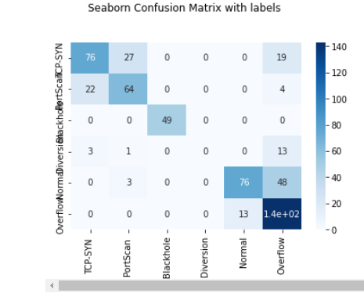
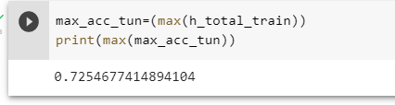
3.5
this is the confusion matrix after apply hyper tuning and max accuracy

Slide 31
Conclusion
Firstly we detect the number of outliers and then apply encoding on data by Label Encoding then splitting the data then we perform normalization
on data after that we train the model baseline and getting the accuracy on baseline model .
We apply Dimensionality reduction using PCA
and we apply the Feature selection techniques using ANOVA and Mutual Information and the best of them is PCA that give us accuracy =73.1%
then we train the model by different parameters like different (optimizers, learning rates ,activation functions)to compare between this variety of parameters and check the training and testing accuracy. Then optimising the parameter tuning process.
The best combination of hyperparameters:
Batch size: 128, number of hidden layers = 8, number of neurons for the layer = 40, best optimizer: AdamW with learning rate: 0.001 and the activation function is Leaky Relu.
The improvements of the performance was clear from the baseline average test accuracy = 49.946 % to 79.82 % after hyperparemeter tuning.

